Slide 1
Opener: write a list of all the natural ingredients you see
Big Mac® Bun: Enriched flour (bleached wheat flour, malted barley flour, niacin, reduced iron, thiamin mononitrate, riboflavin, folic acid, enzymes), water, high fructose corn syrup, sugar, soybean oil and/or partially hydrogenated soybean oil, contains 2% or less of the following: salt, calcium sulfate, calcium carbonate, wheat gluten, ammonium sulfate, ammonium chloride, dough conditioners (sodium stearoyl lactylate, datem, ascorbic acid, azodicarbonamide, mono- and diglycerides, ethoxylated monoglycerides, monocalcium phosphate, enzymes, guar gum, calcium peroxide, soy flour), calcium propionate and sodium propionate (preservatives), soy lecithin, sesame seed. CONTAINS: WHEAT AND SOY.

Slide 2
Basic White Bread Recipe
Ingredients:
1/2C (4 oz.) milk 3 tablespoons sugar 2 teaspoons salt 3 tablespoons butter or margarine 2 (1/4 ounce) packages active dry yeast or 2 teaspoons Instant Yeast (.34 oz.) 1 1/2C (12 oz.) warm water (105F to 110F) 5-6C (1# 13 oz.) unbleached bread flour

Slide 3
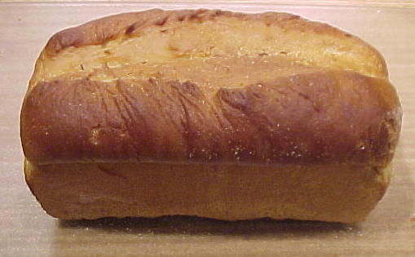
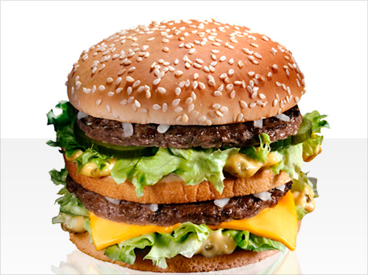
Why is there such a major difference between the McDonald’s bun and the homemade recipe?

Slide 4
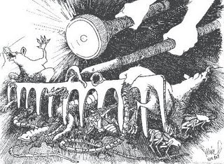
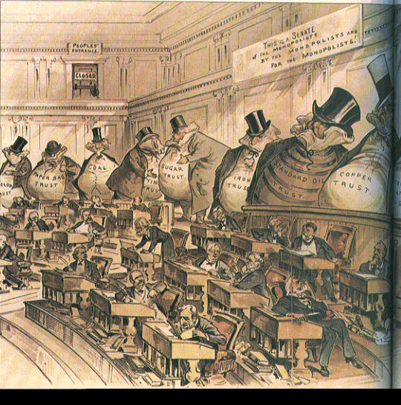
Muckrakers
Investigated social problems
City corruption
Living and working conditions
Ruthless business tactics
Goal- to expose problems of industrialization and urbanization to the public eye

Slide 5
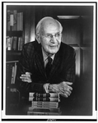
The Jungle
By Upton Sinclair
Listen carefully to the excerpt read aloud

Slide 6
The Jungle excerpt
What do you find most surprising in Upton Sinclair’s account of the meatpacking industry? Why?
How do you think readers reacted to The Jungle when it first came out?

Slide 7
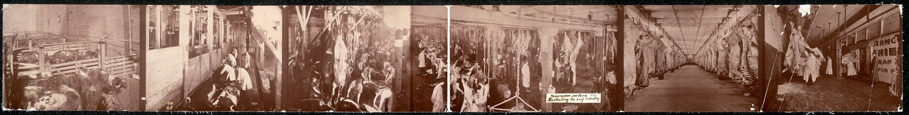
Panoramic picture of the beef industry, 1900

Slide 8
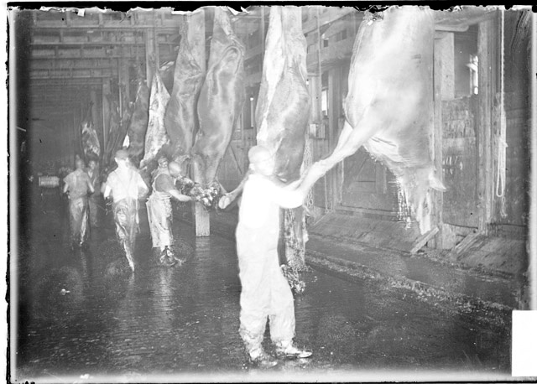
Men, primarily African American, working with cattle carcasses hanging in a slaughter house in the stockyards

Slide 9
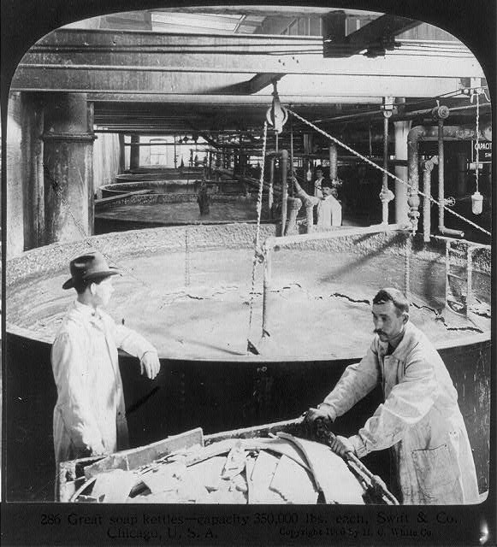
Chicago - Meat Packing Industry - Swift & Co.'s Packing House: great soup kettles - capacity 350,000 lbs. each

Slide 10
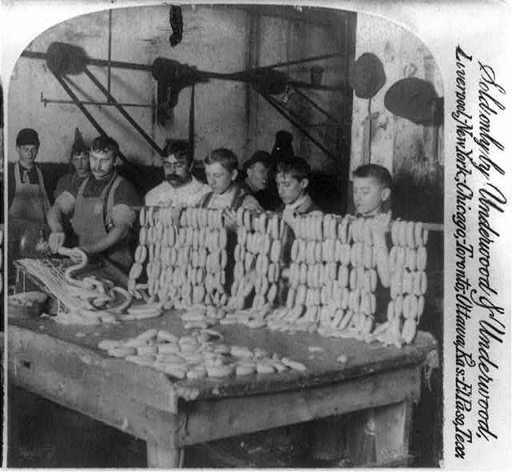
Sausage filling

Slide 11
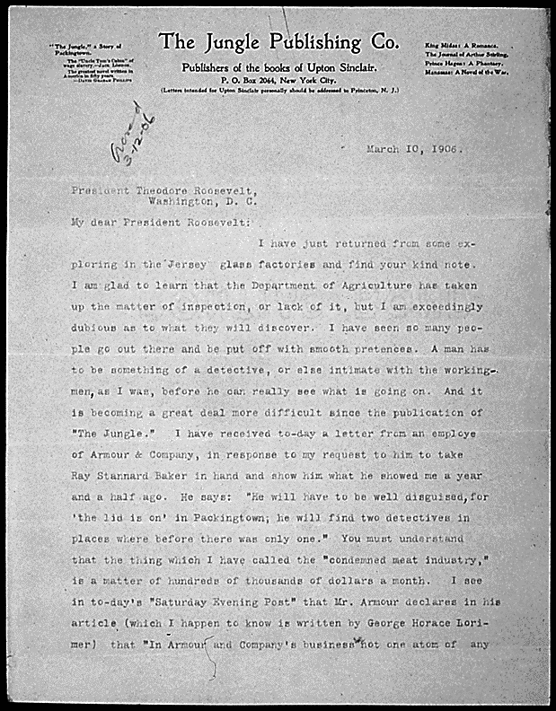
In this letter to President Roosevelt, Sinclair supported the presence of federal inspectors in the meat-packing houses. He advised that inspectors should come disguised as workingmen to discover the true conditions, as Sinclair did when he researched his book "The Jungle."

Slide 12
Selections from the Meat Inspection Act of 1906
Inspection Consists of:
1. Examination of animals and their carcasses at slaughter.
2. Inspection of all stages of preparation to assure sanitary handling and equipment.
3. Destruction of condemned product.
4. Examination of all ingredients.
5. Application of identification standards to products.
6. Accurate labeling enforcement.
7. Inspection of imported products.
8. Administration of product certification.

Slide 13
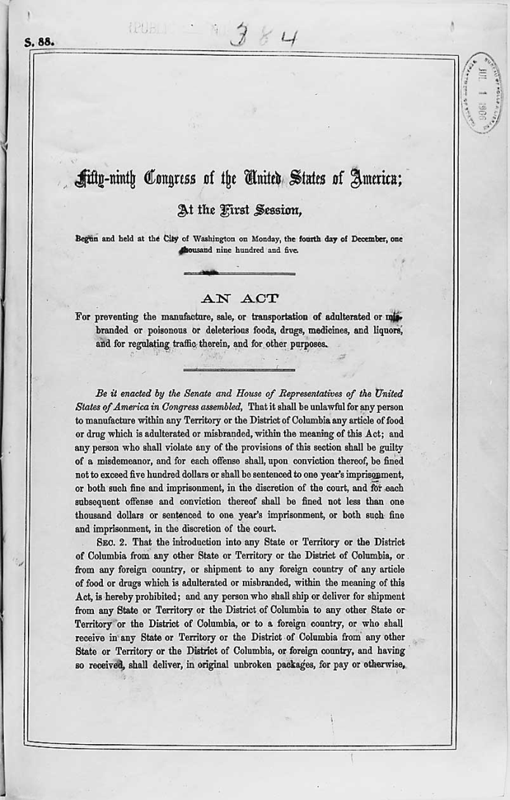
Act of December 4, 1905 (Pure Food and Drug Act), which prevented the manufacture, sale, or transportation of adultered, misbranded, poisonous, or deleterious foods, drugs, medicines, and liquors and the regulation of traffic of such items., 12/04/1905

Slide 14
3. What connection do you see between the public’s reading The Jungle and subsequent progressive legislation (like the Meat Inspection Act and the Pure Food and Drug Act), which were passed within six months of The Jungle’s publication?

Slide 15
Homework tonight:
Meatpacking Industry Political Cartoon Assignment
Objective: students will use pencil, ink and colors to design a political cartoon based on their knowledge of muckraking, The Jungle and the meatpacking industry during the Industrial Era in America.

Slide 16
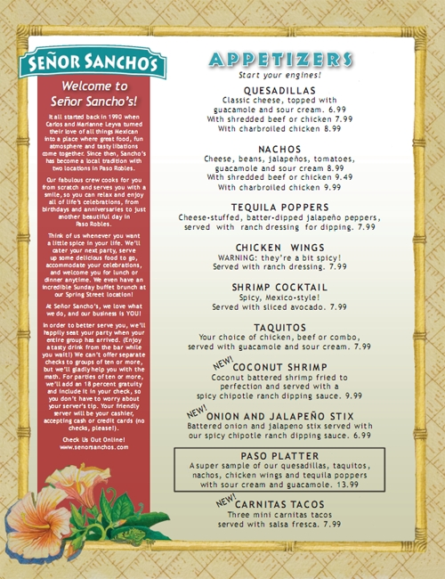
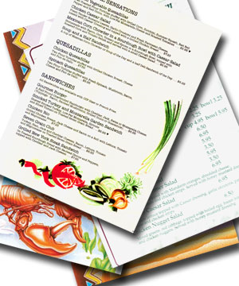
Jungle Café Menu
Create your own restaurant menu following the excerpts from The Jungle

