Slide 1
Warm-up #6
Create a t-chart showing the strengths and weaknesses of the Articles of Confederation. (Use your reading and Cornell Notes to complete this activity.)

Slide 2
Articles of Confederation
National Powers/Strengths
State Powers/ Weaknesses
Federal government could:
    Wage war
    Make peace
    Sign treaties with other nations.
    Print money
Ran country during Revolutionary War.
Passed the Land and Northwest Ordinance to regulate Western Lands.
States could/Fed gov’t can’t:
  Tax
  Enforce federal laws
  Regulate trade between the states.
All states have one vote in the Continental Congress.
All 13 states must agree to make any law/changes.

Slide 3
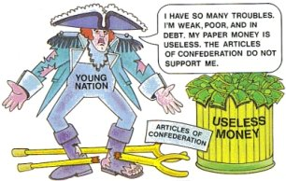

Slide 4
Shays Rebellion Simulation
Have students silently read from the book
Pass out money to students (vary the amounts)
Tax each student the same amount (2 rounds)
Students that cannot afford to pay must auction their seat. Other students can buy their seat from them.
If they still cannot pay they must go to jail
End the lesson by asking the students some reflection questions.

Slide 5
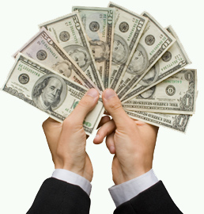
During the 1780’s the state of Massachusetts faced economic problems. People had very little money but the state continued to charge high taxes. The average family owed $200 in taxes

Slide 6
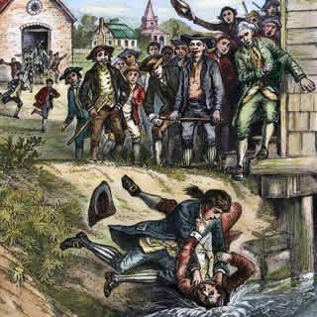
Many of the farmers fell deeply into debt. At that time, anyone who could not pay their debts would have his property auctioned off. If the auction did not raise enough money, then they were thrown into jail.

Slide 7
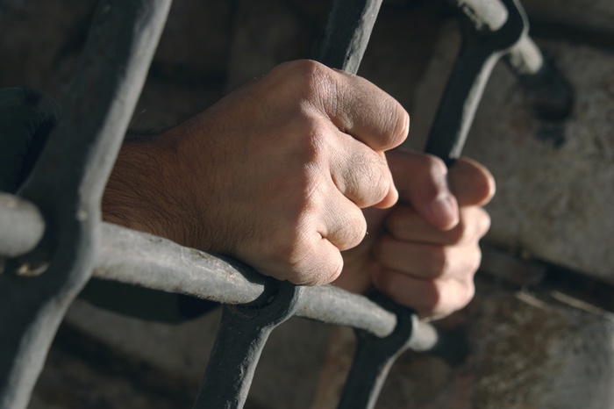
In western Massachusetts the jails soon became packed with debtors.

Slide 8
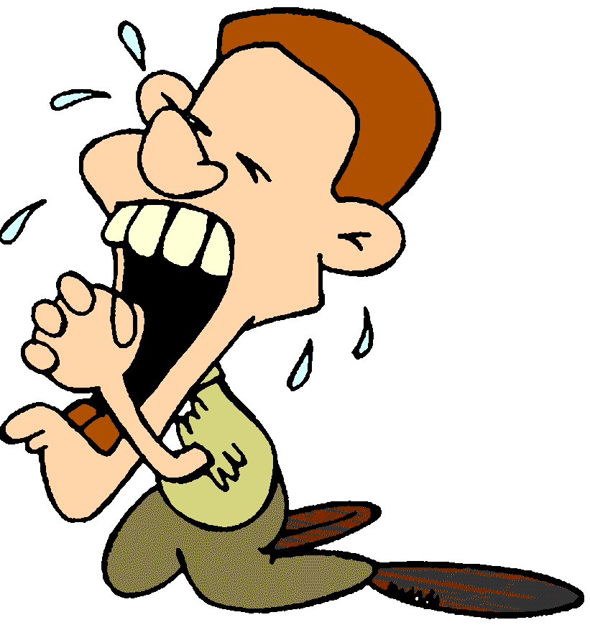
The farmers of Massachusetts asked the government if they could have debt relief. They wanted the government to forgive much of the debt. They said no!

Slide 9

Many of the farmers became so angry that they staged a rebellion. Daniel Shays, a Revolutionary War veteran, and 1,500 men marched to an arsenal in an attempt to steal weapons to use on government officials.

Slide 10
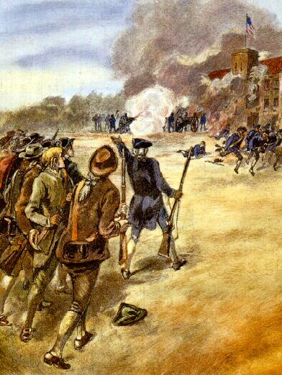
When they arrived the state militia was waiting and fired canons into the rebels. Four were killed, 20 were wounded and hundreds were arrested for their part. The rebellion was over.

Slide 11
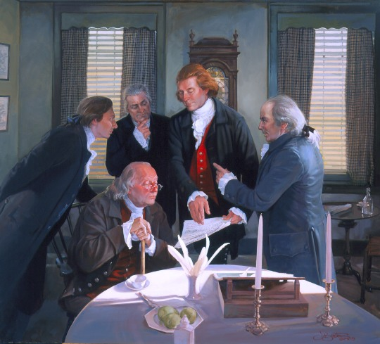
Many Americans had sympathy for Shays and his men. The government realized that other rebellions would threaten the new country. They decided that a stronger government must be formed. That summer, representatives from 12 states met in Philadelphia to rewrite the Articles of Confederation and create a new national government.

Slide 12
Shays Rebellion Reflection
Was this fair, Why or why not?
What would you do if this happened to you today?

