Slide 1
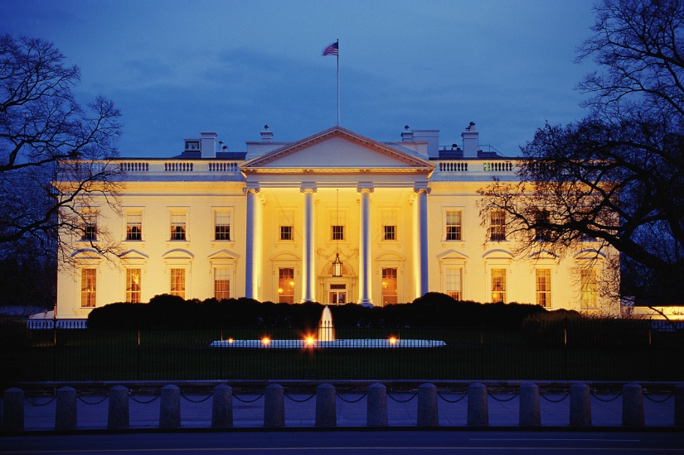

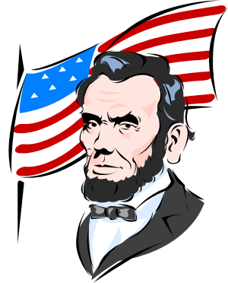

Decision Making in U.S. History
Introduction Lesson
Created by Mrs. Janiak using Decision Making in U.S. History text

Slide 2
Decision Making Objective
Objective: to improve your decision making skills by making choices about U.S. history events before you know what actually happened.

Slide 3
Quickwrite:
How would you explain decision making?

Slide 4
Notes:
“Foresight” history: first you decide, then you find out what really happened.
“Hindsight” history: you just find out what really happened.

Slide 5
P-A-G-E analysis for decision making
P= Problem
Identify any underlying problem: What’s really going on here?
Consider other points of view: How do others see this situation?
What are my assumptions? Emotions?
A= Ask for information (about)
Historical context: What is the history and context of this issue?
Reliability of sources: Does my information come from experts on this topic? Do the sources have a reason to lie? Is the information supported by evidence?
Historical analogies: What has been done in the past about situations like this? In what ways do these other situations differ from this situation?
G= Goals
What are my main goals? Are they realistic?
Generate options to help achieve these goals. Are they ethical?
E= Effects
Predict unintended consequences. What are some long-term effects?
Play out the options. What could go wrong?

Slide 6
Opener: Write in the summary box of yesterday’s “teacher input” page
Reflect on the last big decision you had to make. When you went through the process of making that decision, did you use any of the P-A-G-E analysis skills? Explain!

