Slide 1
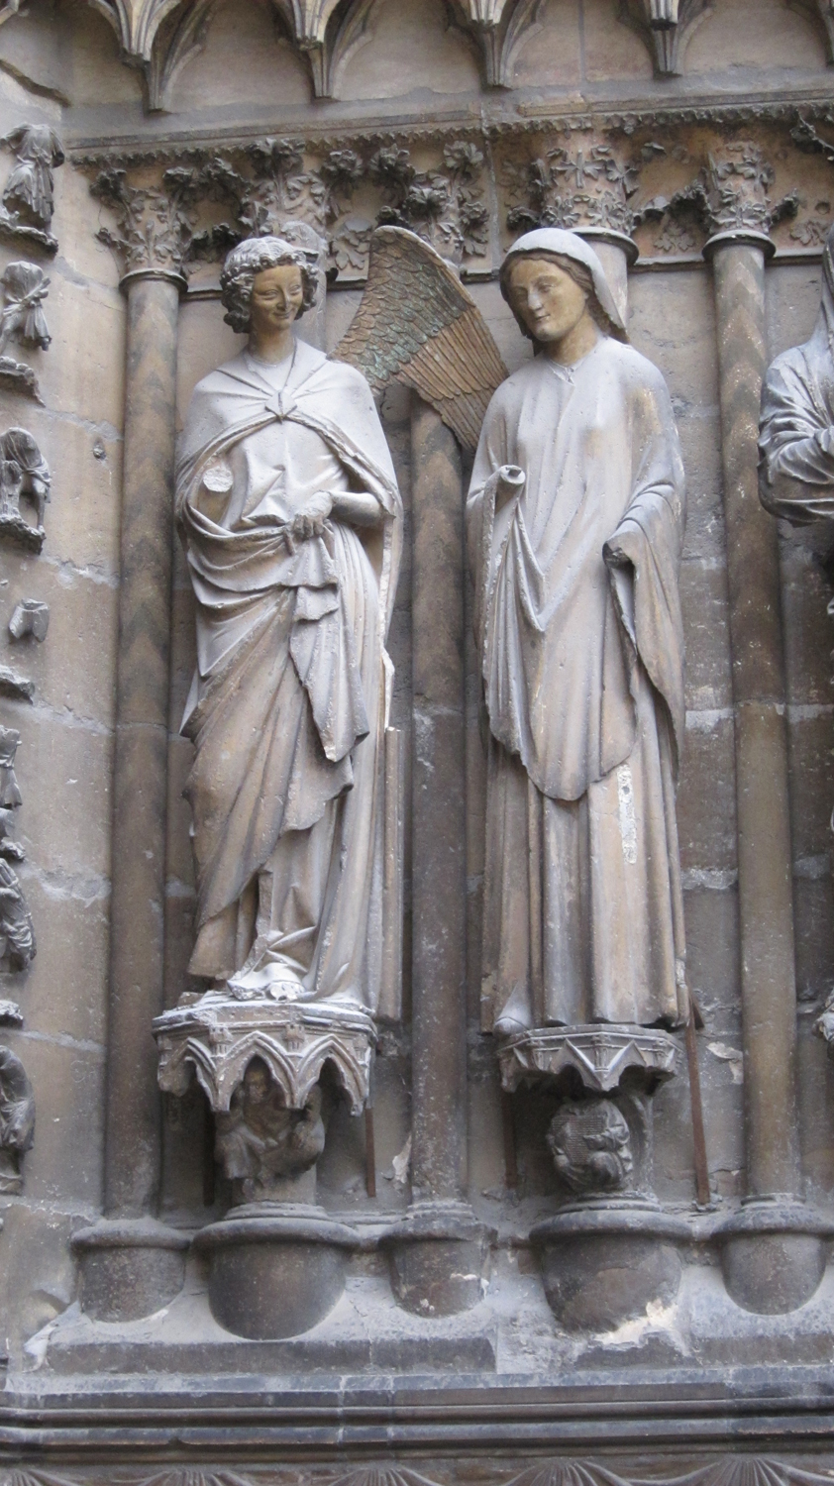
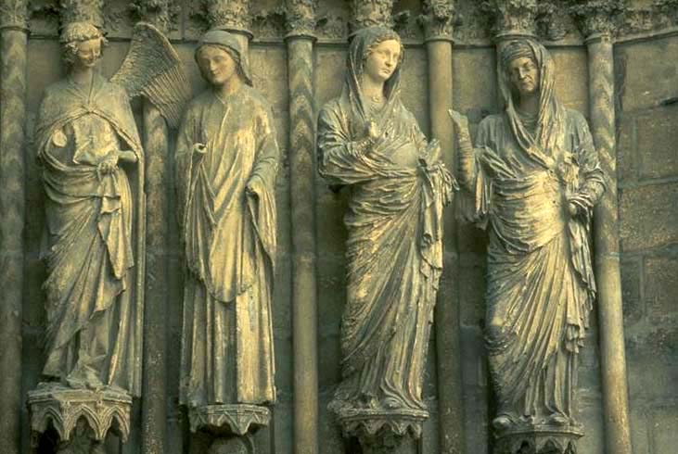
Angel from the Visitation Group 1211-25
Cathedral, Reims

Slide 2
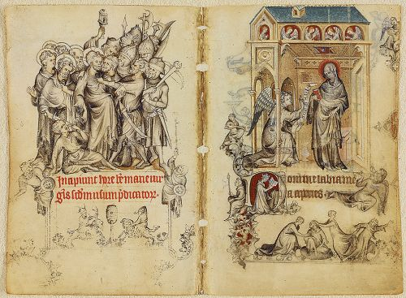
Pages with Betrayal and Arrest of Christ and Annunciation
from The Book of Hours of Jeanne d’Evreux c. 1325-1328

Slide 3
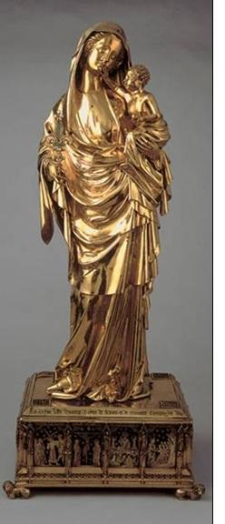
Virgin and Child
Abbey Church of St. Denis
c. 1339

Slide 4
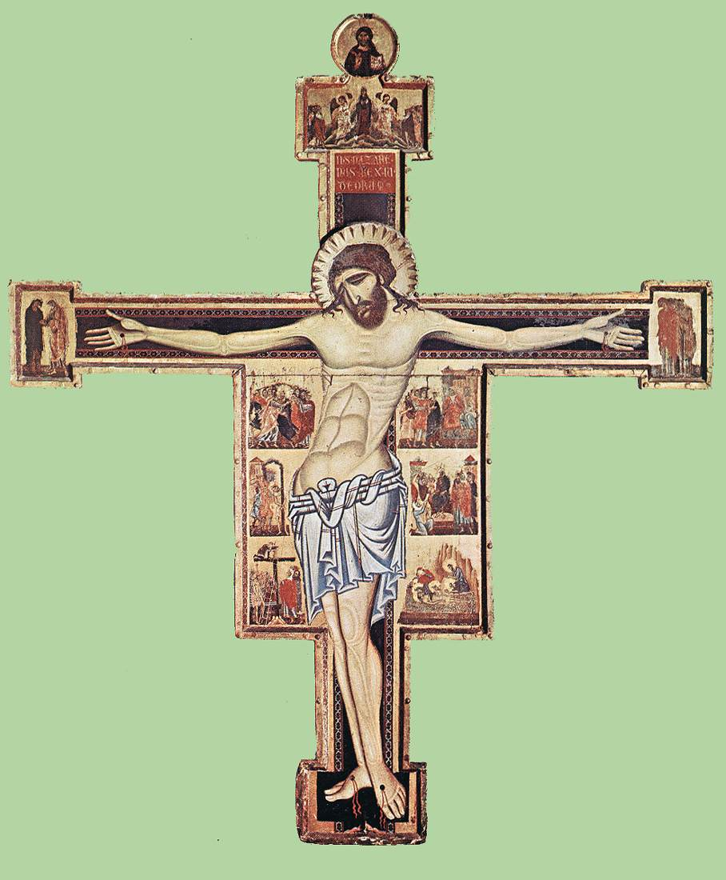
Christus Patiens -- Crucifix
Coppo di Marcovaldo
1250-1300

