Slide 1
Meet the Barbarians
The tribes that helped bring down the Western Roman Empire

Slide 2
Links
Dark Ages (History Channel Part 1) (9:51)
http://www.youtube.com/watch?v=PLNrxajzGCw
Rome vs. Germans from Gladiator (10:42)
http://www.youtube.com/watch?v=EoCVxNTk58g

Slide 3
Costa’s Levels of Questions
Level 1: Know
  Define
  Describe
  Identify
  List
  Name
  Observe
  Recite
  Scan
Level 2: Process
  Compare
  Contrast
  Group
  Infer
  Sequence
  synthesize
  Analyze
Level 3: Apply
  Apply
  Evaluate
  Hypothesize
  Imagine
  Judge
  Predict
  Speculate

Slide 4
Costa’s Levels of Questions
Level 1: Know
Who is your best friend?
Name the first permanent English Colony.
Level 2: process
What is the best thing about your friend?
Compare and contrast John Smith and John Rolfe’s leadership styles.
Level 3: apply
What do you think your best friend will be like in 10 years?
What would you have done differently if you were John Smith?

Slide 5
What Level Am I?
Identify the level for each of the below questions.
Which Barbarian tribe came from Uppland?
Level 1
Vandals
Compare the fate of the Huns and the Franks?
Level 2
The Franks took over Germany, Spain, and Italy (starting the Holy Roman Empire). The Huns mixed into German and Slav populations.
What do you think would have happened to the Vandals had Emperor Justinian had not wanted to recapture Rome?
Level 3
This is your opinion based on what you know. For example. Maybe the vandals would have continued to occupy Spain and Africa and eventually defeated the Franks.

Slide 6
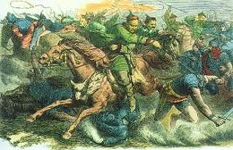
The Huns

Slide 7
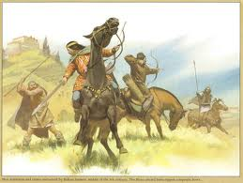
Quick Facts
The Huns are first mentioned by the Caspian Sea in 91 AD
In 370 the Huns crossed the Volga river and attacked the Alans
Next to fall were the Goths, who began to flood into Roman territory in search of protection
The Huns first attacked the Eastern Romans in 395 in the Caucasus, Syria and Anatolia
By 398 they left the Eastern Roman Empire and invaded the Sassanid Empire
In 408 they again invaded the Eastern Roman Empire

Slide 8
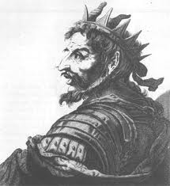
Attila the Hun
Forced the Romans to pay tribute in 435
After the Romans failed to pay this tribute, the Huns invaded, plundering the Eastern Roman Empire before a new peace was reached in 449
Honoria, sister of Western Roman Emperor Valentinian III, sent Attila a ring, asking that he save her from an unwanted arranged marriage. He took it as a proposal and demanded the Western Empire as his dowry.
In 451 the Huns were defeated at the Battle of the Catalaunian Plains by a combined force of Romans, Franks and Goths

Slide 9
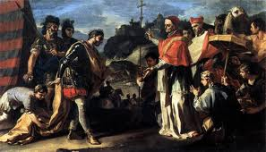
Attila the Hun continued
In 452 Attila led the Huns over the Alps and ravaged Northern Italy, approaching the gates of Rome itself
Emperor Valentinian III sent envoys, including Pope Leo I, to meet Attila, hoping to prevent a sack of Rome
The Pope was able to convince Attila to turn back and leave Rome untouched
The Eastern Roman Emperor had in the meantime sent an invasion force northwards into the new Hunnic homeland in Pannonia
Attila died on his wedding night in 453 while preparing to invade Constantinople

Slide 10
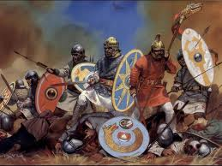
The Goths

Slide 11
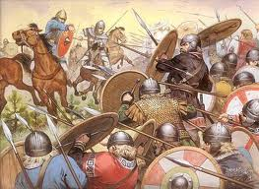
Quick Facts
The Goths are believed to have originated on the Island of Gotland, near present day Sweden
They migrated southeastwards to the region North and West of the Black Sea
Here they divided in the Ostrogoths (Eastern Goths) and Visigoths (Western Goths)
The Romans and Goths fought a series of battles along the Danube River frontier in the Third and Early fourth centuries
The Goths converted to Arian Christianity during this period

Slide 12
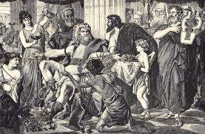
Onwards towards Rome
In the Late 4th century the Huns push the Goths across the Danube river and into the Eastern Roman Empire
The Romans take advantage of the Goths including price gouging and enslavement
In 376 the Goths revolt, crushing the Roman army at Adrianople in 378, killing the Eastern Roman Emperor Valens
In 410, led by their king Alaric, the Visigoths sack Rome
The emperor Honorius offered them Aquitania in southern France as a new homeland

Slide 13
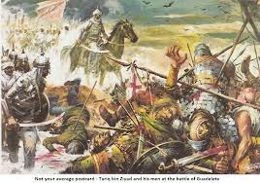
The Outcome
The Visigoths then fought a war to remove the Vandals from the Iberian peninsula ending in 475, expanding their territory
The Ostrogoths broke away from Hunnic rule and invaded Rome in 488
By the beginning of the sixth century, the Ostrogoths ruled the entire Italian peninsula
The Ostrogothic Kingdom fell in 553 when it was defeated by the Eastern Roman Empire under Teia
The Visigothic Kingdom fell in 711 when it was defeated by the Umayyads, an Islamic force from North Africa

Slide 14
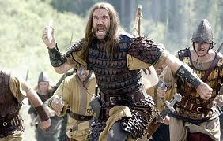
The Vandals

Slide 15

Quick Facts
The Vandals are believed to have originated in Uppland, Sweden before crossing the Baltic Sea and settling in what is today East Germany and Poland in the first and second centuries B.C.
In the second century the Vandals attacked the Roman Empire across the middle Danube
In the fourth century the Vandals were defeated by the Goths and were converted to Arian Christianity
In 400 AD, the Vandals and their allies, the Alans invaded the Roman Empire, perhaps due to pressure from the encroaching Huns

Slide 16
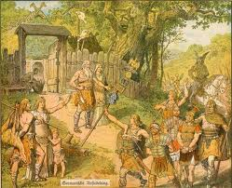
From Germany to Africa
In 406 the Vandals and Alans traveled west along the Danube and invaded the territory of the Franks, defeating them and devastating Gaul
In 409, the Romans set up the Alans as foederati in Western Iberia, and the Vandals as foederati in Eastern Iberia
In 418 the Visigoths entered Iberia and crushed the Alans, who then offered their crown to the Vandal king, Gunderic
In 429 the Vandals crossed into North Africa due to pressure from the Visigoths
In 435 the Romans gave the Vandals control of coastal Numidia to make peace in North Africa

Slide 17
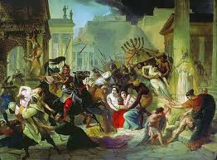
Onwards to Rome
In 439 King Geiseric led the Vandals conquest of Carthage, breaking the peace with Rome
The Vandals went on to conquer Sicily, Sardinia, Corsica and the Balearic Islands
While the Roman focused on the Huns, the Vandals looted the Mediterranean coast
In 455, Emperor Valentinian III was killed by an usurper and his wife sent a letter begging Genseric for rescue, instead he came and sacked Rome
In 533 the Vandals were defeated at the battle of Tricamarum when the Vandal king refused to continue battle after learning of the death of his brother, ending the Vandal kingdom

Slide 18
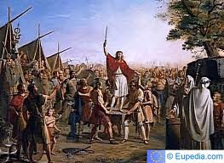
The Franks

Slide 19
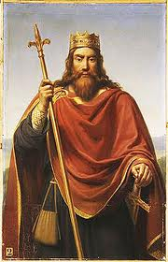
Quick Facts
The Franks appear along the Roman frontier of the Rhine river in late third and early fourth centuries
The Romans began using Franks as Foederati to act as a buffer against other Germanic tribes such as the Suebi and Alamanni
By the end of the fifth century they had come to occupy the region at the mouth of the Rhine near present day Belgium and the Netherlands
In 486, Clovis turned against the Romans, consolidated power by defeating rival Frankish chieftains.
By 509, Clovis had conquered nearly all of Gaul and pushed the Visigoths southwards into Iberia

Slide 20
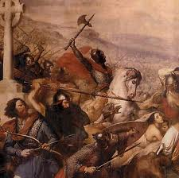
The Merovingian and Carolingian Kingdoms
Clovis divided his kingdom amongst his four sons upon his death, each becoming an independent Merovingian Frankish Kingdom
Until 751, these descendants of Clovis engaged in frequent warfare amongst one another, often fueled by jealousy and vengeance
The real power in the Merovingian kingdom shifted from the Kings to the Mayors of the palace, who ran the day to day operations of government
In 732, Charles Martel, the Mayor of the Palace, defeated the Moors (Islamic raiders from Iberia) at the Battle of Tours, halting the Islamic advance into Western Europe

Slide 21
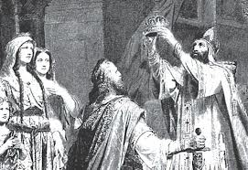
From Roman to Holy Roman
Charles Martel’s son, Pepin “the short” received the Pope’s blessing to depose the Merovingian king Childeric and assumed the Kingship for himself, becoming the first Carolingian King of the Franks
In 768, Pepin divided his Kingdom between his two sons, Charlemagne and Carloman
Carloman resigned as King, leaving his share of the Kingdom to Charlemagne
Charlemagne expanded his territories South into Iberia, East into Italy and Germany and was crowned Emperor of Rome by Pope Leo III on December 25th 800 AD

Slide 22
Cornell Notes: Format Summary
Write a summary at the end of your notes to:
  Restate the main ideas covered in the notes in your own words to provide the “big picture” of the notes.
  and/or
  Describe your feelings about the notes for the day.
  (For example, at what point did the lesson make sense to you? Is there anything you are still confused about?)
Written at the bottom of each page or pages of notes (this is up to teacher preference.
Summary should be four to six lines long.
At the end of class or at home.
Notes:
This section about summaries on Cornell Notes is extremely important. Most students have great difficulty writing summaries. The Cornell Notes summaries are an excellent scaffold into writing more complex content driven summaries.
Pay particular attention to explaining the difference between synthesis summary and reflective summary.

Slide 23
Writing an Effective Summary
The topic of the notes is mentioned at the beginning of the summary.
Main ideas & important details are in the same order as written in the article.
All ideas are paraphrased (writing in your own words) except for key words or facts.
The summary is clear and easy to understand. Be sure all sentences are complete
Only key information is included. Focus of big ideas not details.

