Slide 1
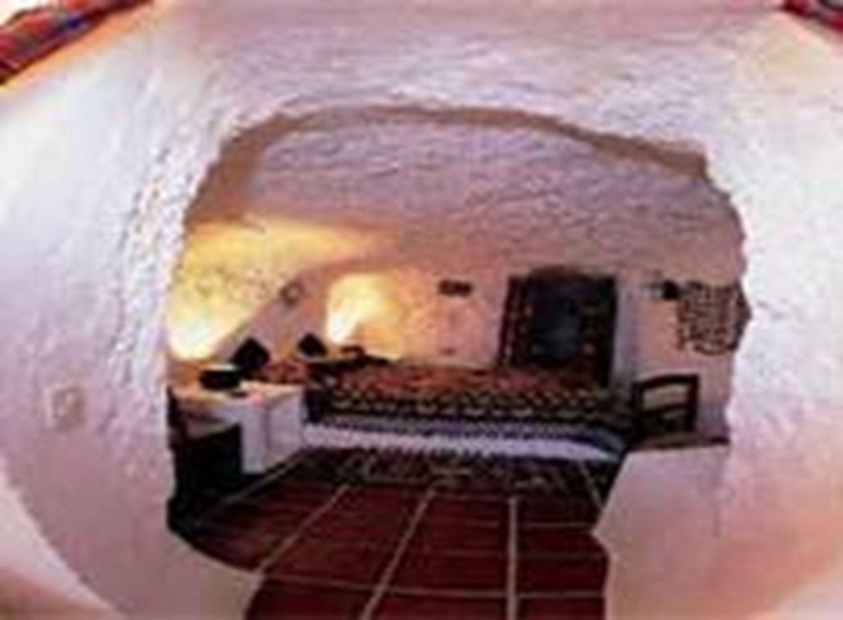
Blood Wedding
Act 2
Summary
&
Analysis

Slide 2

Wedding Day and guests, including the
Bridegroom & Mother, travel for hours to attend
Maid helps the Bride prepare for the wedding
Bride does not act like a typical happy bride
She’s irked when the Maid alludes to the sexual
encounter between the bride and bridegroom that should naturally follow on the evening of the wedding, with her reference to the impending encounter as a “misery”
Angry, she throws down a crown of orange
blossoms that the bride traditionally wears
Clearly, she has some reservations about the
marriage

Slide 3

They are interrupted as the first guest arrives: Leonardo,
her old flame
Leonardo has abused his horse to make expedient time
He reiterates that he doesn’t care if the horse dies
Leonardo is not one to dwell on unfortunate
consequences
Forgetting his family, Leonardo confronts the Bride
about the wedding, claiming that she left him because of his poverty: “Tell me, what have I ever been to you? Look back and refresh your memory! Two oxen and a tumbledown hut are almost nothing. That’s what hurts” Confrontation escalates until the bride exits and the maid intervenes
She grabs Leonardo and asks him to leave
He does, but the confrontation remains unresolved

Slide 4
Brief interlude follows as minor characters chant
romantic reports of an impending marriage in idyllic verse
These images contrast with the heated exchange
that just took place
Bride then appears in traditional attire
Mother sees Leonardo and is upset at his
presence
In a premonition of doom, she utters, “Let’s not
have anything go wrong”
As the entourage leaves for the church, the voices
of minor characters again chant in verse of images of an idyllic marriage.

Slide 5
Leonardo and his family are left alone on
stage
Another heated confrontation occurs
Leonardo is neglecting his family
Although his wife is pregnant, he is looking
at her with hatred, when not ignoring her outright
Wife comments fate of her mother:
Married to a man who does not love her
Again voices intervene, contrasting the
animosity and impending doom with images of a star

Slide 6
Scene 2 opens in a clearing or yard
outside the cave where the Father and Bride have lived
Guests are soon to return for a
banquet
Maid is chanting in verse, again, happy
images of the wedding party contrasted with nature in all her glory.

Slide 7
The Mother & Father arrive; Leonardo has beaten them
back to the cave
According to Maid, he drove callously, like a demon,
scaring the wits out of his pregnant wife
Inappropriate behavior, particularly by someone who
was interested in the Bride; the “ex-boyfriend” is not bowing out gracefully
In answer to a comment about Leonardo having “bad
blood”—Mother is upset knowing, “What blood could he have?—That of his whole family, beginning with his great-grandfather who started the killing, and on through the whole evil clan! Men who use knives! People with false smiles!”
These images of doom are soon contrasted with the
wish by the Mother and Father for many grandchildren; death and birth are contrasted

Slide 8
Other guests arrive, though never staged
Many are remote relatives of the
Bridegroom who have traveled great distances to see the wedding
Meanwhile, Leonardo continues to hover
around Bride while his suspicious wife tails him
Wife and Bridegroom speak briefly
Lorca emphasizes that Leonardo does
not have material wealth
As they speak, they fail to notice Leonardo
slip away, followed by the Bride.

Slide 9
Common wedding dialogue occurs
Maid tells the Bridegroom of preparations for the consummation of marriage
Girls bicker over who received a pin and, according to tradition, will then marry
In an ominous moment, the Bridegroom grabs the Bride from behind
She, utterly surprised, tells him to get away, thinking that it is Leonardo who has grabbed her
The Bride is all out of sorts
She seems frightened and confused; she is not happy at all to see the Bridegroom
Feigning illness, she tells him she needs to lie down
Left alone, the Bridegroom receives more advice on the consummation of marriage from his mother

Slide 10
The scene ends when Bride and Leonardo
are both, suddenly, noticeably absent
Wife, who has been suspicious, exclaims
they have left together on a horse
Father and Mother are horrified
Although the Mother vows revenge, the
memory of her dead kin makes her calls for revenge ominous and confused: “Go! After them! No! Don’t go! Those people kill quickly and well! But—yes—run! And I’ll follow”
Blood feud is re-ignited as the
Bridegroom’s relatives prepare for the hunt

Slide 11
http://www.youtube.com/watch?v=mYCyqfiZaf4&feature=player_detailpage
Act 2 scene 1 - 8 minutes
http://www.youtube.com/watch?v=lWvM2VlRD6k&feature=player_detailpage
Act 2 DUENDE interpretation - 10 minutes
http://www.youtube.com/watch?v=F86KyHDMYQI&feature=player_detailpage
Act 2 scene 2 - 6 minutes

Slide 12
Analysis
Blood Wedding is often interpreted as a play that
questions the validity of tradition and conformity
Tradition is represented by the ceremony of
marriage or a wedding
Although the audience never sees the actual
wedding, all the action in the play revolves around it
The preparations—the dressing of the Bride, the
meeting between the Mother and Father and the discussion of property—are presented in detail
However, love is conspicuously absent from all
these preparations and accounts

Slide 13
As Act II unfolds, the economic reasons
behind the tradition of marriage become even more apparent: the Bridegroom has an estate and Leonardo does not
Passion, alluded to as “blood” (yet another
meaning behind the title), is thwarted in that society does not recognize the natural attraction of the Bride and Leonardo
The Bride’s misgivings about the impending
event and her ambivalence lend an ominous portent to the action.

Slide 14
Lorca contrasts these dark portents with
happy reports of the wedding given by minor characters
These reports, resplendent with imagery of
nature in all her glory—grapefruit trees, white dawn, morning dew, trays of dahlias—and regal symbols—a crown—are not at all in tune with the indifference and lack of passion that the Bride manifests towards the Bridegroom
Seen in this light, the imagery of nature and
fecundity is rather ironic.

Slide 15
Lorca is also a renowned poet
His symbolic verses are among the greatest that
have been produced in twentieth-century Spain
The verses of minor characters who report on the
wedding can be interpreted as poems in their own right
However, these verses are imbued with irony
when they are read or spoken outside the context of a marriage that is bereft of passion and all but a charade to consolidate wealth and social standing
As the Mother says of a wedding day from a
woman’s perspective: “It’s the only good [day]! For
me it was like coming into an inheritance!”

Slide 16
Lorca’s social commentary is magnified by his use
of generic names in the cast listing.
Leonardo is the only character by name
All others have generic name for their specific
part in wedding (Bride & Bridegroom) or social hierarchy imposed by society (Wife & Mother-in-Law)
Furthermore, by creating a play in which Father
and Mother are not married to each other, Lorca is making subtle allusions about Spanish or Andalusian society as an organic whole: the region is a family unto itself with one father and one mother
All the families play a part in this intricate whole

Slide 17
As the play reveals, many of these characters are
unhappy in their roles
  Father was unloved & Wife is unloved and neglected
Bride is pushed by a sense of conformity and social
hierarchy to marry a man she doesn’t love
Mother mourns loss instead of celebrating birth; her constant
allusions to procreation and renewal of “blood” are overshadowed by her references to the spilling of “blood” which prematurely halted the extension of her family “blood”
Only character who escapes a constraining role indicative of an
unhappy fate is Leonardo
His presence at the wedding, though condoned because of his
relationship to the Bride’s family through marriage, is irksome and
particularly ominous
Since he does not conform to society, he is sure to upset the
traditional balance; as he says himself, he is “hot-blooded”
His blood is boiling

Slide 18
Blood Wedding contains multiple symbols
As mentioned in the analysis of Act I, many of
these symbols are straightforward, like the knife. Others have an ominous portent, like the horse of the lullaby
Lorca’s use of “blood” to imply various concepts
shows how the symbols can be interpreted differently
Mother sees blood as the blood of a continuing
family line, an indication of a bad family (bad blood) and as death (spilled blood)
To Leonardo, blood is passion
Though multifaceted, the allusions to blood are all
clear

Slide 19
Image of the star that ends Act II, Scene 1 is a bit
more complex: “On leaving your house / to go to the church, / Remember: you leave / like a star”
Both the Bride and Leonardo are described with
this verse while Bridegroom most emphatically is not: Leonardo and the Bride are destined to be together
However, why are they described as a star?
The ambiguousness of this simile continues as
the symbols in Act III become more intangible and mysterious
In this sense, the play gathers poetic momentum

Slide 20
In order for the events in a tragedy to unfold, the
action must continue on its predicted course
Such is the case in Act II – there are no surprises
Given the motivations of Bride and Leonardo’s
behavior, it is hardly surprising that the two disappear together
Given the combination of Mother’s constant
dwelling on death, her thinly-veiled desire for revenge, and her concurrent fear that history will repeat itself, the audience or reader should have a fair notion of what to expect in Act III
This is especially true in light of the fact that the
drama is in the tradition of classical tragedy, where characters cannot escape a predestined fate

