Slide 1
Classical Civilizations
China 9/28-10/2

Slide 2
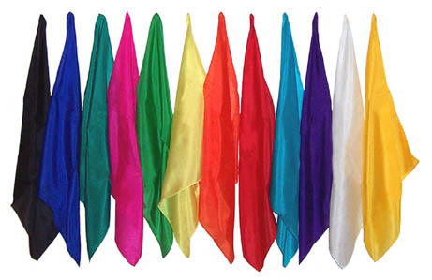
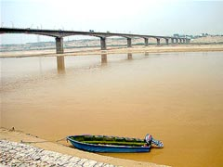
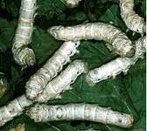
China
Huang He-a valley that had terrible floods and was known as “China’s Sorrow”. People made silk (fine cloth) from silkworms here.

Slide 3
Silkworms
http://www.youtube.com/watch?v=-wbmEjTvszI#!

Slide 4
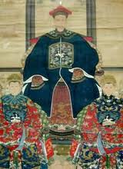
Vocabulary
Ancestor-a relative (family member) from a long time ago.
The Chinese felt that honoring their ancestors was very important, as well as honoring their homes, their families and their land.

Slide 5
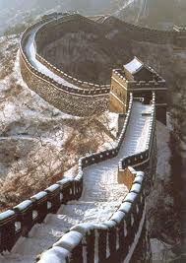
Vocabulary
Dynasty-a period of time in China in which they had one group of people as rulers (bosses).
Great Wall of China-a wall that is over 4,000 miles long, 25 feet high and about 15 feet wide.

Slide 6
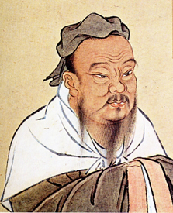
Confucius
Born in 551 B.C.
His ideas had the biggest influence on Chinese life for more than 2,000 years.
He was worried about how people treat each other.

Slide 7
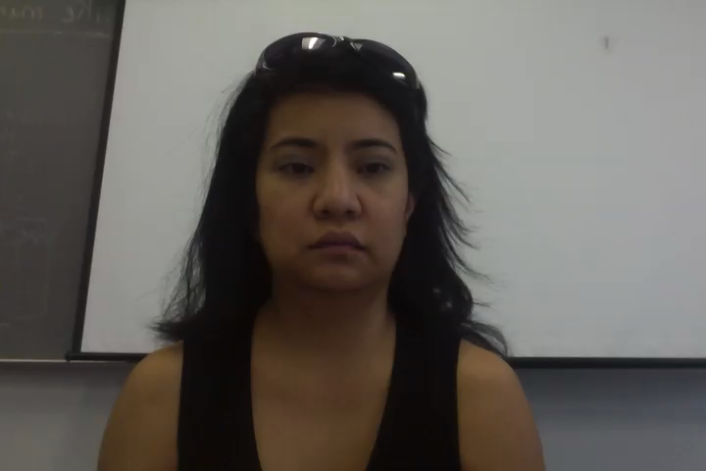
How does it apply to me?
Confucius said.. “Never do to others what you would not like them to do to you”

Slide 8
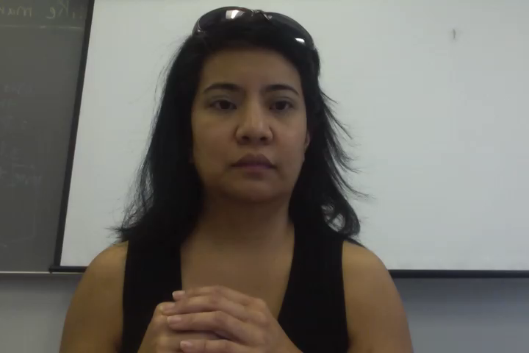
ASL Assignment…

Slide 9
Vocabulary
Write the following words in your notebook and find out what they mean. Write the definitions in your notebook. Finally, videotape yourself spelling out each word and explaining what it means. E-mail me your ASL essay and this essay for a grade. Title it “China”.
Ancestor -Great Wall of China
Dynasty

Slide 10
Questions… Copy in your notebook, and answer from notes.
1. What is the Huang He?
2. Why are silkworms important? (cut and paste the link into your browser).
3. Who is Confucius? What did he do in China?

Slide 11
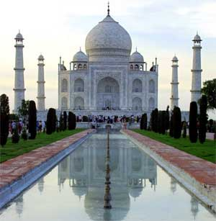
Ancient India
Mohenjo-Daro was one of the biggest cities in the India/Pakistan area.
Around 1500 B.C., the Aryans (from the North) attacked Mohenjo-Daro and killed most people.

Slide 12
Aryans
Caste-a social class.
Aryans believed some people were born “better” than other people.
Four castes in the Aryan system.
First/Highest-Priests, scholars
Second-Rulers, Warriors
Third-Craftworkers, merchants, farmers
Fourth/Lowest-Unskilled Workers

Slide 13
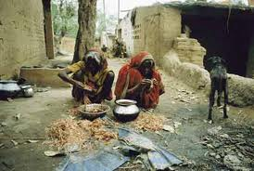
Caste System
People who were conquerered were “outcastes” or UNTOUCHABLES. They did not belong.
You stayed in your caste, you couldn’t move up or down a caste.

Slide 14
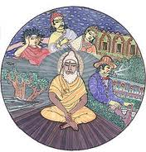
Reincarnation-rebirth of the soul. When you die, you can be born again as another human or an animal.
If you were good, you could be born into a higher caste in your next life.

Slide 15
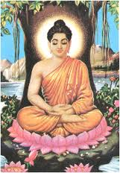
Buddha
He was born rich, but he felt sorry for poor people.
His real name was Siddhartha Gautama, but they called him Buddha.
Buddha means “The Enlightened One”.
Enlightened-means “to know
the truth”

Slide 16
Buddhist Religion
They believe in unselfishness.
SELFISH-means you only think of yourself.
If you are unselfish and not greedy, you will reach “nirvana”.
Buddhism spread to China, Japan and other areas of Asia.

Slide 17
Questions
1. What was Mohenjo-Daro?
2. What happened in Mohenjo Daro around 1500 B.C.?
3. What is a caste?
4. Name the four castes and who was in them.
5. Who belongs to the third caste?

Slide 18
More Questions
6. If you don’t belong to any caste, what are you?
What happens in reincarnation?
What was Buddha’s real name?
What does “Buddha” mean?
Vocabulary..
Class, caste, reincarnation, enlightened

Slide 19
ASL Story
If you were born again into a different body, who or what would you want to be?
Would you want to be an animal or a human?
What sort of animal or human would you be, and why?
Videotape this and e-mail this to me ☺

