Slide 1
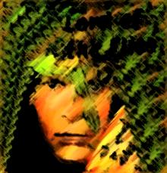
The Lord of the Flies
Reader’s Journal: Pretend you are one of the boys on the island. Write a letter home in which you describe the events, conflicts, setting, characters, etc. Include your feelings and point-of-view about the other boys and about what has happened so far. Include specific details from the novel. Be sure to sign your name—Ralph, Jack, Piggy, or Simon—at the end of your letter. Address the letter to someone specific from home.

