Slide 1

at&t
the “hands” campaign

Slide 2
July 1, 2009
Headline: Dallas, TX
AT&T 'Hands' Advertising Campaign Voted 'America's Favorite Magazine Ad' by Consumers
In the “Hands” campaign, created by BBDO, human hands are intricately painted and posed to depict iconic images representing countries around the world that fall within AT&T’s international footprint. The result is stunning imagery that draws viewers into the artwork while communicating AT&T’s brand proposition of having more phones that work in more places. (at&t.com)
Let’s take a closer look at these “iconic images”…

Slide 3
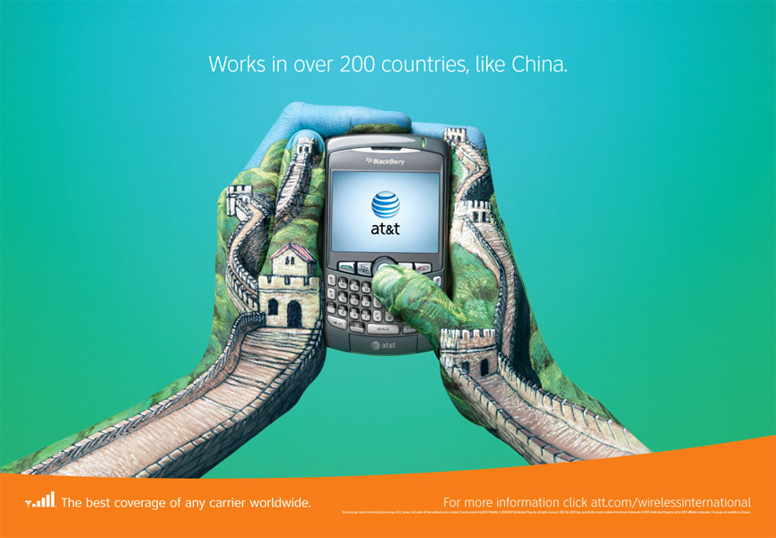

Slide 4
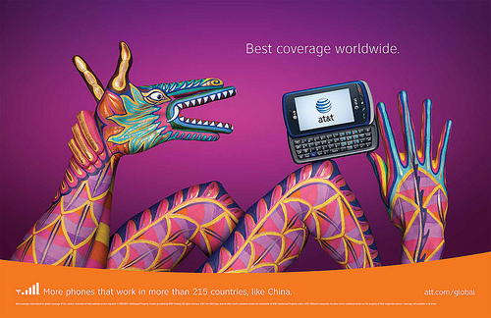

Slide 5
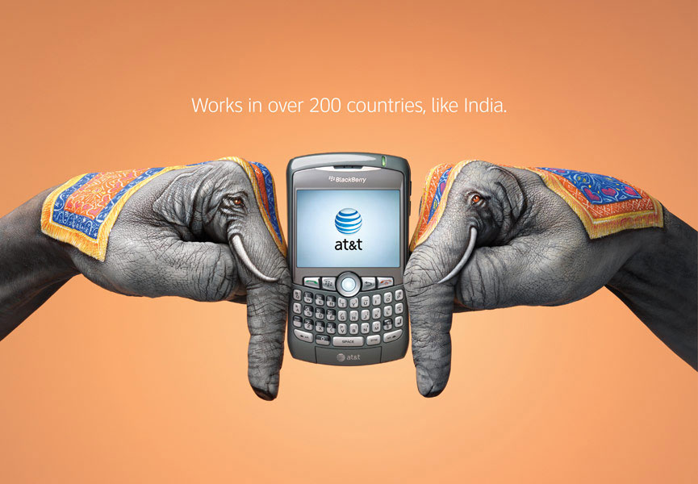

Slide 6
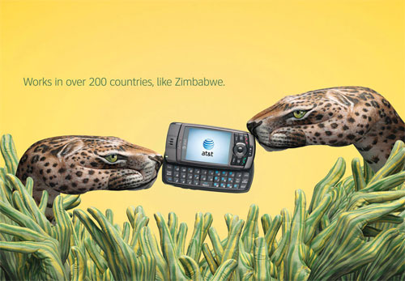

Slide 7
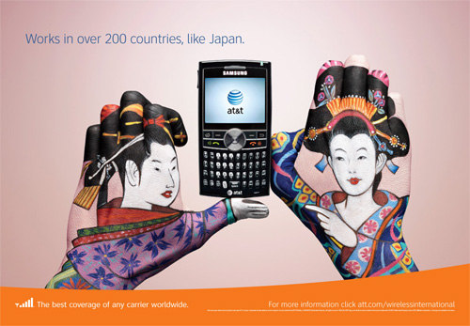

Slide 8
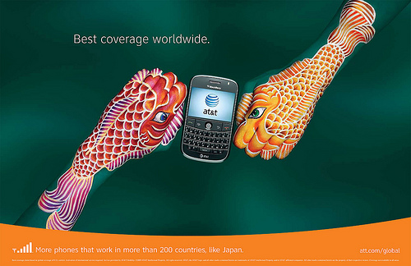

Slide 9
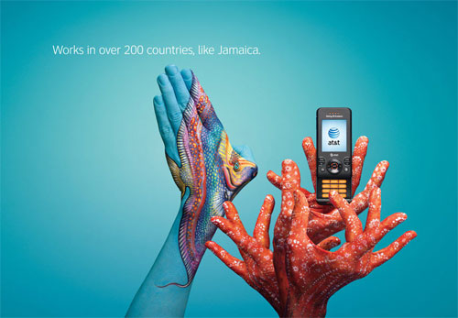

Slide 10
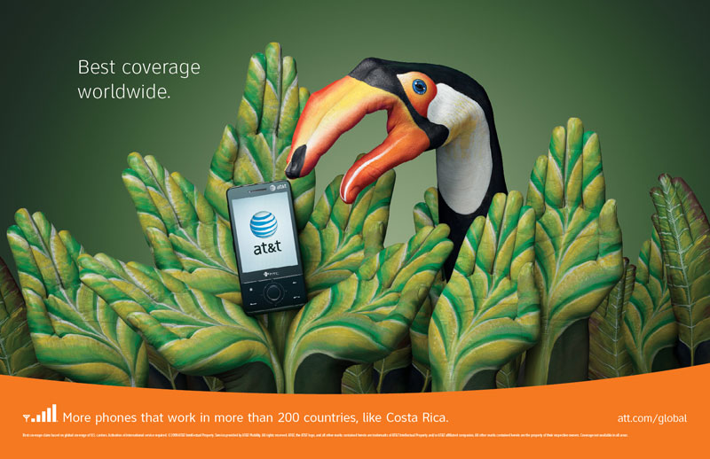

Slide 11
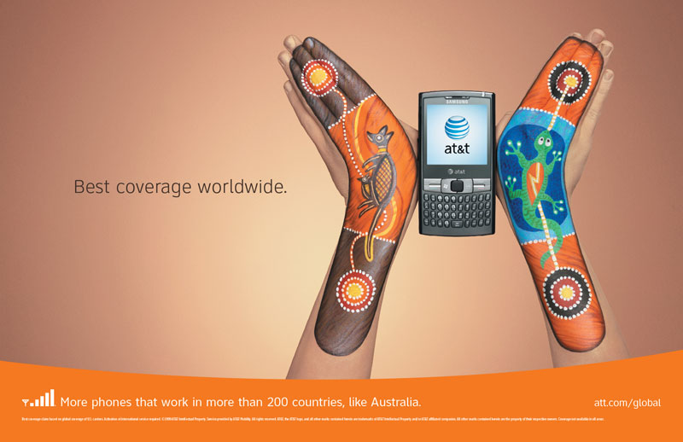

Slide 12
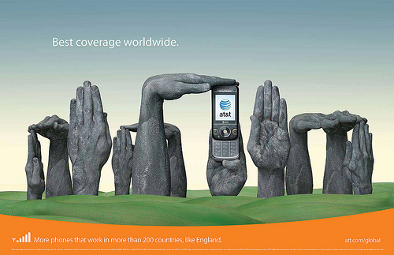

Slide 13
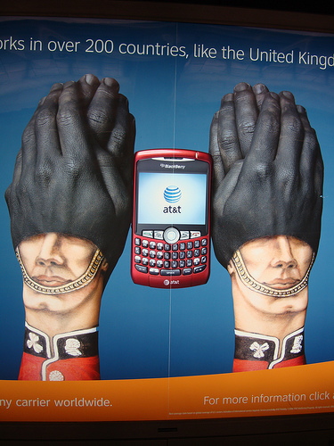
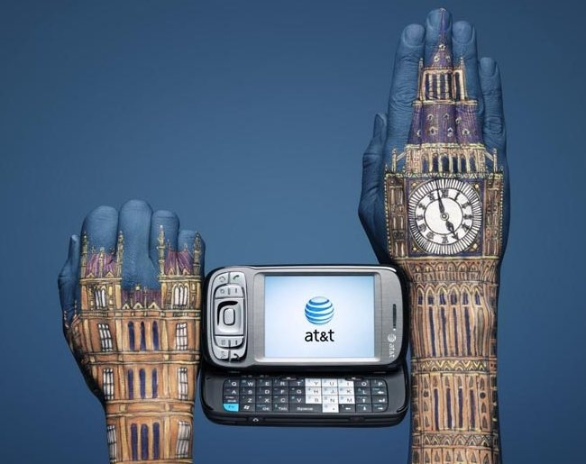

Slide 14
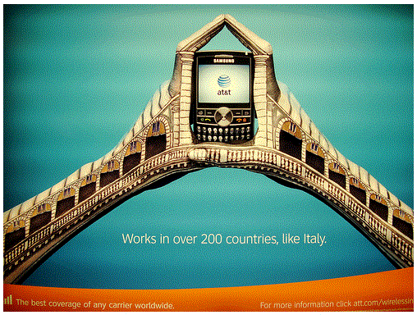

Slide 15
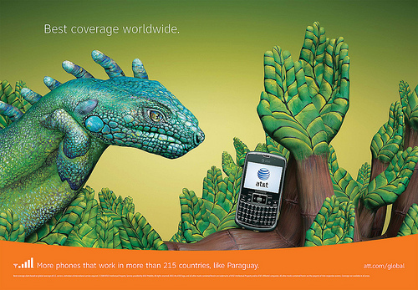

Slide 16
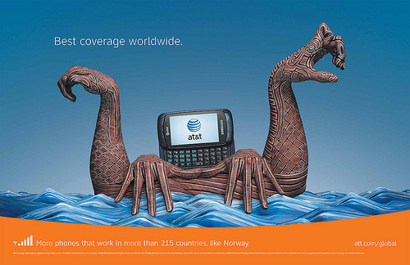

Slide 17
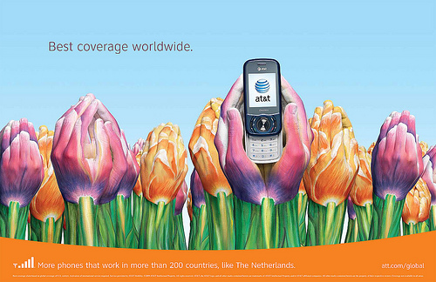

Slide 18
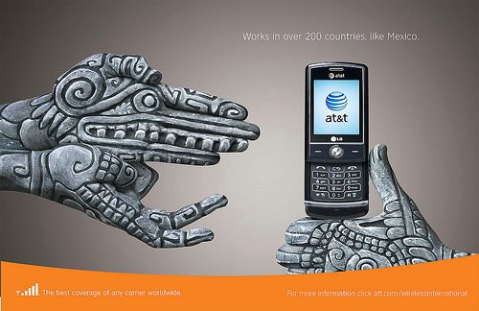

Slide 19
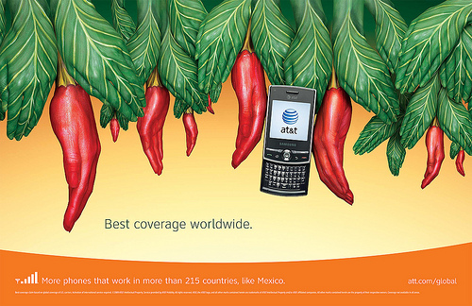

Slide 20
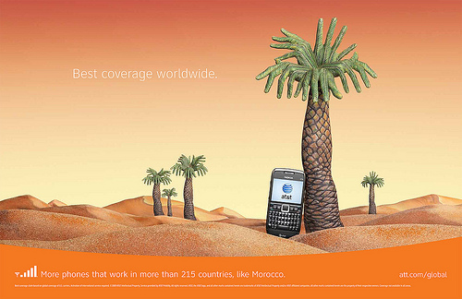

Slide 21
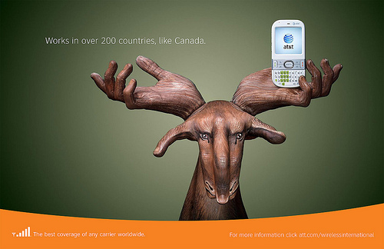

Slide 22
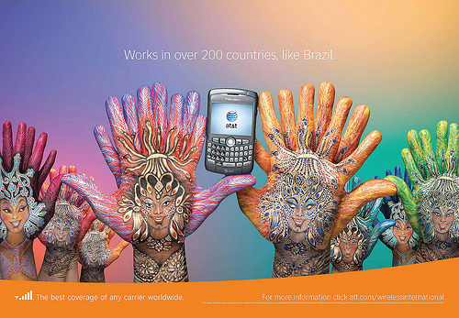

Slide 23
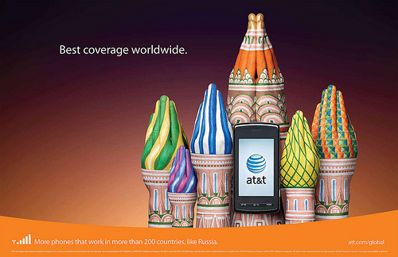

Slide 24
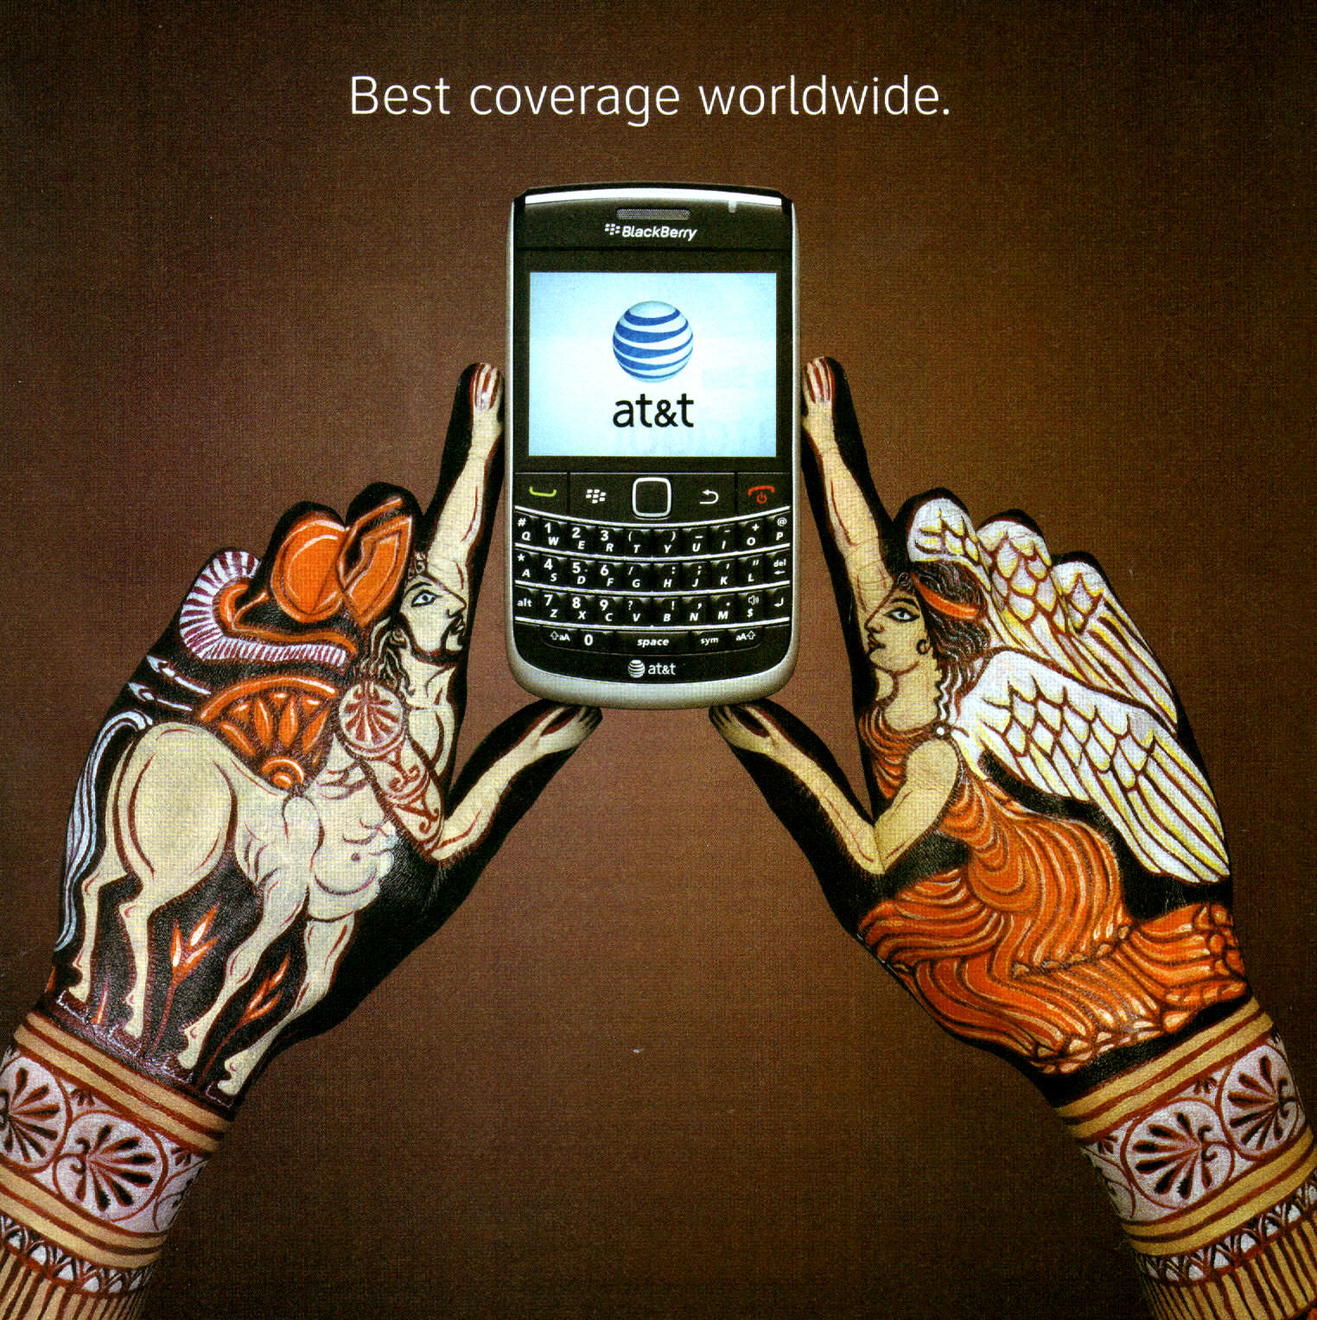

Slide 25
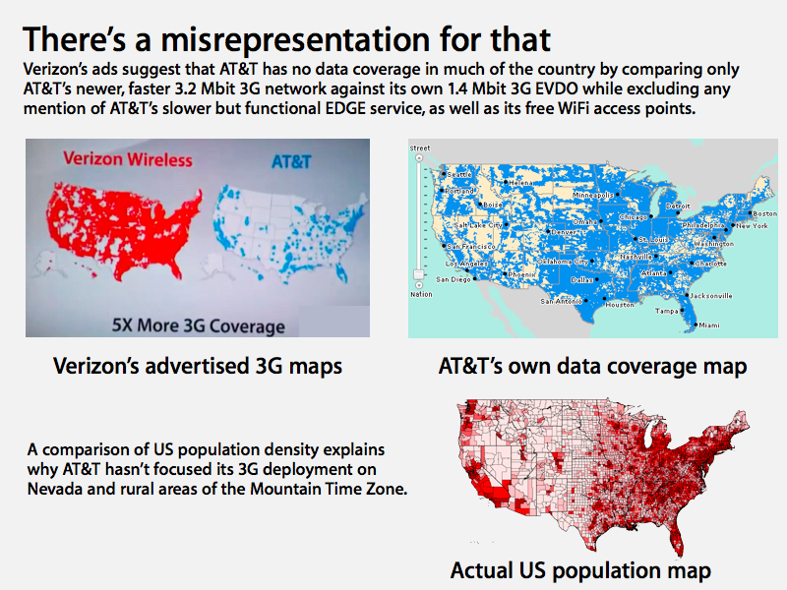

Slide 26
