Slide 1
ENERGY
October 28, 2009
Ms. Stein

Slide 2
If you can only remember one thing…
Energy can change from one form to another without a net gain or loss.
ENERGY IS CONSERVED

Slide 3
But before we get to energy…
When you hear the words “work” and “power” what do you think of?
Talk to the people next to you.

Slide 5
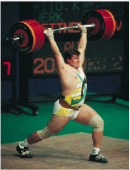
What does energy have to do with it?
Notes:
When work is done by the (sexy) weightlifter in lifting up his barbell, the barbell acquires the ability to do work. Something has been acquired that enables the object to do work – this something is called energy. Like work, energy is measured in joules.

Slide 6
Notes:
Energy appears in many different forms.

Slide 7
Notes:
Mechanical energy = energy due to the position of something or the movement of something
Potential energy = stored energy/energy that has the POTENTIAL to do work
Ex: Gravitational = Potential energy due to elevated position…if I lift a pen it has gravitational potential energy
Kinetic = Energy of Motion

Slide 8
Notes:
Mathematical Terms
KE depends on mass and velocity
PE depends on mass, gravity, and height

Slide 9
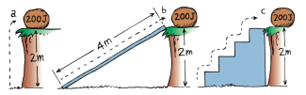
In which scenario is there more potential energy?
PE = mgh
Notes:
All same

Slide 10
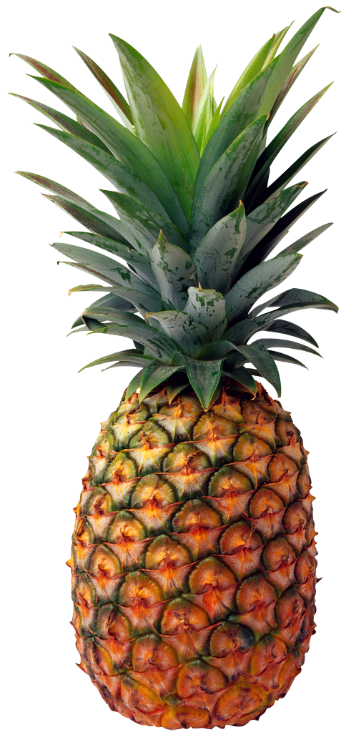
What is the kinetic energy of the flying pineapple?
m = 2 kg
v = 2 m/s
KE = ½mv²
Notes:
4

Slide 11
Work-Energy Theorem
W = ΔKE
Notes:
We know that to increase the kinetic energy of an object, work has to be done on it. Or, if an object is moving, work is required to bring it to rest.
Whenever work is done, energy changes.
Change in kinetic energy = NET work done

Slide 12
Ouch! Mr. Weightlifter drops his 100 kg barbell on his toe.
If the barbell has a velocity of 3 m/s right before it hits the ground, how much work is done by his toe to stop the barbell?
W = ½mv_{f}² - ½mv₀²
Notes:
Back to the sexy weightlifter…

Slide 13

Conservation of Energy
Energy cannot be created or destroyed
Energy can be transformed from one form to another, but the total amount of energy never changes.
Notes:
BIG IDEA

Slide 14
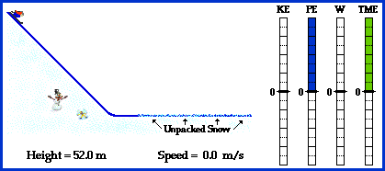
Conservation of Energy for Downhill Skiing

Slide 15
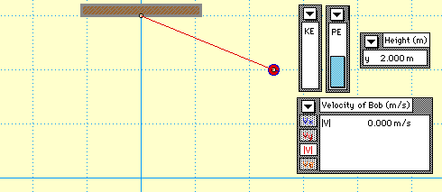
Conservation of Energy in a Swinging Pendulum

Slide 16
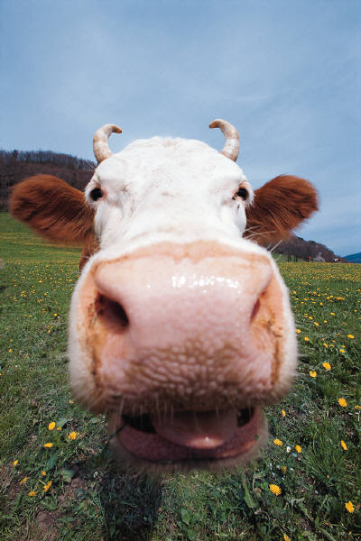

Did ya get it?
Billy Bob is speeding down the country road when he sees a cow in front of him.
Billy Bob slams on the breaks and comes to a stop right before he hits the cow. Kinetic energy is lost as Billy Bob comes to a stop, but where does this energy go?
Notes:
When a car’s brakes are applied, the car’s KE is changed into internal energy in the brake pads, tires, and road as they become warmer.

Slide 17
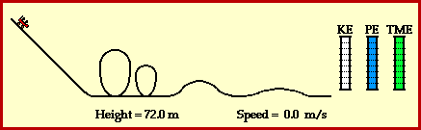
Conservation of Energy in a Roller Coaster

Slide 18
MORE ENERGY
October 29, 2009
Ms. Stein

Slide 19
What was the “Big Idea” about energy?
Energy can change from one form to another without a net gain or loss.
ENERGY IS CONSERVED

Slide 20


Transfers energy form one form to another or from one place to another
Notes:
A machine is a device used to multiply forces or simply change the direction of forces
Every machine uses the concept of conservation of energy
The lever is an example of a simple machine, one that changes the direction of force by doing work on one end
Work input = work output

Slide 21
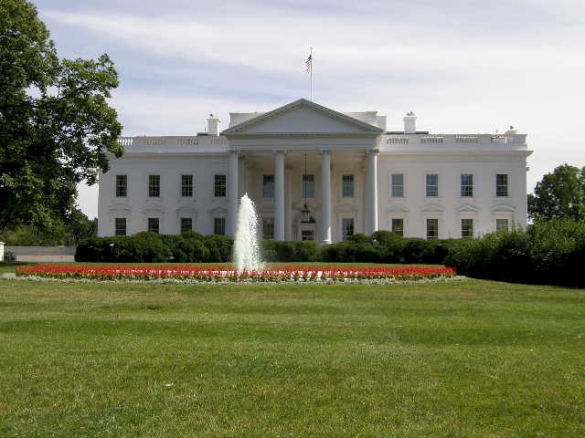
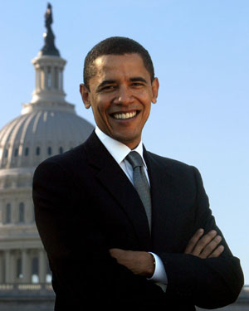

President Obama is trying to lift his new LCD TV into the white house.
Good thing the President knows physics! He decides to use a pulley to lift the TV.
If the President pulls on the rope with a force of 5 N, how many N of force are pulling up on the TV?
5 N
Notes:
Same rope!

Slide 22
Mechanical Advantage
Mechanical Advantage = Output force/Input force
= Input distance/Output distance
If President Obama pulls with 5 N and the ropes exert 10 N upwards to pull the TV, what is the mechanical advantage of the pulley?

Slide 23
Efficiency
In real life, machines aren’t perfect.
Some energy is turned into heat that warms the machine.
useful work output
efficiency =
total work input
Notes:
The ratio of useful energy output to total energy input, the percentage of the work input that is converted to work output
Efficiency = useful work output/ total work input
Efficiency = actual mechanical advantage/
Theoretical mechanical advantage

Slide 24
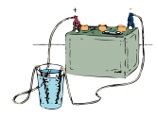

Sources of Energy
Water
Solar
Fuel Cells
Geothermal
Nuclear
Wind
Notes:
Sun is source of practically all of our energy on earth
Nuclear fuels – uranium and plutonium
Geothermal – hot water underground
Fuel Cell - H and O combine to produce electricity
Physicists researching newer and cleaner forms of energy

