Slide 1
Warm-up #1
What is a colony? Who are they controlled by? Who owns them?
What groups were the colonies divided into?

Slide 2
Geography and Immigration Notes
What factors encourage people to move now and in the past?

Slide 3
I. Geography:
A) Definitions
City – a populated area (town) with an organized government.
State - one of the geographic and political units united under a government
Country – a group of political territories run by a single government.
Continent - One of the seven main land masses of the earth. (How many can you name?)

Slide 4
City
State
Country
Continent

Slide 5
Los Angeles
California
USA
North
America

Slide 6
II. Immigration
Take two minutes to brainstorm as many reasons as you can that someone would move to a new country.
A. Definitions
Push-factors –things that force someone to leave their country.
Pull-factors – things that attract someone to a new country.

Slide 7

Homework
Use the atlas in your textbook, an atlas, and/or internet resources to complete the mapping activity.

Slide 8
Warm-up #2
Write a paragraph explaining the difference between a city, state, country, and continent? Provide examples.

Slide 9
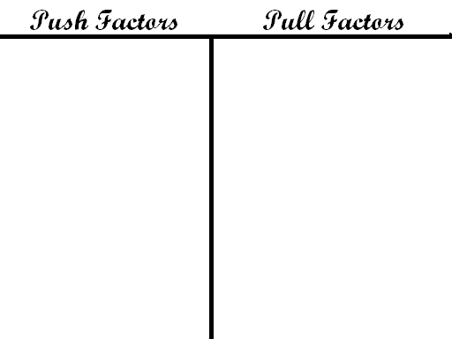
Warm-up #2
Create a T-Chart and group your immigration factors on your chart

Slide 10
Return to your notes

Slide 11



b. Three main motivators for immigration are:
God (religion, to escape religious persecution in Eu Europe)
    Gold (wealth, money, and land were promised to colonist and indentured servants who were poor in Europe)
    Glory (Enlightenment ideas of fame, curiosity, and adventure motivated people to explore)
Return to your T Chart and draw the above symbols on factors that fit into each group.

Slide 12
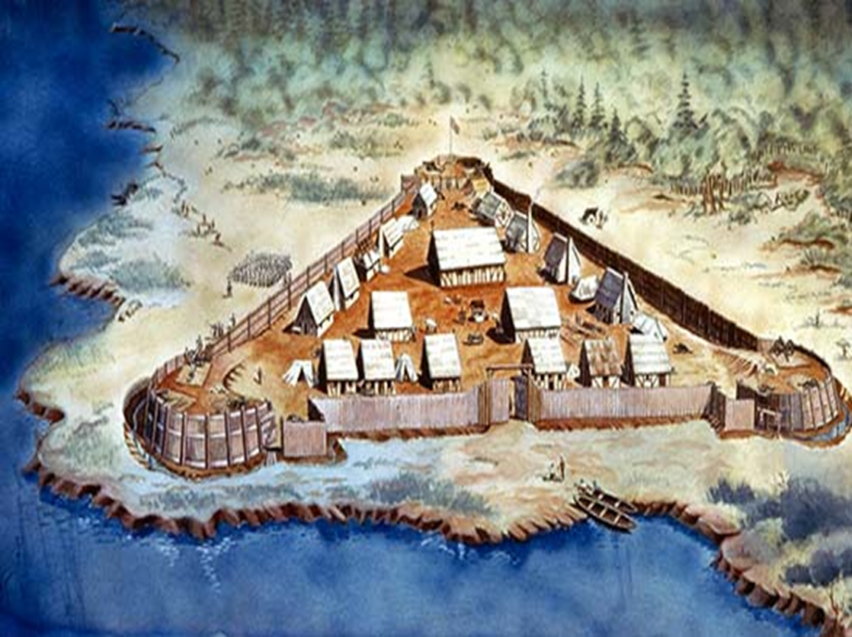
Jamestown Comic Strip
Flip your notebook horizontally and divide your page into six boxes.

Slide 13
1
Jamestown was established in 1607 when the Virginia Company asked the king for a charter. The colonists wanted to become rich. They believed gold would be easy to find.

Slide 14
2
Jamestown was in a swamp. It was hot and humid in the summer and cold in the winter. There were many diseases and danger from the powerful Powhatan tribe in the surrounding area.

Slide 15
3
The winter of 1609 was called the Starving Time. That year the Native Americans stopped trading with Jamestown. Of the 500 colonists only 60 survived. John Smith helped them survive the next winter by making everyone work.

Slide 16
4
John Rolfe introduced tobacco that could be grown in Virginia and sold for good prices in England. The colony profited from its tobacco crops. Rolfe later married Pocahontas.

Slide 17
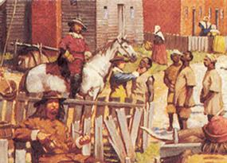
1619 about 20 Africans arrive with Jamestown colonists. They were indentured servants at first but later became life-long slaves (by 1662). After that most Africans were slaves along with their offspring.
5

Slide 18
The End
6

Slide 19
Homework
Complete Jamestown Comic Strip.
Vocabulary half sheet (use your book).

Slide 20
Warm-up #3
What challenges faced the colonists in Jamestown?
What or who do you think was responsible for Jamestown’s survival? Explain.

Slide 21
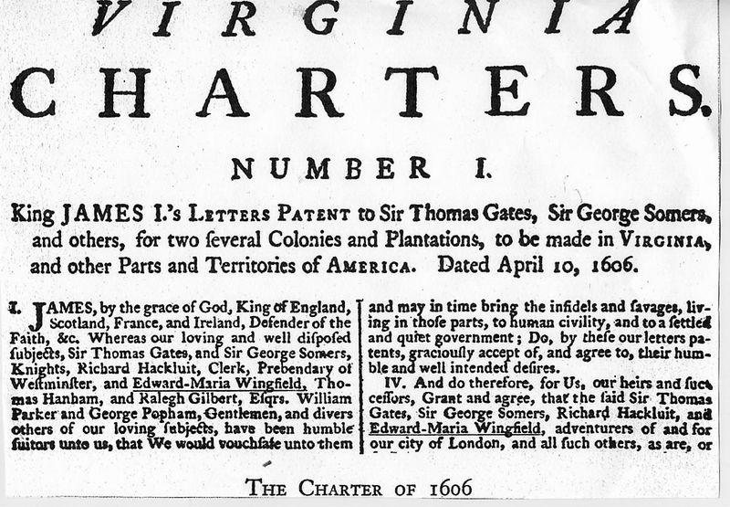
Charter - a government contract that gives the holder the right to establish a colony.

Slide 22
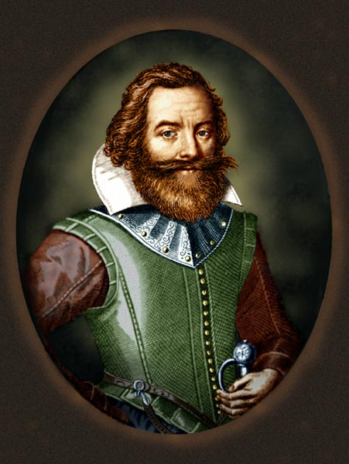
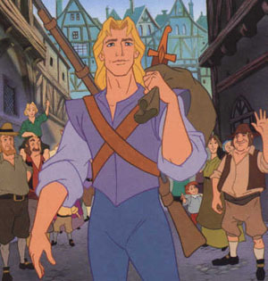
John Smith - The founder of Jamestown

Slide 23
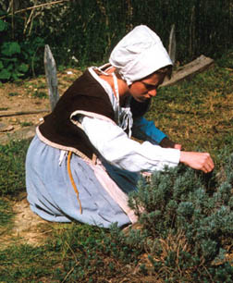
Indentured Servant - A person who sold their labor for 5 to 7 years in exchange for passage to America.

Slide 24
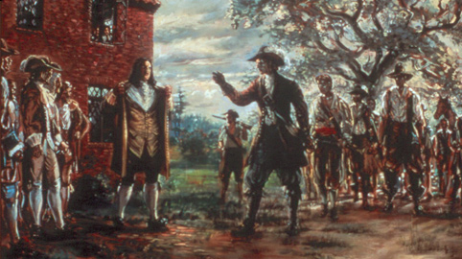
Bacon’s Rebellion - a revolt against Jamestown’s colonial authority led by Nathaniel Bacon in 1676.

Slide 25
Around the Clock Jamestown Review
1 o’clock – First permanent English settlement in the New World.
4 o’clock – What is a charter? Who owned the charter for Jamestown?
5 o’clock – What were some challenges faced in Jamestown?
10 o’clock – What role did John Smith play in the survival of Jamestown?
12 o’clock – What role did the introduction of tobacco play in Jamestown?

Slide 26
Colonial Regions Brochures
Number off
  1 = New England
  2 = Middle Colonies
  3 = Southern Colonies
You will become an expert on your region, go through a series of interviews, then make a travel brochure about your region.
Use your book to help you fill out the matrix on your colonial region.

Slide 27
Do Now
Take out your materials and read the project check list and rubric on your desk.

Slide 28
Do Now
Take out your materials and on your project.

