Slide 1
Warm-up #8
Write a paragraph describing feudalism in Japan. Include specific details and a description of each social group’s roles.

Slide 2
Japan Quiz
Use a separate piece of paper.
Do not copy questions.
Just write the answer choice.
No talking or wondering eyes.

Slide 3
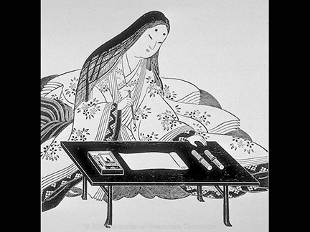
Lady Murasaki Shikibu

Slide 4
Tale of Genji
Then and Now Chart:
Assignment:
Pages 209-211
Then and Now chart
Questions 1-3 on page 211
Modern Society | Heian Court

Slide 5
Women in Feudal Japan
Read
Answer the questions using complete sentences.
Marking the text is optional.

