Slide 1
Ch. 6-1 Effects of Evolution on Species
EQ: What are the 2 main types of evolution and what evidence is used to verify that they occur?

Slide 2

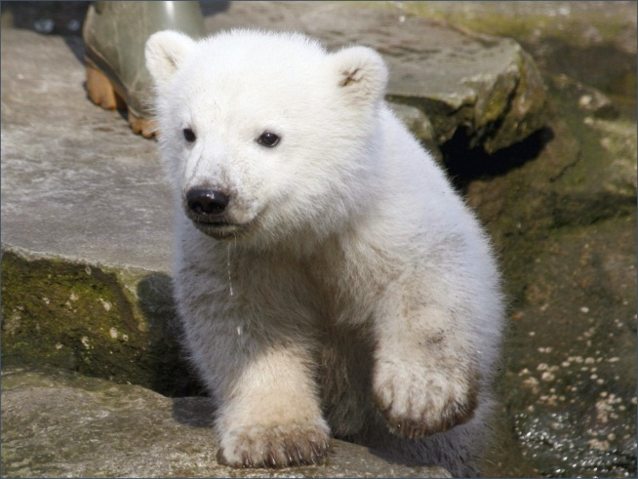
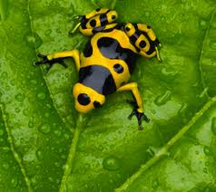
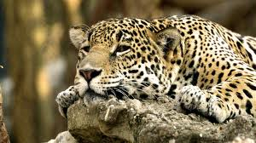

Speciation
What is a species, and how do new species form?
Speciation - is the evolutionary process by which new biological species arise

Slide 3
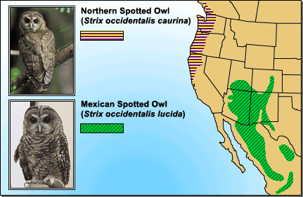
Geographic Isolation
Over time, two populations of a species can become so different that they no longer can breed with each other if separated by a geographical barrier such as mountains and bodies of water (rivers, lakes , oceans).

Slide 4
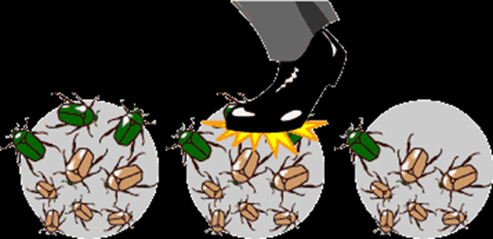
Genetic Drift
In each generation, some individuals may, just by chance, leave behind a few more descendants (and genes, of course!) than other individuals
The genes of the next generation will be the genes of the “lucky” individuals, not necessarily the healthier or “better” individuals

Slide 5
Speed of Evolution
Many scientists hypothesize that evolution occurs slowly, perhaps over tens or hundreds of millions of years.
Others hypothesize that evolution can occur quickly
Most agree that evidence supports both of these

Slide 6
Gradualism
The model that describes evolution as a slow, ongoing process by which one species changes to a new species is known as gradualism
This model says that a continuing series of mutations and variations over time will result in a new species
A series of intermediate forms can indicate a gradual change from the earliest species to today’s species

Slide 7
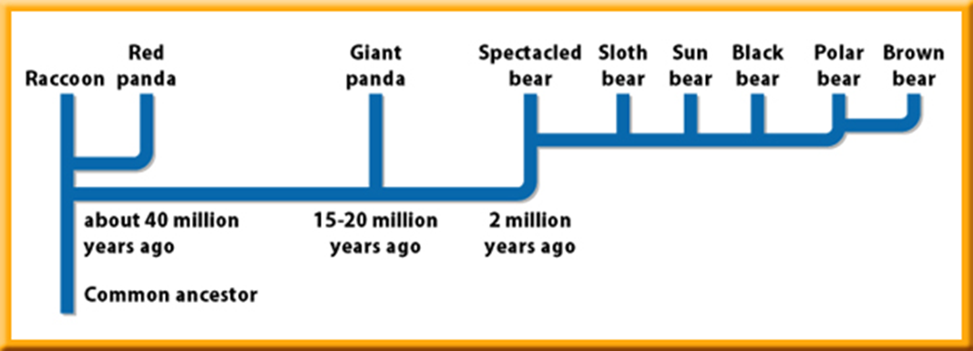
Punctuated Equilibrium
According to the punctuated equilibrium model, rapid evolution comes about when the mutation of a few genes results in the appearance of a new species over a relatively short period of time.

Slide 8
Punctuated Equilibrium Today
Evolution by the punctuated equilibrium model can occur over a few thousand or million years, or sometimes even faster.
For example, many bacteria have changed in a few decades.
The antibiotic penicillin originally came from the fungus Penicillium.
But many bacteria species that were once easily killed by penicillin no longer are harmed by it.

Slide 9
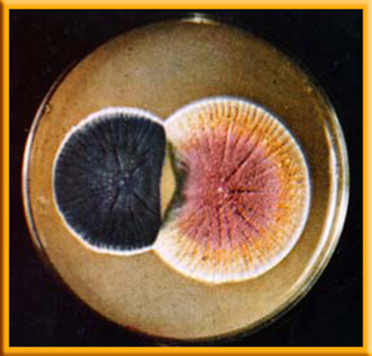
Punctuated Equilibrium Today
Penicillin has been in use since 1943.
Just four years later, in 1947, a species of bacteria that causes pneumonia and other infections already had developed resistance to the drug
By the 1990s, several disease-producing bacteria had become resistant to penicillin and many other antibiotics

Slide 10
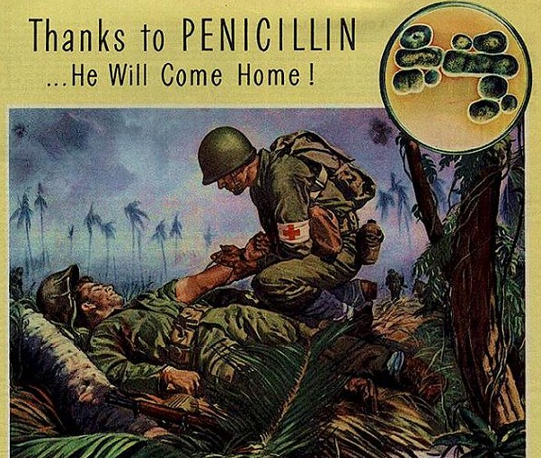
Punctuated Equilibrium Today
When penicillin was used to kill bacteria, those bacteria with the penicillin-resistant variation survived, reproduced, and passed this trait to their offspring.
Over a period of time, this bacteria population became penicillin-resistant

