Slide 1
The World Economy
Chapter 16

Slide 2
What advantages allowed Spain and Portugal to expand 1st?
Portuguese leaders drawn to excitement of Exploration and desire to hurt the Muslim world
Henry the Navigator funded exploration
Spanish explorers had been in the Atlantic since the 1400s
Spanish wars against the Moors led to advanced weapons

Slide 3
Spanish and Portuguese Exploration
Portuguese explorers push down the west coast of Africa
Set up small forts as they go
Vasco de Gama discovers Cape of Good Hope and sails around Africa
Spain pushes west across the Atlantic looking for a South West passage
Columbus discovers new lands across the Atlantic

Slide 4
Spain and Portugal: Conflict
Rather than fight over territory, Spain and Portugal appeal to the Pope for help.
The Inter Caetera establishes a line of demarcation dividing the world into Spanish and Portuguese spheres
The Treaty of Tordesillas moves the line west to give the Portuguese access to Brazil

Slide 5
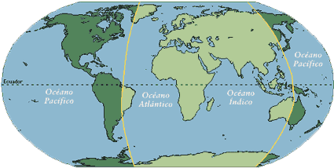
The Line of Demarcation

Slide 6
Control of Exploration moves North
By the late 1500s, Northern European countries get involved in Exploration
  Looking for North East and North West passages
  Protestant Reformation weakens papal power (Kings can defy the Pope’s Line of Demarcation)

Slide 7
England and the Dutch
Try to match Catholic holdings
Joint Stock Companies better able to fund the expenses of exploration and trans-Atlantic trade than southern monarchies
Although unsuccessful in gaining northern passages to the Indies, they do settle lands around the Atlantic

Slide 8
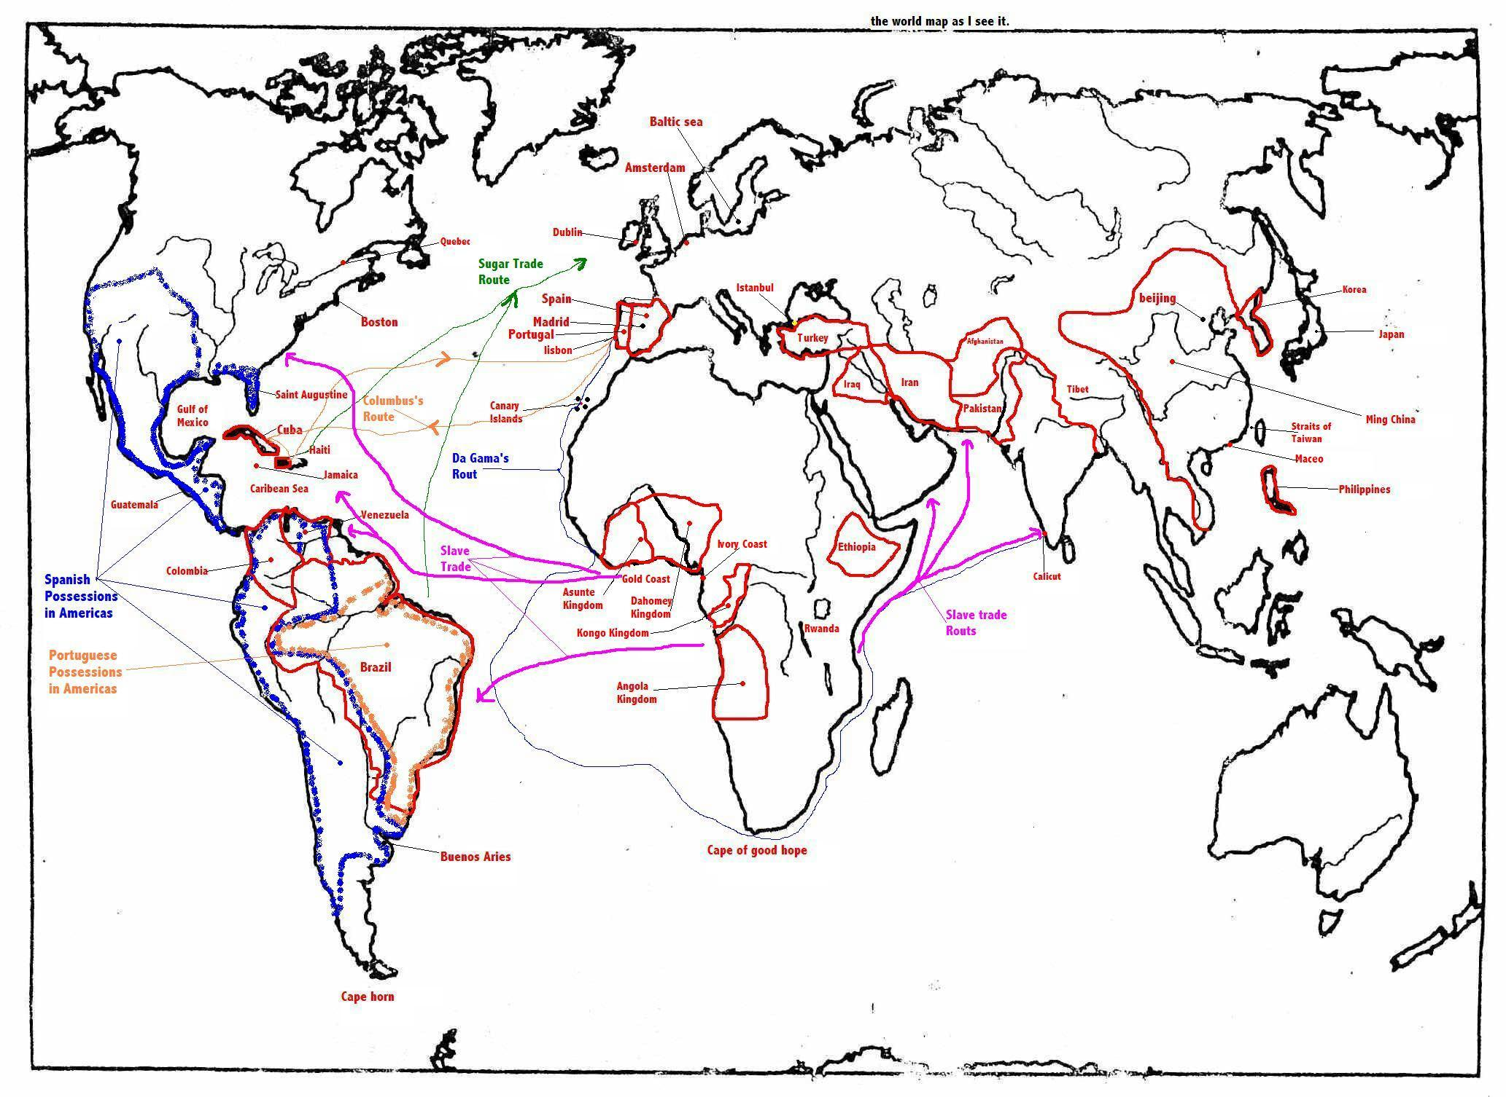
The Columbian Exchange

Slide 9
The Commercial Dominance of the West
Western Europe dominates most of Atlantic trade
Merchant countries gain dominance
Europeans set up small trade posts, but are not interested in setting up large land colonies (Spain in the new world = exception)

Slide 10
Imbalances in Trade
England, France and the Dutch make majority of profits
Export expensive finished goods and import raw materials
Mercantilism: Economic policy in which countries try to increase their wealth by exporting more than they import

Slide 11
International Inequality
Dependent areas like Latin America and Western Africa were not poor
  Silver mines in South America grew wealthy
  Commercial estates made money on cash crops
  Some West Africans states grew rich on the sale of slaves
  Most of the world has no effect

Slide 12
Is it really a world economy?
No!
Most of the world is not effected
  China is isolated, some trade but limited interaction
  Most Japanese were forbidden to interact with foreigners
  Mughals and Safavid could not compete with European traders
  Most of Africa isolated due to geography

Slide 13
Expansionism
By the 17th century European powers were looking to expand
Mughal empire begins to disintegrate
Spanish colonize land in the Indies and Central and South America
France trades furs in Canada
England sets up coastal plantation colonies

Slide 14
  “Early colonies in the Americas typically were developed by small bands of gold-hungry Europeans often loosely controlled by colonial administration back home.”

Slide 15
Spanish Colonies
Islands in the Caribbean(Sugar Plantations)
  Cuba
  Hispaniola
  Jamaica
Large land Colonies in central and South America
  Gold and Land!!!!!!

Slide 16
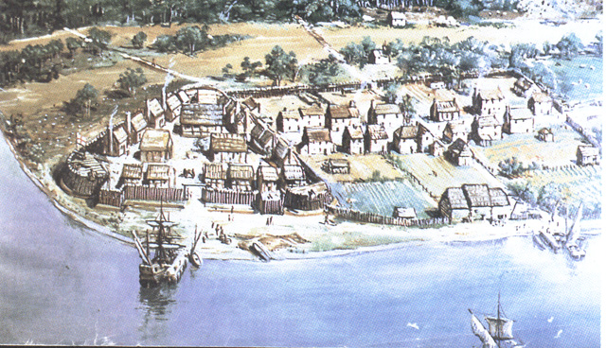
British and French North America
Back Water Colonies

Slide 17
British Colonies
Settled land along the Atlantic
  Plantations in the south
Religious refugees
  Calvinists like the pilgrims in the North East

Slide 18
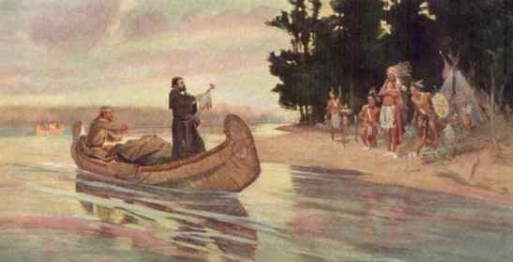
French Colonies
Along the Mississippi and into Canada
Mostly traded furs

Slide 19
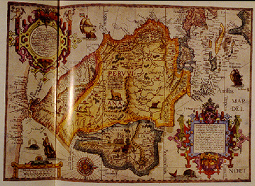
Dutch
Colonized New York
Mostly focused on Asian colonies

Slide 20
Life in the Colonies
North America:
  Similar family patterns to Europe
  Slightly higher focus on children
  New emphasis on affection

Slide 21
Life in the Colonies
Africa
  Small coastal fortresses
  No family units
  Trade only

Slide 22
Life in the Colonies
Asia
  British and French struggle for control of India
  Mughal Empire in decline
  Limited effect on Indian people

Slide 23
Effect on Europe
Economic Effects
  Average Europeans can afford luxuries like sugar
  Wealth goes into development of manufacturing operations
Diplomatic effects
  Wars

