Slide 1
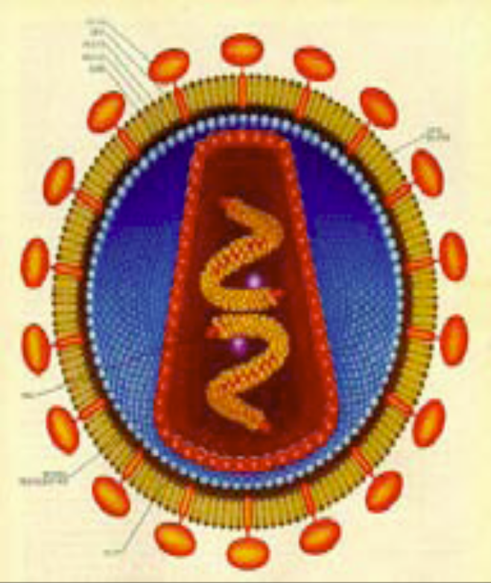
Viral genetics

Slide 2
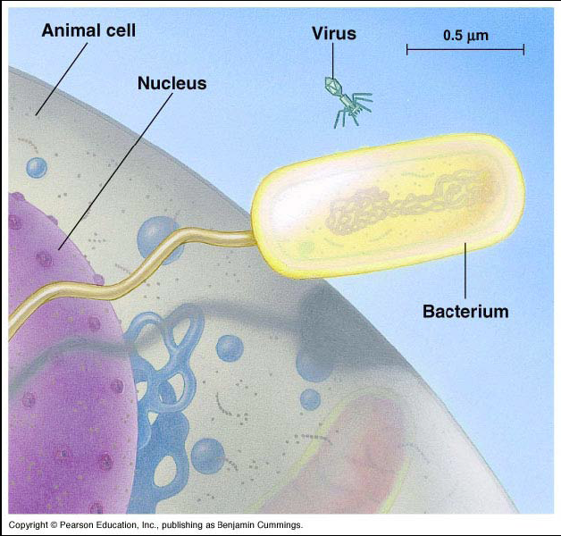
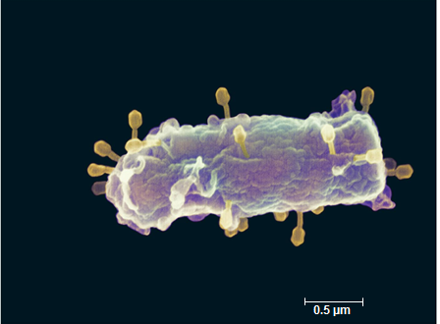
A sense of size
Comparing
  Eukaryote
  Bacterium
  virus

Slide 3
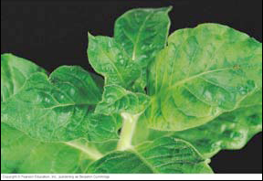
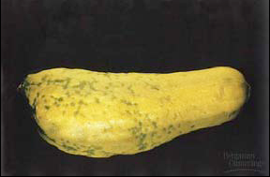
What is a virus?
DNA or RNA enclosed in a protein coat
Viruses are not cells
Extremely tiny
  Electron microscope size
  Smaller than ribosomes
  ~20-50 nm
First discovered in plants (1800s)
  Tobacco mosaic virus
  Couldn't filter out
  Couldn’t reproduce on media like bacteria

Slide 4
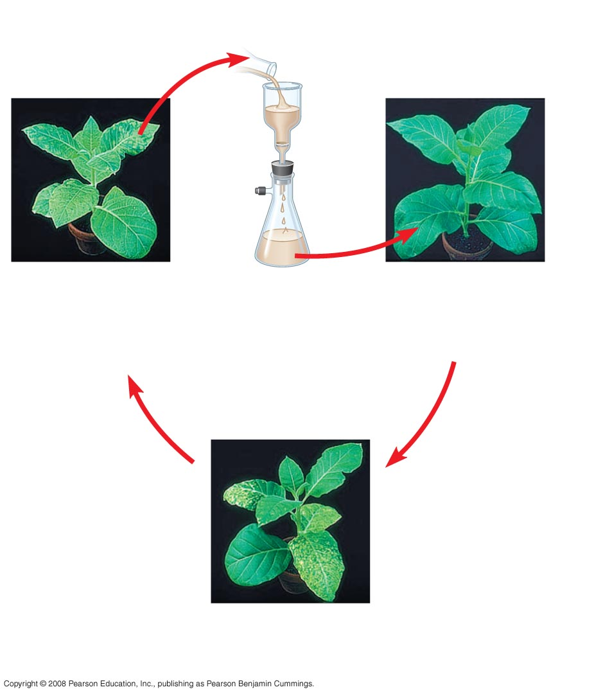
1935, Wendell Stanley crystallized infectious particle
1
Extracted sap
from tobacco
plant with
tobacco
mosaic
disease
2
Passed sap
through a
porcelain
filter known
to trap
bacteria
3
Rubbed filtered
sap on healthy
tobacco plants
4
Healthy plants
became infected
Notes:
Figure 19.2 What causes tobacco mosaic disease?

Slide 5
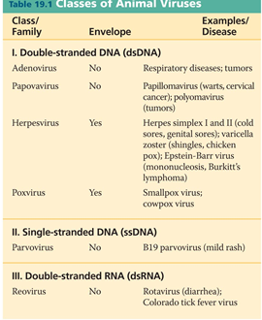
Viral genomes
Viral nucleic acid varies
  Double-stranded DNA
  Single-stranded DNA
  Double-stranded RNA
  Single-stranded RNA
Linear or circular molecule of nucleic acid
  Smallest viruses have only 4 genes, while largest have several hundred

Slide 6
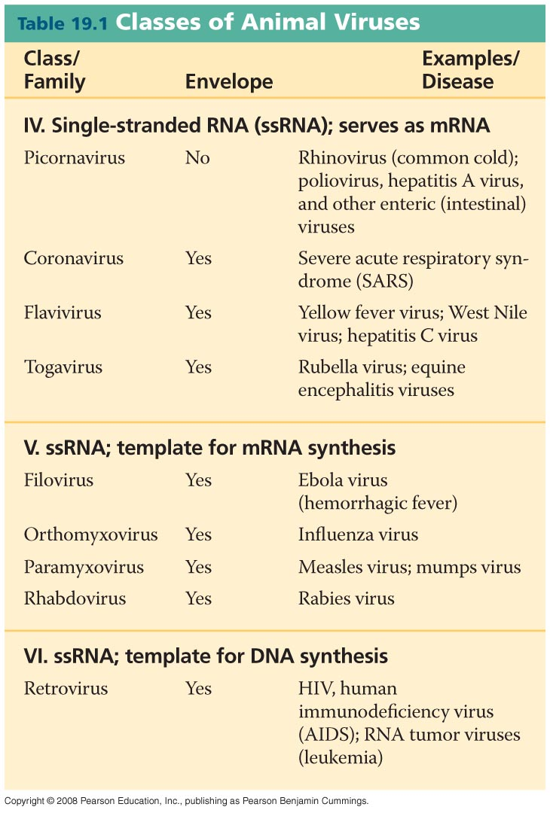
Table 19-1b
Notes:
Table 1

Slide 7
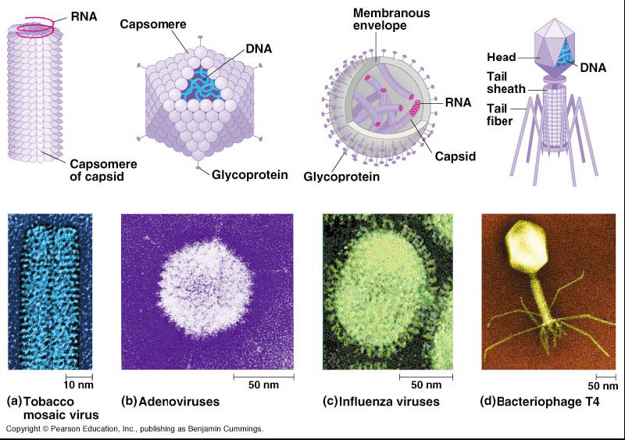
Viral protein coat
Capsid
  Crystal-like protein shell
  1-2 types of proteins
  Many copies of same protein = capsomere

Slide 8
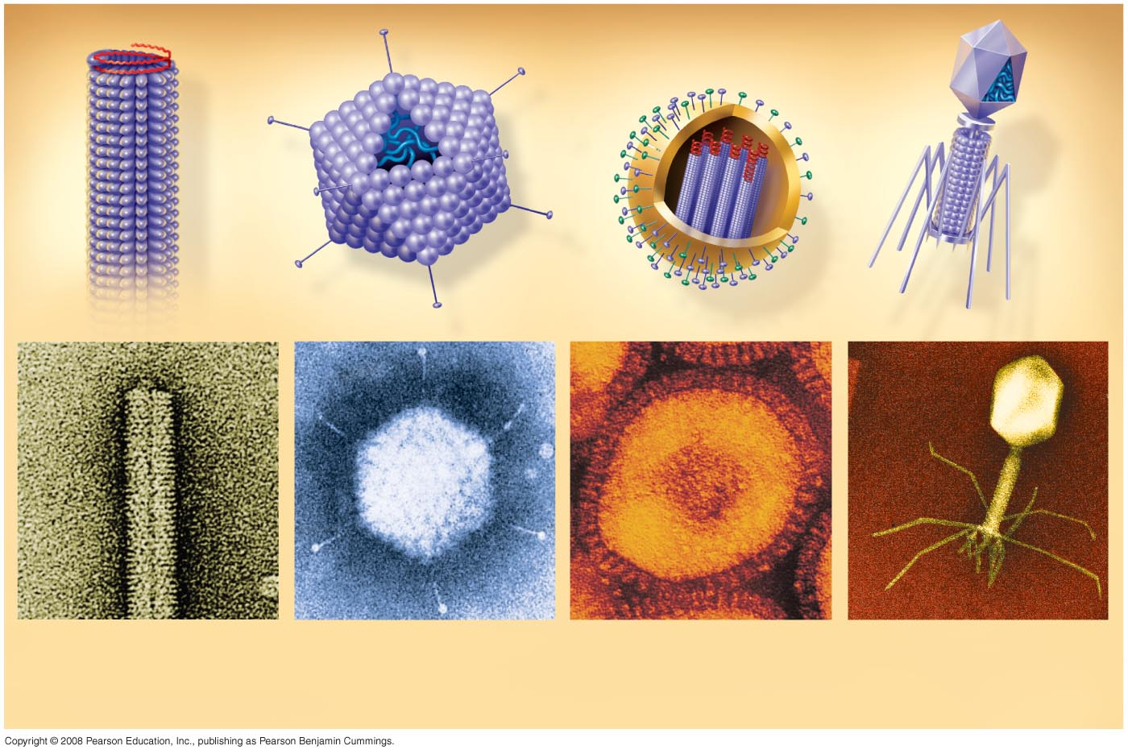
Variation in Viruses
RNA
DNA
Membranous
envelope
RNA
Head
Capsomere
DNA
Capsid
Tail
sheath
Capsomere
of capsid
Tail
fiber
Glycoprotein
Glycoproteins
18  250 nm
70–90 nm (diameter)
80–200 nm (diameter)
80  225 nm
20 nm
50 nm
50 nm
50 nm
(a) Tobacco mosaic
virus
(b) Adenoviruses
(c) Influenza viruses
(d) Bacteriophage T4
Notes:
Figure 19.3 Viral structure

Slide 9
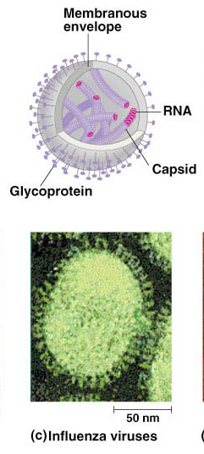
Viral envelope
Lipid bilayer membranes cloaking viral capsid
  Helps viruses infect host
  Envelopes are derived from host cell membrane as the viral capsids exit
  Glycoproteins on surface bind to specific receptors on the surface of a host cell
  Other viral membranes form from the host’s nuclear envelope and are then replaced by an envelope made from the Golgi apparatus

Slide 10

Bacteriophages
Viruses that infect bacteria
Ex. Phages that infect E. coli
20-sided capsid head encloses DNA
Protein tail attaches phage to host & injects phage DNA inside

Slide 11
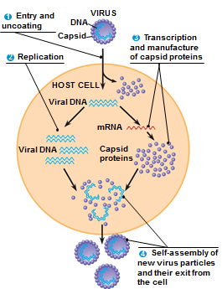
Generalized viral life cycle
Obligate Intracellular Parasites
  Lack enzymes for metabolism
  Lack ribosomes for protein synthesis
  Need host “machinery”
Entry
  Virus DNA/RNA enters host cell
Assimilation
  Viral DNA/RNA takes over host
  Reprograms host cell to copy viral nucleic acid & build viral proteins
Self assembly
  Nucleic acid molecules & capsomeres self-assemble into viral particles
  Exit cell

Slide 12
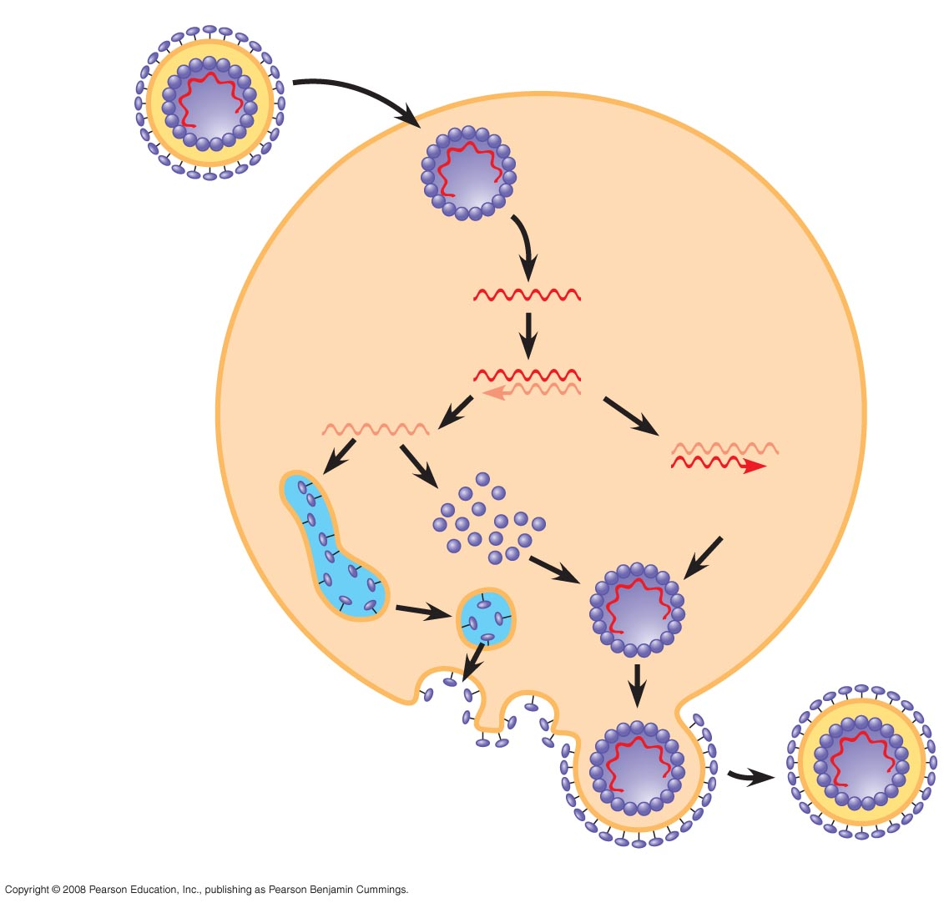
Fig. 19-7
Capsid and viral genome
enter the cell
Capsid
RNA
Envelope (with
glycoproteins)
HOST CELL
Viral genome (RNA)
Template
mRNA
ER
Capsid
proteins
Glyco-
proteins
Copy of
genome (RNA)
New virus
Notes:
Figure 19.7 The reproductive cycle of an enveloped RNA virus

Slide 13
The Lytic Cycle
a phage reproductive cycle that culminates in the death of the host cell
produces new phages and digests the host’s cell wall, releasing the progeny viruses
A phage that reproduces only by the lytic cycle is called a virulent phage

Slide 14
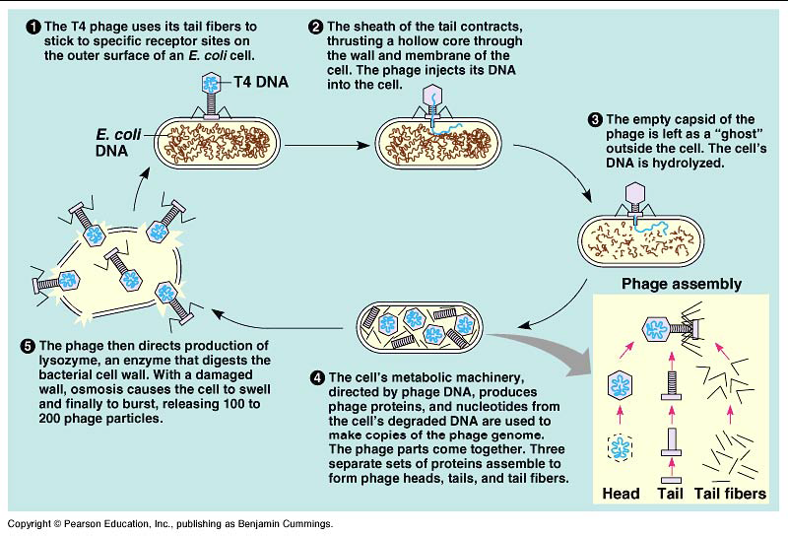
Lytic life cycle of phages

Slide 15
The Lysogenic Cycle
The lysogenic cycle replicates the phage genome without destroying the host
The viral DNA molecule is incorporated into the host cell’s chromosome
  prophage
Every time the host divides, it copies the phage DNA and passes the copies to daughter cells
An environmental signal can trigger the virus genome to exit the bacterial chromosome and switch to the lytic mode
Temperate phages
  Use both lytic and lysogenic cycles

Slide 16
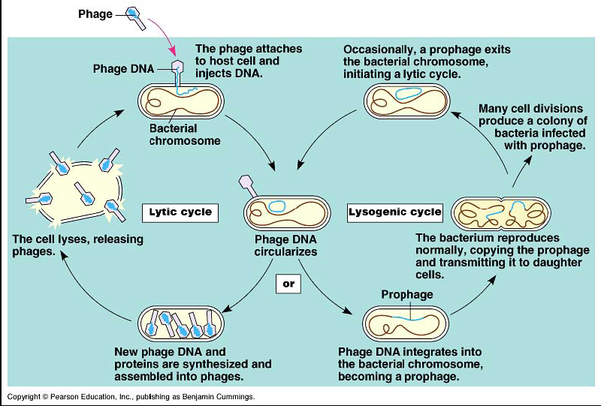
Lysogenic life cycle of phages

Slide 17
Viral Hosts
Host Range
  Each type of virus can infect & parasitize only a limited range of host cells
  Identify host cells via “lock & key” fit
    Between proteins on viral coat & receptors on host cell surface
  Broad host range
    Rabies = can infect all mammals
  Narrow host range
    Human cold virus = only cells lining upper respiratory tract
    AIDS virus = binds only to specific WBC

Slide 18
Defenses against viruses
Bacteria have defenses against phages
  Natural selection favors bacterial mutants with receptor sites that are no longer recognized by a particular type of phage
  Bacteria produce restriction enzymes that recognize & cut up foreign DNA
    Modifications to bacteria’s own DNA prevent its destruction by restriction enzymes
It’s an escalating war!
  Natural selection favors phage mutants resistant to the bacterial defenses

Slide 19
RNA Viruses
Retroviruses
  Use an enzyme = reverse transcriptase
  Copies viral RNA into DNA in host
    Viral DNA can be integrated into host chromosome
      provirus
    Can be passed to other cells
  Host’s RNA polymerase now transcribes viral DNA into viral RNA molecules
    Produces viral components

Slide 20
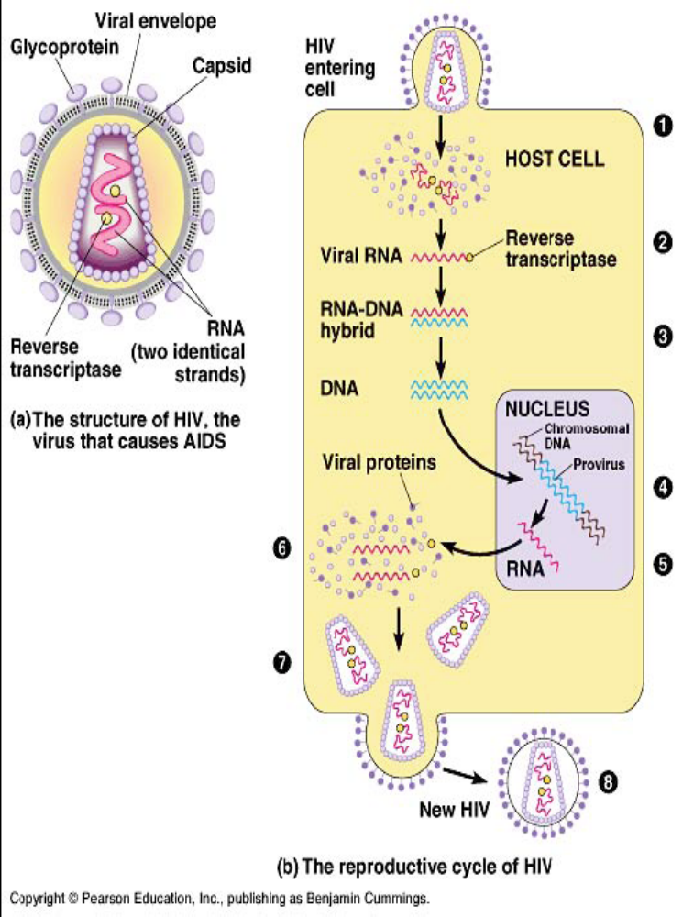
Retroviruses: HIV
Human immunodeficiency virus
Causes AIDS
  Acquired immunodeficiency syndrome
Envelope with glycoproteins for binding to specific WBC
Capsid containing 2 RNA strands & 2 copies of reverse transcriptase

Slide 21
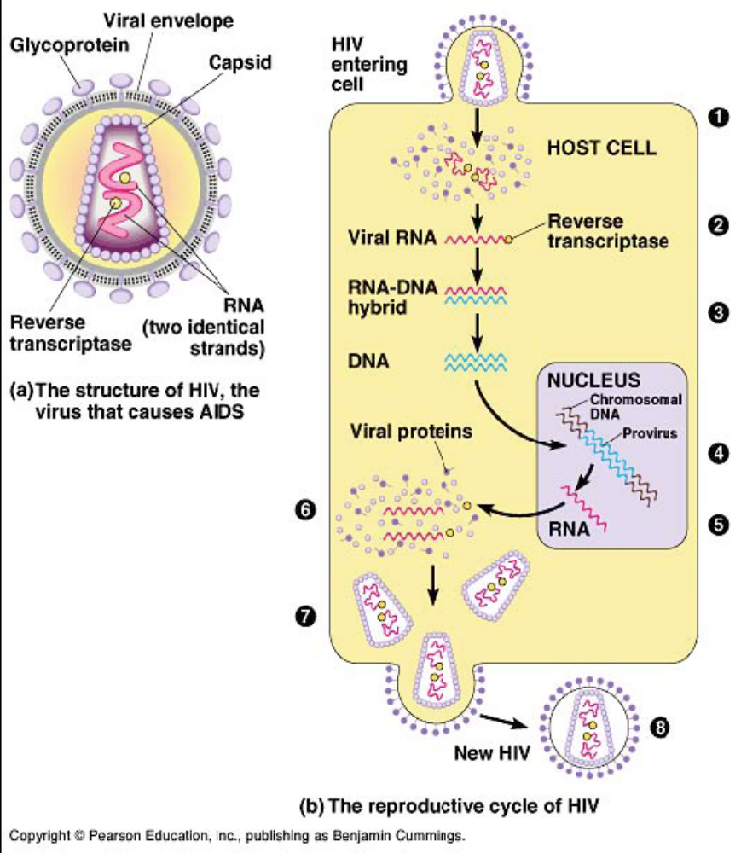
HIV infection
HIV enters host cell
  Reverse transcriptase synthesizes double stranded DNA from viral RNA
Transcription produces more copies of viral RNA
  Translated into viral proteins
  Proteins & viral RNA self-assemble into virus particles & leave host

Slide 22
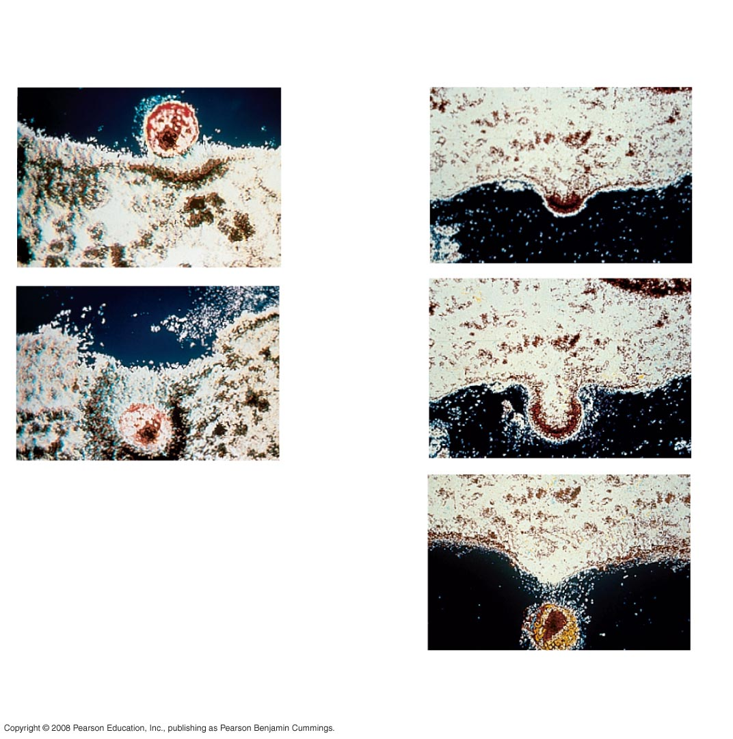
Fig. 19-8b
Membrane of
white blood cell
HIV
0.25 µm
HIV entering a cell
New HIV leaving a cell
Notes:
Figure 19.8 The reproductive cycle of HIV, the retrovirus that causes AIDS

Slide 23
Symptoms of viral infection
Link between infection & symptoms varies
  Kill cells by lysis
  Cause infected cell to produce toxins
  Viral components, such as envelope proteins, may be toxic
Damage?
  It depends…
    After the flu, the lung epithelium is repaired
    After polio, nerve cell damage is permanent

Slide 24
Cancer Viruses
Viruses appear to cause certain human cancers
  Hepatitis B virus
    Linked to liver cancer
  Epstein-Barr virus = infectious mononucleosis
    Linked to Burkitt’s lymphoma
  Papilloma viruses
    Linked to cervical cancers
  HTLV-1 retrovirus
    Linked to type of adult leukemia

Slide 25
Cancer viruses
Transform cells into cancer cells after integration of viral DNA into host DNA
  Carry oncogenes that trigger cancerous characteristics in cells
  Version of human gene that normally controls cell cycle or cell growth
Most tumor viruses probably cause cancer only in combination with other mutagenic events

Slide 26
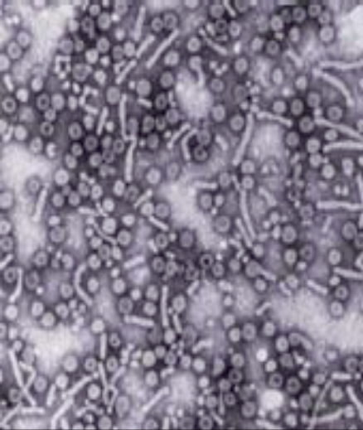
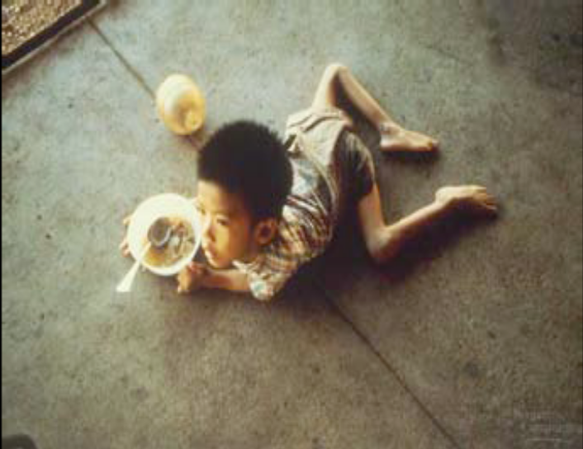
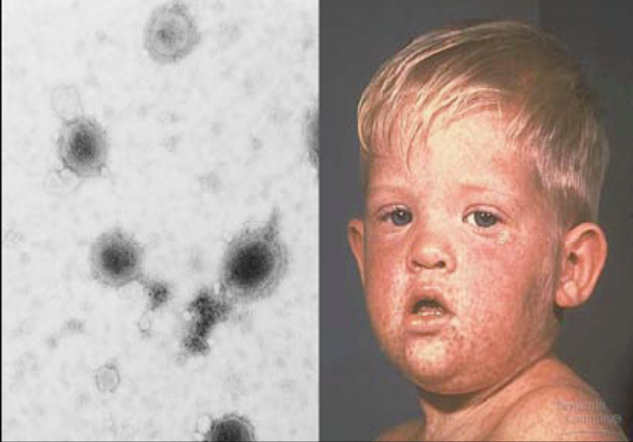
Viral diseases
Hepatitis
Polio
Measles

Slide 27
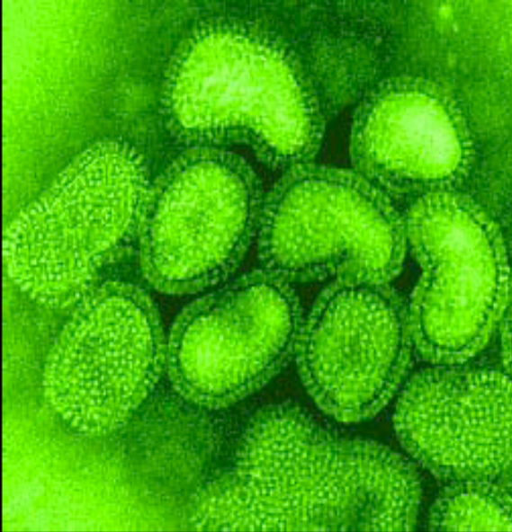
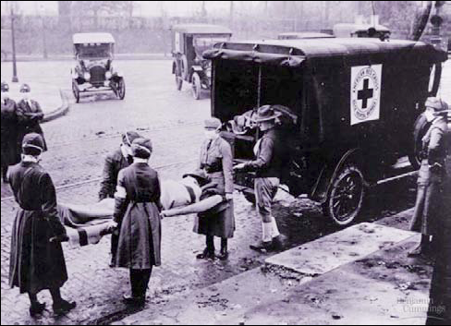
Influenza: 1918 pandemic
30-40 million deaths worldwide
RNA Virus

Slide 28
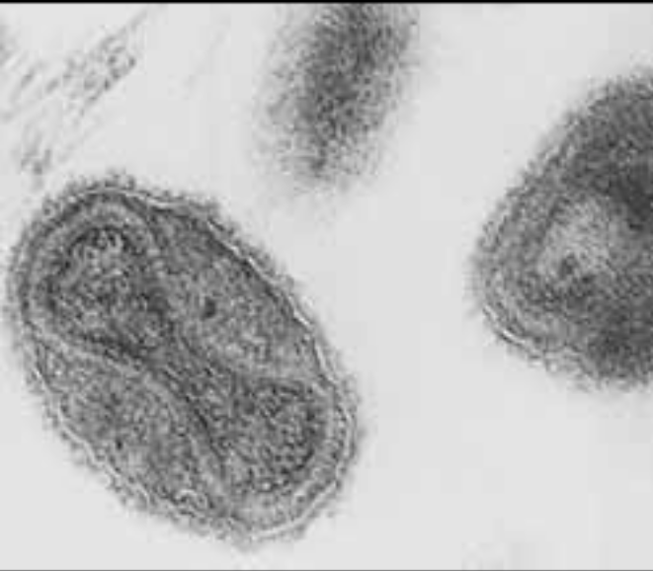
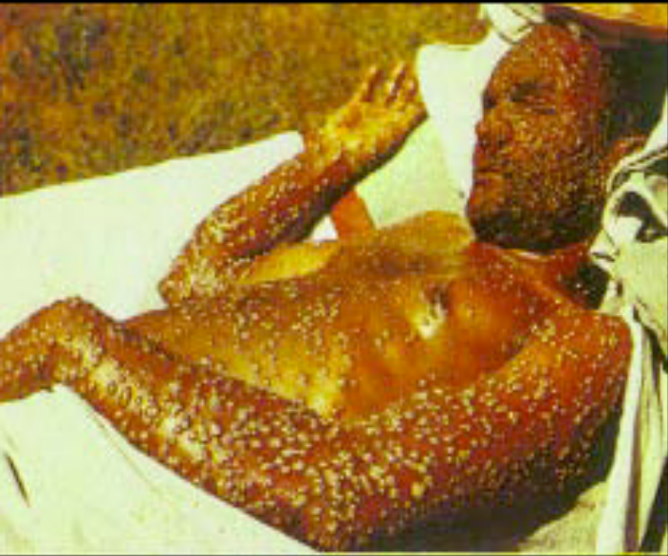
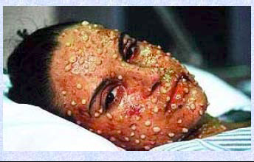
Smallpox
Eradicated in 1976
  Vaccinations ceased in 1980

Slide 29
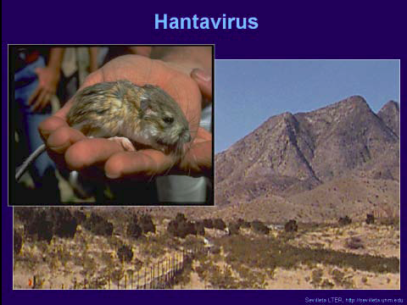
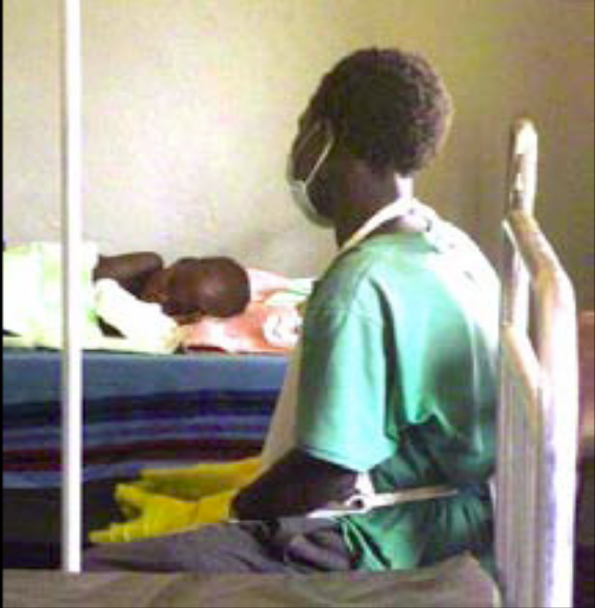
Emerging viruses
Viruses that mutate & “jump” host species
  Hanta virus
  Ebola virus

Slide 30
Evolution of Viruses
Viruses do not fit our definition of living organisms
Since viruses can reproduce only within cells, they probably evolved as bits of cellular nucleic acid
Candidates for the source of viral genomes are plasmids, circular DNA in bacteria and yeasts, and transposons, small mobile DNA segments
Plasmids, transposons, and viruses are all mobile genetic elements

