Slide 1
Class discussion
Healthy and productive

Slide 2
objective:
Students will be able to identify the 6 rules for Class Discussion in English 4P (ERWC) and classify their relationship with the skills required for participation.

Slide 3
Essential question 1:
What skills are required for participation in class discussion?

Slide 4
Skills required
Speaking
Listening
Thinking
Preparing
“Discussion is an exchange of knowledge; argument is an exchange of ignorance”
-Robert Quillen

Slide 5

rules
Take an active
speaking role.
Good Discussion
Requires EVERYONE

Slide 6
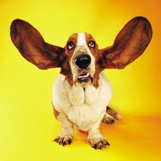
2. Listen Attentively
Good listening leads to
good questions, that is
when good discussion
has begun.
“We have two ears and one mouth so that we can
listen twice as much as we speak.”
-Epictetus

Slide 7

3. Examine all sides of an issue.
Complex issues must
Be seen from a
Variety of angles.

Slide 8

4. Suspend Judgment
Be receptive to the
beliefs of others

Slide 9
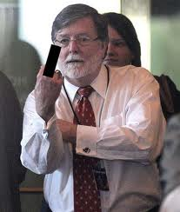

5. Avoid abusive or insulting language
If we do not show respect , then we embarrass ourselves and close off the possibility for an intelligent and productive exchange of ideas.

Slide 10
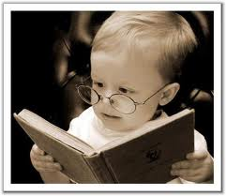
6. Be prepared
Discussion demands
Preparation and Focus.
You must consider
assigned topics
beforehand.
Read whatever is
required.

Slide 11
opinions
Opinions are statements or beliefs expressed with some degree of doubt or skepticism.
Facts can be confirmed or verified.

Slide 12
examples
Fact: “Washington, D.C., is the capital of the United States of America.”
This is a matter of record that can be established with certainty.

Slide 13
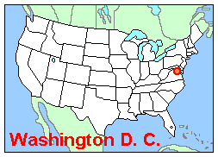
examples
Opinion:
“Washington, D.C., is too poorly located to be the capital of a vast nation.”

Slide 14

Is one person’s opinion as good as another’s?
Of course not!

Slide 15
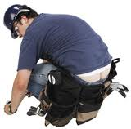
Would you ask this guy to diagnose
Your medical problems?

Slide 16
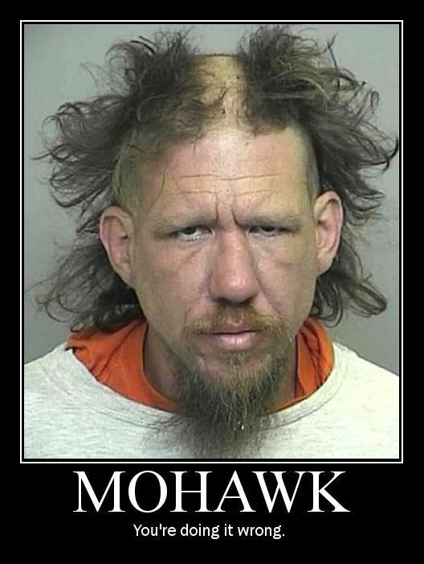
Would you ask
this guy about
hairstyles?
Or anything at
All?

Slide 17
How do we form opinions?
Opinions
Inherited
Involuntary
Adapted
Concealed
Linked
Considered

Slide 18
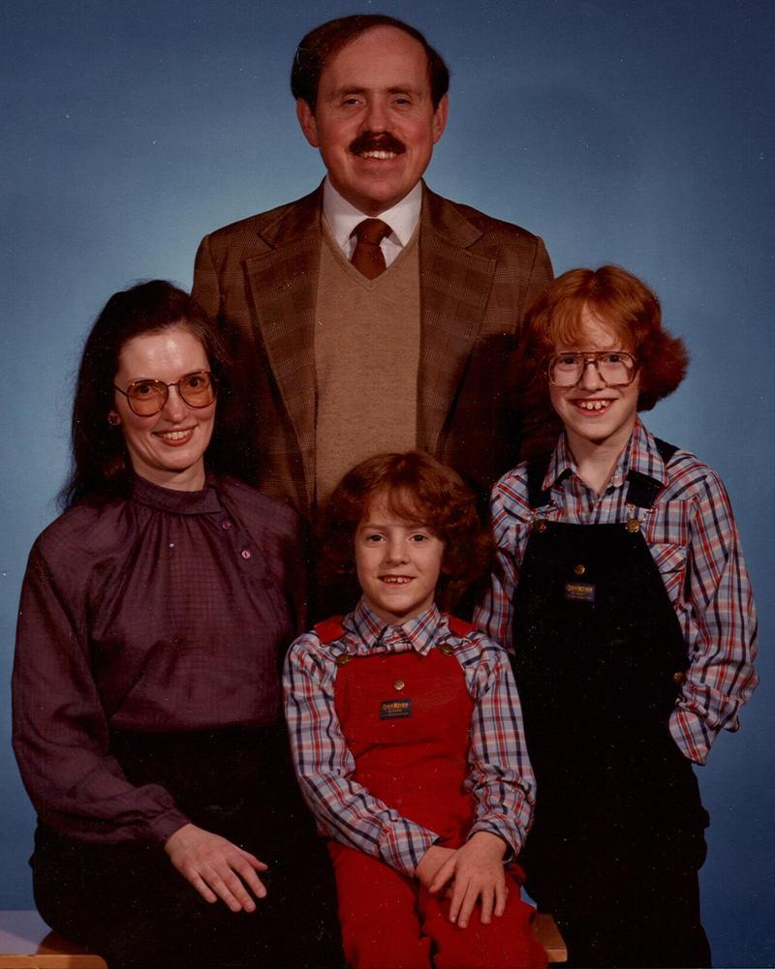
Inherited:
Family
Culture
Regions
Social groups
Religion

Slide 19


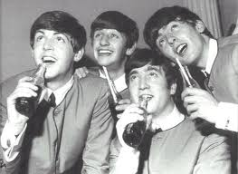
Involuntary: “brainwashing”

Slide 20

Linked opinions
“following a party line.”

Slide 21
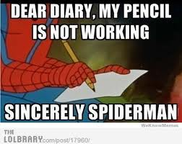
concealed
Not wanting to “rock
The boat”
Individuals may keep
Opinions to themselves.
Even having “secret
Identities”

Slide 22
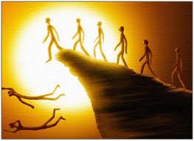
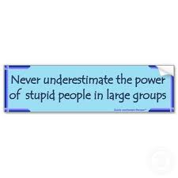
Adaptive opinions
Following the path of least resistance

Slide 23
Considered opinions
Discussions
Debate
Thinking
Reading

Slide 24
activity
Summarize and evaluate the various ways that we form opinions.
1. Which opinions seem most valid?
2. Is everyone entitled to an opinion?
3. How can we apply this knowledge to class discussions?

