Slide 1

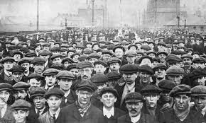
During the Industrial Revolution
Think of 3 ways of how the expanded use of the factory system helped and hurt:
  The workers
  The owners of factories/businesses
  The general population
  The economy

Slide 2
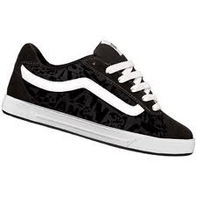
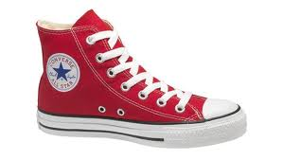
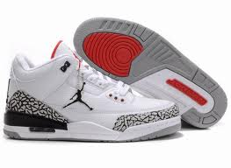
Benefits
Created many jobs
Increased production of goods
Technological innovations that promoted efficiency
More factories= More competition= More choice of good.

Slide 3
Disadvantages
Workers no longer owned the means of production (tools used to produce wealth)
Workers had to work in unsafe conditions
Factories had people work extremely long hours
Workers were paid very low wages

Slide 4
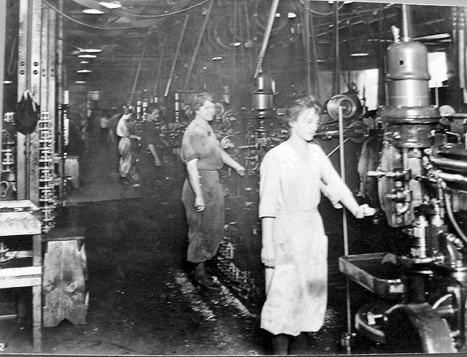
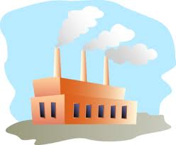
Industrial Revolution, Capitalism, and the Factory System

Slide 5
Development of Capitalism During the Industrial Revolution
Capitalism- Economic system based on private ownership of the means of production and the creation of goods or services for profit
TECHNOLOGICAL INNOVATIONS
MORE FACTORIES ARE BUILT
MANY PEOPLE LEFT THEIR HOME TO WORK IN FACTORIES
FACTORY SYSTEM FLOURISHES!
Individuals and businesses own property and the means of production

Slide 6



Nice Side of Capitalism
Progress results when individuals compete with others and follow their own self interest($$$)
Business try to produce goods or services that are better and less expensive then those of competitors
Standard of living raised
Creates jobs for many people

Slide 7
Problems with the Factory System
Pre-Industrial Revolution rural families did not rely solely on wages for sustenance
  Owned their own farms or gardens where they raised most of their own food
  Made their own clothing
Industrialization limited workers’ independence
  Workers in cities did not have the means to grow their own food or make their own clothing
  Workers relied entirely upon their employers for wages with which they bought everything they needed

Slide 8

Problems with the Factory System
Factories were crowded, dark, and dirty
Workers worked from dawn to dusk
Young children worked with dangerous machinery
Employment of women and children put men out of work
Factories driven solely by profit

Slide 9
Poor Living Conditions
Factory towns
  Often built and owned by factories to house workers
  Few services
  Overcrowded and unsanitary
Workers charged higher prices than normal for rent, groceries, etc.
  Workers often became indebted to their employers
  Created a type of forced servitude as workers had to stay on at their jobs to pay their debts

Slide 10
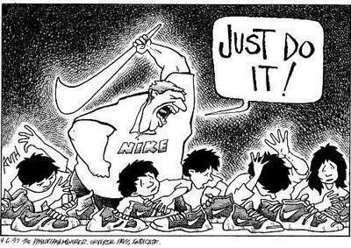
Bottom-Line
While there are many advantages to capitalisms and the factory system, workers get the short end of the stick.
“Rich get richer and the poor get poorer”
Workers were unsatisfied both inside and outside the factories
Notes:
*socioeconomic inequality

Slide 11
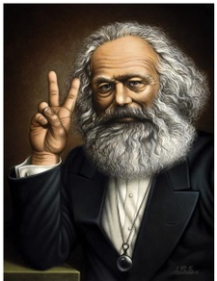
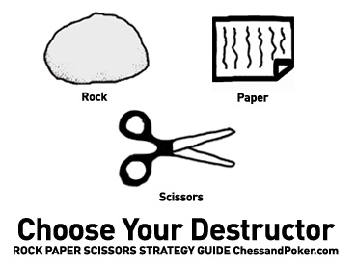
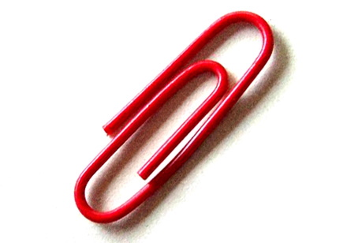
Rock, Paper, Scissors
& Karl Marx!!!

Slide 12
You may accept or refuse a challenge to play, except from a player with more money.
You may go at it alone, pool resources, divide winnings or create alliances.
The winner of each challenge takes one unit of money from the loser.
If you run out of money and lose a match, you become the employee of the winner of said match.
  As an employee, you must challenge others on behalf of your boss. Once two units are earned for the boss, the employee keeps one unit, gives one to the boss and gains their independence.
If an employee with nothing loses to another, he becomes the employee of the new winner
Employees may not challenge their boss!

Slide 13
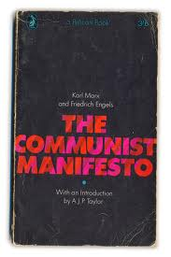
The Communist Manifesto
Written by Karl Marx and Friedrich Engels (1848)
About their theories about the nature of
society and politics
Response to the horrendous conditions in factories
  Blamed the system of industrial capitalism for the terrible conditions.
Solution was to create a new
social system
(eventually known as communism)

Slide 14
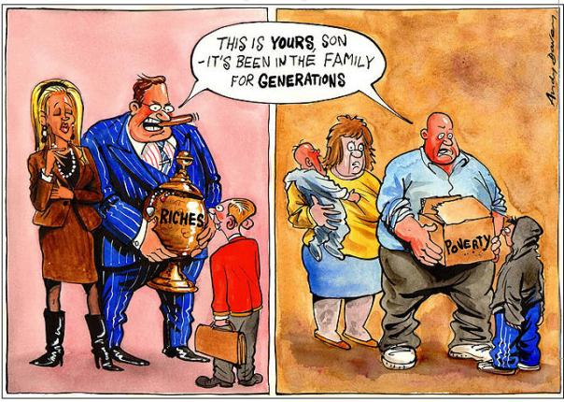
Marx’s Beliefs
All of history was a “history of class struggles”
Oppressors vs. oppressed
Oppressors: own means to production (land, raw materials and money)
  Controlled government and society
Oppressed: dependent on the owners of the means of production

Slide 15
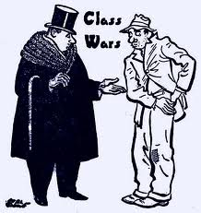
“Society as a whole is more and more splitting up into two great hostile camps, into two great classes directly facing each other: Bourgeoisie and Proletariat”
Bourgeoisie- the middle/upper class- also known as the oppressors
Proletariat-working class –also known as the oppressed.

Slide 16
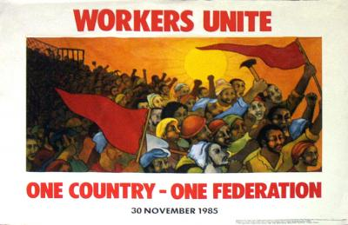
Struggle between proletariat and bourgeoisie will eventually lead to a revolution.
Proletariat would overthrow bourgeoisie
End economic differences that create separate social classes.
Have a classless society

Slide 17
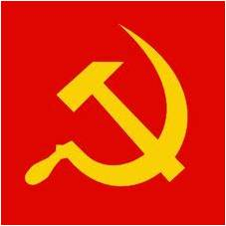
Characteristics of Communism

Slide 18
DEFINITION &PHILOSOPHY
A theory or system of social organization based on the holding of all property in common, with actual ownership ascribed to the community or state
“From each according to his ability, to each according to his needs.”

Slide 19
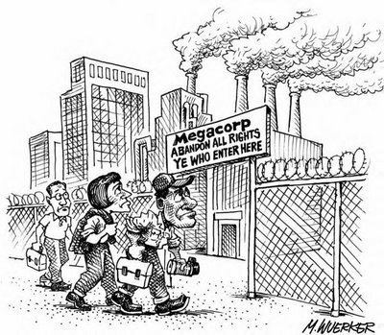
MAJOR IDEAS BEHIND COMMUNISM
Human societies have always been divided into warring classes.
The Industrial Revolution enriched the wealthy and impoverished the poor.
The workers must overthrow the Bourgeois.

Slide 20
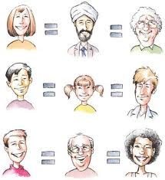
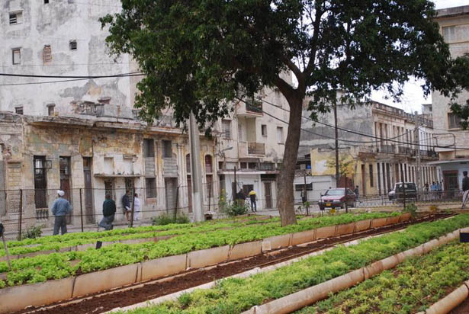
SOCIAL STRUCTURE
All class distinctions are eliminated. In theory, all members of the state are considered equal.

Slide 21
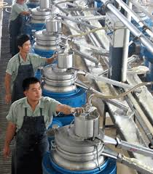

ECONOMIC SYSTEM
Wealth redistributed so that everyone is given equal shares of the benefits derived from labor. All means of production are controlled by the state.

Slide 22
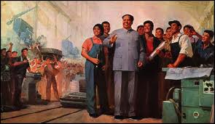
ECONOMIC COORDINATION/ KEY ELEMENTS
Government controls all business, as well as business decisions.

Slide 23

OWNERSHIP STRUCTURE
Private property abolished.
The means of production are commonly-owned.
Importance is ascribed to "user-ship" over “ownership”.

Slide 24
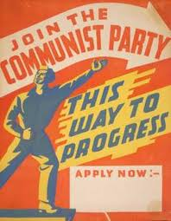
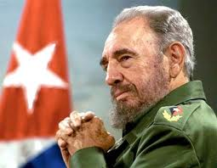
POLITICAL SYSTEM
Government directed by the people with no leader. This has never been actually practiced.

