Slide 1
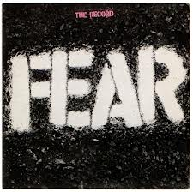

Slide 2
Objective
1st Reading: SWBAT describe and clarify the idea of “fear” by writing a QuickWrite and identifying the Big Idea of an article
2nd Reading: SWBAT assess the validity of arguments regarding rational and irrational fear by annotating and categorizing the ideas in an article

Slide 3
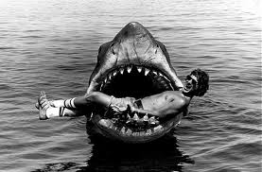
Essential Question:
What do we FEAR?

Slide 4
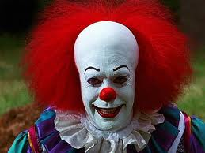
Quick-write
What are you afraid of? Can you explain this fear?
Please complete a single paragraph response to these questions.

Slide 5
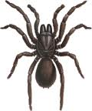
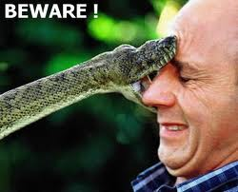
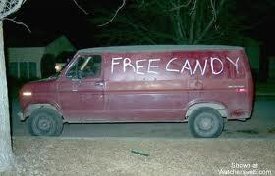
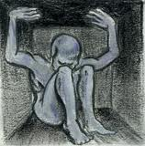
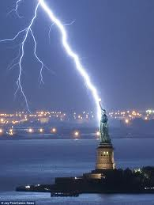
What do you think are the most common fears or phobias?

Slide 6
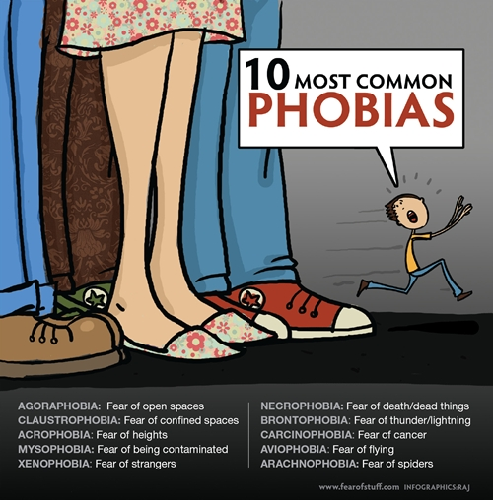

Slide 7
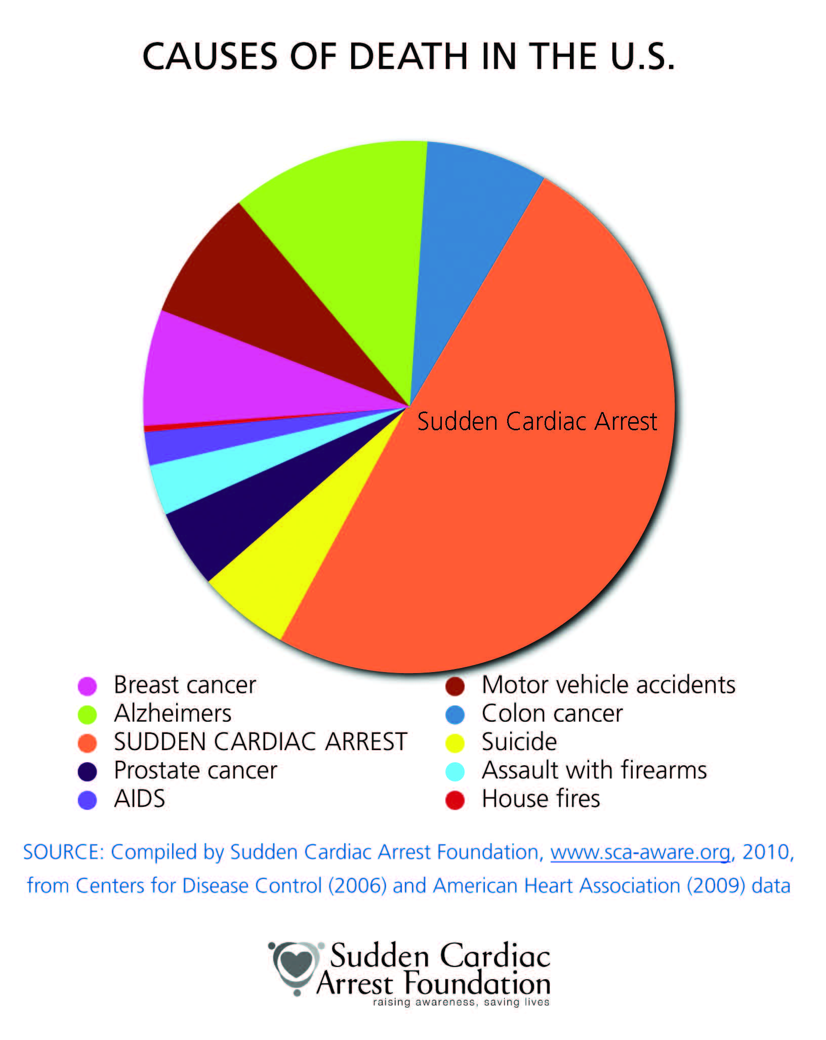

Slide 8

Read article 1: “What Should You Worry About”
First Reading: Read for the Big Idea. What is the main point the authors are trying to convey?
Respond in your notes (2-3 sentences)

Slide 9



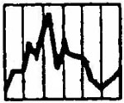


Read article 1: “What Should You Worry About”
Second Reading: Guided Annotation
1. Highlight examples of PATHOS in one color, and LOGOS in another color.
2. Add CM (your own words) to explain, such as:
* The authors use logos in order to ___
* The authors’ use of logos is particularly effective because ___.
* By employing pathos, the authors are able to convey ___.
3. Look also for evidence of:

Slide 10
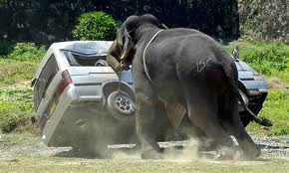
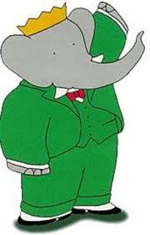

Read article 1: “What Should You Worry About”
According to Levitt and Dubner, the ideas involved with economics are effective tools for assessing risk because ____.
Levitt and Dubner claim that our fears and perceptions of risk are shaped by ___. (List several)

Slide 11


Article 1 Continued:
3) Besides taking an economists view of “unsolvable” problems, the writers provide historical context, as well. The historical “script” that has “nearly always been the same,” according to Levitt and Dubner, is ___.

Slide 12

Article 2: “Quit Living in Swine Fear”: Write your responses as a paragraph
According to Zucco, people are in hysterics over the Swine flu because ___.
Zucco argues that the media
contributes to a “Culture of fear” by ___.
3.) Her most persuasive argument is when she uses (ethos/pathos/logos) to assert _(quote)__. It is effective because ___.
4) The writer claims that we
live in a “constant state of
concern,” and she proposes ___.

Slide 13
According to Zucco, people are in hysterics over the Swine flu because the media over-publicizes certain illnesses in the interest of ratings, which leads to public panic and a belief that things are worse than they really are. Zucco argues that the media contributes to a “Culture of fear” (3) by “constantly construct[ing] widespread perceptions of danger – sometimes by accident and sometimes on purpose” (4). The writer claims that we live in a “constant state of concern (6),” and she proposes “we need to use our own judgment and those of people we trust to discern between the actual and the exaggerated” (7).

Slide 14

Article 2 Continued: Respond to ONE
4) The writer implies that the media, public policy makers, and corporations create a “Culture of Fear”. Take a stance: Do you agree? Why would they do this? Write your response without using the word “I.”
5) Zucco raises questions about trust in the government. Does the government play a helpful role in determining real “threats” and effective responses? Do you trust the government to protect you from danger? Write your response without using the word “I.”

