Slide 1
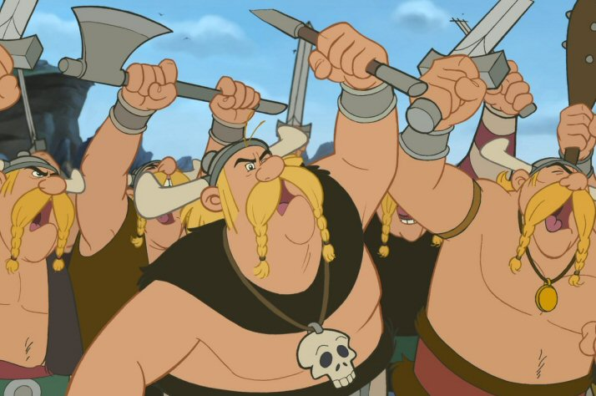
Europe during the Middle Ages and the Renaissance
AP World History I

Slide 2
Periodization
The Middle Ages lasted from approximately 500 to 1500 CE.
  The medieval era is broken down into three phases
    Early Middle Ages: ca. 500 – 1000 CE
      Political decentralization
    High Middle Ages: ca. 1000 – 1300 CE
      Revival
      Nations became defined
      Economy grew healthier
    Late Middle Ages: ca. 1300 – 1500 CE
      Crisis and advancement
        Social Unrest, Warfare, and the Black Death
        The Renaissance

Slide 3
Feudalism
After the collapse of the Roman Empire, no single ruler was able to provide Europe with Central Authority
  No power, no money, or military strength
The solution was: Feudalism
  Lords and Monarchs (lieges) award (infeudated) land to loyal followers (vassals).
  In exchange, the vassals guaranteed that
    their parcel of land (fief) would be governed
    Law and justice would be dispensed
    Crops would be grown
    The land would be protected.

Slide 4
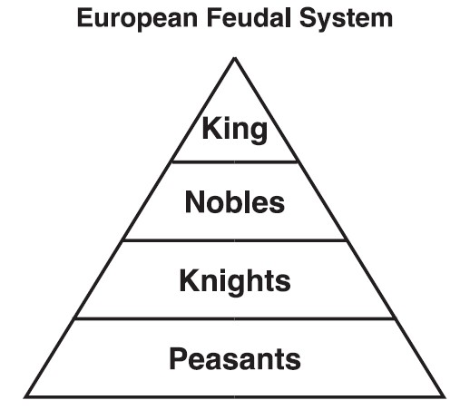
Feudalism
Those who monarchs gave land grants to become Europe’s noble class.
All members of the feudal nobility were tied to the monarch by bonds of loyalty and landownership.

Slide 5
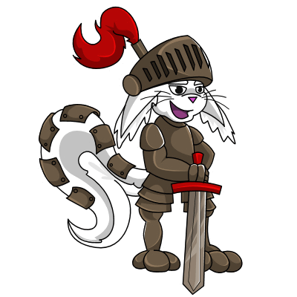
Feudalism
Feudalism also provided a military function: to provide an elite force of armored cavalry (knights).
  Only members of the upper class could become knights because of the cost of weapons and training.
  The code of Chivalry theoretically managed the behavior of the knights
    Treated the lower classes with justice
    Acted gentlemanly toward women
      Tends to be more myth than reality…

Slide 6
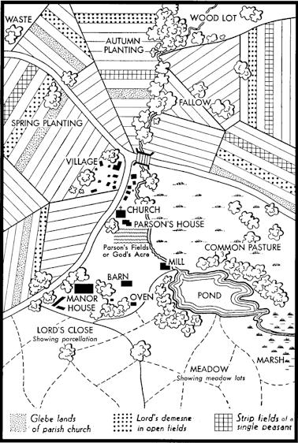
Manorialism
The vast majority of people in Medieval Europe were peasants.
The basic unit of land ownership was the manor, which typically surrounded the lord’s residence (which was an estate or castle) and included the peasant village, fields for farming, as well as woodland where animals were hunted and wood was gathered.

Slide 7
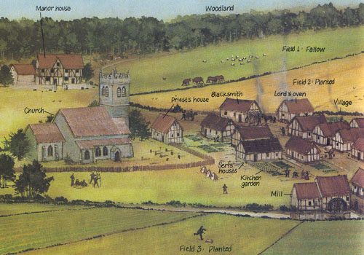
Manorialism

Slide 8
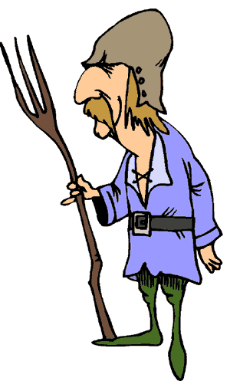
Economy of the Middle Ages
Feudal system relied on the labor of the peasant. Most peasants were serfs.
  Technically, not slaves, but…also, not free
  Not allowed to change residence or profession without permission
  Most of their work benefitted the Lord
  Labor devoted to building roads, clearing forests, gathering firewood, farming the lord’s private fields.
  Had to pay fees to use the manor’s facilities, including the bread oven, water mill, and cider press.
  In times of war, serfs had to fight.

Slide 9
Christianity
Christianity acted as a binding force for European nations following the fall of Rome.
  Cultural and Political unification…
1054: Great Schism
  Doctrinal differences between the Roman Catholic and Eastern Orthodox church (centered in Constantinople) led to a permanent split.
Monasteries preserve Latin and Greek manuscripts from the Roman Era
  Scientific and philosophical essays, literary works, etc.

Slide 10
Christianity
Leader of the Catholic Church was the pope
  Archbishops and Cardinals act as advisors
  Bishops
  Priests
  Monks and Nuns
After 1000 CE, the church became increasingly powerful.
  In contrast to the Eastern Orthodox Church, which viewed itself as subservient to worldly authority

Slide 11
Christianity
What did the Pope do?
  Many popes (especially Innocent III 1198 – 1216) went to great lengths to assert the authority of the papacy as superior to that of kings and emperors.
  Moral authority to determine what was heresy
  Had the right to excommunicate worshippers from the Catholic Church
  Had the right to issue calls for holy wars (crusades).
  Goal was to join all of Europe into a Single, Christian Community. The attempt as this is known as Christendom.

Slide 12
Christianity
Catholic Church owned vast amounts of land
  Right to collect tithes (taxes)
The Church exercised power by controlling education, thought, and culture.
  1231: The Holy Inquisition was a set of courts with wide-ranging powers set up to hunt out and punish heresy and religious nonconformity.
Monasticism: formation of religious communities whose members (monks and nuns) are not ordained by priests.
  Benedictine model was most influential from 500s – 1100s and stressed contemplation and seclusion
  After the 1100s, the Dominicans and Franciscans carry the works of the church to the wider world.

Slide 13
Early Kingdoms
Weak states, decentralized governments dominate the 500’s and 600’s
  Viking raids and Muslim invasions
The Frankish Kingdom (Carolingian Empire by the 700s)
  The Franks were a Germanic tribe
  Under King Clovis (465-511) who acquired parts of Germany, France, etc.
    Converted his people to Catholicism

Slide 14
Early Kingdoms
Under Charles Martel the Frankish Kingdom grew strong again (688-741)
  Successfully turned the Muslims back at the battle of Tours (732 CE)
  His son, Pepin, strengthened ties with the Catholic church
Pepin’s son, Charlemagne (768-814) was even more successful.
  Defended Frankish territory against Viking, Barbarian, and Muslims.
  Expanded the kingdom and transformed it into the Carolingian Empire
  Pope crowned him Holy Roman Emperor in 800.
  Supporter or education (church-based)
  Strong, but still feudal.
  In 843, Charlemagne’s three grandsons divided the territory into smaller parts
    The concept of the Holy Roman Empire remained though…
      A state allied with the church, yet able to provide central authority…

Slide 15
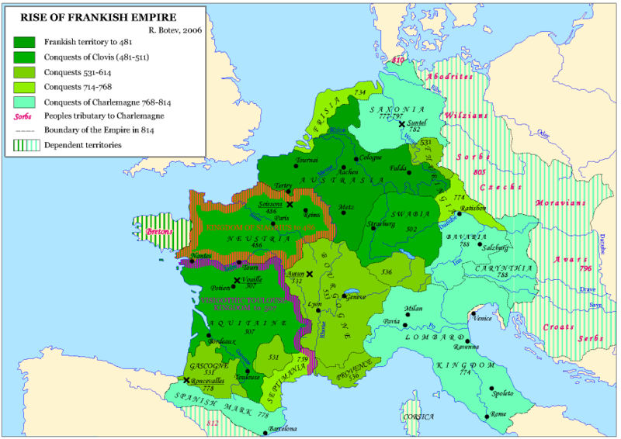

Slide 16
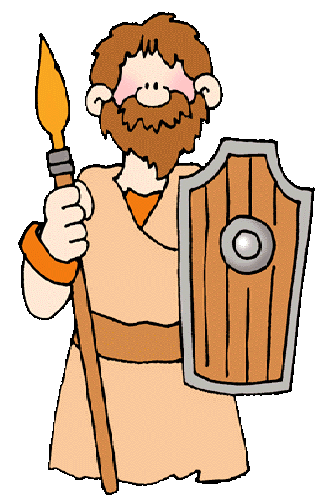
Early Nations…
800s and 900s
  Saxon Kings unite large parts of England
  Capetian Dynasty comes to rule the area around Paris and gradually all of France
  Eastern, Germanic portion of Charlemagne’s empire reformed itself as the Holy Roman Empire
    Will rule most of Central Europe for years…

Slide 17
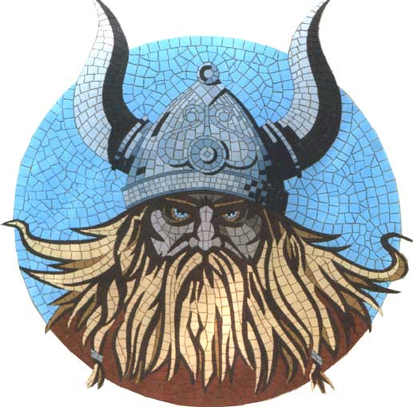
The Vikings
Expert Sailors, fierce warriors
From Scandinavia
Overcrowding causes exploration, migration throughout the 800s to the 1100s.
  Raided and conquered land throughout Europe
  Colonized Iceland and Greenland
  Leif Erikson lands in Canada around 1000 CE.
  Settle in parts of England, Scotland, and Ireland.
  Establish kingdoms in France and Sicily
  Establish trade route from Scandinavia to Byzantium, through Russia, creating the first Russian “state”

Slide 18
England and France
In 1066, William the Conqueror leads the Norman Conquest of England.
  Normans were descendents of Vikings who had settled in France.
  William defeated the Saxon King in England.
  The rule of England and France was thus interconnected through blood ties from 1066 to around 1400.
Norman Conquest brought French-style Feudalism to England
  Cultural Fusion with Celtic and Anglo-Saxon groups.

Slide 19
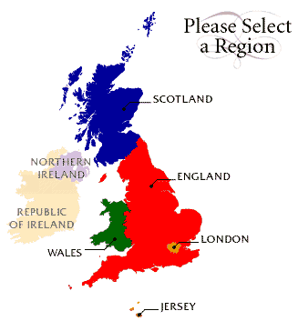
England and France
England became more centralized, even as significant checks were placed on the monarch.
  1100’s: Common Law (single law code) and Jury based trials
  1215: Magna Carta-Guaranteed rights to English nobility in limiting the power of King John.
  Later 1200’s: Nobility wins the right to form a Parliament
    Will become a representative law-making body that governs in conjunction with the monarch
  1200s and 1300s: English monarchs extend rule to Wales, Scotland and Ireland

Slide 20
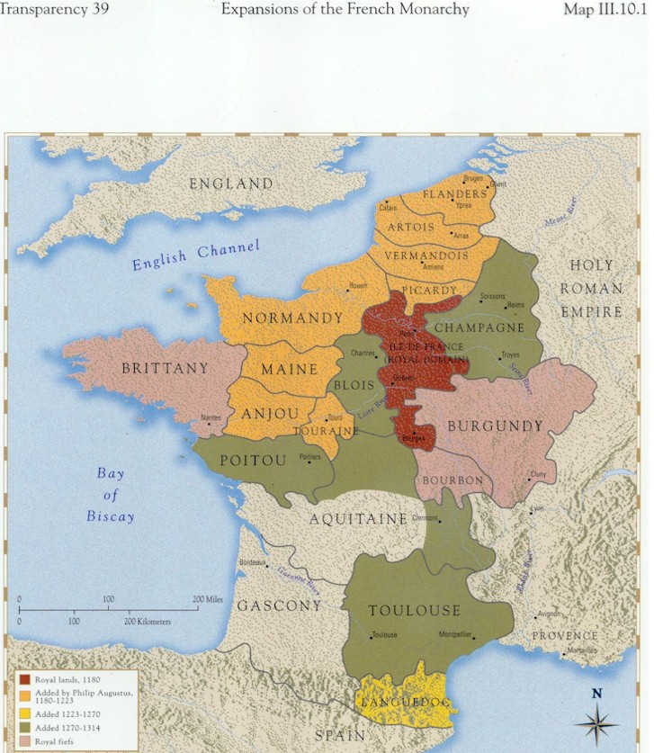
England and France
In France, Capetian kings centralize their nation by increasing their own power.
  They only ruled a tiny part of France at first…
    England controlled Aquitaine and Brittany
    Flanders and Burgundy were independent.

Slide 21
England and France
Capetian monarchs will expand the size and scope of the French Kingdom by gaining control over independent regions and beating the English in a number of wars.
  By the mid-1400s, France was large and centralized
  French kings were of the most powerful in Europe
    French monarchs were not limited or obligated to share power
100 Years War (1337-1453)
  England vs. France
  England was the early victor, gaining control over more than ½ of France.
  After the 1420’s, with the help of warrior maid, Joan of Arc, the French King was able to drive out the English.
  This ended many of the awkward connections between the English and French royal families.

Slide 22
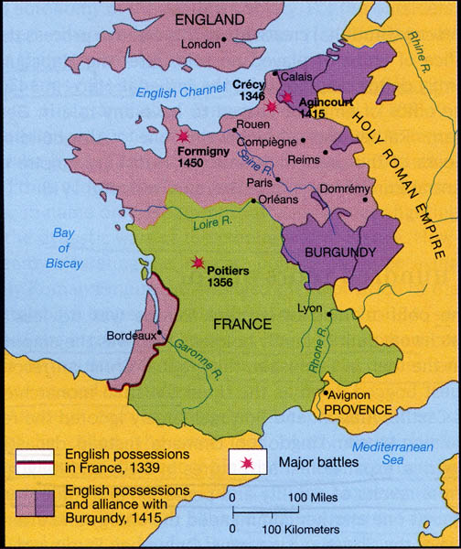
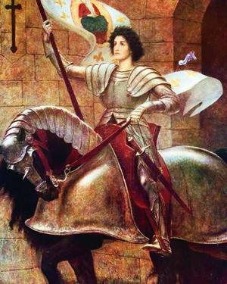
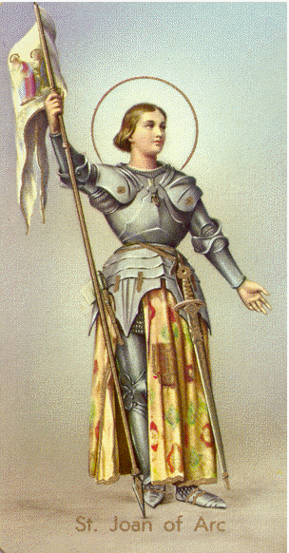
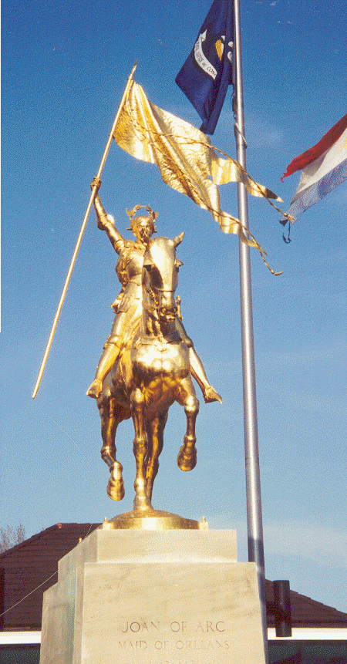

Slide 23
Central and Southern Europe
Holy Roman Empire dominated most of Central Europe
  Multi-cultural monarchy in which the crown passed back and forth amongst a group of German noble families.
  Founded in the 900’s by the heirs of Charlemagne
  The Emperor was supposed to work in partnership with the Pope, but in reality they clashed more than cooperated.
The Holy Roman Empire was one of Medieval Europe's largest states, but the Emperor’s powers were comparatively weak.
  Position was not hereditary…chosen by the empire’s most powerful noble families

Slide 24
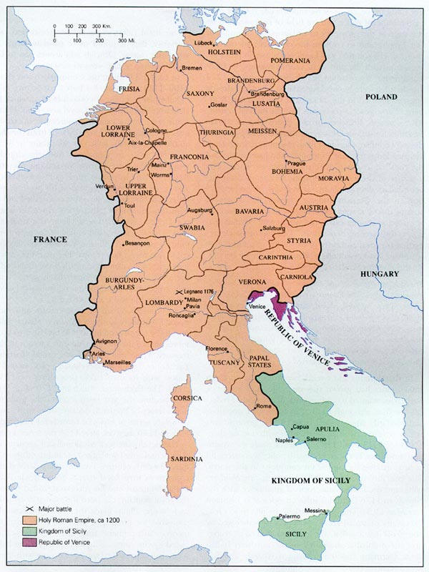
Central and Southern Europe
The Holy Roman Empire was ethnically diverse
  German, Italian, Hungarian, Slavic, and more!)
Almost 200 duchies, kingdoms, and principalities in the mid-1300s!!

Slide 25
Central and Southern Europe-movement towards centralization
Charles IV issues the Golden Bull (golden seal…Latin bulla) of 1356.
  Asserted the rights and powers of rulers under the emperor
  Attempted to distance rule from the Pope
  Reduced the number of states allowed to elect the emperor (from all to seven)
The Habsburg family of Austria emerge as major players in imperial politics during the late 1200s.
  By 1438, the Habsburgs will have power over the Imperial throne, not losing it until 1918.

Slide 26
Central and Southern Europe
Italy: Part of Northern Italy was under the control of the Holy Roman Empire. Areas in the south passed in and out of foreigners control (French, Spanish, Muslim, Byzantine).
The parts of Italy that remained free were governed by dozens of city-states.
Italy was highly urbanized, highly cultured, and had a strong commercial economy.
  Florence, Milan, and Venice in the North, and Naples in the South.
  Venice created this era’s richest and most powerful maritime and commercial empires.

Slide 27
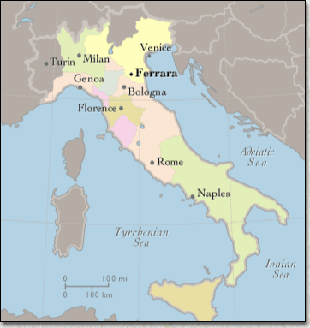
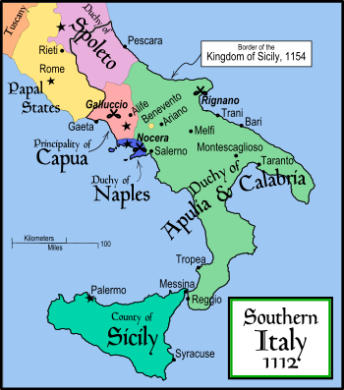

Slide 28
Spain and Portugal
Medieval development of Spain and Portugal was shaped by the fact that they were taken over by Muslims in the 700s (known as Moors).
From 1031 onward, the people of Spain and Portugal fought the Moors in what was known as the Reconquista.
  By the 1200s, the Spanish had pushed the moors into Granada, the southernmost part of the country.
  The Moors held out in Granada for the next 200 years until they were expelled by Ferdinand and Isabella in 1492.

Slide 29
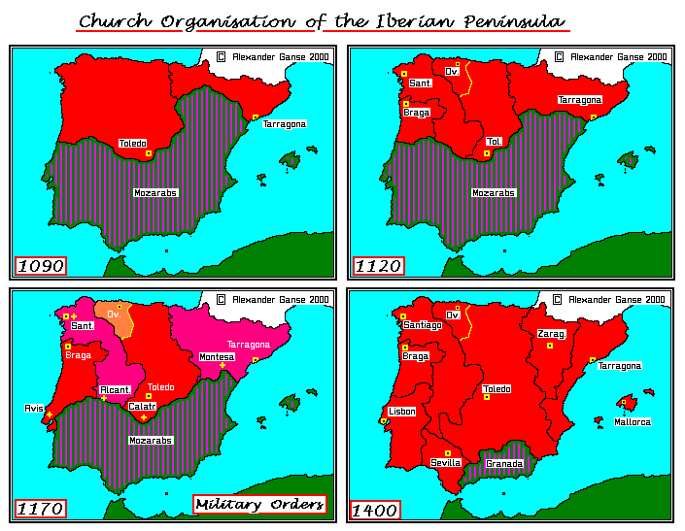

Slide 30
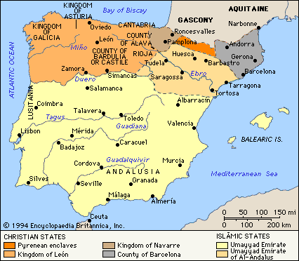

Slide 31
Spain and Portugal
Effects of the Moorish occupation:
  Spanish territory was liberated region by region, thereby leaving newly freed areas as independent, delaying centralization.
  By the 1400’s there were about 6 Spanish kingdoms
  Only in the late 1400’s when the leaders of the two largest Spanish kingdoms, Ferdinand of Aragon and Isabella of Castile, married and joined their lands together did Spain take shape as a single country.
  Catholic authorities became rigid in terms of doctrine
  Muslims and Jews were persecuted.
Benefits: Islamic culture was more advanced than that in Medieval Europe
  Spain had access to medical, scientific, and technological knowledge.
  Spanish city of Cordoba was one of Europe’s greatest centers of learning and science.
  This will have a direct result on Portugal’s move towards world exploration beginning in the mid-1400s.

Slide 32
Eastern Europe and Byzantium
Byzantine Empire becomes the crossroads between Christian Europe and the Islamic Middle East.
The Byzantine Empire also joined the Middle East with China, India, and the East Indies via overland trade routes.
While the Byzantine Empire directly inherited the superiority of the Roman Empire, it had entered a long period of decline.
11th Century: The Seljuk Turks become a formidable enemy.
  Battle of Manzikert (1071) and onward continually strip territory away from the Byzantine Empire.
    Followed by the conquests of the Ottoman Turks
    1453: Ottoman Seizure of Constantinople, destruction of the Byzantine Empire, Constantinople becomes Istanbul

Slide 33
Eastern Europe and Byzantium
Eastern Europe tended to be poorly defined, politically.
  Invasions from the East…Mongols, Ottomans, etc.
Hungary, Sweden, and Poland were exceptions
  Stable and sophisticated.
Russia was a loose confederation of city-states, governed by feuding princes.
  Mongolian invasions bring the rule of the Golden Horde in the 1240s
  Freedom in the 1400s under the leadership of the tsars of Moscow (Muscovite Princes)

Slide 34
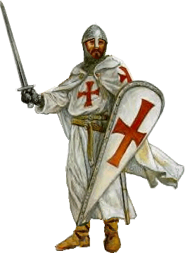
The Crusades
Reasons for:
  Convert nonbelievers
  Crush Christian movements the papacy considered to be heretical
  Resist attack by foreigners that were not Christian.
First Crusade (1096-1099): Byzantine Emperor asked Christian Europe for military assistance against the Seljuk Turks, who had captured Jerusalem.
  Pope Urban II summons the Council of Clermont and calls upon the knights of Western Europe to retake Jerusalem and the Holy Land from the Turks.
  First crusade was a success for the Christian knights by 1099 in one of the bloodiest examples in military history, butchering every Muslim and Jew within the city walls.
  Lack of unity amongst the Turks, Arabs, and Muslims contributed to their defeat.

Slide 35
The Crusades
After the First Crusade, the Europeans set up four Latin Kingdoms, which served as a military and political ground-zero in the middle-east.
  It also allowed Christians to get involved in the lucrative trade and commercial economy already existent.
Christians remained for two centuries, but Muslims organized to drive them out on numerous occasions.
  Jerusalem fell back to the Muslims in 1187.
  Crusades lost focus in the 1200s
    Crusaders sack Christian Constantinople in 1204.
  In 1291 the Christians abandoned their last major outpost in the Middle East, Acre.

Slide 36
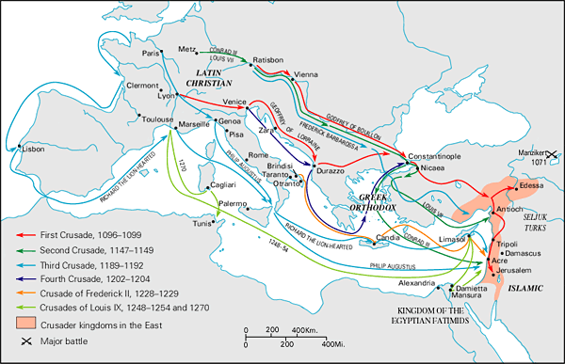

Slide 37
Effects of the Crusades
Deteriorating relationship between Christian/Muslim worlds.
Greater awareness of the wider-world
Knowledge of, and desire for the economic wealth to be gained by greater interaction with the East.
Fighting for a cause…leads to the development of powerful myths of knighthood, chivalry, etc.
Fighting for a common cause united a decentralized Europe.

Slide 38
Urbanization
From 1000 to 1300 population growth in Europe was considerable.
  Advanced agricultural techniques
    Three-field system of crop rotation
    Invention of better plows
  Food supply increases
Trade and commerce become a part of European economy.
Political stability encourages
  Banking
  Movement of goods (on water)
  Trade routes
Trade routes sprang up in Italy, on the Rhine River, in the North Sea and English Channel, and throughout the Baltic Sea
  Hanseatic League: Group of traders whose influence stretched from England in the west to Russia in the East.

Slide 39
Urbanization
Banking made trade more feasible and dependable.
The majority of people remained on the countryside as peasants and serfs. But, there was an increasingly large number of people moving to cities.
  Great sources of trade
  Attracted artists, writers, and scholars.
  Urban populations included shopkeepers, artisans, tradespeople, and laborers
Growth of cities encouraged specialization of labor.
  Skilled trades were organized in the Guild System, which were labor groups that maintained a monopoly on their trade.
    Restricted membership, established prices, and set standards of quality and fair practice.

Slide 40
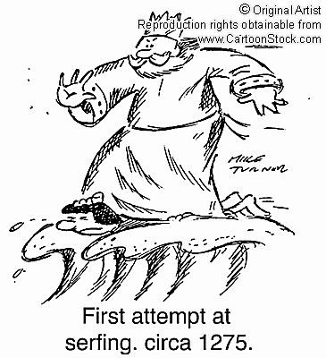
Urbanization
City life was often overcrowded, polluted, and many people lived in poverty.
Cultural opportunities and the opportunity to gain greater wealth were benefits to city life.
“City air makes you free”
  If a person left the countryside and went to the city for a year and a day, they were released from their status as a serf.

Slide 41
Social Stress
Increasing urbanization was coupled with tremendous social stress
  Uprisings and revolts by peasants
Causes:
  Cooling of the climate (little ice age) affected harvests
  More and longer wars were being fought
    Armies grew larger
    Increased cost of new technology like gunpowder
    More peasants were forced into military service
  Taxes increased

Slide 42
Social Stress
Persecution of witches
Black Death (bubonic plague)
  After killing millions of people in China, the disease traveled westward to the Middle East, then onto the shores of Sicily in 1347.
    1347-1348: Southern Europe
    1349-1350: Central Europe and the British isles
    1351-1353: Russia and Scandinavia
  The initial bout of the plague killed 25-30 million people, roughly 1/3 of the population of Europe.

Slide 43
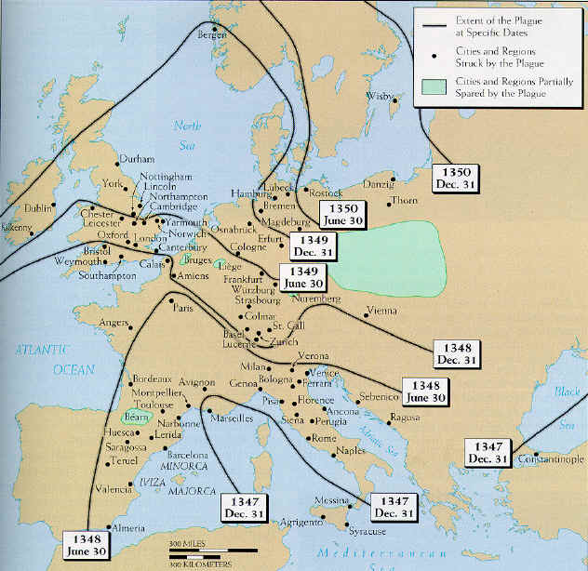

Slide 44
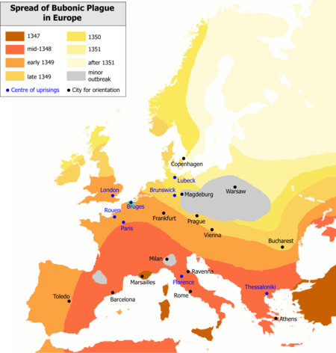

Slide 45
Women in Medieval Europe
Women were subservient to men in Europe. Rights were determined by social status.
Lower Status: Cared for the household and assisted with farm work, bore children and raised them, work as servants for upper class families.
  Of the few peasant women to leave a mark was Joan of Arc (1410-1431)
Women had some property rights
  Could own and inherit land and property.
  Women could separate from husbands, but divorces and annulments were difficult.
  Women had legal protection, but often not equal.

Slide 46
Women in Medieval Society
Aristocratic women could exert much political and cultural influence.
  If a women was heir to valuable property or a kingdom, she was a desirable match.
  Mothers often served as regents for young kings whose fathers had died early, until their sons came of age.
Some women ruled in their own right…as queens (not customary),
  Countries where their legal system was based on Germanic tribal law (Salic), such as France and the Holy Roman Empire did not allow women to inherit the throne
  Women could rule in England, parts of Spain, Russia, and other places.
    Example: Eleanor of Aquitane who married Louis VII of France, then Henry II of England.

Slide 47
Medieval Culture
Dark Ages?
  Not so during the High and Late Middle Ages, but even so…Medieval Europe lagged behind Byzantium and Islamic Middle East
Most important factor influencing culture was the Catholic Church
  Administered institutions of learning (Monasteries, then universities)
  Largest employer of artists, architects, and musicians.
  Art and ideas that were not in line with Church doctrine could be banned.

Slide 48
Medieval Culture
Another factor influencing Medieval culture was classical learning that was preserved from Ancient Rome and Greece.
  Latin was Europe’s language of learning and culture.
  Knowledge of Greek learning came later through Jewish and Arab translations
  Aristotle’s writing on Science, philosophy, ethics, and politics were adapted by Christian scholars.
Sometimes, Greek science encouraged mistaken ideas in their application to Christianity, such as the Geocentric model of the universe, which argues that the sun revolve around the earth.

Slide 49
Medieval Culture
Medieval Art was religious in nature
  Icons, or religious paintings, were inspired by Byzantine styles, even in Catholic Europe.
Medieval music was plainsong, known as Gregorian chant…human voice, unaccompanied by instruments.
  Over time, arrangements become more complex, including instruments
The greatest achievement of medieval architecture was the cathedral, which required skill, money, and decades to build.

Slide 50
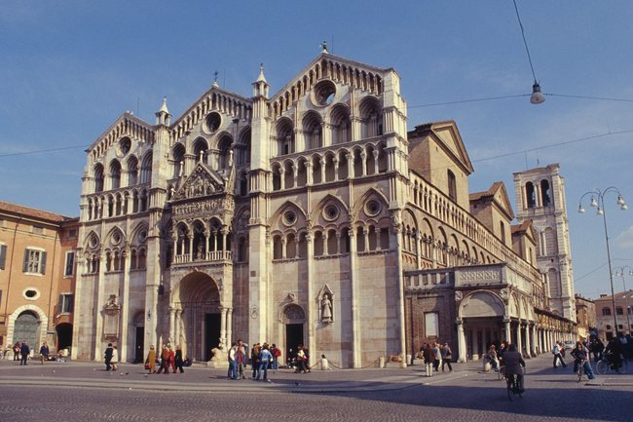
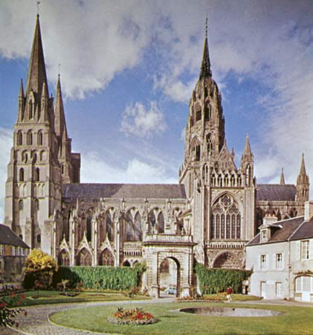
Medieval Culture
The Cathedral
  Romanesque: thick walls, small windows, square build
  Gothic: tall, slender spires, large stained glass windows, ornate carvings, flying buttresses.

Slide 51
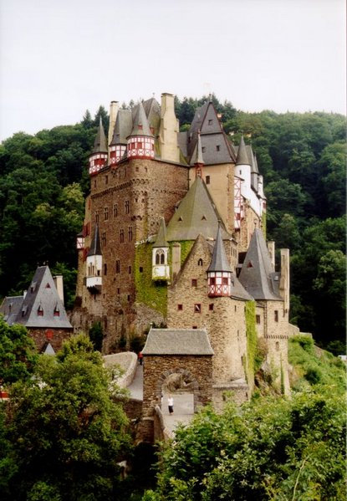
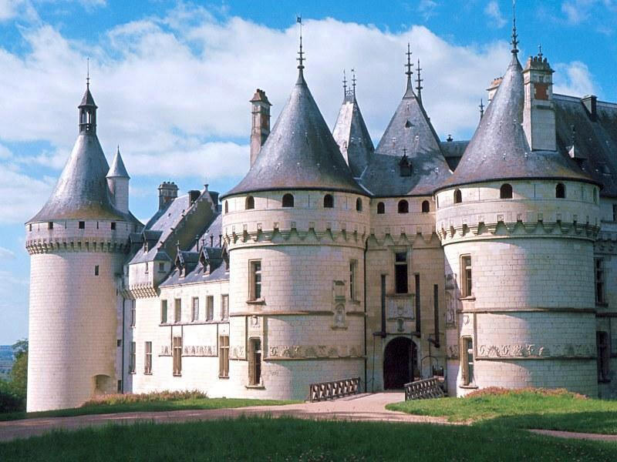
Medieval Culture
Medieval Europeans were great Castle-Builders…

Slide 52
Medieval Culture
Troubadours and Minstrels popularized nonreligious music in the 11th and 12th centuries.
Dante Alighieri, Geoffrey Chaucer encourage the use of the vernacular, or native language.
  Latin remains the language of the educated elite, but it became more acceptable to write in the vernacular for serious poetic and literary works.
    Stimulated growth in literacy.

Slide 53
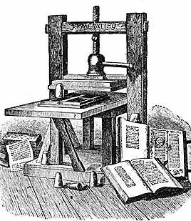
Medieval Culture
Principal philosophy during the Middle Ages was Scholasticism
  Attempted to reconcile reason (logic, the sense, and the learning of the ancient Greeks and Romans like Aristotle) with faith in God and Christianity.
  Thomas Aquinas (1225-1274) was foremost in this field of Philosophy.

Slide 54
Medieval Culture
Between 1436 and 1437, Johannes Gutenberg (German) developed the concept of the Printing Press.
  Originated in China, possibly Korea.
  Block printing was expensive…Gutenberg created a movable-type printing press in which individual, reusable, metal characters could be placed in a frame to form text.
    Raised literacy rates
    Spread information
    Increased the impact of new ideas and scientific theories
    Encouraged the expansion of libraries and universities.
    Indispensable role in the Renaissance, Protestant Reformation, etc.

Slide 55
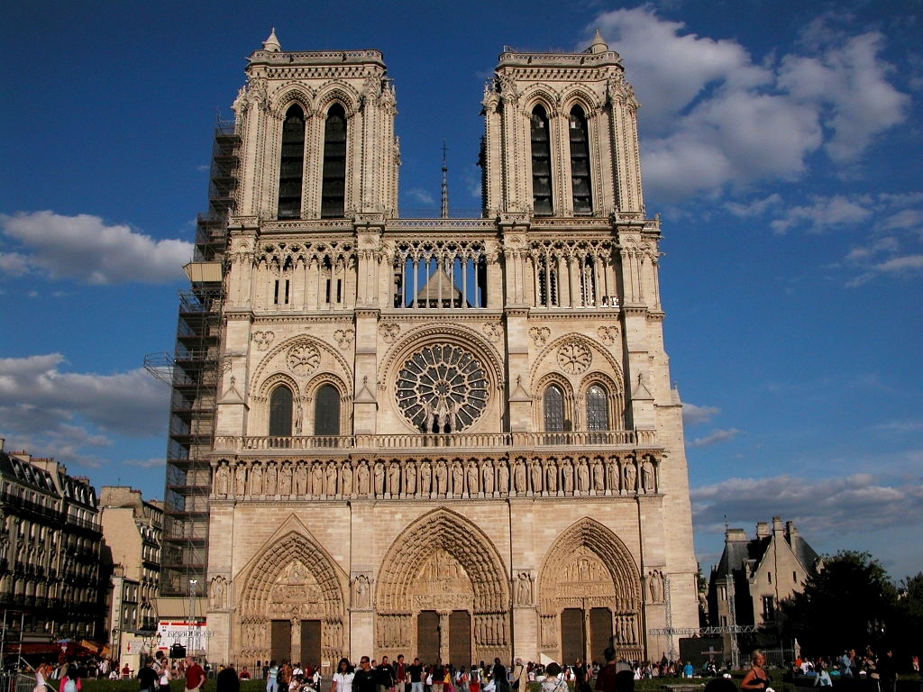
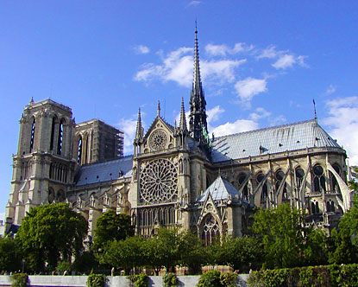
Notre Dame Cathedral

