Slide 1
Biblical Allusions 2
The Old Testament: Abraham and his family

Slide 2
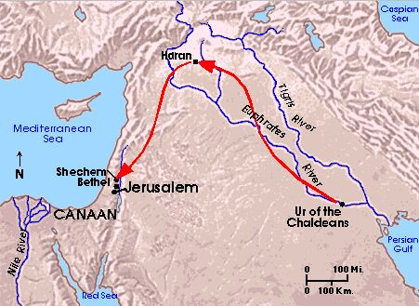
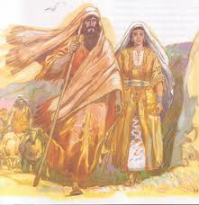
Abram / Abraham
The 1st Patriarch
Notes:
Abram was a righteous man who left Ur, the land of his birth with his wife (perhaps a ½ sister) Sarai, his nephew Lot and his father and moved to Haran. After the death of his father, Abram is given God then tells him that Abram that if Abram will covenant (make a contract) to be faithful to God, God will bless him with a great land for his progeny in Canaan. This land is also known as “the Promised Land.” God changes his name to Abraham [and his wife’s from Sarai to Sarah]. The other great promise that Abraham will have as many children as there are grains of sand in the sea – a great promise to a couple who had long been childless.

Slide 3
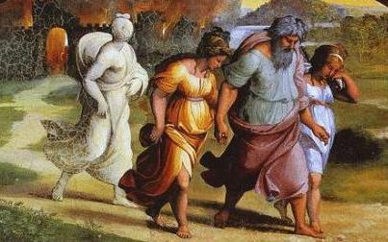
Lot and Lot’s wife
Notes:
Lot is Abraham’s nephew. Because both he and Abraham are greatly blessed, their livestock is too plentiful to graze together. They divide the promised land and Lot takes the plains where the cities of Sodom and Gomorrah are.

Slide 4
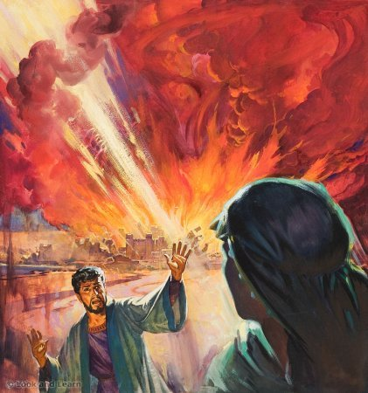
SODOM
&
GOMORRAH
Notes:
Sodom and Gomorrah were cities filled with evil, wicked people. Lot and his family lived there. An angel warned them to leave. However, they would only be safe if they didn’t look back. Lot’s wife, turned to look, and was turned to a pillar of salt. The English word sodomy comes from the town of Sodom.

Slide 5
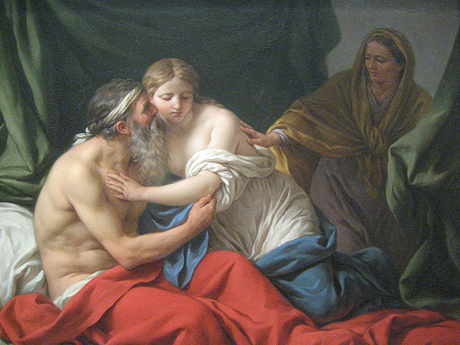
Sarah’s Handmaiden: Hagar
Notes:
Sarah was barren. Knowing God had promised Abraham many children, she decided to offer her husband her handmaiden, Hagar. She believed that any children Hagar would bare would be hers since Hagar is her slave. Hagar became pregnant with Abraham’s child; there arose great animosity/jealousy between the women, and Sarah tried to expel Hagar but an angel sent her back; Hagar is also told that her son will be the father of a great nation. She goes back.

Slide 6
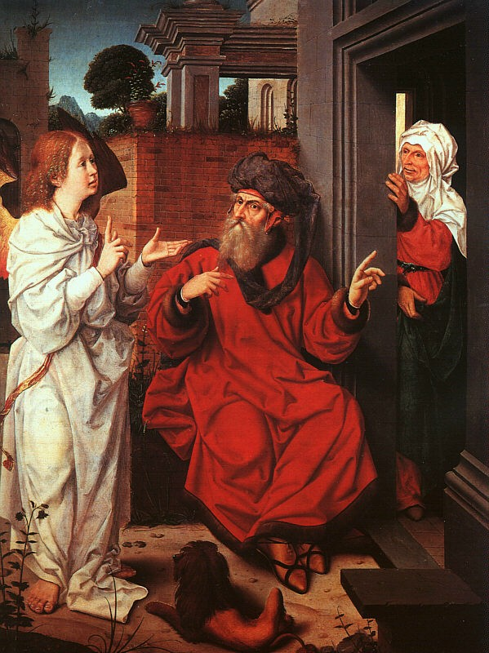
The Great Announcement
Notes:
14 years later, an angel appears to 100 year old Abraham and 99 year old Sarah telling them that Sarah would bear Abraham a child.

Slide 7
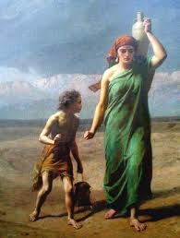
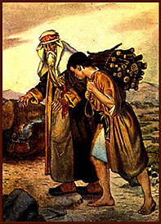
Abraham’s Sons
Ishmael
Isaac
Notes:
After Sarah gave birth to her son Isaac, the relationship became more difficult between Sarah and Hagar. Finally Sarah insisted to Abraham that he expel thirteen year old Ishmael and his mother. Ishmael and Hagar leave. Ishmael grows up to found the Ishmaelite nation (Arabs). Muslims revere Ishmael as the true son of Abraham’s birthright. Jews (and therefore Christians) believe that Isaac, the son of the marriage, is the rightful heir to Abraham’s legacy.

Slide 8
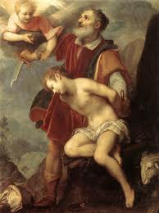
The Sacrifice of Isaac
Notes:
At some point when Isaac was a boy or young man, God told Abraham to sacrifice Isaac. Abraham doesn’t want to but finally agrees. After placing his son on the alter, an angel stops him and a ram is found to sacrifice instead.

Slide 9
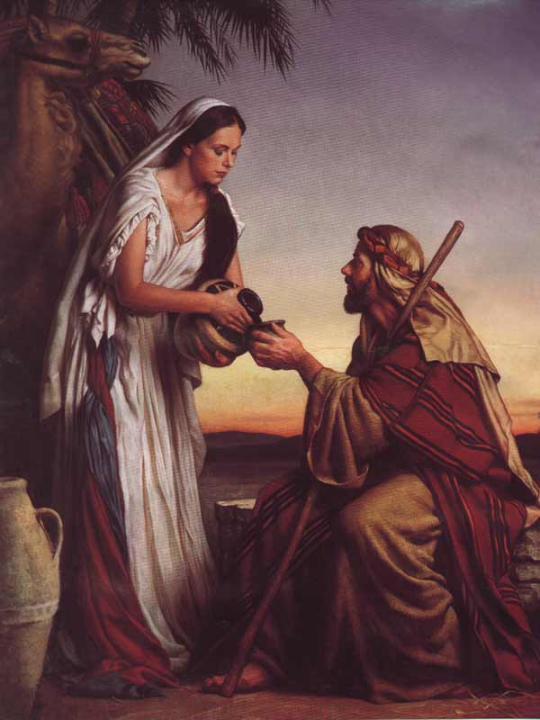
Rebecca at the well
Notes:
After the death of Sarah, Abraham realized his son Isaac was getting older and needed a wife. Because the local girls didn’t practice their faith, he sent a trusted servant back to his home in Haran to find a suitable girl who practiced their faith. While resting by a well, the servant saw a beautiful girl who offered him water. They talked, and the servant found out that she was related to Abraham and Isaac and was of their faith. She accepted the servant’s offer to marry Isaac who “loved her.”

Slide 10
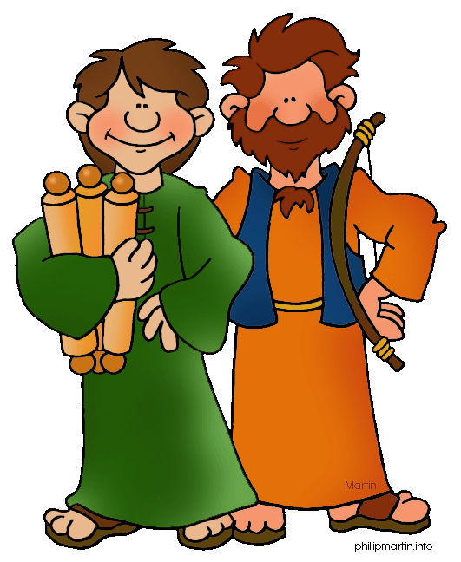
Isaac & Rebecca’s Twins: Jacob and Esau
Notes:
While pregnant, Rebecca felt much turmoil. Asking God, she found out she was carrying twins who were fighting in the womb and, she was told, would continue to fight after they were born. Esau, the oldest, was red and hairy. He was his father’s favorite. Jacob was born hanging onto Esau’s heel, and was his mother’s favorite. Esau became a hunter; Jacob a “dweller of tents.”

Slide 11
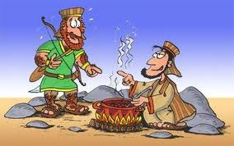
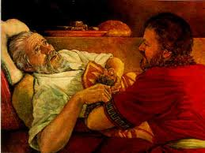
The Birthright
Notes:
A birthright is the promise of a father’s inheritance. One day after unsuccessfully hunting, Esau returned home hungry. Seeing that Jacob had made a stew, Esau asked for some. Jacob agreed IF Esau would sell him his birthright in exchange. Esau foolishly agreed and got the stew. Time passed, and as Isaac aged, he lost his sight. One day when Esau went out to hunt, Rebecca, knowing that Isaac won’t live long, dressed Jacob in Esau’s clothes and wrapped animal skins around his arms so Isaac would believe he was speaking to Esau. Jacob went in to his father and pretended to be Esau and asked for his birthright and a blessing. Isaac gave the blessing of the birthright to Jacob. When Esau returned and found out what his mother and brother did, he vowed to kill Jacob after Isaac’s death. Rebecca, fearful for Jacob, had him steal away to her family far away in Haran. Later as old men, the two brothers made amends.

Slide 12
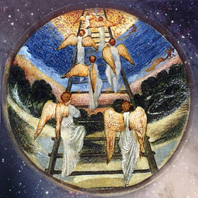
Jacob and the Ladder
Notes:
Jacob was traveling from Beersheba to Haran. Jacob became tired and decided to rest for the night due to the sunset. He laid his head on stone and fell asleep.
In his dream he witnessed angels climbing a ladder to heaven. He experienced a revelation as God stood before him and promised that the land he rested on would soon be bestowed upon his countless descendants.

Slide 13
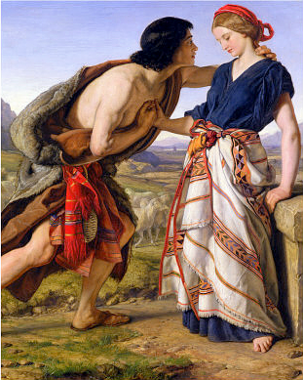
Jacob and Rachel
Notes:
Jacob went to Haran to escape his brother Esau’s wrath. He went to the same well his father’s servant had been to when he met Rebekah. There, Jacob meets Rachel; Rachel is, like Rebekah, a believer in the faith and related to Jacob. She invited him to her family’s home, and he fell in love with Rachel. After asking for Rachel’s hand in marriage, her father Laban asked that Jacob work for 7 years for her hand. Jacob agreed.

Slide 14
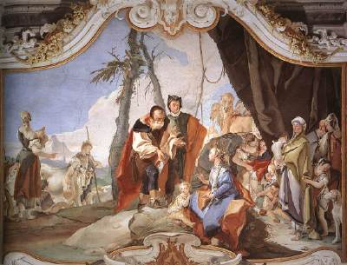
Jacob’s troubles with women
Notes:
Jacob loved Rachel more than Leah, and Leah felt hated. God opened Leah's womb and she gave birth to four sons rapidly. Rachel, however, remained barren. Following the example of Sarah, who gave her handmaid to Abraham after years of infertility, Rachel gave Jacob her handmaid, Bilhah, in marriage so that Rachel could raise children through her. Bilhah gave birth to two sons. Seeing that she had left off childbearing temporarily, Leah then gave her handmaid Zilpah to Jacob in marriage so that Leah could raise more children through her. Zilpah gave birth to two sons. Afterwards, Leah became fertile again and gave birth to two sons and a daughter. God remembered Rachel, who gave birth to Joseph and Benjamin.

Slide 15
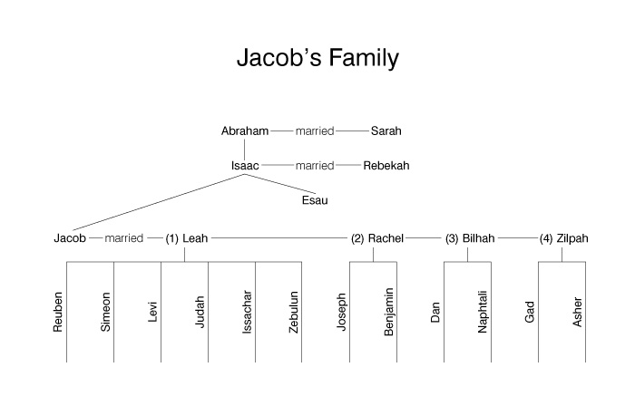
Jacob’s Children

Slide 16
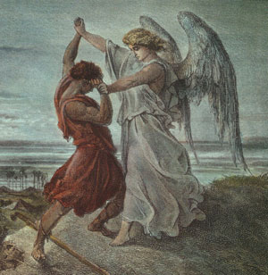
Jacob Wrestling with an Angel
Notes:
A highly symbolic story: On the way home to Canaan with his wives and children, Jacob wrestles with an angel. At the end of the fight the angel tells him that God has changed his name to Israel.

Slide 17
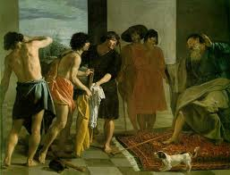
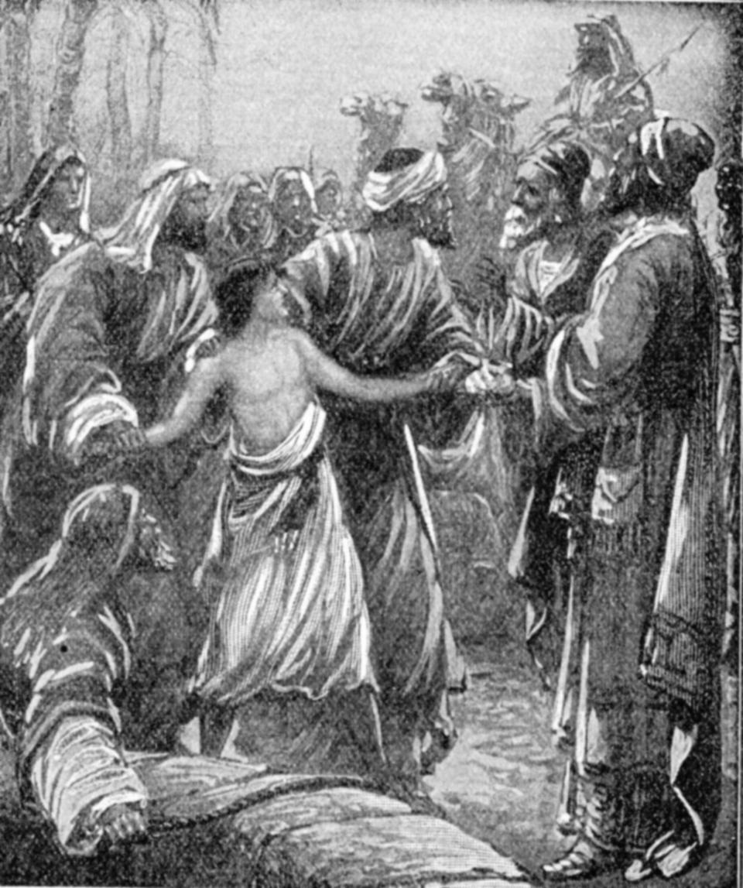
Joseph: Jacob’s Favorite Son
Notes:
Jacob favored Joseph. He was next to the youngest and also the son of Jacob’s most beloved wife. Joseph had several dreams all symbolically claiming that one day Joseph would rule over his father and his brothers. Jacob gives Joseph a coat of many colors which may have caused some jealousy among the brothers. One day Jacob sent Joseph out to the fields to report on what his older brothers were doing. The older brothers believed Joseph would tattle on them. They decide to kill him but change their minds and sell him as a slave. They tell their father that he was killed by a wild animal and offer his bloody coat as proof.

Slide 18
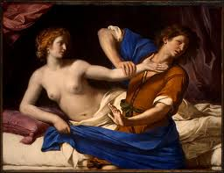
Potiphar’s wife
Notes:
The Egyptian slave traders took him into Egypt and sold him to Potiphar, chief of Pharaoh’s army. Potiphar’s wife began to develop a sexual attraction to Joseph. When he rejected her feelings, she brought accusations against Joseph claiming he attempted to rape her, and Joseph was thrown in jail

Slide 19
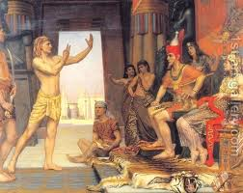
The Jail and the Dream
Notes:
The prison keeper befriended Joseph, and he learned of Joseph’s divine ability to interpret dreams. The warden put Joseph in charge of the other prisoners, and soon afterward Pharaoh's chief cup-bearer [wine steward] and chief baker, who had offended the Pharaoh, were thrown into the prison. They both had dreams, and Joseph offered to interpret them. Joseph told them that within three days the chief cup-bearer would be reinstated but the chief baker would be hanged. Joseph requested the cup-bearer to mention him to Pharaoh and secure his release from prison, but the cup-bearer, reinstalled in office, forgot Joseph.
After Joseph was in prison for two more years, Pharaoh had two dreams which disturbed him. He dreamt of seven lean cows which rose out of the river and devoured seven fat cows; and, of seven withered ears of grain which devoured seven fat ears. Pharaoh's wise men were unable to interpret these dreams, but the chief cup-bearer remembered Joseph and spoke of his skill to Pharaoh. Joseph was called for, and interpreted the dreams as foretelling that seven years of abundance would be followed by seven years of famine, and advised Pharaoh to store surplus grain during the years of abundance Joseph was called upon to interpret a dream that deeply troubled the Pharaoh that none of his consultants could decipher. Joseph interpreted the dreams as foretelling that seven years of abundance would be followed by seven years of famine, and advised Pharaoh to store surplus grain during the years of abundance.
Joseph was rewarded with the position of overseeing the lands of Egypt and stored abundant harvest towards the tragic times ahead and Egypt became prosperous under his care.

Slide 20
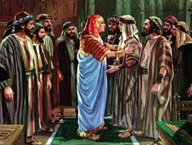
Joseph’s Family Reunion
Notes:
When famine struck, Joseph’s brothers (except Benjamin) came to Egypt for food. As a prominent person in the Egyptian government, the now adult Joseph spoke Egyptian and dressed in that manner, so he was unrecognizable to his brothers, but he recognized them. He gives them some food and put his brothers’ money back in their sacks of grain
He demanded that the rest of them bring their youngest brother Benjamin to Egypt. They do and Joseph announces who he is. The family moves to Egypt to join Joseph. They prosper and the families grow.

