Slide 1


Welcome to. . .
AGHS

Slide 2

Physical Education Staff
Name Phone e-mail
Mr. Nate Erickson ext. 2141* nerickson@lmusd.org
Mr. Steve Allen ext. 2140* sallen@lmusd.org
Mr. James Gross ext. 2139* jgross@lmusd.org
Mr. Tom Goossen ext. 2402* tgoossen@lmusd.org
Mr. Tyler Inouye ext. 2332* tinouye@lmusd.org
Mrs. Claudia Souder ext. 2326* csouder@lmusd.org
Mrs. Gail Varvel ext. 2325* gvarvel@lmusd.org
*dial 474-3200 and then the extension number

Slide 3
California Department of Education Physical Education Requirements
Students must complete 20 units of credit in Physical Education (2 years) and Pass 5 of the 6 State Mandated Personal Fitness Tests (Fitnessgram)
Students who do not pass a test in 5 of the 6 testing categories must continue to take Physical Education until they are able to successfully pass the Fitnessgram or have completed 4 years of Physical Education.
Fitnessgram is administered in late March in conjunction with the State mandated testing window.

Slide 4
Dress Policy
You must be dressed in physical education uniform. If not you will be sent to your administrator.
Loaners are available:
First time per month is “Free”
They are washed after each use.

Slide 5
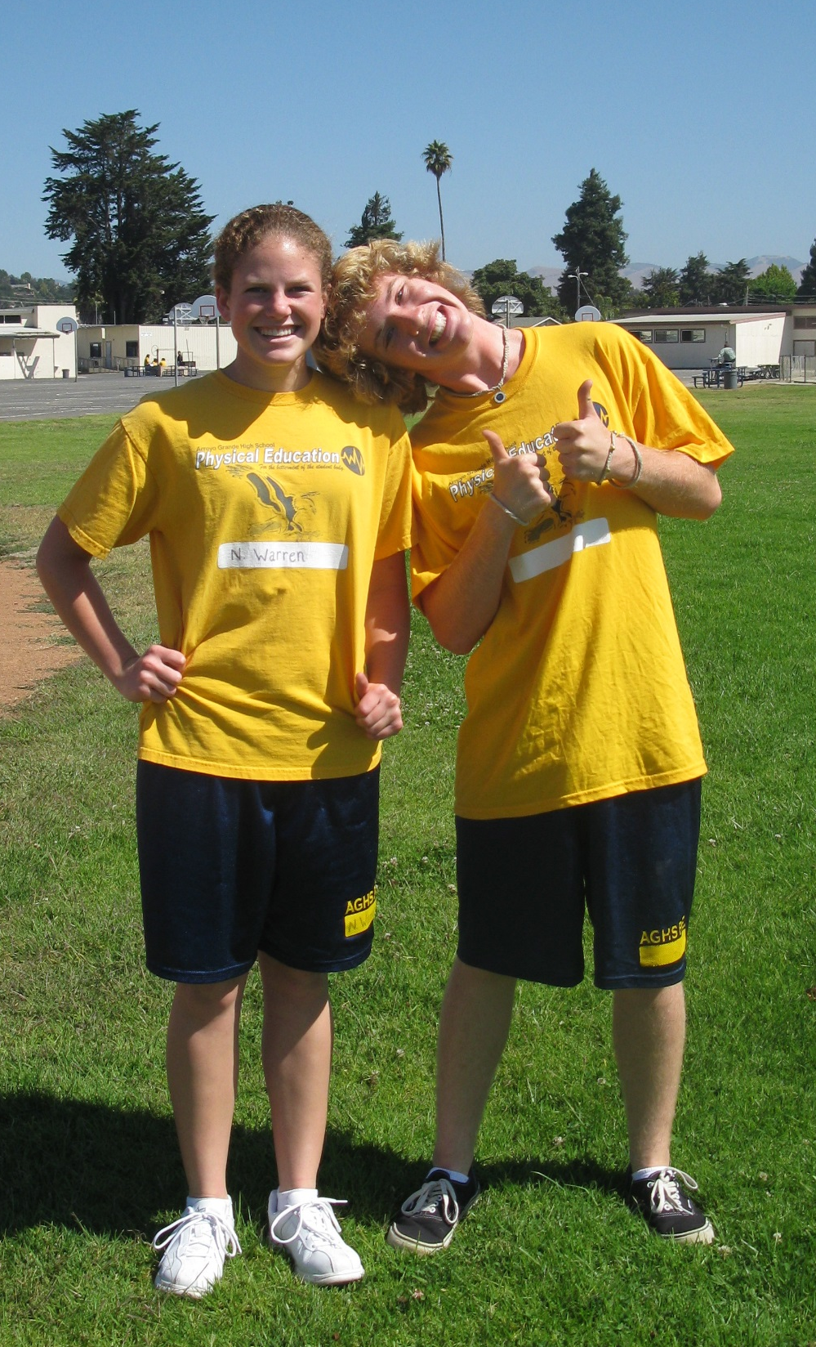
Uniform
Yellow Shirt
Blue Shorts
Socks
Athletic Shoes
Fleece Sweatshirt and /or Sweatpants are Optional. PE Shirt must be worn under sweatshirt.

Slide 6

Uniform Identification
Identify All Garments with First Initial and Last Name
Write name on inside of Fleece Sweatpants and Sweatshirts.
Sharing of Clothing Prohibited!
(It’s Gross)
NO ALTERATIONS!!!!!
Loaners available on a limited basis
Please don’t abuse the privilege.

Slide 7
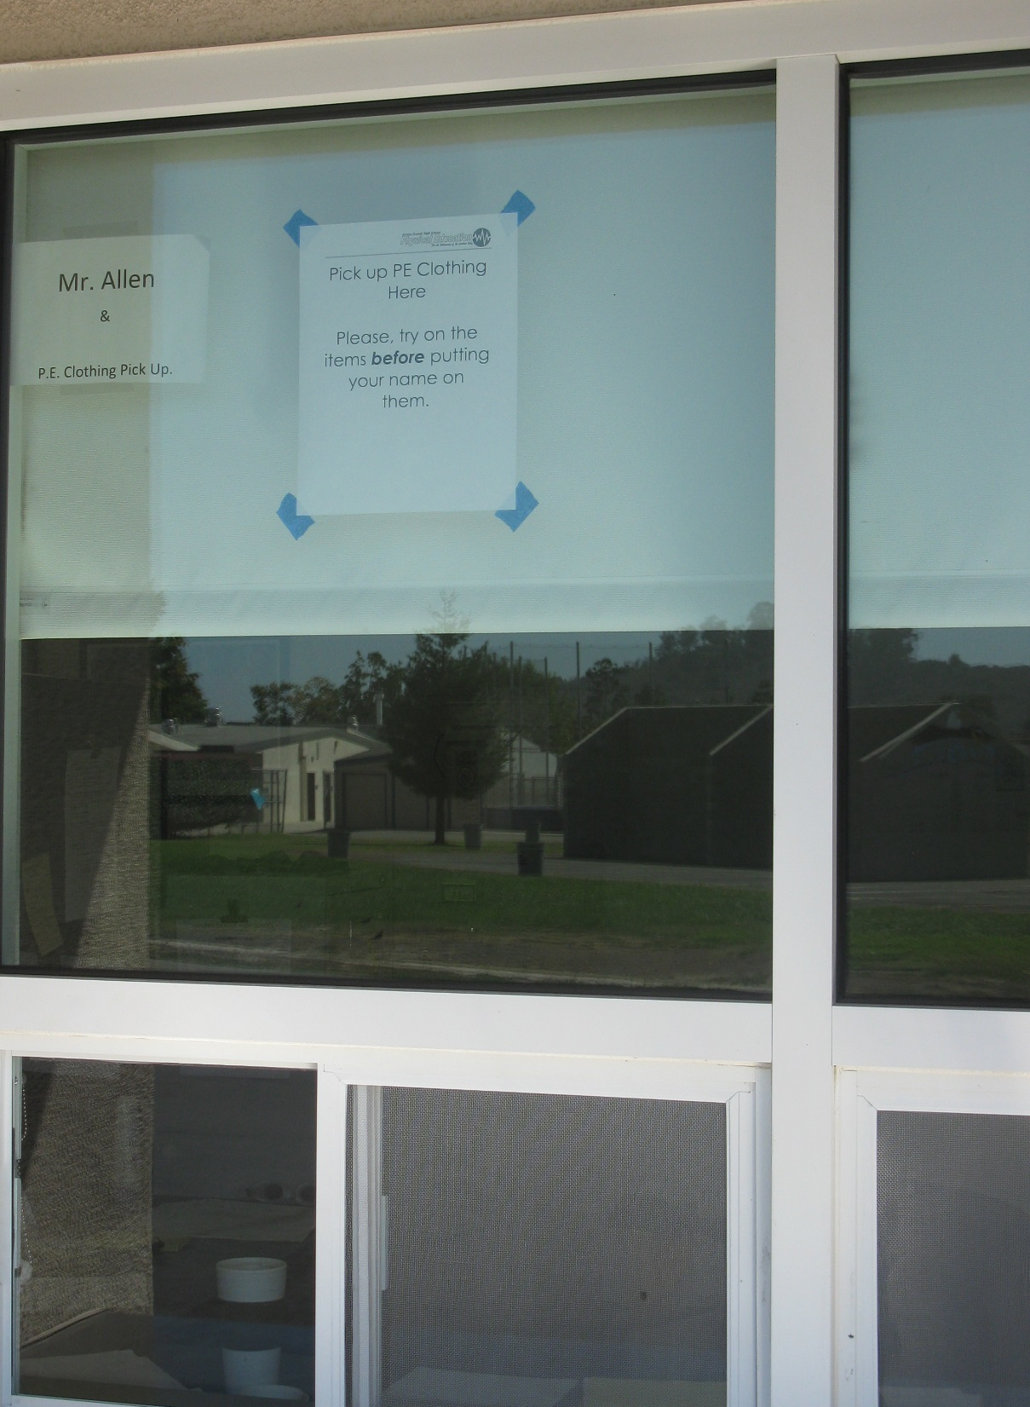
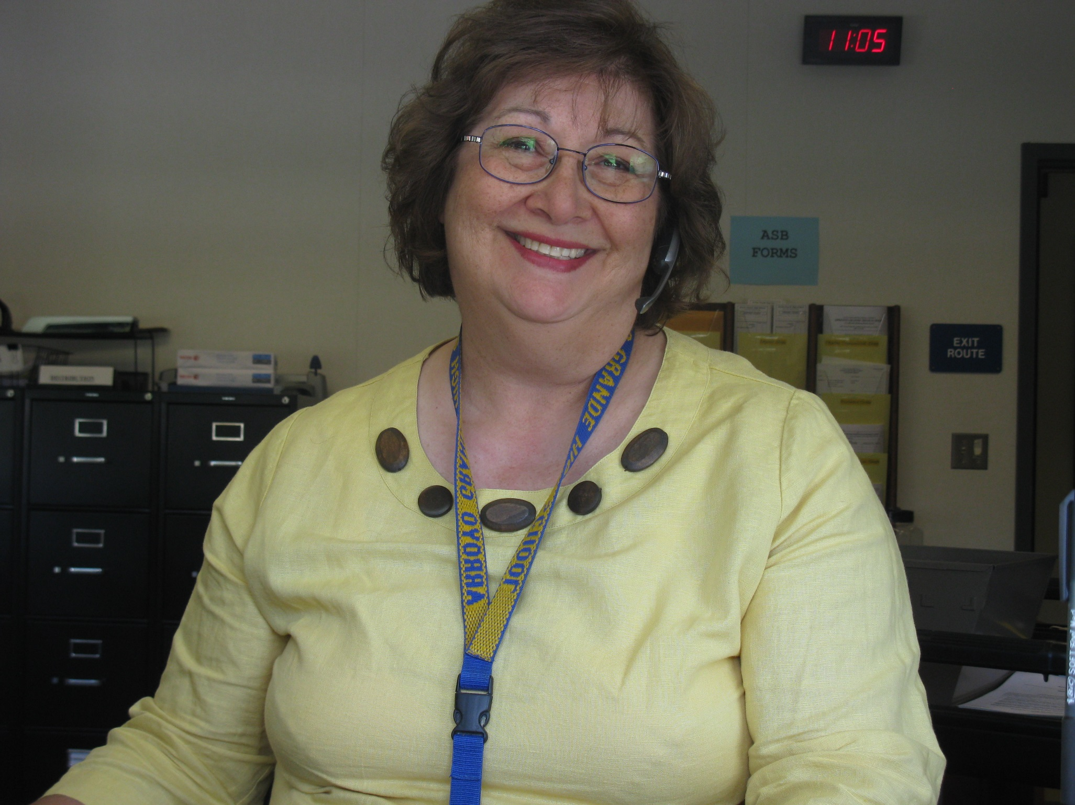
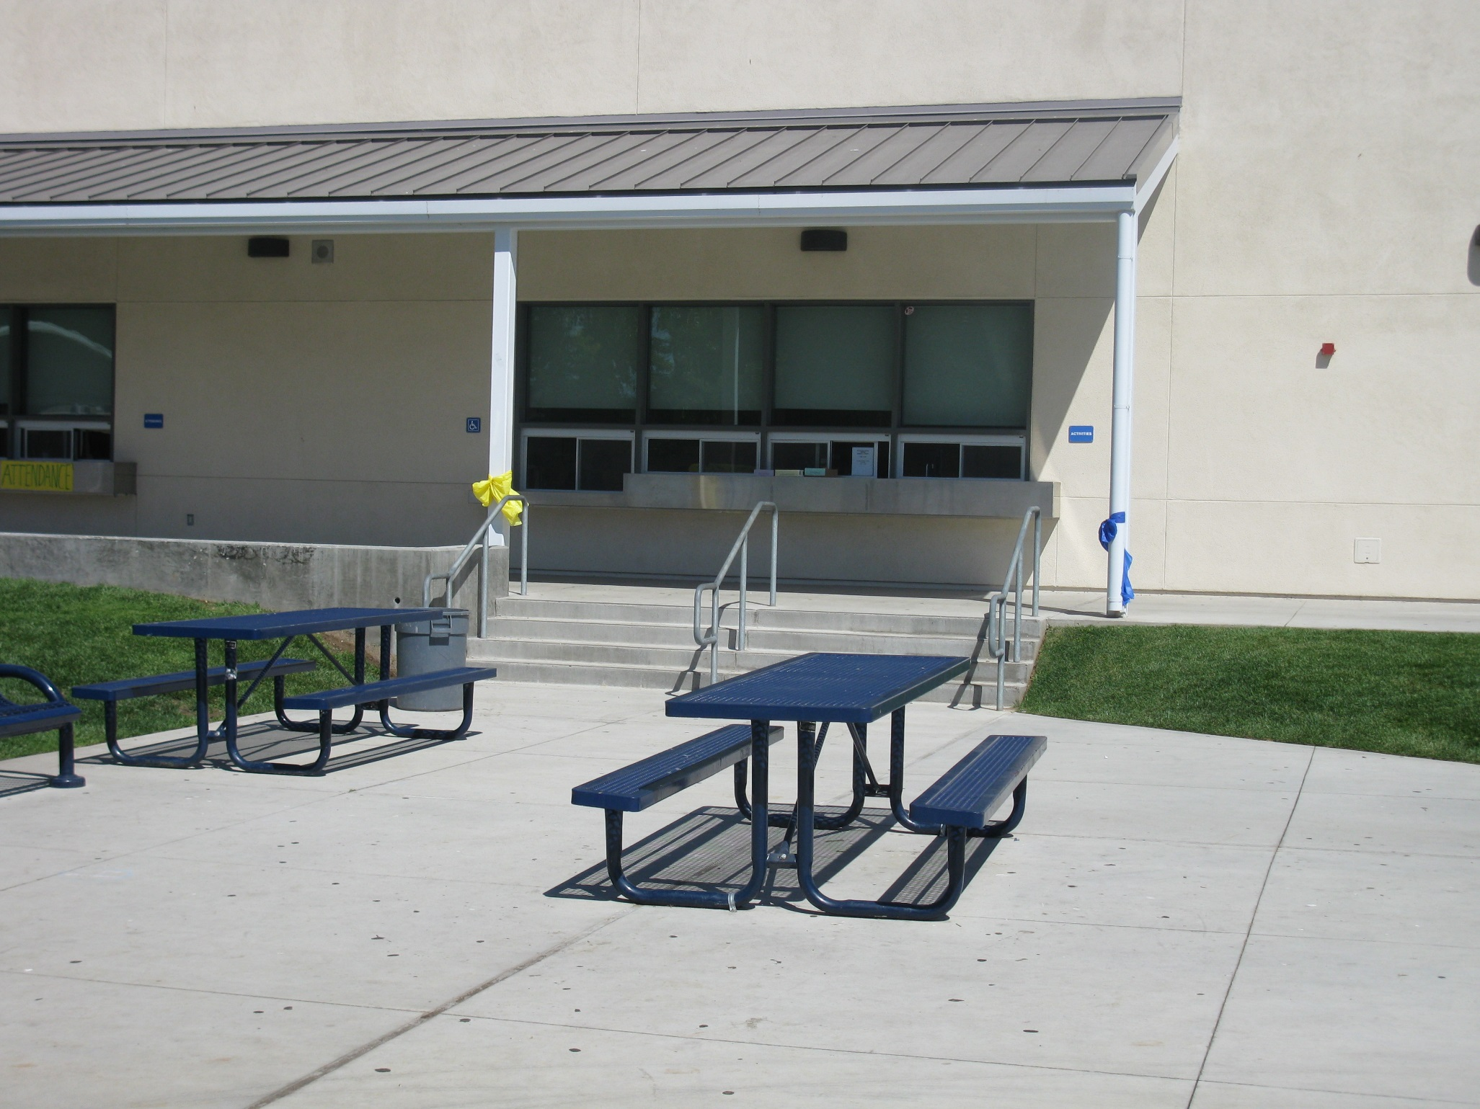
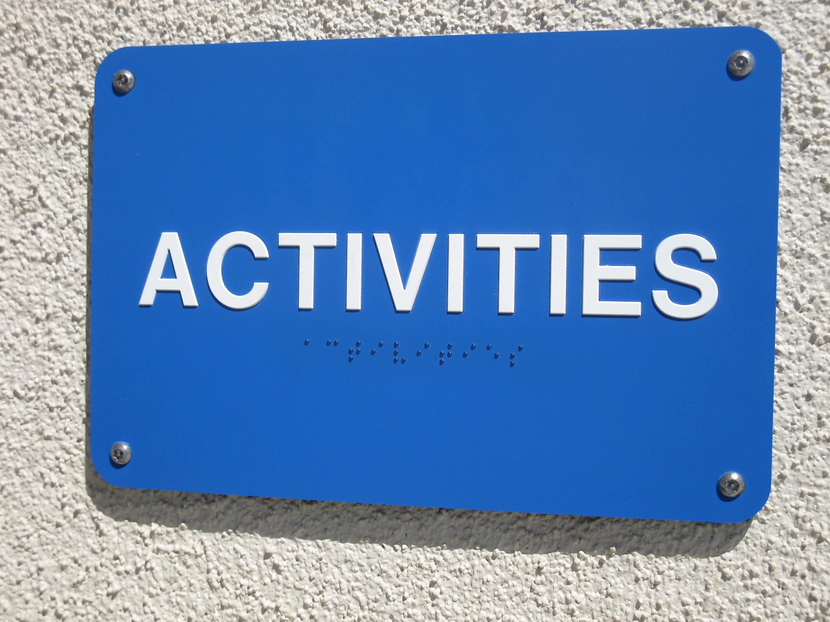
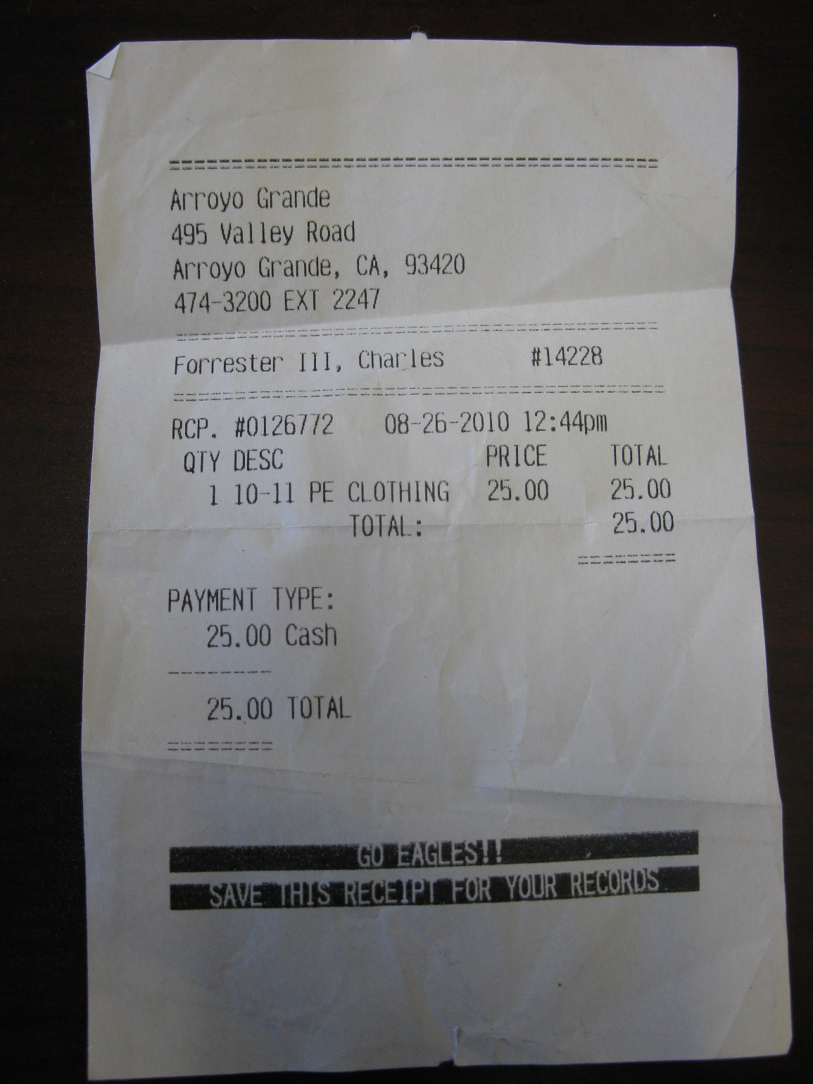
Uniform Availability
For convenience logoed uniforms are available for purchase at AGHS
Go to the AGHS activities office to pay.
  $30.00 per set
    $13.00 for shirt
    $17.00 for short
Bring receipt to Boys PE to redeem clothes.
Don’t lose your receipt!
30.00
30.00
30.00

Slide 8
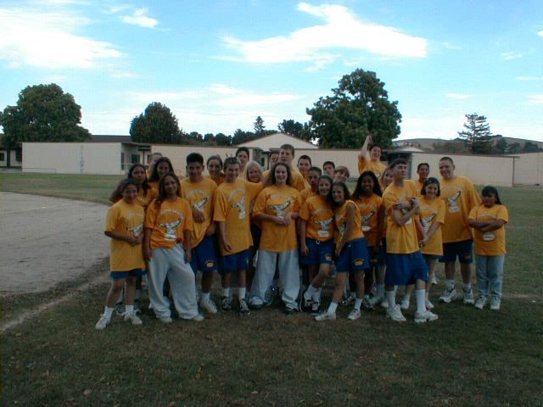
First Day to Dress
PE Course 2 (Upper Class)
Friday, August 22
PE Course 1 (9th Grade)
Monday, September 15th.

Slide 9
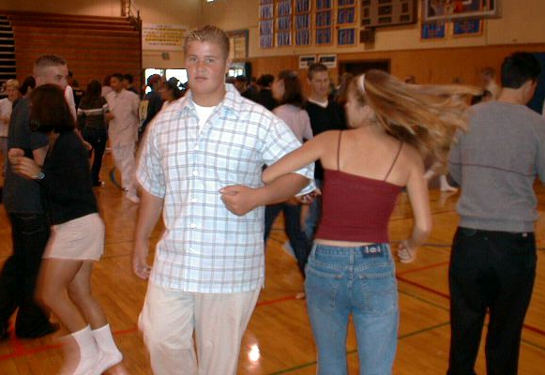
Square Dance

Slide 10


Grading
PE Course 1
Participation Points
(5 Per Day)
PLUS
Assessment / Assignment
Points
EQUAL
Total Points
Grading Scale
90% - 100% = A
80% - 89%= B
70% - 79% = C
60% - 69% = D
Less Than 60% = F
75% Participation, 25% Classwork and Assessments

Slide 11
Grading
PE Course 2
70% Participation
(5 Points Per Day)
20% Assessments / Classwork
10% Fitness Proficiencies

Slide 12


Non-Participation
ALL MISSED DAYS MUST BE MADE UP.
Talk with your teacher before the period begins to see how they want to handle your situation.
Students unable to participate must bring a note from a Parent or Doctor.
Parent Note:
Excuses a student from participation up to three days
Doctor Note:
Required when a student must miss more than three days of participation.
Must state what the student CAN do.

Slide 13
Make-up Work
Don’t wait until its too late!
Check with your teacher for make-up opportunities: after school, before school, during school (lunch).
Attendance and participation in a make-up activity excuses one absence or non-participation day.

Slide 14
Lockers and Locker Rooms
AGHS is not responsible for lost or damaged personal items.
Lost or damaged lock charge $5.00
You are advised NEVER to share lockers and combinations with any students.
Money and valuables SHOULD NOT be kept in the locker room. Locker rooms provided minimal security.

Slide 15
Remainder of the Week
Tomorrow meet here in the gym we will assign locks and lockers. Bring your PE Clothes or $30.00 to purchase them.
Friday
  PE Course 2: Dress Out and check your teacher’s window for meeting place.
  PE Course 1: Meet in the gym for square dance.

Slide 16


