Slide 1
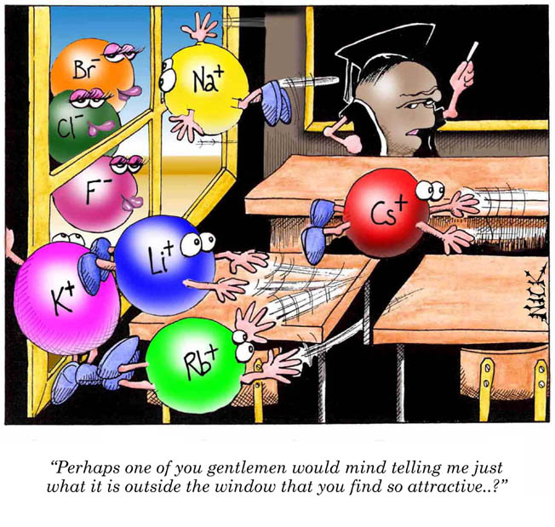
Unit 3:
Chemical
Bonding and
Molecular
Structure
Cartoon courtesy of NearingZero.net

Slide 2
Bonds
Forces that hold groups of atoms
together and make them function
as a unit.
Ionic bonds – transfer of electrons
Covalent bonds – sharing of electrons

Slide 3
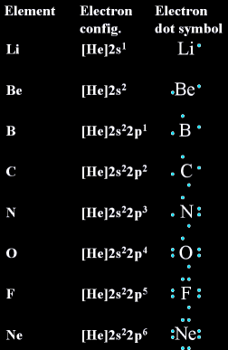
Electron Dot Notation

Slide 4
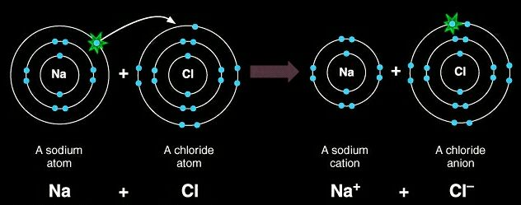
The Octet Rule – Ionic Compounds
Ionic compounds tend to form so that each atom, by gaining or losing electrons, has an octet of electrons in its highest occupied energy level.

Slide 5
Ionic Bonding:
The Formation of Sodium Chloride
Sodium has 1 valence electron
Chlorine has 7 valence electrons
An electron transferred gives
each an octet
Na 1s²2s²2p⁶3s¹
Cl 1s²2s²2p⁶3s²3p⁵

Slide 6
Ionic Bonding:
The Formation of Sodium Chloride
This transfer forms ions, each with an octet:
Na⁺ 1s²2s²2p⁶
Cl⁻ 1s²2s²2p⁶3s²3p⁶

Slide 7
Ionic Bonding:
The Formation of Sodium Chloride
The resulting ions come together due to electrostatic attraction (opposites attract):
Na⁺
Cl⁻
The net charge on the compound must equal zero

Slide 8
Examples of Ionic compounds
All salts, which are composed of metals bonded to nonmetals, are ionic compounds and form ionic crystals.
Examples:
Mg²⁺Cl⁻₂
Na⁺₂O²⁻
Ca²⁺O²⁻
K⁺I⁻
Li⁺F⁻
Ba²⁺S²⁻

Slide 9
Monatomic Cations | Name
H⁺ | Hydrogen
Li⁺ | Lithium
Na⁺ | Sodium
K⁺ | Potassium
Mg²⁺ | Magnesium
Ca²⁺ | Calcium
Ba²⁺ | Barium
Al³⁺ | Aluminum

Slide 10
Monatomic Anions | Name
F⁻ | Fluoride
Cl⁻ | Chloride
Br⁻ | Bromide
I⁻ | Iodide
O²⁻ | Oxide
S²⁻ | Sulfide
N³⁻ | Nitride
P³⁻ | Phosphide

Slide 11
Properties of Ionic Compounds
Structure: | Crystalline solids
Melting point: | Generally high
Boiling Point: | Generally high
Electrical Conductivity: | Excellent conductors, molten and aqueous
Solubility in water: | Generally soluble

Slide 12
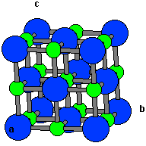
Sodium Chloride Crystal Lattice
Ionic compounds form solids at ordinary temperatures.
Ionic compounds organize in a characteristic crystal lattice of alternating positive and negative ions.

Slide 13
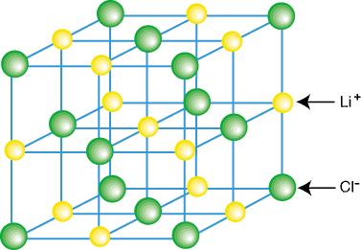
Representation of Components in an Ionic Solid
Lattice: A 3-dimensional system of points designating the centers of components (atoms, ions, or molecules) that make up the substance.

Slide 14
Metallic Bonding
The chemical bonding that results from the attraction between metal atoms and the surrounding sea of electrons
Vacant p and d orbitals in metal's outer energy levels overlap, and allow outer electrons to move freely throughout the metal
Valence electrons do not belong to any one atom

Slide 15
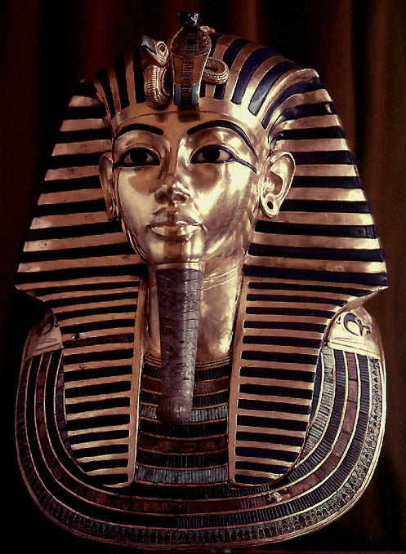
Properties of Metals
Metals are good conductors of heat and electricity
Metals are malleable
Metals are ductile
Metals have high tensile strength
Metals have luster

Slide 16
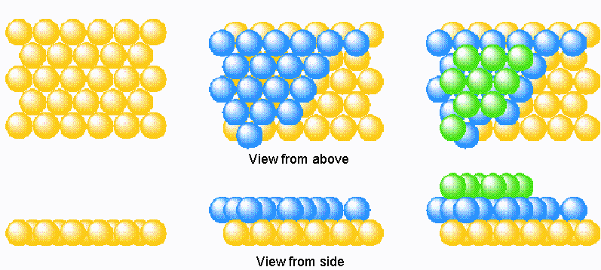
Packing in Metals
Model: Packing uniform, hard spheres to best use available space. This is called closest packing. Each atom has 12 nearest neighbors.

Slide 17
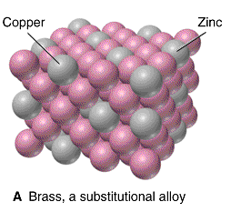
Metal Alloys
Substitutional Alloy: some metal atoms replaced by others of similar size.

Slide 18
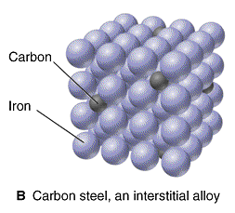
Metal Alloys
Interstitial Alloy: Interstices (holes) in closest packed metal structure are occupied by small atoms.

Slide 19
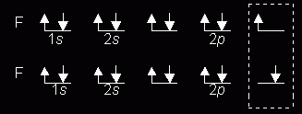
The Octet Rule – Covalent Compounds
Covalent compounds tend to form so that each atom, by sharing electrons, has an octet of electrons in its highest occupied energy level.
Diatomic Fluorine

Slide 20
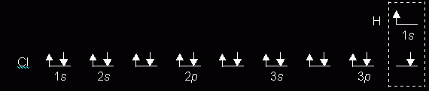
Hydrogen Chloride by the Octet Rule

Slide 21
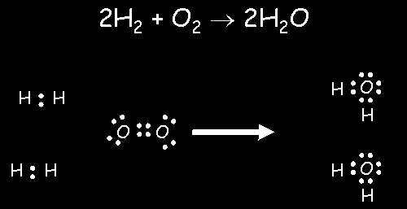
Formation of Water by the Octet Rule

Slide 22
Comments About the Octet Rule
2nd row elements C, N, O, F observe the octet rule.
2nd row elements B and Be often have fewer than 8 electrons around themselves - they are very reactive.
3rd row and heavier elements CAN exceed the octet rule using empty valence d orbitals.
When writing Lewis structures, satisfy octets first, then place electrons around elements having available d orbitals.

Slide 23
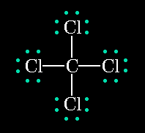
Lewis Structures
Shows how valence electrons are arranged among atoms in a molecule.
Reflects central idea that stability of a compound relates to noble gas electron configuration.

Slide 24
Completing a Lewis Structure -CH₃Cl
Make carbon the central atom
Add up available valence electrons:
C = 4, H = (3)(1), Cl = 7 Total = 14
Join peripheral atoms
to the central atom
with electron pairs.
H
..
..
H
..
..
Complete octets on
atoms other than
hydrogen with remaining
electrons
C
..
Cl
..
..
H

Slide 25
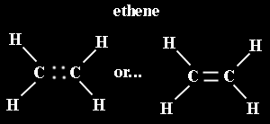
Multiple Covalent Bonds:
Double bonds
Two pairs of shared electrons

Slide 26

Multiple Covalent Bonds:
Triple bonds
Three pairs of shared electrons

Slide 27
Bond Length and Bond Energy
Bond | Length (pm) | Energy (kJ/mol)
C - C | 154 | 346
C=C | 134 | 612
C≡C | 120 | 835
C - N | 147 | 305
C=N | 132 | 615
C≡N | 116 | 887
C - O | 143 | 358
C=O | 120 | 799
C≡O | 113 | 1072
N - N | 145 | 180
N=N | 125 | 418
N≡N | 110 | 942

Slide 28
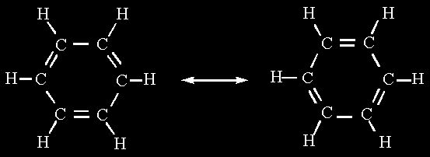
Resonance
Occurs when more than one valid Lewis structure can be written for a particular molecule.
These are resonance structures.
The actual structure is an average of
the resonance structures.

Slide 29

Resonance in Ozone
Neither structure is correct.

Slide 30
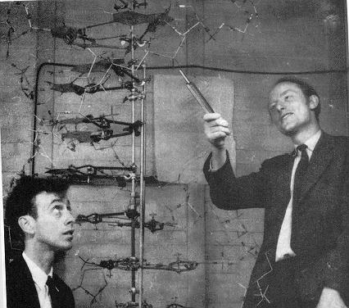
Models
Models are attempts to explain how nature operates on the microscopic level based on experiences in the macroscopic world.
Models can be physical as with this DNA model
Models can be mathematical
Models can be theoretical or philosophical

Slide 31
Fundamental Properties of Models
A model does not equal reality.
Models are oversimplifications, and are therefore often wrong.
Models become more complicated as they age.
We must understand the underlying assumptions in a model so that we don’t misuse it.

Slide 32
VSEPR Model
(Valence Shell Electron Pair Repulsion)
The structure around a given atom is determined principally by minimizing electron pair repulsions.

Slide 33
Predicting a VSEPR Structure
Draw Lewis structure.
Put pairs as far apart as possible.
Determine positions of atoms from the way electron pairs are shared.
Determine the name of molecular structure from positions of the atoms.

Slide 34
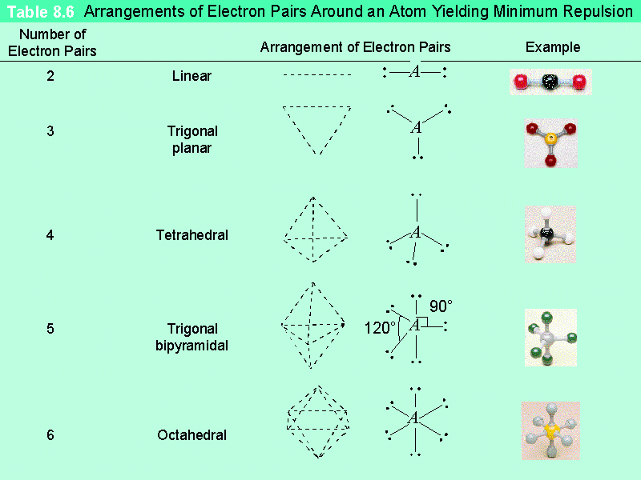
Table – VSEPR Structures

Slide 35
Polarity
A molecule, such as HF, that has a center of positive charge and a center of negative charge is said to be polar, or to have a dipole moment.

Slide 36
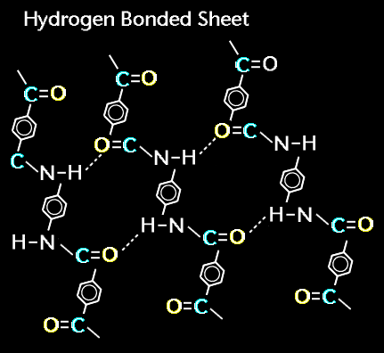
Hydrogen Bonding
Bonding between
hydrogen and more electronegative neighboring atoms such as oxygen and nitrogen
Hydrogen bonding in Kevlar, a strong polymer used in bullet-proof vests.

Slide 37
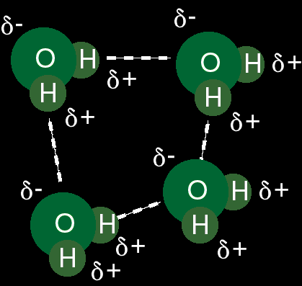
Hydrogen Bonding in Water

Slide 38
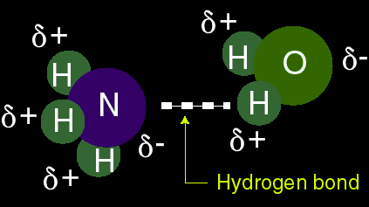
Hydrogen Bonding between
Ammonia and Water

Slide 39
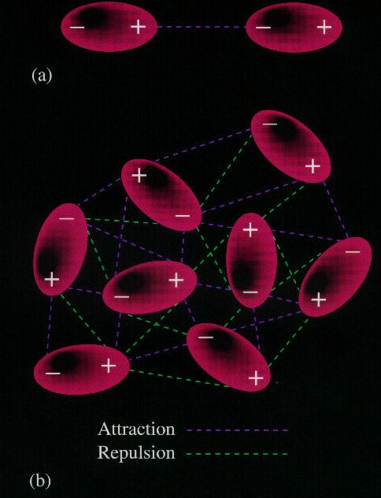
Dipole-Dipole Attractions
Attraction between oppositely charged regions of neighboring molecules.

Slide 40
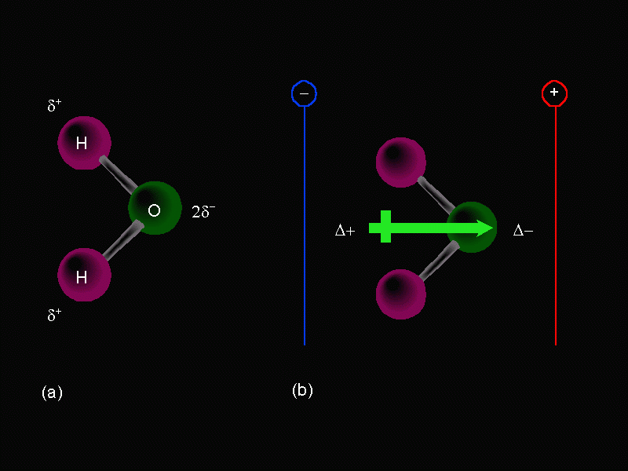
The water dipole

Slide 41
Relative magnitudes of forces
The types of bonding forces vary in their strength as measured by average bond energy.
Strongest
Weakest
Covalent bonds (400 kcal)
Hydrogen bonding (12-16 kcal )
Dipole-dipole interactions (2-0.5 kcal)
London forces (less than 1 kcal)

