Slide 1
Cell Reproduction and Meiosis
EQ: What are the major differences between Meiosis and Mitosis?

Slide 2
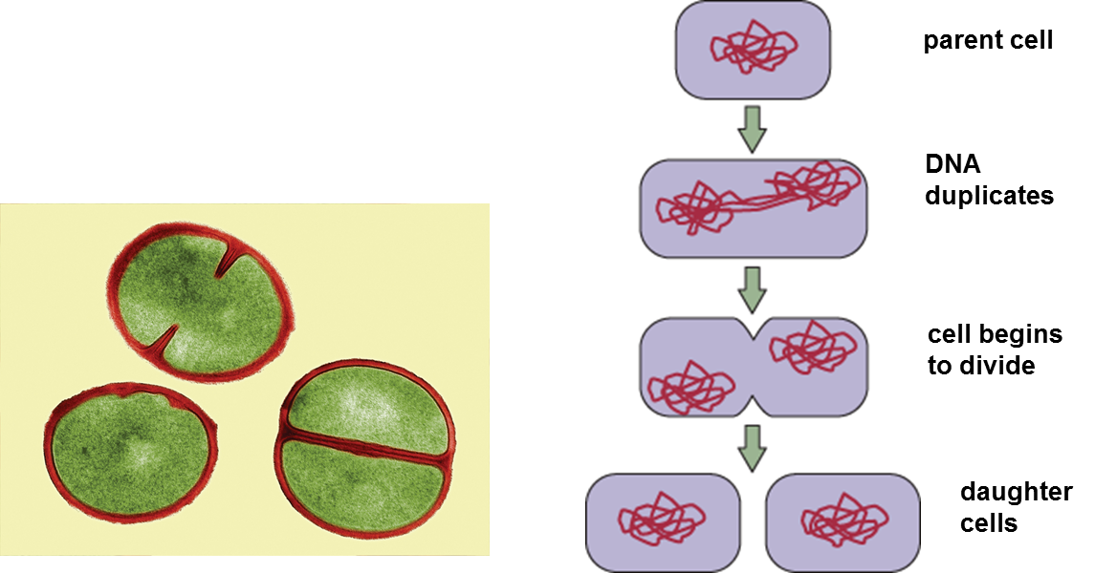
Asexual Reproduction
Binary fission is similar to mitosis
Asexual reproduction is the creation of offspring from a single parent

Slide 3
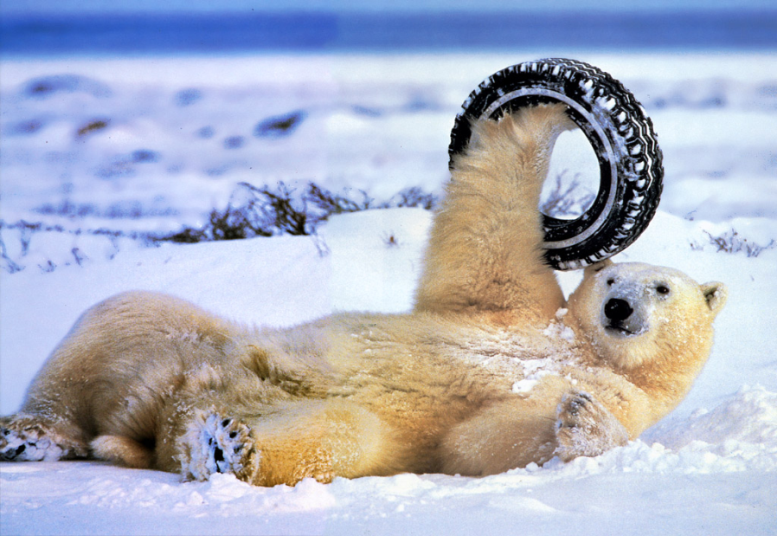
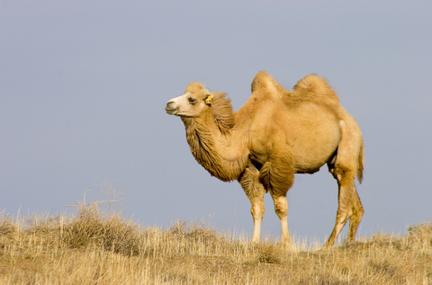
Asexual v. Sexual Reproduction
Asexual reproduction is an advantage in environmental conditions that stay the same
Sexual Reproduction is an advantage in environmental conditions that change constantly.
  Allows for variation of traits
  Variation allows for species to survive different environmental conditions

Slide 4
Question 1
Why is sexual reproduction more advantageous than asexual reproduction?

Slide 5
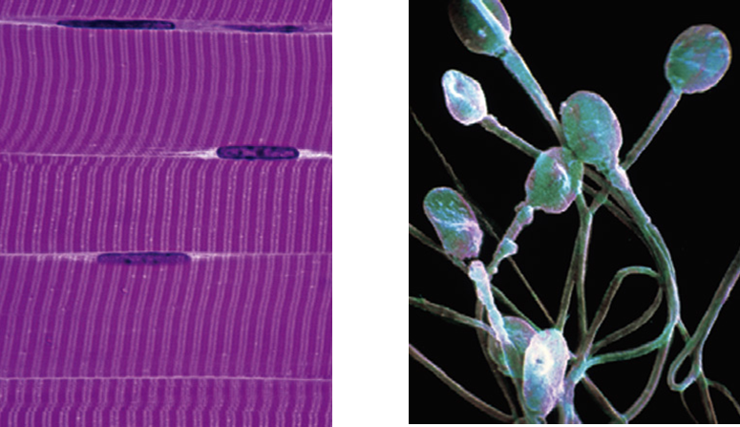
Gametes
You have body cells and gametes
Gametes have half the number of chromosomes that body cells have.
  Gametes cells are located in the ovaries and testes.
  Gametes are sex cells: egg and sperm
  Gametes have DNA that can be passed to offspring

Slide 6
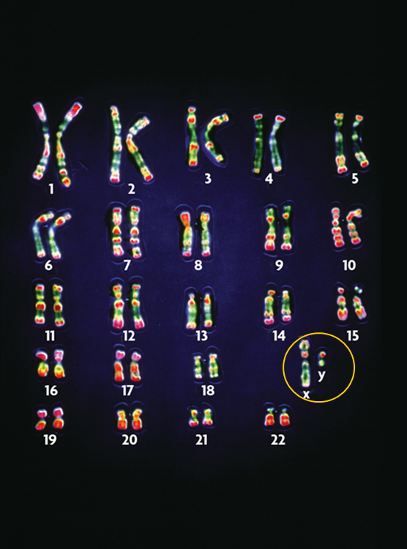
Human Chromosome numbers
Your body cells have 23 pairs of chromosomes.
Autosomes are your normal chromosomes 1-22
Sex Chromosomes, X and Y determine gender in mammals.

Slide 7
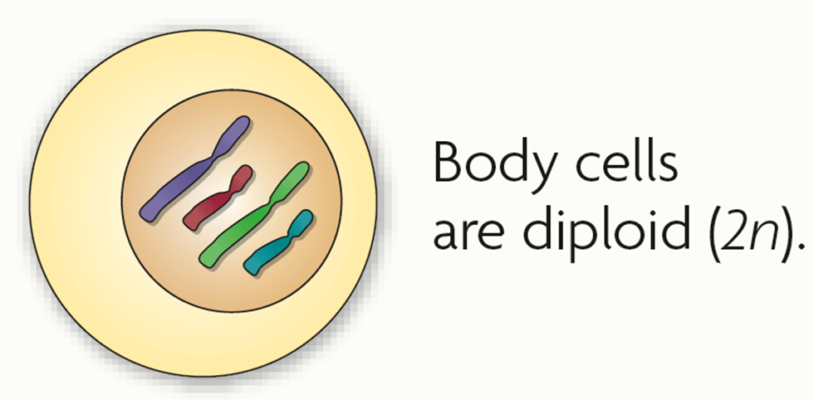
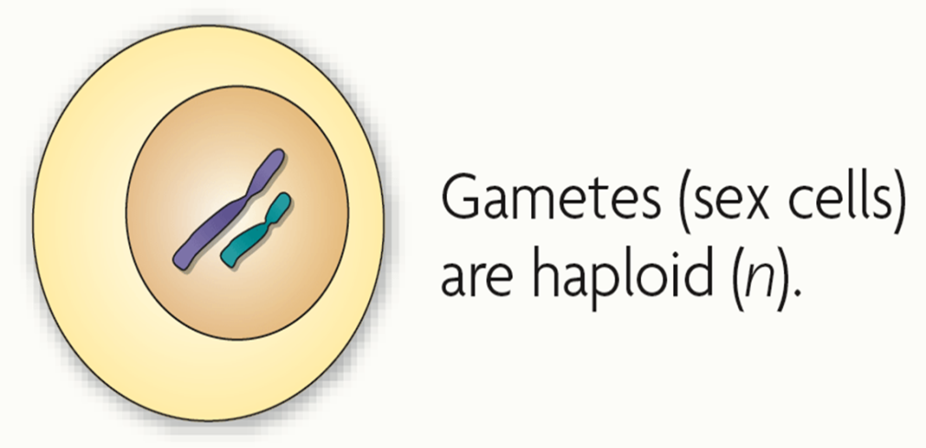
Gametes and Body Cells
Body cells are diploid; gametes are haploid
  Fertilization between egg and sperm occurs in reproduction.
  Diploid cells have two copies of every chromosome.
    Body cells are diploid
    Get chromosomes from each parent
  Haploid cells have one copy of every chromosome
    Gametes are haploid

Slide 8
Question 2
What are Gametes and how many chromosomes do humans have in them?

Slide 9
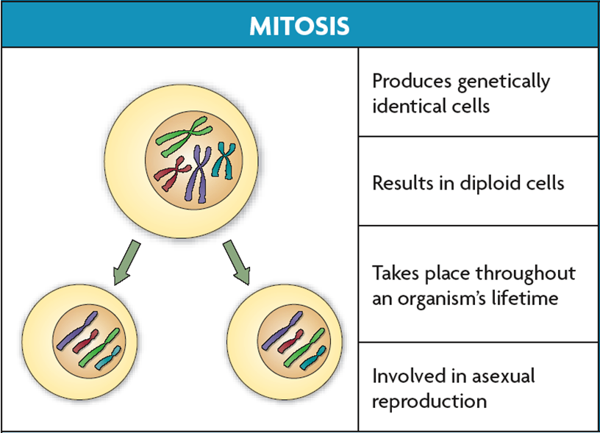
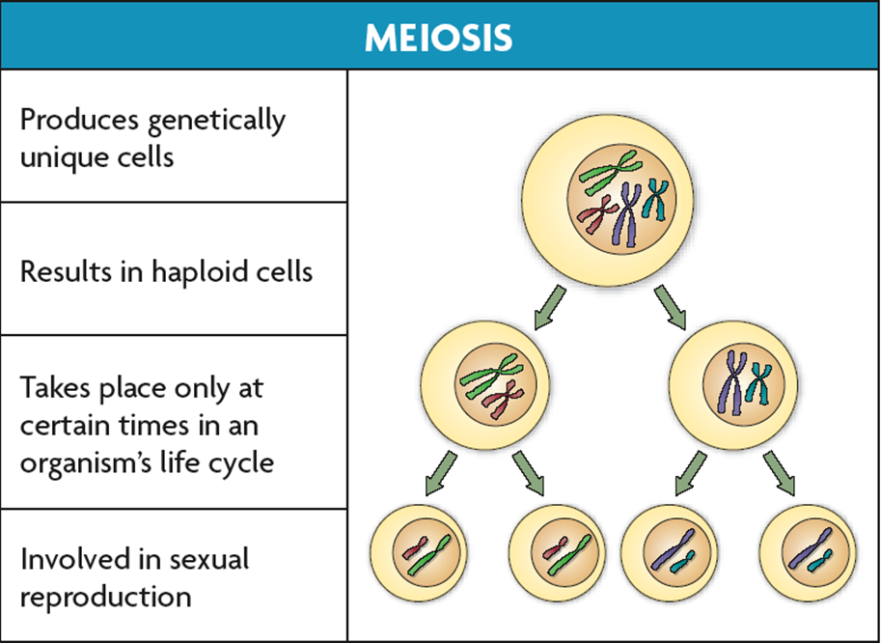
Mitosis v. Meiosis
Mitosis and Meiosis are types of cell division that make different types of cells
Mitosis makes more diploid cells
Meiosis makes haploid cells from diploid cells
  Occurs in sex cells
  Produces gametes

Slide 10

Meiosis
During Meiosis, diploid cells undergo two cell divisions that result in haploid cells
Meiosis reduces chromosome number and creates genetic diversity

Slide 11
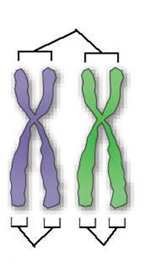



Meiosis
Meiosis I and Meiosis II each have four phases similar to those of mitosis
  Pairs of chromosomes separate in Meiosis I
  Paired chromosomes are similar but not identical
  Sister chromatids divide in meiosis II
  Sister chromatids are copies of the same chromosome

Slide 12
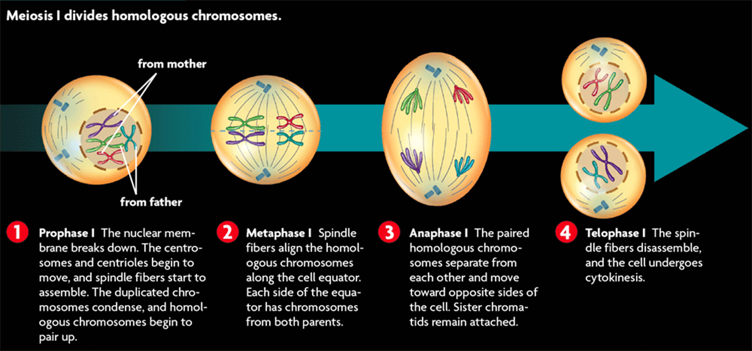
Meiosis
Meiosis I occurs after DNA has been replicated
Meiosis I divides paired chromosomes in four phases

Slide 13
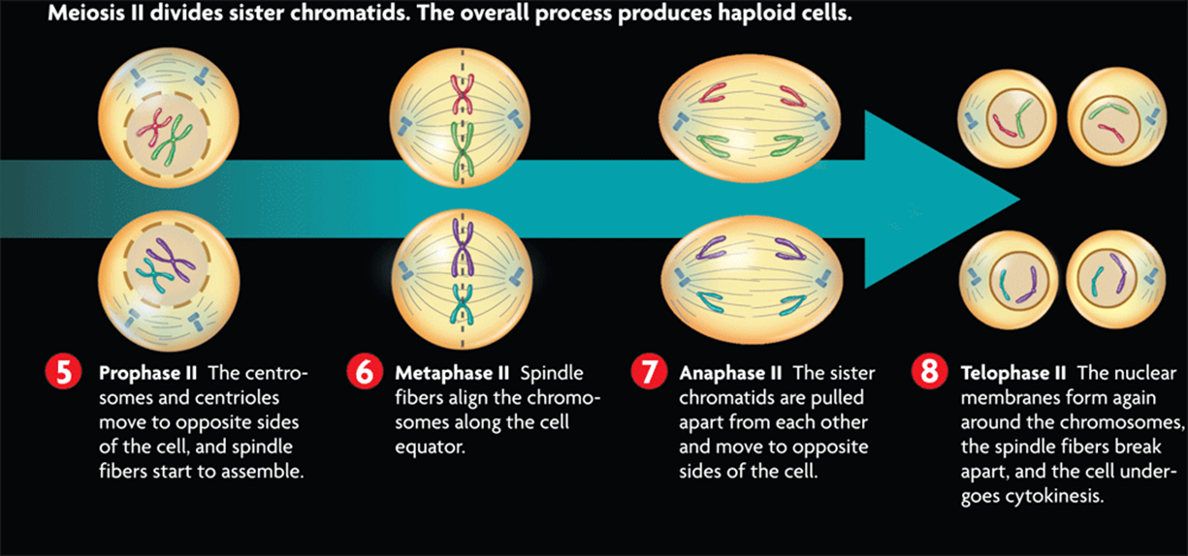
Meiosis
Meiosis II divides sister chromatids in four phases
DNA is not replicated between meiosis I and meiosis II

Slide 14
Question 3
What happens during Meiosis I and Meiosis II?

Slide 15
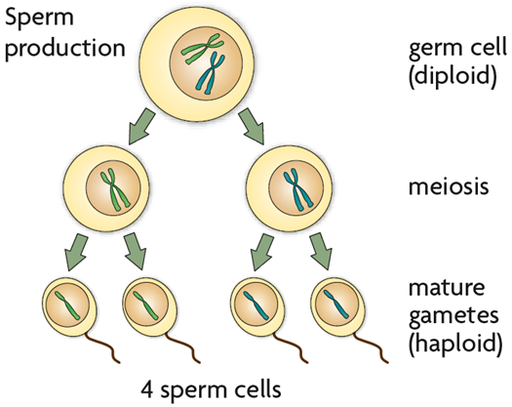
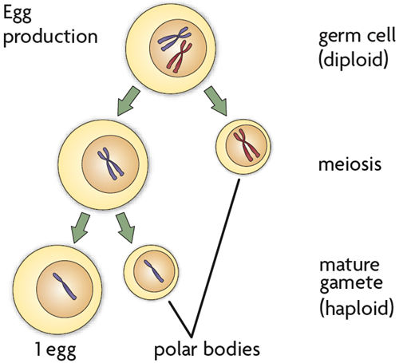
Meiosis
Meiosis produces either sperm or eggs.
Sperm primarily contribute DNA to an embryo
Eggs contribute DNA, cytoplasm, and organelles to an embryo.

Slide 16
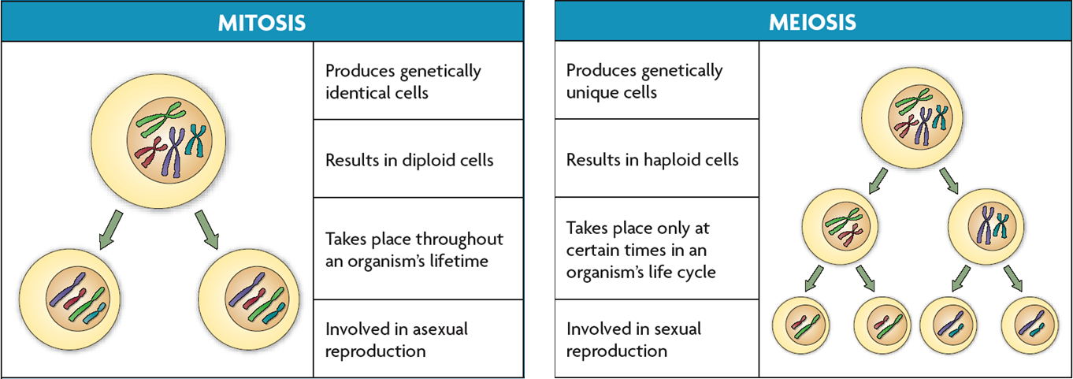
Mitosis v. Meiosis
Meiosis differs from mitosis
  Meiosis has two cell divisions while mitosis has one
  In mitosis, chromosomes do not pair
  Meiosis results in haploid cells; mitosis results in diploid cells

Slide 17
Summary
What are some of the major difference between Mitosis and Meiosis?

