Slide 1
Map Projections
http://www.mapsofworld.com/projection-maps/miller/world-miller-political-map-text.html

Slide 2
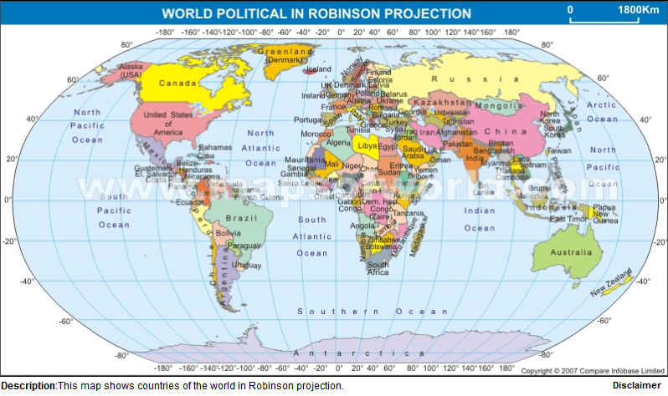
Robinson Projection

Slide 3
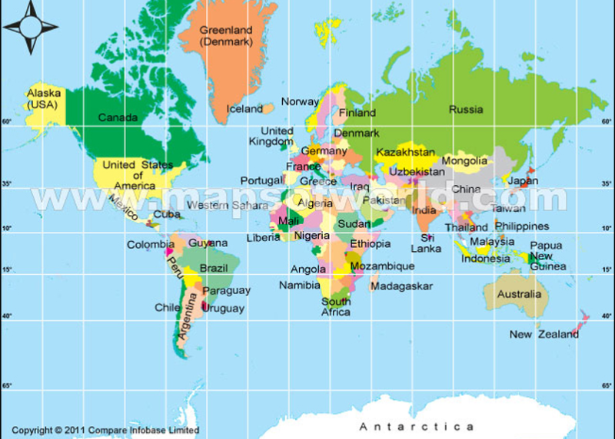
Mercator Projection

Slide 4
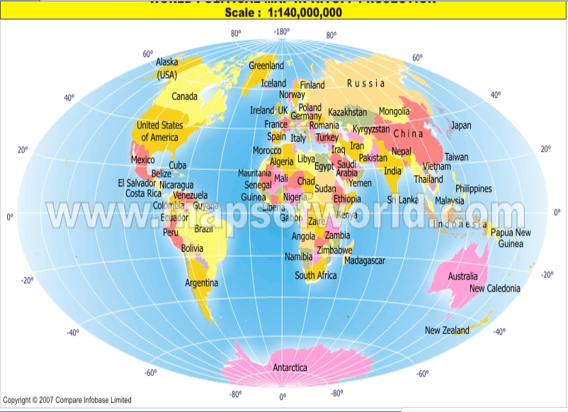
Aitoff Projection

Slide 5
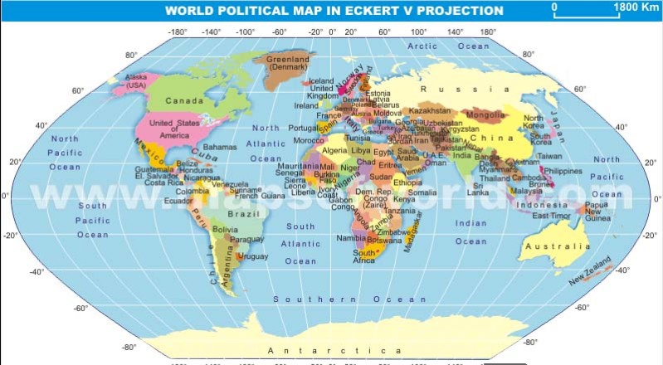
Eckert V Projection

Slide 6
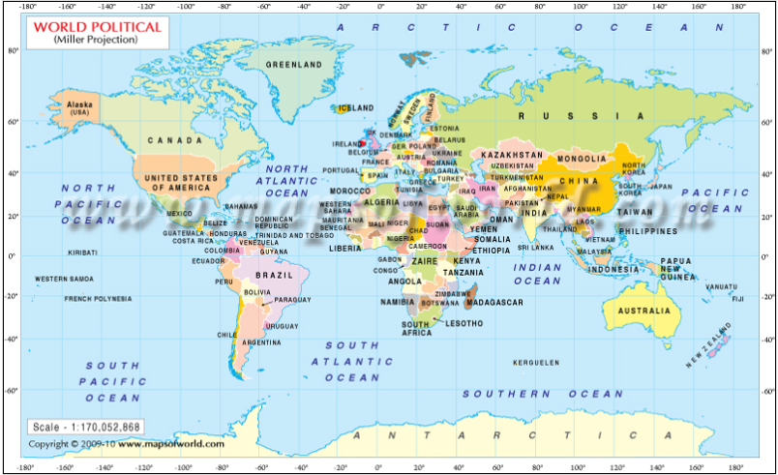
Miller Projection

