Slide 1
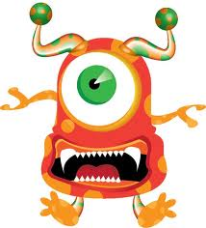
Create a Creature
Meet the One Eyed- Odonto
Uni= one
Oculo= eye
Poly= many
Odonto= teeth
Tox= poisonous
Isk=small
Scientific Name: Unioculopolyodontotoxisk
Explanation: A small, orange spotted, one-eyed creature whose bite releases a toxic venom.

Slide 2
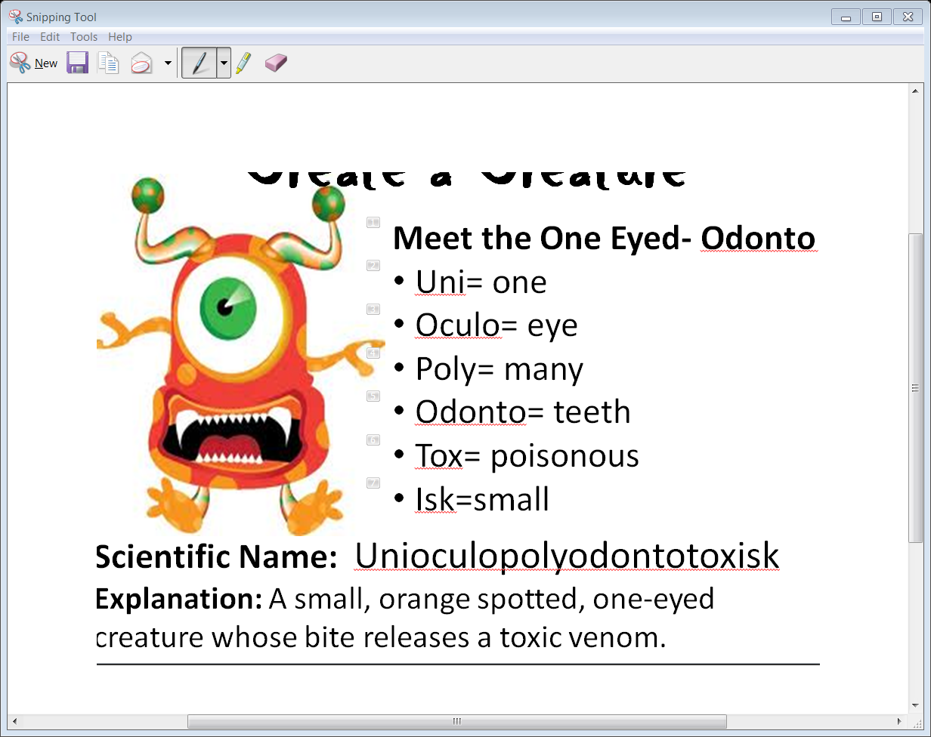
Create a Creature
Choose 6-8 words to create your creature- write down the words as well as their meanings
Draw, color, and name your creature
Make sure you have its scientific name as well
Write a one sentence description of your creature

