Slide 1
Reproductive System
Core 6.6

Slide 2
Sexual reproduction – requires union of egg and sperm ( )
  Male produces sperm, female produces eggs
  Sex cells are made in the
  Eggs and sperm are (made by ) so that when they unite, the

Slide 3
Male Reproductive System
  Main organ: testes
  Located at the base of the abdominal cavity
  Develop from

Slide 4
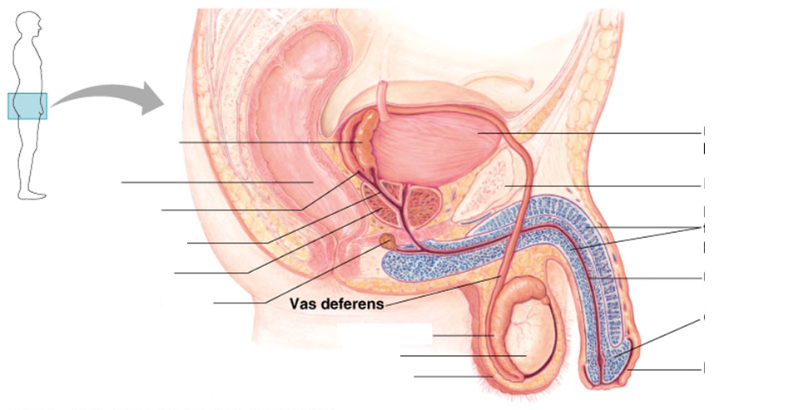
6.6.1 Draw and label diagrams of the adult male and female reproductive systems.

Slide 5
Testes have 2 functional components:
  – produces ; only functional at .
    Scrotal sac approximately 1.5° C cooler that abdomen
    – coiled tube where sperm travel from seminiferous tubules; lie on top of testes;
  – secrete male sex hormone

Slide 6
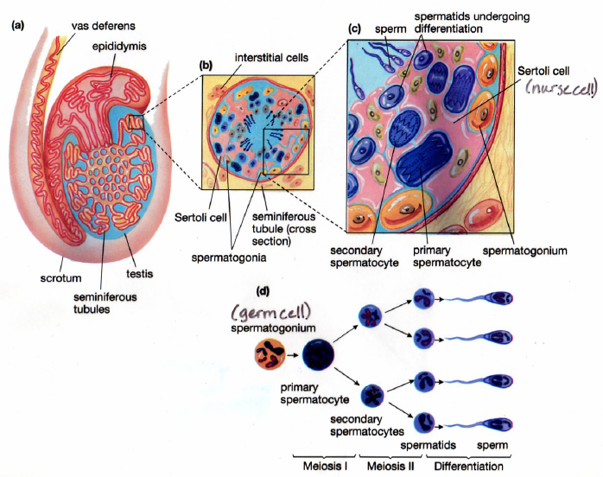

Slide 7
– 2 long ducts that (common duct for passage of )
Urethra passes through penis and empties to outside
As sperm passes through the vas deferens, sperm is mixed with
  Seminal fluids are secreted by
  Seminal fluid functions as:
    Vehicle for transport of sperm
    Lubricates passages where sperm pass
    Acts as a buffer fluid to protect sperm from acids in female reproductive tract
    Contains fructose for source of energy

Slide 8
6.6.4 List three roles of testosterone in males.
Hormonal control of male reproduction:
  During embryonic development –
    Testosterone levels remain low until onset of puberty (no sperm production)
    At puberty, testes begin to release testosterone which begins production of sperm
  After puberty, (beard, pubic hair, underarm hair, deepening of voice, development of larger and stronger muscles)
  In adults, it maintains the

Slide 9
Female Reproductive System
  – located in abdominal cavity; held in place by ligaments; produce
  At time of birth, ovaries already contain hundreds of
  Each oocyte is enclosed in a – each month when egg ripens, follicle grows and fills with fluid and bulges on surface of ovary, ovulation occurs and egg is released into body cavity

Slide 10
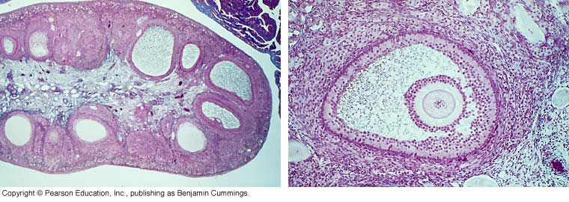
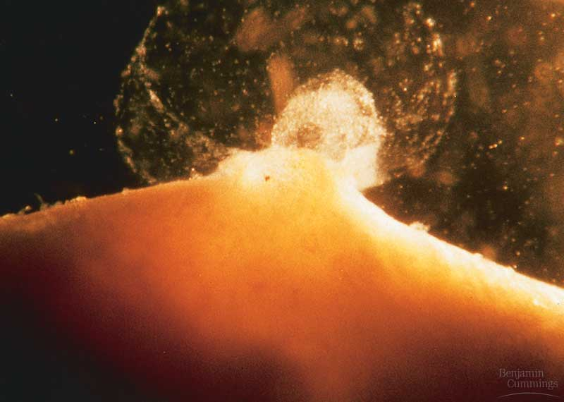
Follicles in ovary
Ovulation

Slide 11
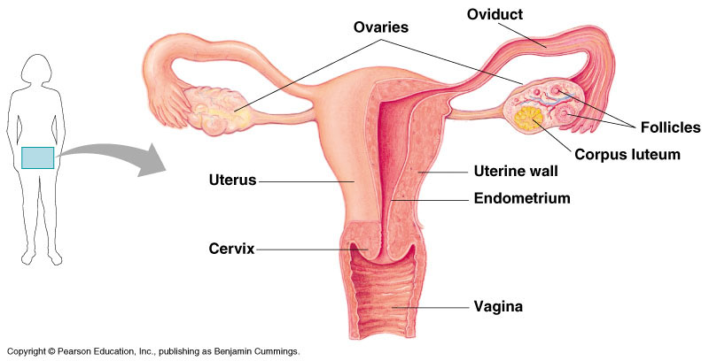
  Egg is taken up by
  Fertilization must occur in
  Egg finishes maturation ( ) with

Slide 12
  Oviducts empty directly into
  Uterus:
    About the size of a
    Lies in lower portion of abdomen behind bladder
    Muscular sac with
    Location where

Slide 13
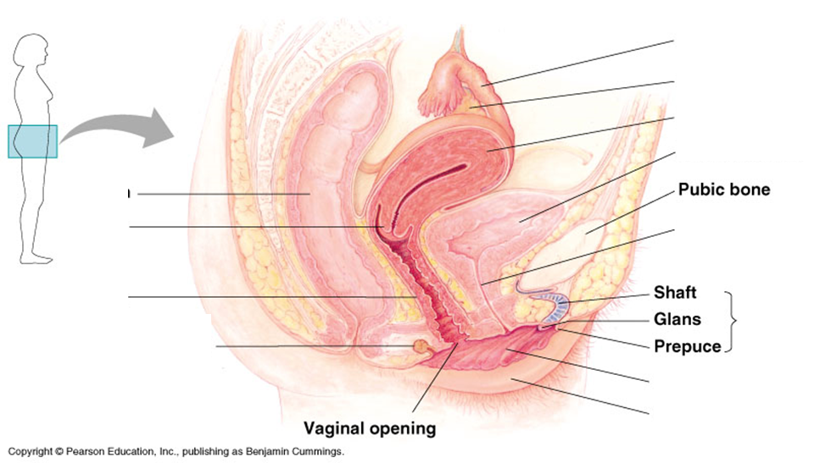
6.6.1 Draw and label diagram of the adult male and female reproductive systems.

Slide 14
6.6.2 Outline the role of hormones in the menstrual cycle, including FSH (follicle stimulating hormone), LH (luteinizing hormones), estrogen and progesterone.
Hormonal control of female reproductive system
  At puberty, . This starts .
  Estrogen (pubic and underarm hair, broadening of pelvis, development of breasts, distribution of fat, changes in voice)

Slide 15
6.6.2 Outline the role of hormones in the menstrual cycle, including FSH (follicle stimulating hormone), LH (luteinizing hormones), estrogen and progesterone.
Human Menstrual Cycle
  Averages every
  1st day of menstruation is day one of cycle
  Days 1-5: lining is sloughed off ( )

Slide 16
6.6.2 Outline the role of hormones in the menstrual cycle, including FSH (follicle stimulating hormone), LH (luteinizing hormones), estrogen and progesterone.
  Events during the 1st half of the cycle (approximately days 1-14):
    releases (only 1 will complete maturation); also
      Estrogen stimulates
      Estrogen stimulates the release of an abrupt surge of ; LH surge is followed by (around the middle of the cycle – about day 14)
      Estrogen

Slide 17
6.6.2 Outline the role of hormones in the menstrual cycle, including FSH (follicle stimulating hormone), LH (luteinizing hormones), estrogen and progesterone.
  Events during the 2nd half of the cycle (days 15-28)
    After ovulation, ; continues to release estrogen and also
      Progesterone promotes continued (also )
      If no fertilization occurs ,

Slide 18
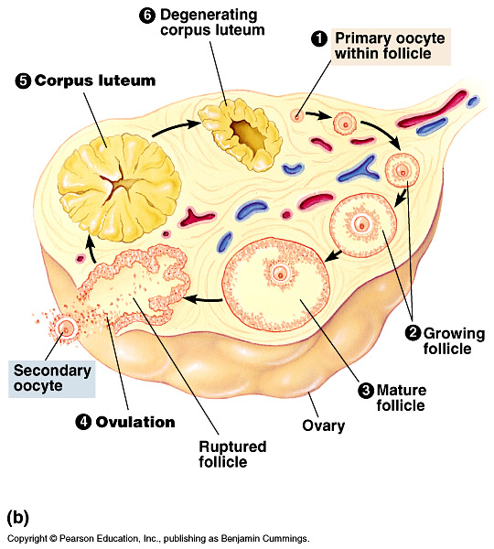

Slide 19
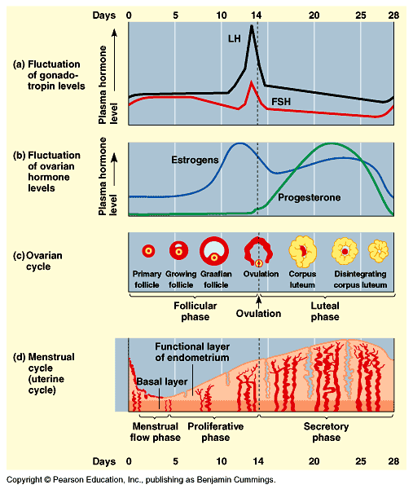
6.6.3 Annotate a graph showing hormone levels in the menstrual cycle, illustrating the relationship between changes in hormone levels and ovulation, menstruation and thickening of the endometrium.

Slide 20
Hormonal control of pregnancy
  Once fertilized, – membrane changes consistency
    Fertilized egg forms the
  occurs as

Slide 21
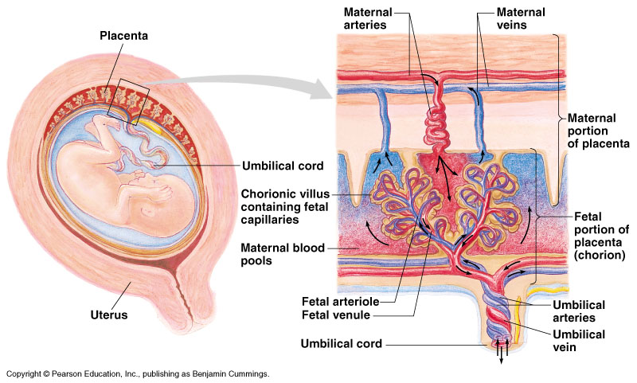
  After implantation – (formed from embryonic and uterine tissues; ; exchange occurs between circulatory systems)

Slide 22
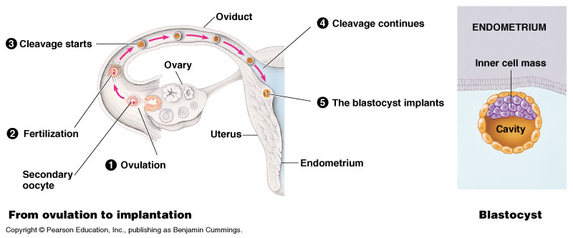
  Fertilized egg produces , which continues to produce to sustain pregnancy
  Eventually

Slide 23
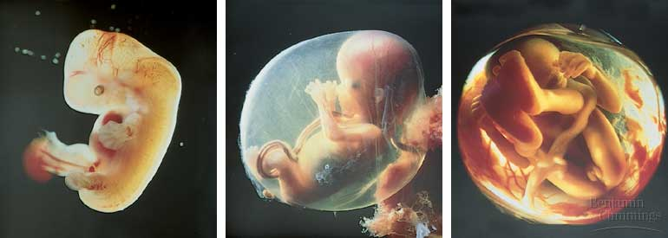
5 weeks
~1 cm long
14 weeks
~6 cm long
20 weeks
~30 cm at end of 24 weeks

Slide 24
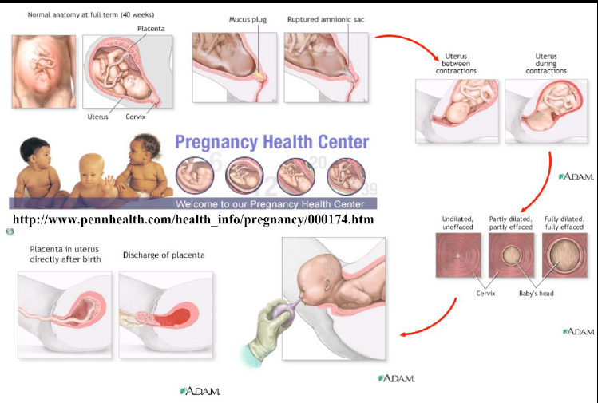

Slide 25
6.6.5 Outline the process of in vitro fertilization (IVF).
In vitro Fertilization (IVF)
  takes place in the
  Sometimes a couple may be – unable to conceive a baby
  involves fertilization of eggs in the laboratory in a test tube

Slide 27
6.6.6 Discuss the ethical issues associated with IVF.
Pro | Con
Allows infertile couples to have children | Infertility may be passed on to child
Allow individuals that survive cancer treatments to have children using gametes harvested prior to radiation or chemotherapy | Excess embryos are produced to ensure success, those not used must be destroyed
Allows screening for disease and selection of embryo | Often times the mother has multiple pregnancies which can be a risk to the mother’s health, premature birth and put baby at risk (ex. Cerebral palsy)
Individuals that have medical problems that result in the inability to have children would remain childless | Infertility isn’t always caused by health problems but may be that the couple waited too late in life
IVF children are much longed-for and will be more loved and cared for | There are many children in orphanages and foster homes that may benefit by adoption from these caring, childless couples

