Slide 1
Why is folk culture clustered?
Ch. 4 Key Issue 2
Isolation promotes cultural diversity
Influence of the physical environment

Slide 2
Isolation Promotes Cultural Diversity (p. 120)
- Himalayan Art

Slide 3
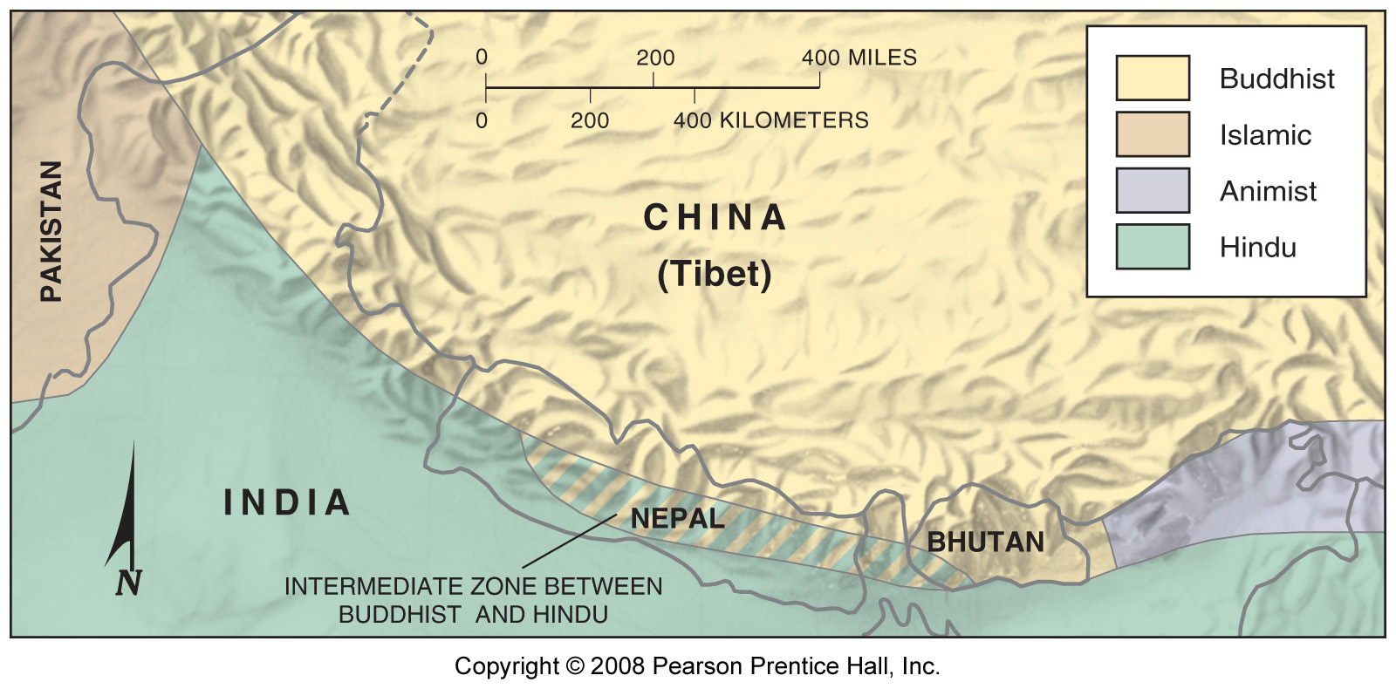
Notes:
Figure: 04-04
Title:
Cultural regions in the Himalaya Mountains.
Caption:
Cultural geographers P. Karan and Cotton Mather found four cultural areas in the rugged Himalayan region of Bhutan, Nepal, and northern India. Variations among the four groups were found in painting, dance, and other folk customs.

Slide 4
Influence of the Physical Environment (p. 120)

Slide 5
Influence of the Physical Environment (p. 121)
Distinctive Food Preferences
Environment:

Slide 6
Food Diversity in Transylvania (region in Romania):

Slide 7
Food Attractions and Taboos:

Slide 8
Folk Housing (p. 124)

Slide 9
Distinctive Building Materials:

Slide 10
Distinctive House Form and Orientation:

Slide 11
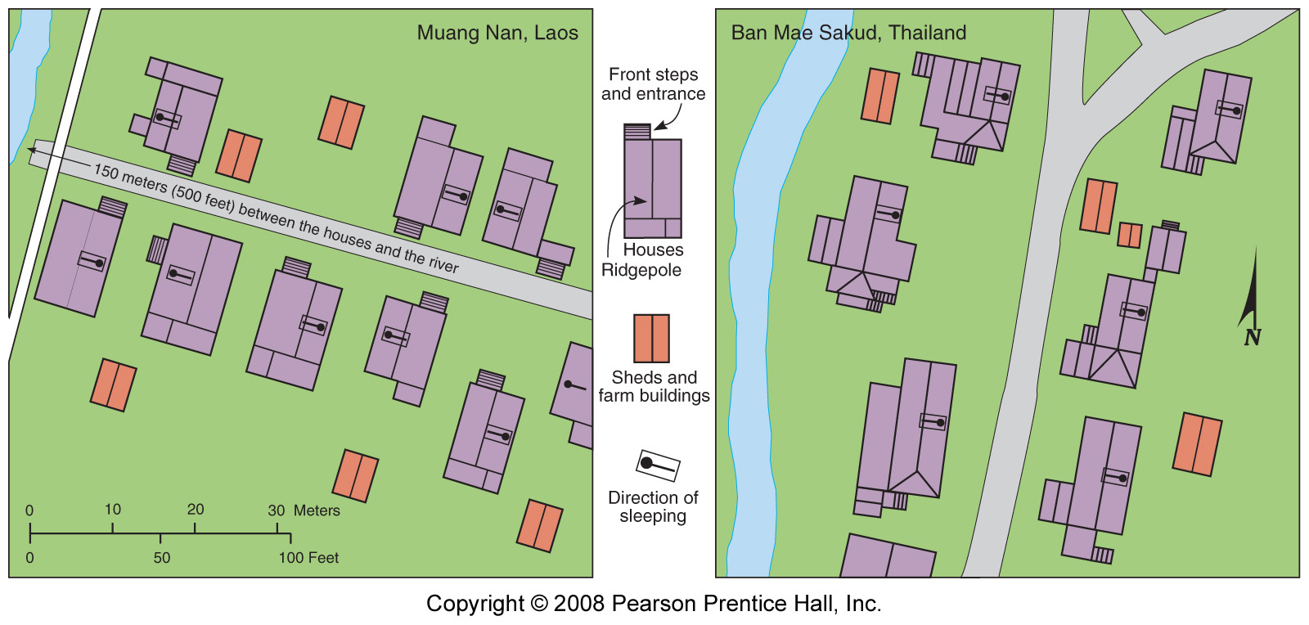
Notes:
Figure: 04-07
Title:
Houses of Lao people in northern Laos.
Caption:
The fronts of Lao houses, such as those in the village of Muang Nan, Laos, face one another across a path, and the backs face each other at the rear. Their ridgepoles (the centerline of the roof) are set perpendicular to the path but parallel to a stream if one is nearby. Inside adjacent houses, people sleep in the orientation shown, so neighbors are head-to-head or feet-to-feet. (right) Houses of Yuan and Shan peoples in northern Thailand. In the village of Ban Mae Sakud, Thailand, the houses are not set in a straight line because of a belief that evil spirits move in straight lines. Ridgepoles parallel the path, and the heads of all sleeping persons point eastward.

Slide 12
Housing and Environment:

Slide 13
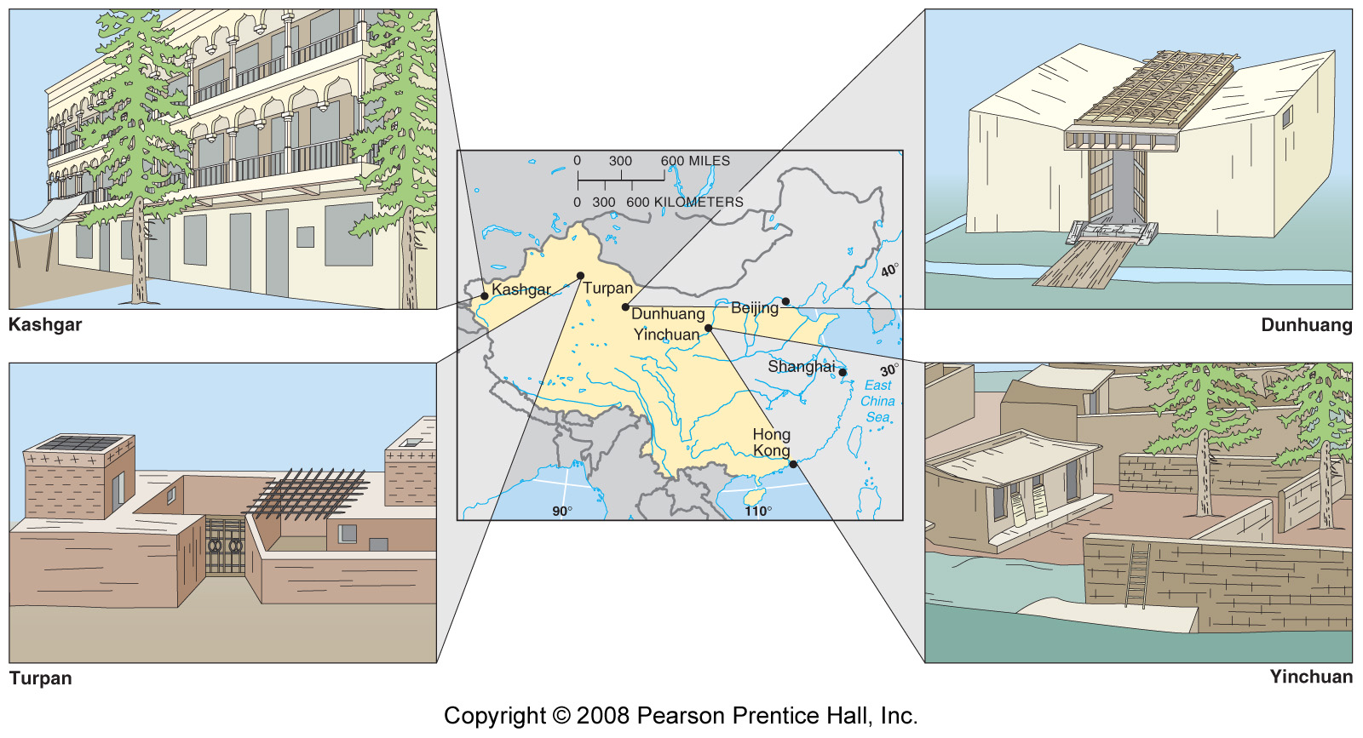
Notes:
Figure: 04-08
Title:
House types in four communities of western China.
Caption:
(upper left) Kashgar houses have second-floor open-air patios, where the residents can catch evening breezes. Poplar and fruit trees can be planted around the houses, because the village has a river that is constantly flowing rather than seasonal, as is the case in much of China's dry lands. These deciduous trees provide shade in the summer and openings for sunlight in the winter. (lower left) Turpan houses have small, open courtyards for social gatherings. Turpan is situated in a deep valley with relatively little open land, because much of the space is allocated to drying raisins. Second-story patios, which would use even less land, are avoided, because the village is subject to strong winds. (lower right) Yinchuan houses are built around large, open-air courtyards, which contain tall trees to provide shade. Most residents are Muslims, who regard courtyards as private spaces to be screened from outsiders. The adobe bricks are square or cubic rather than rectangular, as is the case in the other villages, though R. W. McColl found no reason for this distinctive custom. (upper right) Dunhuang houses are characterized by walled central courtyards, covered by an open-lattice grape arbor. The cover allows for the free movement of air but provides shade from the especially intense direct summer heat and light. Rather than the flat roofs characteristic of dry lands, houses in Dunhuang have sloped roofs, typical of wetter climates, so that rainfall can run off. The practice is apparently influenced by Dunhuang's relative proximity to the population centers of eastern China, where sloped roofs predominate.

Slide 14
U.S. Folk House Forms (p.125)

Slide 15
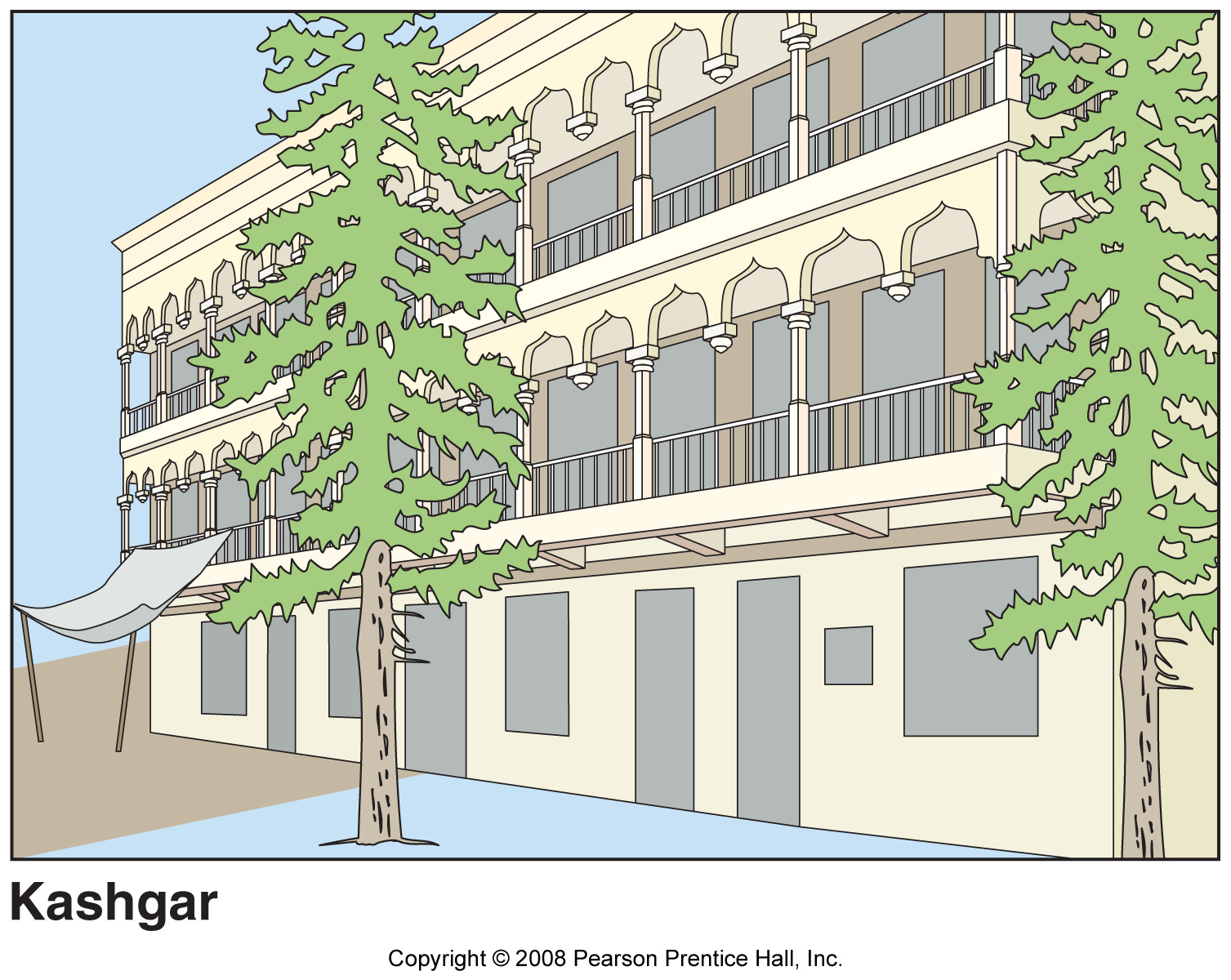
Notes:
Figure: 04-08lt
Title:
House types in four communities of western China.
Caption:
Left top: Kashgar houses have second-floor open-air patios, where the residents can catch evening breezes. Poplar and fruit trees can be planted around the houses, because the village has a river that is constantly flowing rather than seasonal, as is the case in much of China's dry lands. These deciduous trees provide shade in the summer and openings for sunlight in the winter.

Slide 16
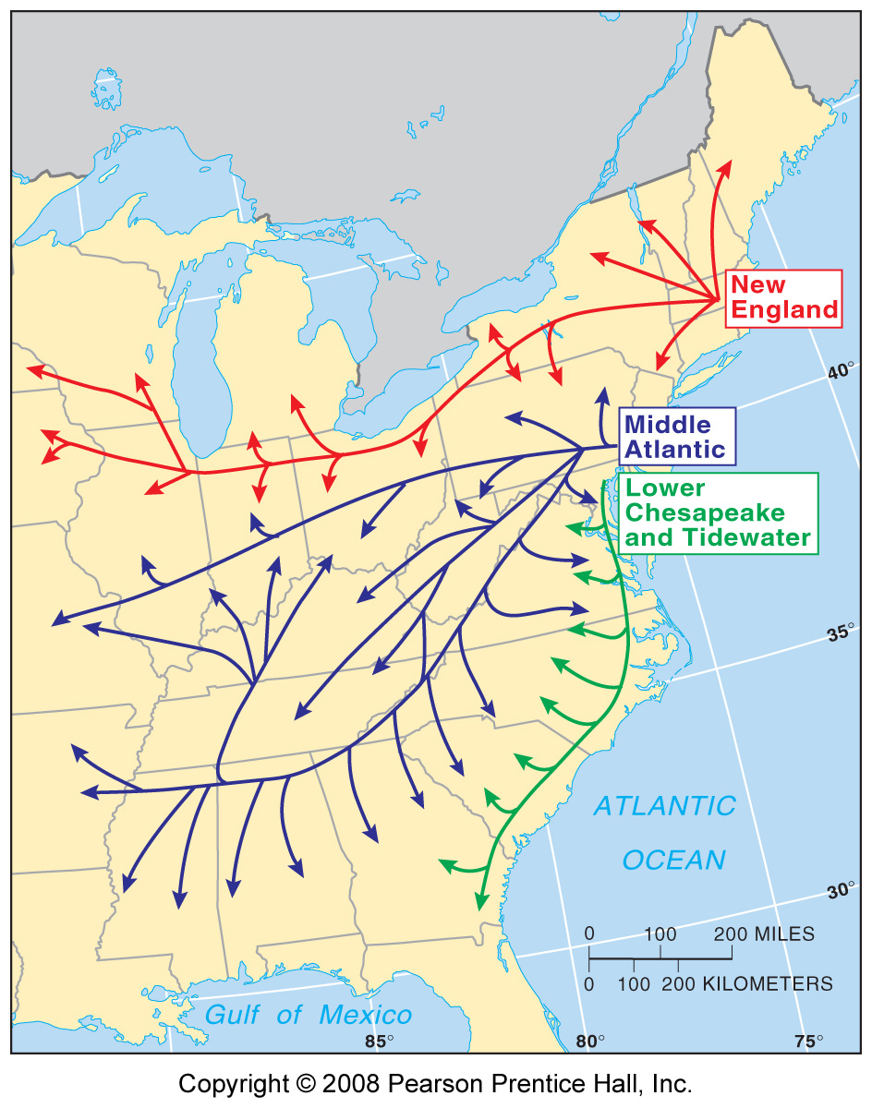
Notes:
Figure: 04-09
Title:
Source areas of U.S. house types.
Caption:
According to Fred Kniffen, house types in the United States originated in three main source areas and diffused westward along different paths. These paths coincided with predominant routes taken by migrants from the East Coast toward the interior of the country.

Slide 17
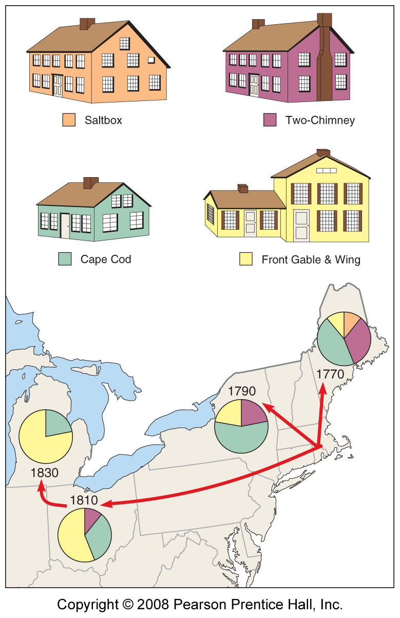
Notes:
Figure: 04-10
Title:
Diffusion of New England house types.
Caption:
Fred Kniffen suggests that these four major house types were popular in New England at various times during the eighteenth and early nineteenth centuries. As settlers migrated, they carried memories of familiar house types with them and built similar structures on the frontier. Thus New Englanders were most likely to build houses like the yellow one when they began to migrate to upstate New York in the 1790s, because that was the predominant house type they knew. During the 1800s, when New Englanders began to migrate farther westward to Ohio and Michigan, they built the type of house typical in New England at that time, shown here in yellow.

