Slide 1
Warm-up #10
Why was Zen Buddhism appealing to the samurai?
Why was writing and literature important to samurai?

Slide 2
Warm-up #10
  It stressed self-discipline and helped them overcome their fear of death.
  The times were more peaceful. Writing and literature helped focus the samurai’s mind.

Slide 3
Bushido Cornell Notes
Compare and contrast Bushido and Chivalry.

Slide 4
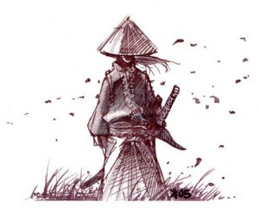
Bushido

Slide 5
Bushido
-The way of the warrior-
What is Bushido?
  It is a code of honor that all samurai lived by.
What did Bushido value?
Honor
Courage
Loyalty
Wisdom
Benevolence (kindness)
Honesty
Respect

Slide 6
Bushido
Bushido emphasized loyalty and honor above all others.
  Loyalty to the Lord was vital and all samurai would gladly die an honorable death for their Daimyo.
  Death was welcomed over dishonor.
Bushido allowed the feudal system to exist as long as it did.

Slide 7
Seppuku
What is Seppuku?
Ritual suicide as part of samurai bushido.
Reason for seppuku:
  Dying with honor-volunteering for death rather than fall into the hands of the enemy.
  Dying with dishonor-punishment for a serious crime or reasons that brought shame.
Seppuku a ritual death: wore all white, eat favorite meal, and people watched

Slide 8

Seppuku

Slide 9
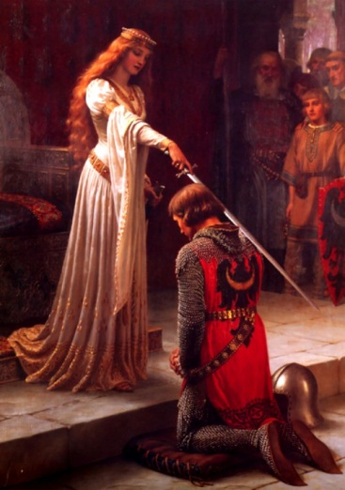
Chivalry

Slide 10
Chivalry
What is Chivalry?
The code of honor that European knights lived by.
What did Chivalry value?
Fear God and maintain his Church
Serve the liege lord in velour and faith
Protect the weak and defenseless
Live by honor and for glory
Fight for the welfare of all
Obey those placed in authority
Respect the honor of women

Slide 11

Code of Chivalry

Slide 12
Chivalry
Knights were expected to have great strength and skill in combat.
  They were also expected to temper their aggressive side with a gentlemanly side.
Knights would take vows or oaths that were sworn in during Knighthood ceremonies that would emphasize the values of Chivalry.
Codes of Chivalry were publicized in poems, ballads (songs), and literally works.
The Legends of King Arthur and the Knights of the Round Table further strengthened the idea of a Code of Chivalry.

Slide 13
Homework
Regular:
  Read chapter 8.3
  Chapter 8.3 Assessment page 217 #s 1a, 2a, 3a, 3b, and 4.
Advanced:
  Read 8.3
  Chapter 8.3 Assessment page 217 #s 1b, 2b, 3a, 3b, and 4.

Slide 14
