Slide 1
Warm-up #5
In what ways did Christians begin to challenge the church in the late Middle Ages?
What did Pope Gregory VII and Emperor Henry IV disagree over?
Bonus: Why do you think Gregory made Henry wait for three days before forgiving him?

Slide 2
Review Homework
We’re going to check the answers for you homework.
Be sure to correct anything you missed.
I will call on students randomly so be ready!

Slide 3
Reconquista Event Sort
Take 2 minutes to preview pages 283-285 of your book. Close your book.
Based on what you saw, put the following events in chronological order.
Match the events to the corresponding dates.
When we correct create your own timeline on page 12 of your notebook.

Slide 4
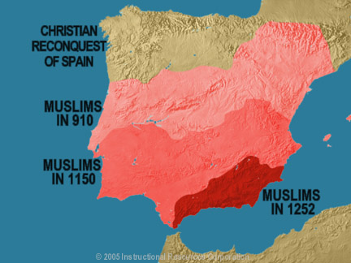

Slide 5
Effects of the Reconquista
It created “Fueros”, which were charters granted to Christian peasants to escape the feudal system by establishing settlements in areas abandoned by the Muslims. This was an attempt to repopulate Iberia with Christians, but would lay the foundations for the charters given to settlers in the Americas.
It was an inspiration for the Crusading culture that arose in Europe. Pope Urban II even called on Knights fighting on the Iberian peninsula to stay there, rather than joining the march to the Holy Lands, because their cause was just as important.
The culture of religious warfare also led to the expulsion of the Jews and Muslims living in the Iberian peninsula. This established Catholicism as the dominant religion in Iberia. Spanish Inquisition kills over 2,000 heretics.
It shaped the Spanish culture of Christianizing other cultures that would become important in the colonization of the Americas.
The Reconquista led directly into the voyage of Columbus. Ferdinand and Isabella sponsored Columbus’ voyage in part as a celebration of their victory over the Muslims in Granada, the last Muslim emirate in Iberia.

Slide 6
CFU The Reconquista Map
Use the map to select the best answer on the questions below.

Slide 7
Homework
Read Chapter 10.5
Chapter 10.5 Assessment #s 1b, 2a, 2b, 2c & 3.

