Slide 1



Slide 2
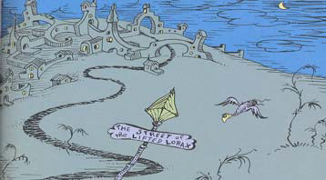
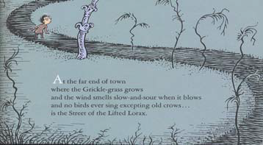
At the far end of town
where the Grickle-grass grows
and the wind smells slow-and-sour when it blows
and no birds ever sing excepting old crows...
is the Street of the Lifted Lorax.

Slide 3
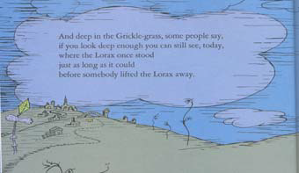
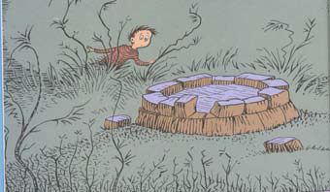
And deep in the Grickle-grass, some people say,
if you look deep enough you can still see, today,
where the Lorax once stood
just as long as it could
before somebody lifted the Lorax away.

Slide 4
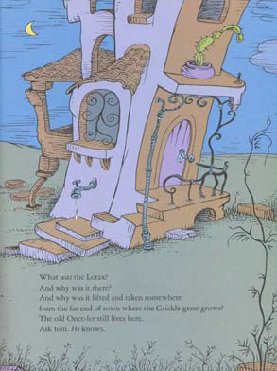
What was the Lorax?
And why was it there?
And why was it lifted and taken somewhere
from the far end of town where the Grickle-grass grows?
The old Once-ler still lives here.
Ask him. He knows.

Slide 5
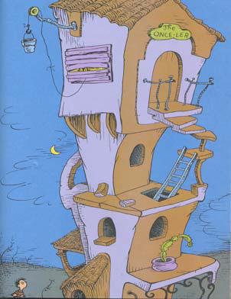
You won't see the Once-ler.
Don't knock on his door.
He stays in his Lerkim on top of
his store.
He lurks in his Lerkim, cold
under the roof,
where he makes his own clothes
out of miff-muffered moof.
And on special dank midnights in
August,
he peeks out of the shutters
and sometimes he speaks
and tells how the Lorax was lifted
away.

Slide 6
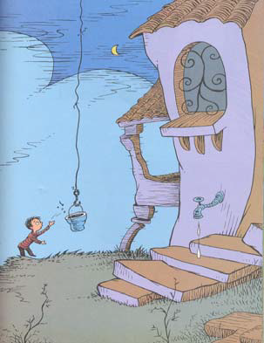
He'll tell you, perhaps…
If you're willing to pay.
On the end of a rope
he lets down a tin pail
and you have to toss in fifteen
cents
and a nail
and the shell of a great-greatgreatgrandfather
snail.

Slide 7
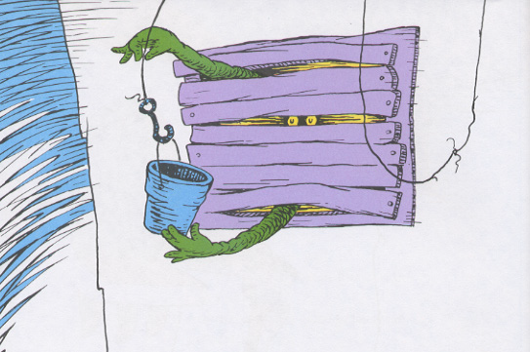
Then he pulls up the pail,
makes a most careful count
to see if you've paid him
the proper amount.

Slide 8
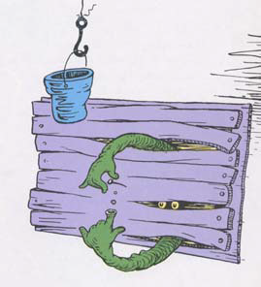
The he hides what you paid him
away in his Snuvv,
his secret strange hole
in his gruvvulous glove.

Slide 9
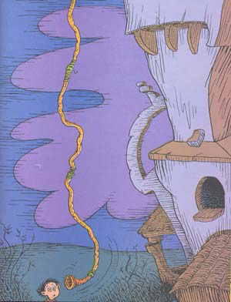
Then he grunts, "I will call you
by Whisper-ma-Phone,
for the secrets I tell are for your
ears alone."
SLUPP!
Down slupps the Whisper-ma-
Phone to your ear
and the old Once-ler's whispers
are not very clear,
since they have to come down
through a snergelly hose,
and he sounds
as if he had
smallish bees up his nose.
"Now I'll tell you," he says, with
his teeth sounding gray,
"how the Lorax got lifted and
taken away…

Slide 10
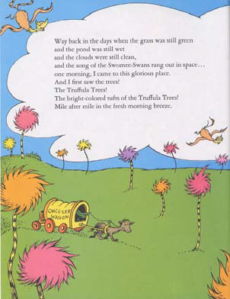

Way back in the days when the grass was still green
and the pond was still wet
and the clouds were still clean,
and the song of the Swomee-Swans rang out in space...
one morning, I came to this glorious place.
And I first saw the trees!
The Truffula Trees!
The bright-colored tufts of the Truffula Trees!
Mile after mile in the fresh morning breeze.

Slide 11
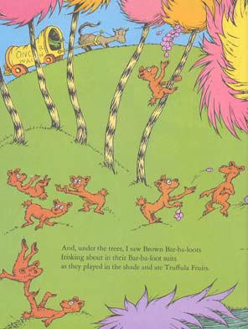
And, under the trees, I saw Brown Bar-ba-loots
frisking about in their Bar-ba-loot suits
as they played in the shade and ate Truffula fruits.

Slide 12
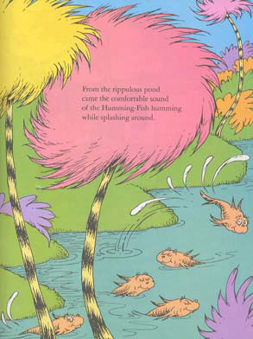
From the rippulous pond
came the comfortable sound
of the Humming-Fish humming
while splashing around.

Slide 13
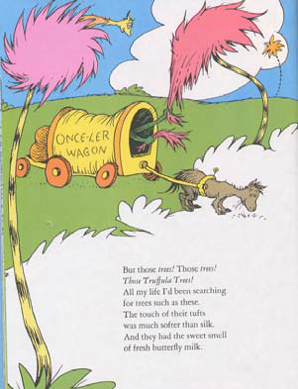
But those trees! Those trees!
Those Truffula Trees!
All my life I'd been searching
for trees such as these.
The touch of their tufts
was much softer than silk.
And they had the sweet smell
of fresh butterfly milk.

Slide 14
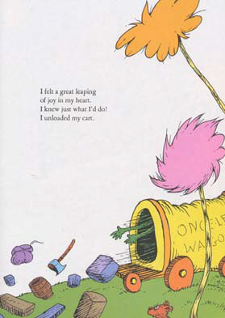
I felt a great leaping
of joy in my heart.
I knew just what I'd do!
I unloaded my cart.

Slide 15
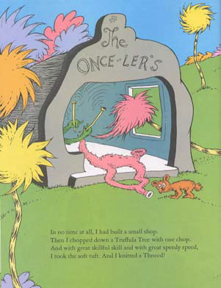
In no time at all, I had built a small shop.
Then I chopped down a Truffula Tree with one chop.
And with great skillful skill and with great speedy speed,
I took the soft tuft, and I knitted a Thneed!

Slide 16
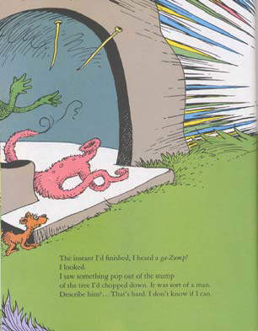
The instant I'd finished, I heard a ga-Zump!
I looked.
I saw something pop out of the stump
of the tree I'd chopped down. It was sort of a man.
Describe him?... That's hard. I don't know if I can.

Slide 17
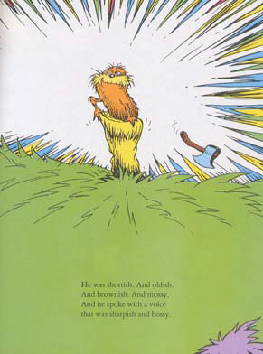
He was shortish. And oldish.
And brownish. And mossy.
And he spoke with a voice
that was sharpish and bossy.

Slide 18
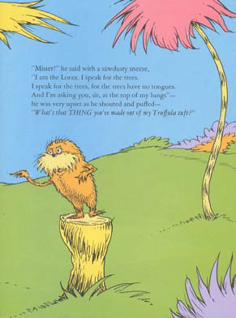
"Mister!" he said with a sawdusty sneeze,
"I am the Lorax. I speak for the trees.
I speak for the trees, for the trees have no tongues.
And I'm asking you, sir, at the top if my lungs"-
he was very upset as he shouted and puffed-
"What's that THING you've made out of my Truffula tuft?”

Slide 19
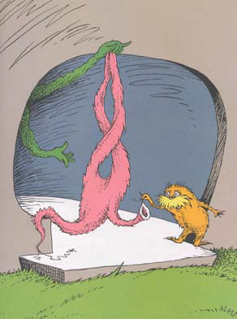
"Look Lorax," I said. "There's no
cause for alarm.
I chopped just one tree. I am doing
no harm.
I'm being quite useful. This thing
is a Thneed.
A Theend's a Fine-Something-
That-All-People-Need!
It's a shirt. It's a sock. It's a glove.
It's a hat.
But it has other uses. Yes, far
beyond that.
You can use it for carpets. For
pillows! For sheets!
Or curtains! Or covers for bicycle
seats!"

Slide 20
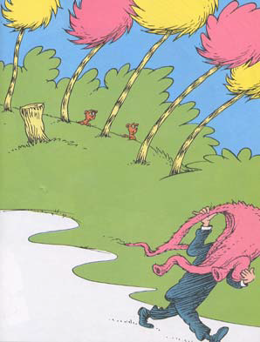
The Lorax said,
"Sir! You are crazy with greed.
There is no one on earth
who would buy that fool Thneed.
But the very next minute I proved
he was wrong.
For, just at that minute, a chap
came along,
and he thought that the Thneed I
had knitted was great.
He happily bought it for three
ninety-eight.

Slide 21
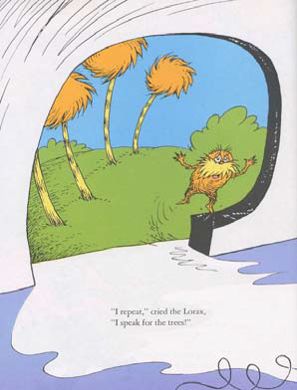
I laughed at the Lorax,
"You poor stupid guy!
You never can tell what
some people will buy."
"I repeat," cried the Lorax,
"I speak for the trees!"
"I'm busy," I told him.
"Shut up, if you please."

Slide 22
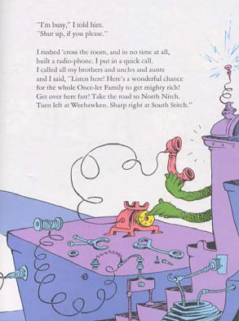
I rushed 'cross the room, and in no time at all,
built a radio-phone. I put in a quick call.
I called all my brothers and uncles and aunts
and I said, "Listen here! Here's a wonderful chance
for the whole Once-ler Family to get mighty rich!
Get over here fast! Take the road to North Nitch.
Turn left at Weehawken. Sharp right at South Stitch.”

Slide 23
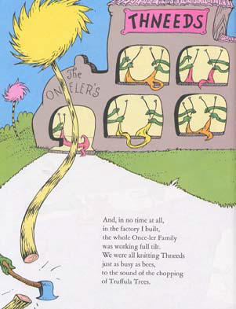
And, in no time at all,
in the factory I built,
the whole Once-ler Family
was working full tilt.
We were all knitting Thneeds
just as busy as bees,
to the sound of the chopping
of Truffula Trees.

Slide 24
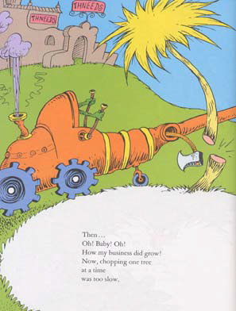
Then...
Oh! Baby! Oh!
How my business did grow!
Now, chopping one tree
at a time
was too slow.

Slide 25
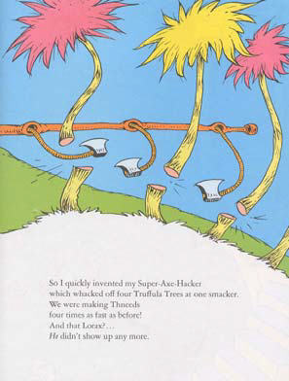
So I quickly invented my Super-Axe-Hacker
which whacked off four Truffula Trees at one smacker.
We were making Thneeds
four times as fast as before!
And that Lorax?...
He didn't show up any more.

Slide 26
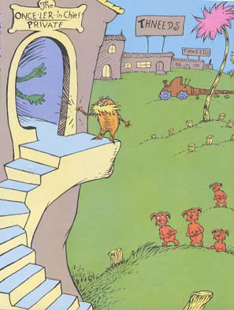
But the next week
he knocked
on my new office door.
He snapped, "I'm the Lorax who
speaks for the trees
which you seem to be chopping as
fast as you please.
But I'm also in charge of the
Brown Bar-ba-loots
who played in the shade in their
Bar-ba-loot suits
and happily lived, eating Truffula
Fruits.
"NOW…thanks to your hacking
my trees to the ground,
there's not enough Truffula Fruit
to go 'round.
And my poor Bar-ba-loots are all
getting the crummies
because they have gas, and no
food, in their tummies!

Slide 27
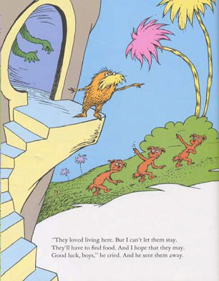
"They loved living here. But I can't let them stay.
They'll have to find food. And I hope that they may.
Good luck, boys," he cried. And he sent them away.

Slide 28
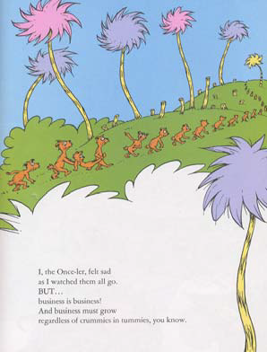
I, the old Once-ler, felt sad
as I watched them all go.
BUT...
business is business!
And business must grow
regardless of crummies in tummies, you know.

Slide 29
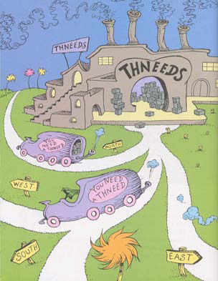
I meant no harm. I most truly
did not.
But I had to grow bigger. So
bigger I got.
I biggered my factory. I biggered
my roads.
I biggered my wagons. I biggered
the loads
of Thneeds I shipped out. I was
shipping them forth
to the South! To the East! To the
West! To the North!
I went right on
biggering…selling more
Thneeds.
And I biggered my money, which
everyone needs.

Slide 30
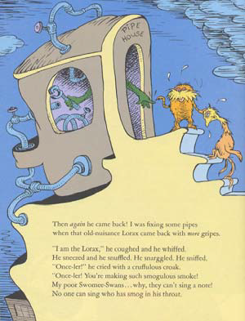
Then again he came back! I was fixing some pipes
when that old-nuisance Lorax came back with more gripes.
"I am the Lorax," he coughed and he whiffed.
He sneezed and he snuffled. He snarggled. He sniffed.
"Once-ler!" he cried with a cruffulous croak.
"Once-ler! You're making such smogulous smoke!
My poor Swomee-Swans... why, they can't sing a note!
No one can sing who has smog in his throat.

Slide 31
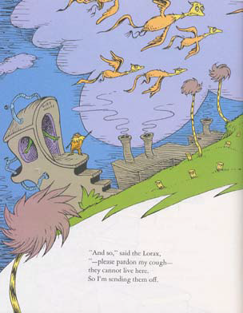
"And so," said the Lorax,
"-please pardon my cough-
they cannot live here.
So I'm sending them off.

Slide 32
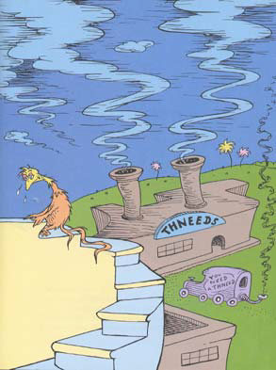
"Where will they go?…
I don’t hopefully know.
They may have to fly for a
month…or a year…
To escape from the smog
you've smogged-up around
here.

Slide 33
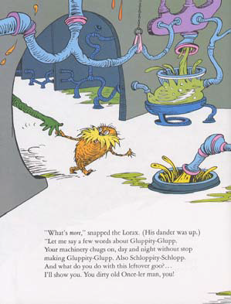
"What's more," snapped the Lorax. (His dander was up.)
"Let me say a few words about Gluppity-Glupp.
Your machine chugs on, day and night without stop
making Gluppity-Glupp. Also Schloppity-Schlopp.
And what do you do with this leftover goo?...
I'll show you. You dirty old Once-ler man, you!

Slide 34
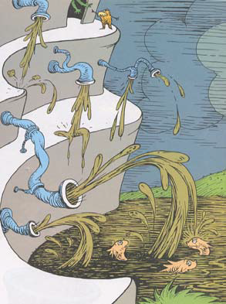
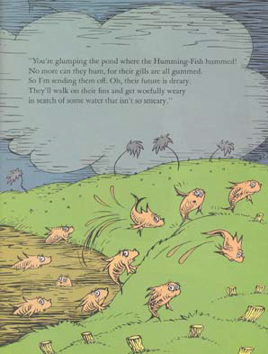
"You're glumping the pond where the Humming-Fish hummed!
No more can they hum, for their gills are all gummed.
So I'm sending them off. Oh, their future is dreary.
They'll walk on their fins and get woefully weary
in search of some water that isn't so smeary.”

Slide 35
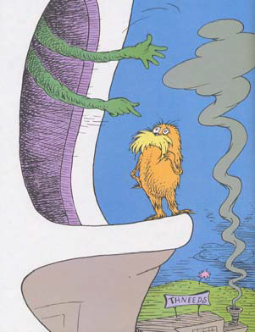
And then I got mad.
I got terribly mad.
I yelled at the Lorax, "Now listen
here, Dad!
All you do is yap-yap and day,
'Bad! Bad! Bad! Bad!'
Well I have my rights, sir, and
I'm telling you
I intend to go on doing just what
I do!
And, for your information, you
Lorax, I'm figgering
on biggering
and Biggering
and BIGGERING
and BIGGERING,
turning MORE Truffula Trees
into Thneeds
which everyone, EVERYONE,
EVERYONE needs!"

Slide 36
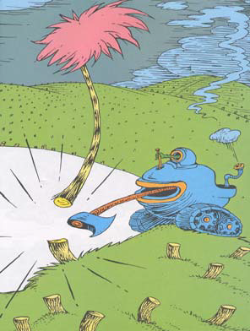
And at that very moment,
we heard a loud whack!
From outside in the fields
came a sickening smack
of an axe on a tree. Then we
heard the tree fall.
The very last Truffula Tree of
them all!

Slide 37
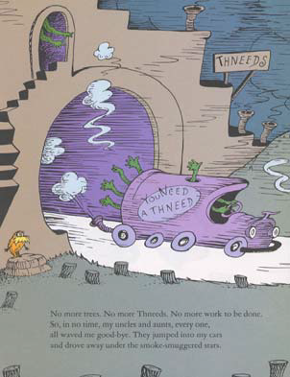
No more trees. No more Thneeds. No more work to be done.
So, in no time, my uncles and aunts, every one,
all waved me good-bye. They jumped into my cars
and drove away under the smoke-smuggered stars.
Now all that was left 'neath the bad smelling-sky
was my big empty factory...
the Lorax...and I.

Slide 38
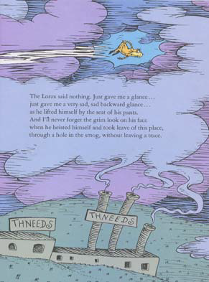
The Lorax said nothing. Just gave me a glance...
just gave me a very sad, sad backward glance...
as he lifted himself by the seat of his pants.
And I'll never forget the grim look on his face
when he heisted himself and took leave of this place,
through a hole in the smog, without leaving a trace.

Slide 39
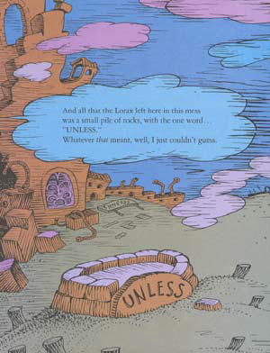
And all that the Lorax left here in this mess
was a small pile of rocks, with one word...
"UNLESS."
Whatever that meant, well, I just couldn't guess.

Slide 40
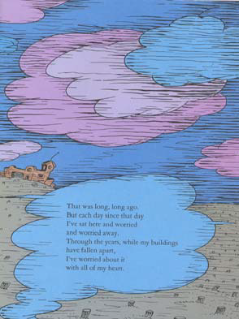
That was long, long ago.
But each day since that day
I've sat here and worried
and worried away.
Through the years, while my buildings
have fallen apart,
I've worried about it
with all of my heart.

Slide 41
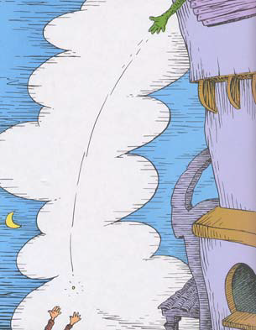
"SO…
Catch!" calls the Once-ler.
He lets something fall.
"It's a Truffula Seed.
It's the last one of all!
You're in charge of the last of
the Truffula Seeds.
And Truffula Trees are what
everyone needs.
Plant a new Truffula. Treat it
with care.
Give it clean water. And feed it
fresh air.
Grow a forest. Protect it from
axes that hack.
Then the Lorax
and all of his friends
may come back."

Slide 42
THE END

