Slide 1


Leaves Don’t fall too far from the stem
Stem-and-leaf display

Slide 2
What is it?
A stem-and-leaf plot where each data value is split into a "leaf" (usually the last digit) and a "stem" (the other digits). For example "32" would be split into "3" (stem) and "2" (leaf).
The "stem" values are listed down, and the "leaf" values go right (or left) from the stem values.
The "stem" is used to group the scores and each "leaf" indicates the individual scores within each group.

Slide 3
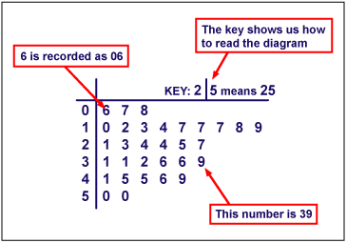
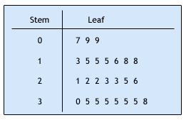
What does it look like?

Slide 4
How is it useful?
Stem-and-leaf displays are not a permanent organization. You can use the display to retrieve the specific data values if needed. For that reason, stem-and-leaf displays are often preferred over other methods of data organization.

Slide 5
How do you make it?
1. Divide digits into two parts. The left digit is called the stem, and the right digit is called the leaf.
2.Once you have established your stems, write them in a vertical column, then draw a vertical line to right of your column.

Slide 6
What’s next?
3. Write all of the leaves with the same stem in a row next to the stem, in numerical order.
Create a key above your display to indicate the magnitude of the numbers in the display.

Slide 7
What are they used for?
They are usually used when there are large amounts of numbers to analyze. Series of scores on sports teams, series of temperatures or rainfall over a period of time and series of classroom test scores are examples of when Stem and Leaf Plots could be used.

Slide 8
References
Allaboutmath.com
picasaweb.google.com
icoachmath.com/mathdictionary
Brase Understandable Statistics Concepts and Methods

