Slide 1
Parasites: -Schistosoma -Lung Fluke

Slide 2
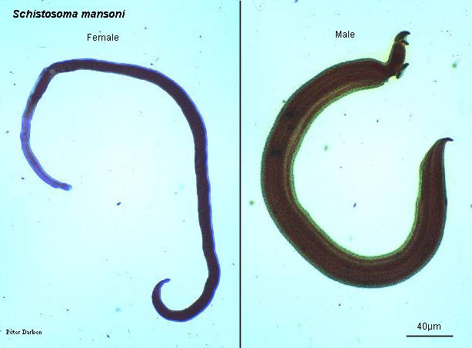
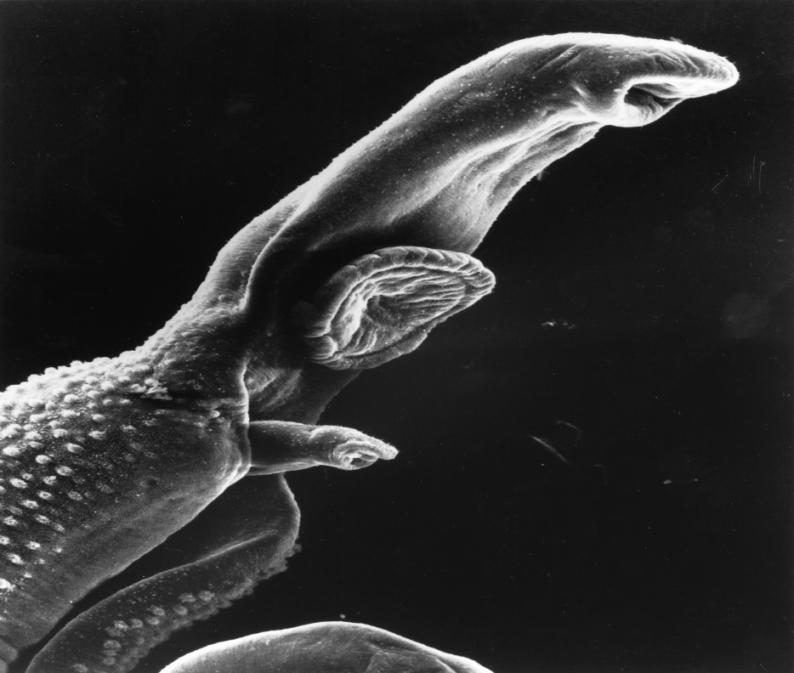
Schistosoma
There are 3 species of Schistosoma that are important to humans
S. mansoni
S. japonicum
S. haematobium
Adult worms live in the circulatory system and the eggs are found in the feces.
Different from other flukes because there are male and females.
Snail is the intermediate host

Slide 3
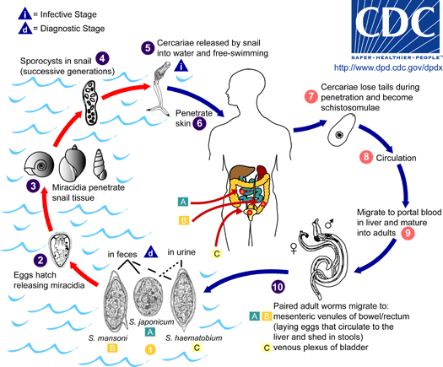
Life Cycle
Eggs passed in feces
Miracidia hatch and find way to a snail species
Cercaria enter unbroken skin and migrate to veins near liver.

Slide 4
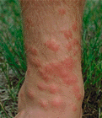
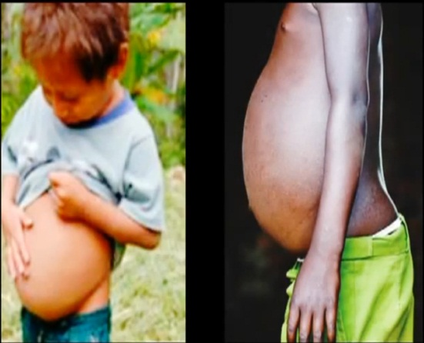
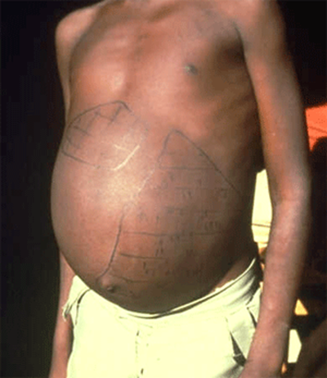
Symptoms
Localized bleeding and heals within days at point of cercariae penetration. (Swimmers itch)
Symptoms not necessarily caused by worm but by the body’s reaction to the eggs.
Stage 1: (1-3 months)
Fever, abdominal pain, general feeling of sickness, liver tenderness. Katayama fever
Stage 2:
Severe liver damage and becomes enlarged as well as the spleen
Does lead to death in some cases

Slide 5
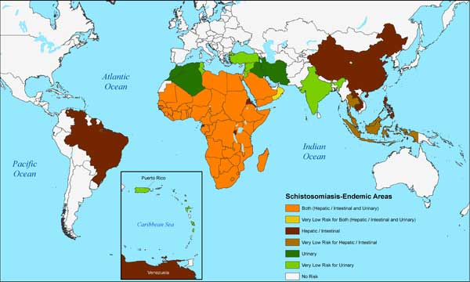
Epidemiology
Most commonly associated with regions that have poor sanitation. Younger school aged children most at risk.

Slide 6
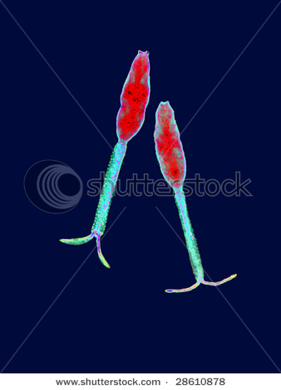

Treatment / Prevention
Prevention:
Avoid swimming in freshwater in countries known to have parasite.
Drink Safe Water
Safe bathing
Create better sanitary conditions
Using chemicals to kill snails
Treatment:
Praziquantel for infections
Vasnil to treat S. mansoni, also cheaper
Most commonly used when infection is on a large scale.

Slide 7
Review Questions
What is the intermediate host for Schistosoma?
What is the best way to prevent Schistosoma?
What is swimmer itch and how is it caused?

Slide 8
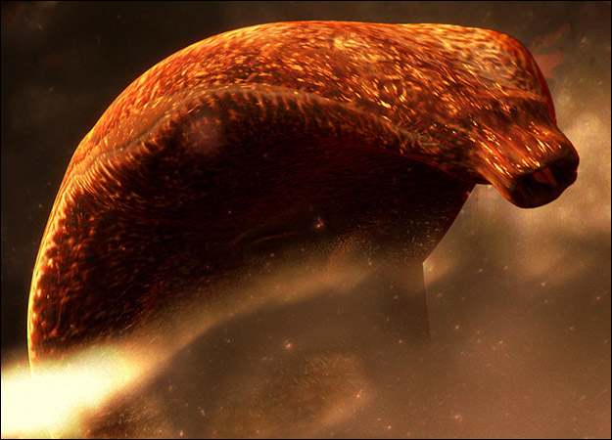
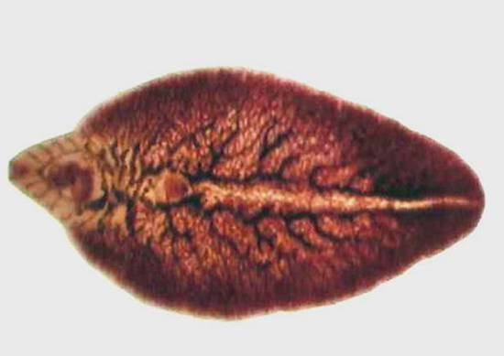
Lung Fluke
Humans many times are accidental host of these parasites
Primary host of wild cats such as tigers, lions, leopards other animals like foxes and wolves as well.
Main lung fluke to infect humans : Paragonimus

Slide 9
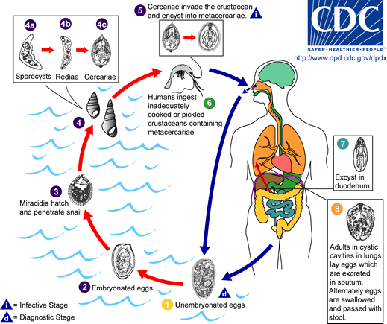
Life Cycle
Miracidia find shelled snail and mature
Cercariae invade a crustaceans: crabs, lobster, shrimp
Get infected by ingesting improperly cooked crustaceans

Slide 10

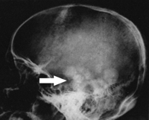
Symptoms
After ingestion they migrate to lungs where they reproduce in the lungs. No symptoms with migration
Cough up the eggs and swallow them and then eggs are deposited in our feces.
Symptoms similar to a bad cough or bronchitis
Because humans are not a suitable host, parasite may enter other parts of the body such as the brain, spinal cord and abdominal cavity.
Headache, fever, vomiting and some visual disturbance
Leads to, in severe cases, convulsive seizures

Slide 11
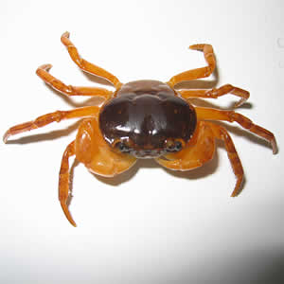
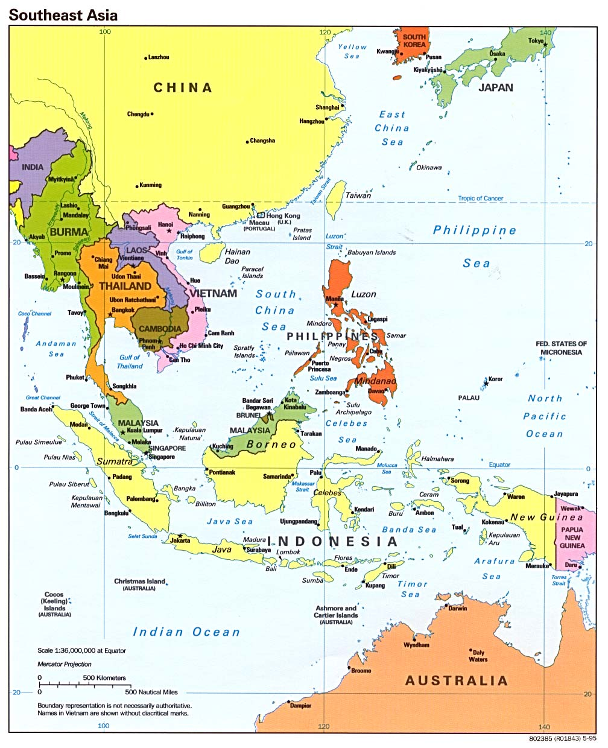
Epidemiology
Most common occurrences in China, the Philippines, Japan, Vietnam, South Korea, Taiwan and Thailand.

Slide 12
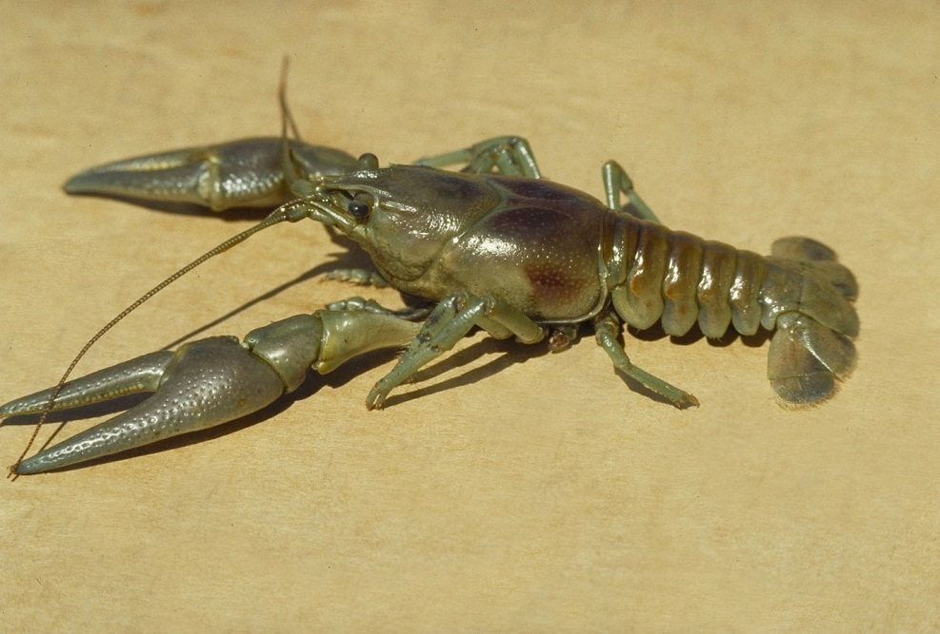
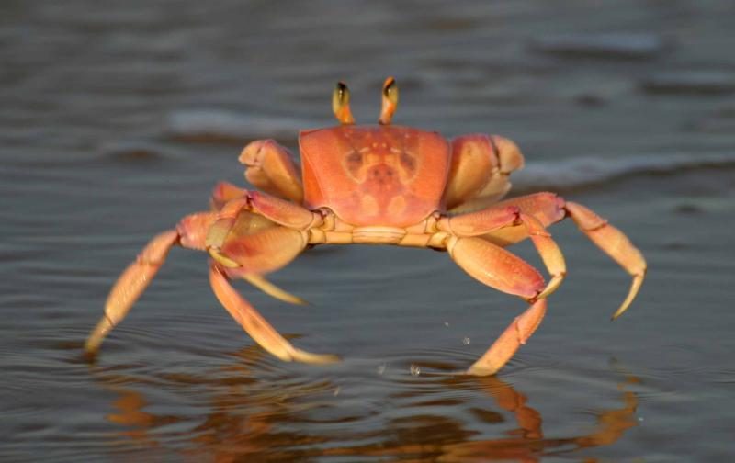
Treatment/Prevention
Prevention:
Cooking crayfish, crabs, lobster and other crustaceans
Treatment:
Praziquantel taken 3 times daily for 2 days.
If daily doses are changed the drug was seen to be ineffective

Slide 13
Group Response
In your table group talk and come up with some common themes that have been seen in our investigation of all the parasites covered up to this point.
Look at:
Life Cycles
Hosts
Prevention/Treatment
Talk about 1 parasite you think has the biggest repercussions for a community stricken with it.
Take about 5 minutes to discuss and then we will discuss as a class. Each group will share

