Slide 1
Ch. 5 Key Issue 4
Why do people preserve local languages?
  Preserving language diversity
  Global dominance of English

Slide 2
Distribution of a language is a measure of the fate of an ethnic group.
  Example: English from a small northwestern island diffused because of cultural dominance from England and the U.S.
  VS. Icelandic remaining as a little-used language due to the isolation of Icelandic people.
Language displays 2 competing geographic trends of 1) globalization 2) local diversity

Slide 3
Preserving Language Diversity
Extinct languages: no longer spoken or read in daily activities by anyone in the world.
Example: Gothic was spoken in Eastern and Northern Europe in 200 AD. The language and language group are both extinct. Language died because Gothics were converted to other languages due to political dominance and cultural preferences.
  Ethnologue considers 516 languages as nearly extinct.
    46 in Africa
    170 in the Americas
    78 in Asia
    12 in Europe
    210 in the Pacific

Slide 4
Hebrew: Reviving an extinct language
Hebrew is a rare case of an extinct language being revived.
In biblical times, Hebrew was the language of daily activity. By Jesus’ time, Hebrew was replaced with Aramaic, then later Arabic.
Reviving Hebrew meant words had to be created for thousands of objects and inventions previously unknown in biblical times (phones, cars, etc.)

Slide 5
Celtic: Preserving an endangered language
Celtic: major language before Germanic tribes invaded the British Isles.
Celtic survives only in remote parts of Scotland, Wales, Ireland, and Brittany, France.
2 branches of Celtic: Gaelic and Brythonic
Celtic languages declined because the Celts lost most territory to speakers of other languages.
1300s- Irish were forbidden to speak Gaelic and children were punished for any Irish words spoken in school. Parents encouraged their children to learn English to aspire for better careers than their own.
Recent efforts to revive Celtic: road signs in English and Celtic, TV stations offering the language, learning the language in school, preserving local identities.

Slide 6
Multilingual Countries
Belgium: has had more difficulty reconciling differences in languages.
  Southern Belgians speak French
  Northern Belgians speak Flemish (dialect of Dutch)
  Economic and political differences between the languages= tried to divide the country into 2 different regions.
  Difficulty drawing boundaries between the 2 regions of languages.
Switzerland: peacefully exists with multiple languages.
  Decentralized government: local authorities in regions hold most of the power and decisions are made by voters.
  4 official languages
    German (65% of people)
    French (18%)
    Italian (10%)
    Romansh (1%)

Slide 7
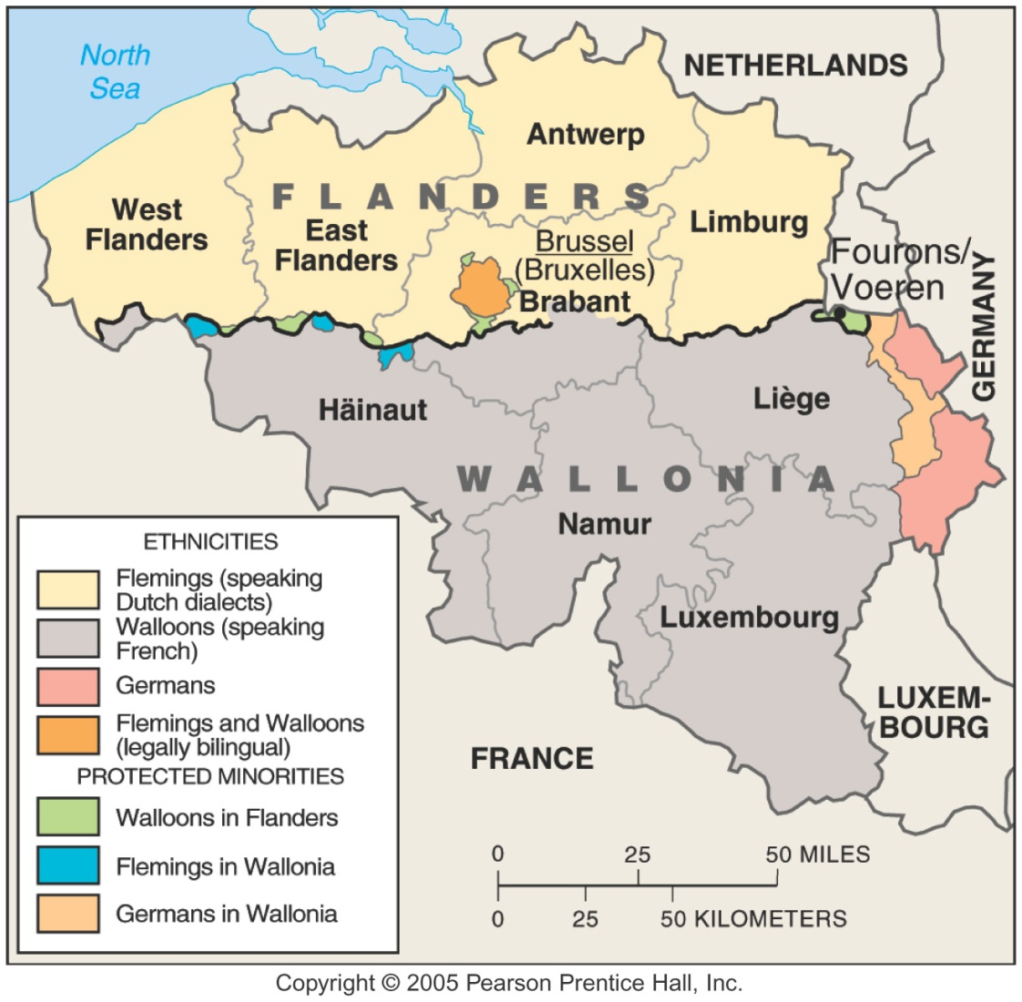
Language Divisions in Belgium
Fig. 5-16: There has been much tension in Belgium between Flemings, who live in the north and speak Flemish, a Dutch dialect, and Walloons, who live in the south and speak French.

Slide 8
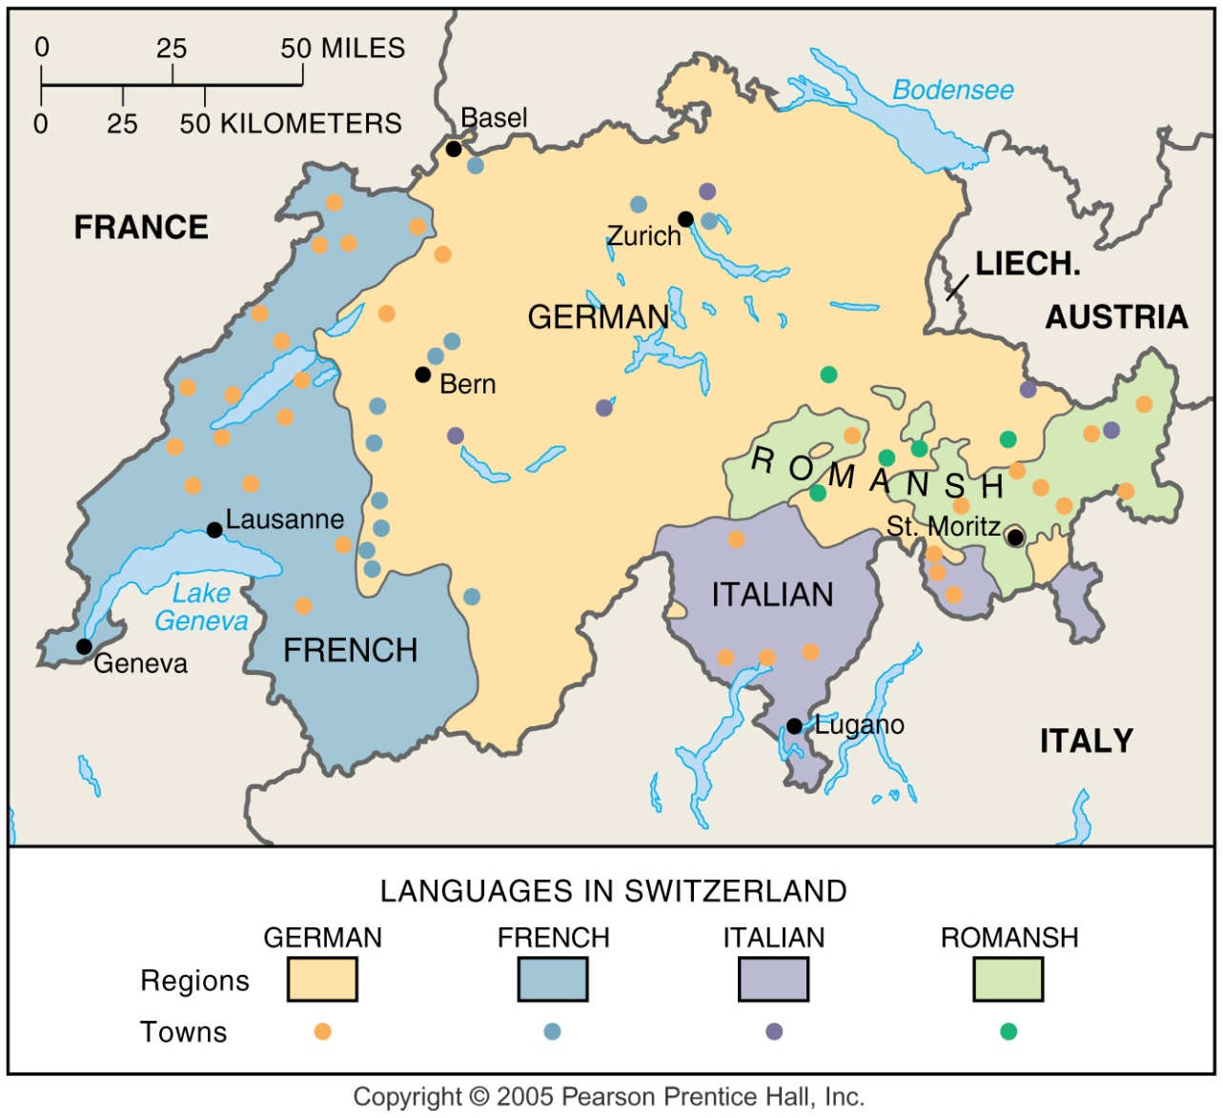
Language Areas in Switzerland
Fig. 5-17: Switzerland remains peaceful with four official languages and a decentralized government structure.

Slide 9
Isolated Languages
Isolated language: language unrelated to any other and is not attached to a language family.
    Arise through lack of interaction with speakers of other languages.
Icelandic: over the past thousand years, it has barely changed compared to other Germanic languages.
Example: Basque, a Pre-indo-European survivor
  Only language currently spoken in Europe that survives from the period before Indo-European speakers.
  600,00 people in the Pyrenees Mountains of Northern Spain and southwestern France= lack of connection to other languages due to mountain isolation has helped preserve their language.
Ancestors migrated to Iceland with Germanic language.
When an ethnic group migrates- takes the home languages with them but in Iceland, the migrants had little outside contact with the home countries so their language didn’t change, learn new words and had no reason for changing.

Slide 10
English- an example of lingua franca
Lingua franca: a language of international communication. Speakers of 2 different languages can create a lingua franca by mixing elements of the 2 languages into a simple common language.
Example: Polish airline pilot flies over France and speaks to the air traffic controller in English.
Pidgin language: to communicate with speakers of another language, 2 groups construct a pidgin language by learning a few of the grammar rules and words of a lingua franca, while mixing in some elements of their own languages.
  Examples: Swahili in East Africa, Hindustani in South Asia, Indonesian in Southeast Asia, Russian in the former Soviet Union.

Slide 11
Expansion diffusion
  Current growth in the use of English is an example of expansion diffusion- spread of a trait through the snowballing effect of an idea rather than through the relocation of people.
  English has changed through diffusion of new vocabulary, spelling and pronunciation.
  English words are fusing with other languages.
For a language to continue- new words and usage must always be created to deal with new situations.
  Example: Ebonics: a combination of ebony and phonics, distinctive dialect of African Americans. Controversial- some see Ebonics as a measure of poor education, and an obstacle to success. Others see it as preserving African American culture.

Slide 12
Franglais
French are especially upset with the increasing worldwide dominance of English and the usage in France. Example: cowboy, hamburger, jeans, t-shirt…
Franglais: combination of francais and anglais (French and English)
Protection of French is even more extreme in Quebec, which is completely surrounded by English-speaking provinces and U.S. states.

Slide 13
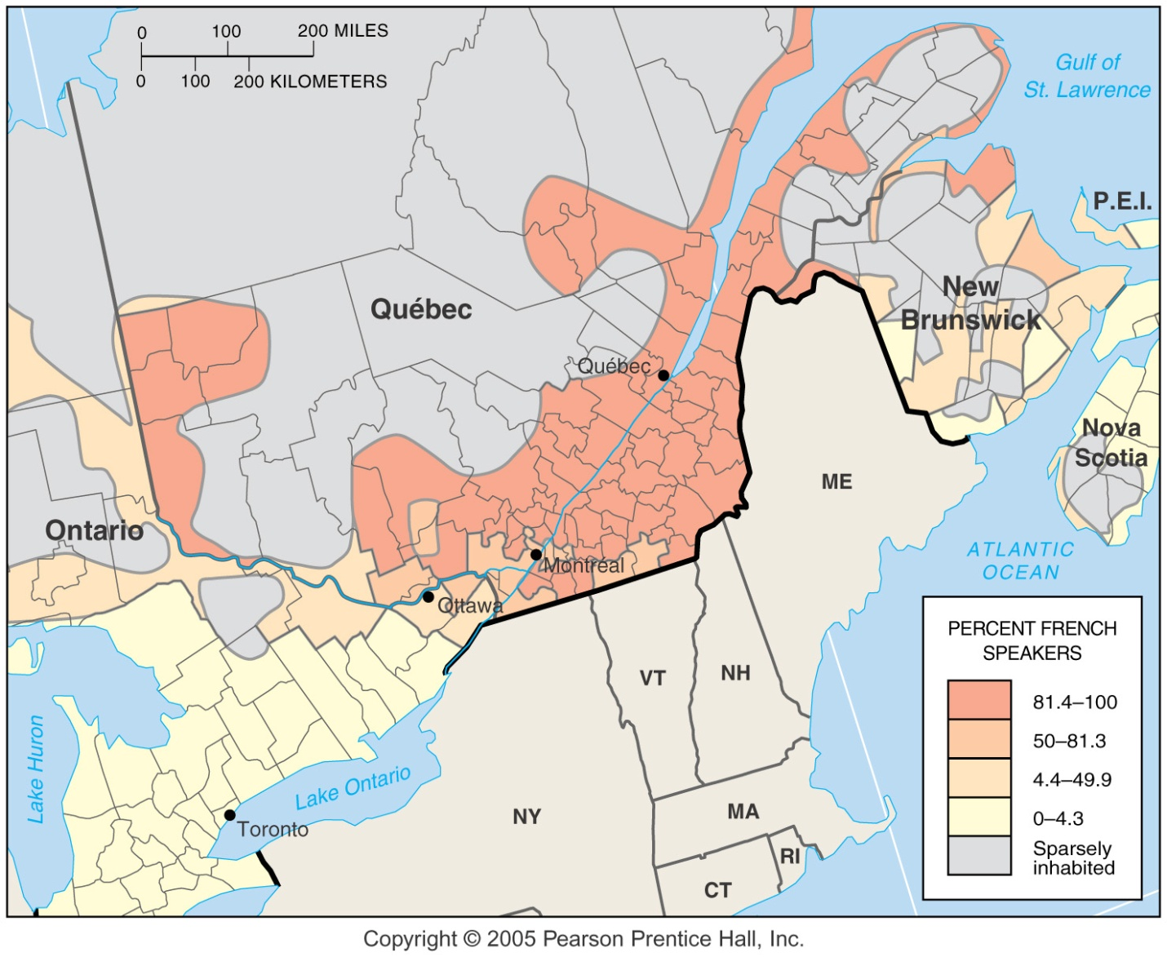
French-English Boundary in Canada
Fig. 5-18: Although Canada is bilingual, French speakers are concentrated in the province of Québec, where 80% of the population speaks French.

Slide 14
Spanglish- combination of Spanish and English.
Denglish- diffusion of English words into German. “D” for Deutsch (German)
Converting English words to Spanish, modifying spelling to conform to Spanish preferences and pronunciations.
Widespread in popular culture- music, TV., magazines
Seen as enriching both English and Spanish by adopting the best of both elements.
Diffusion of English words into German.

Slide 15
FOR THE TEST
Know Vocabulary
Focus on Key Issues
  Read the summary at the end of the Chapter
Know the Major Language Families
Know the Indo-European Branches
Origin and Diffusion of English

