Slide 1
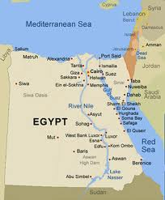
Ancient Egypt-Land of the Pharaohs, Ch 4.
9/6-9/7

Slide 2
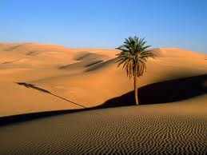
A long time ago, the area called the Sahara was green and covered with grass. Over time, it dried up and became a desert.
People living in the Sahara moved to look for water. Some moved to Egypt along the Nile.

Slide 3
The Nile is a great river in Egypt. People built a civilization along the river.
The Nile floods over every July.

Slide 4
Before, Egypt was separate into Lower Egypt and Upper Egypt around 3200 B.C.
King Menes became the first pharaoh of Egypt.
Pharaohs collected TAXES and had people build TOMBS for them.
Those TOMBS are called PYRAMIDS.

Slide 5
Inside the tomb, the pharaoh put his favorite things-food, jewelry and clothes.
Pharaohs showed how rich and strong they were by having their people build them nice tombs.

Slide 6
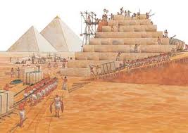
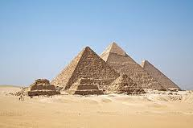
Tombs are called PYRAMIDS in Egypt. They were built from stone.

Slide 7
Vocabulary
Desert
Pharaoh
Tax
Tomb
Pyramid
COPY these words onto Word.
Write down (in English) or type what they mean. Use Google to look up pictures or aslpro.com to look up signs if you aren’t sure.
Videotape yourself FINGERSPELLING each word and then EXPLAIN what they mean. E-mail this to me: Alisa Nakano

Slide 8
Assignment:
Copy and answer the following questions (type in your History Folder).
1. Why did people live along the Nile River?
2. Why did the Egyptian pharaohs have their people build the pyramids?
3. Why did the pharaohs want all of their favorite things to be buried with them?
4. Define these words.. mummy, hieroglyphics, papyrus.

Slide 9
Copy these questions into your Journal and find the answers in the powerpoint-write them down.
1. What kind of life did a pharaoh live?
2. Who wore makeup?
3. What kind of makeup did they wear?
4. Who is Osiris?
5. How did Egyptians write?
6. WHAT did they write on?

Slide 10
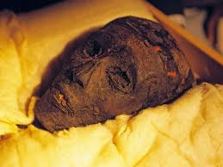
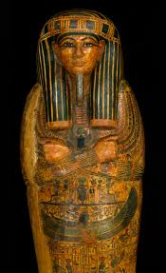
Part 2-Egyptians..
Mummy-dead person-their brain and organs (heart, lungs, etc) are removed, and then their body is treated with a special chemical.
The body is wrapped around and around with layers of cloth.

Slide 11
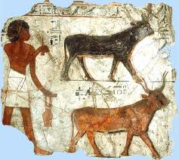
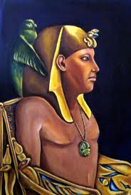
Egyptian Life
Pharaohs and nobles-lived rich lives
Everyone else-simple lives
Usually-plenty of food.

Slide 12
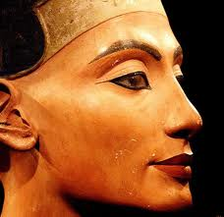
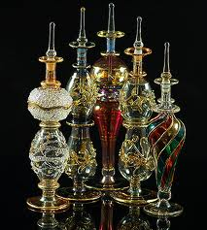
Looks
Egpytians liked to look good.
Men and women both wore makeup.
Lips-red
Eyes-green or gray kohl around them.
Liked perfume.

Slide 13
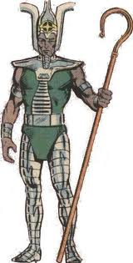
Religion
Most Egyptians believed in many gods.
Each city had its own special god.
Osiris was the god of Death.
Egyptians believed the dead went across a big river to meet Osiris in the “next world”.

Slide 14
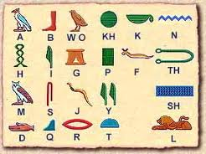
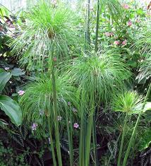
Inventions
Egyptians invented a kind of writing called HIEROGLYPHICS.
They learned to make paper using river reeds called PAPYRUS
Egyptians learned how to chart the stars, and they decided there were 365 days in one year.

Slide 15
Activity:
Go to www.brainpopjr.com
Log in with the username: tsdeaf and the password: rangers
Watch the movie. Write a one-paragraph (4-6 sentences) of the movie.
Do the hieroglyphic activity worksheet.

