Slide 1
Representations of Women: The Ideal

Slide 2
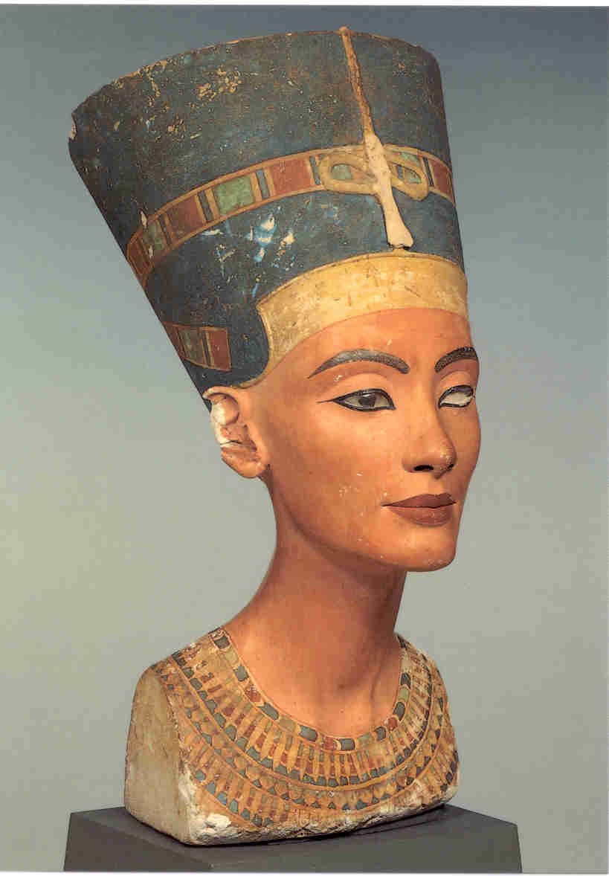
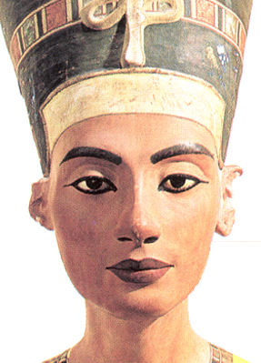
Nefertiti Thutmose
Dynasty 18, c. 1352-1336 BCE
painted limestone

Slide 3
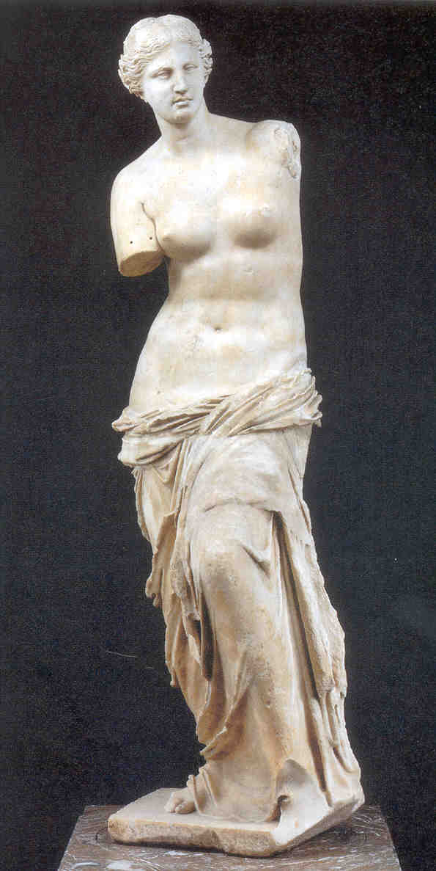
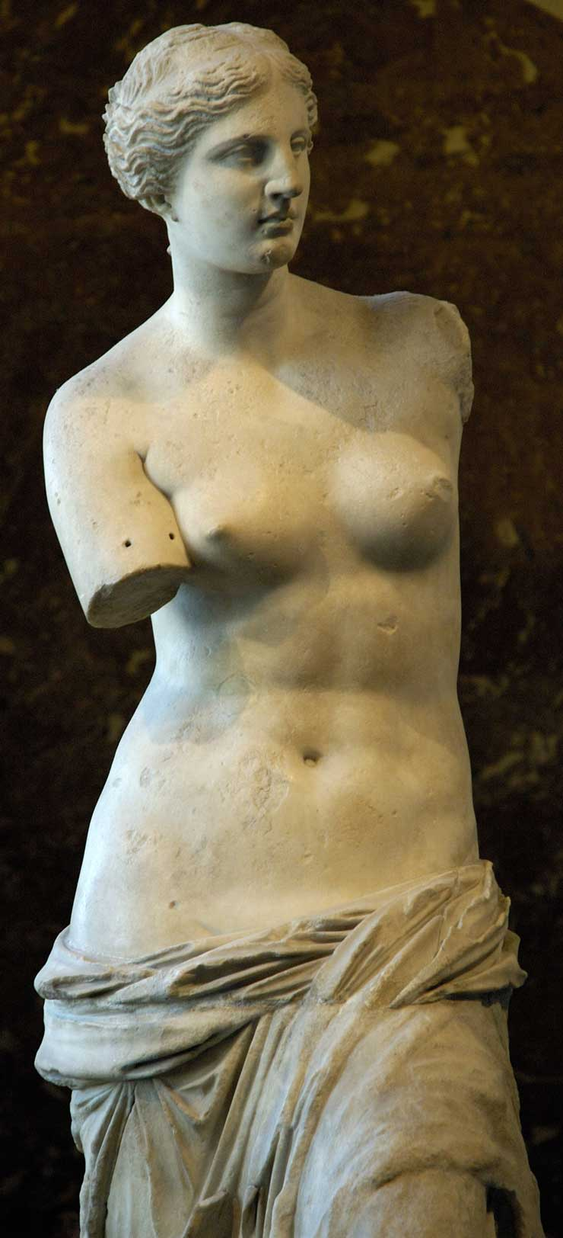
Aphrodite of Melos
or Venus de Milo
c. 150 BCE

Slide 4
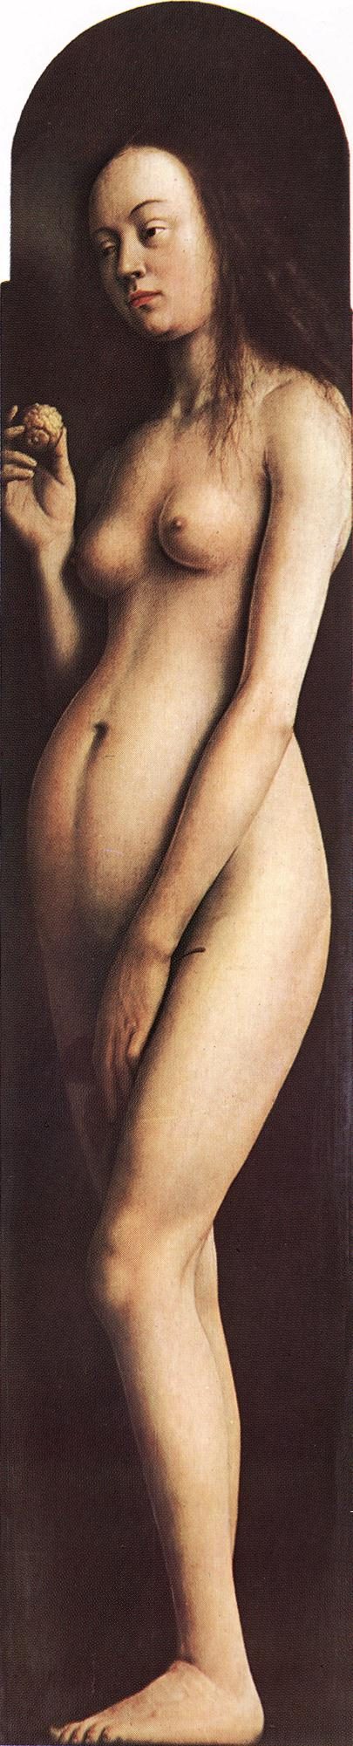
Jan van Eyck
The Ghent Altarpiece: Eve
1425-29
oil on wood,
Cathedral of St Bavo, Ghent

Slide 5
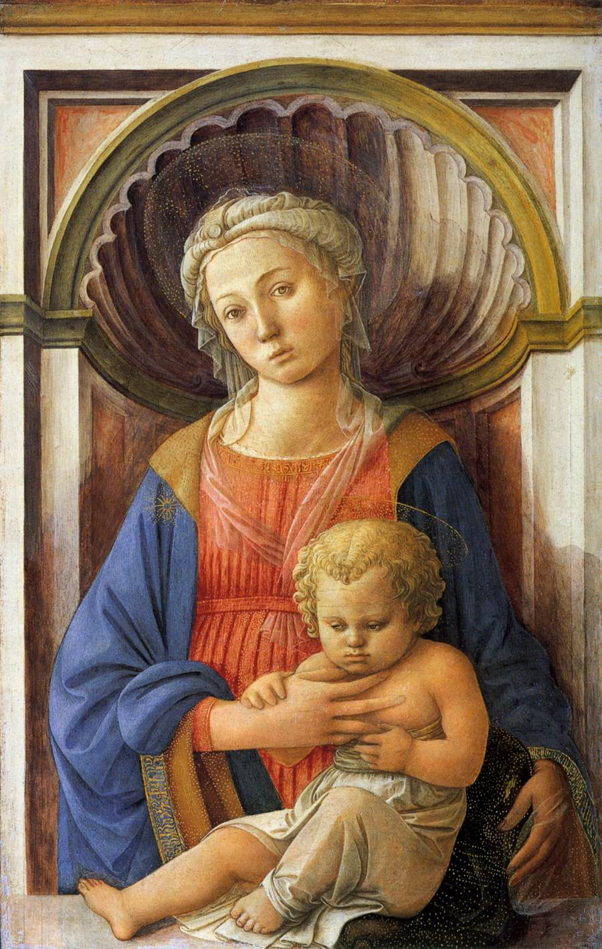
Fra Filippo Lippi
Madonna and Child
c. 1440
tempera on panel

Slide 6
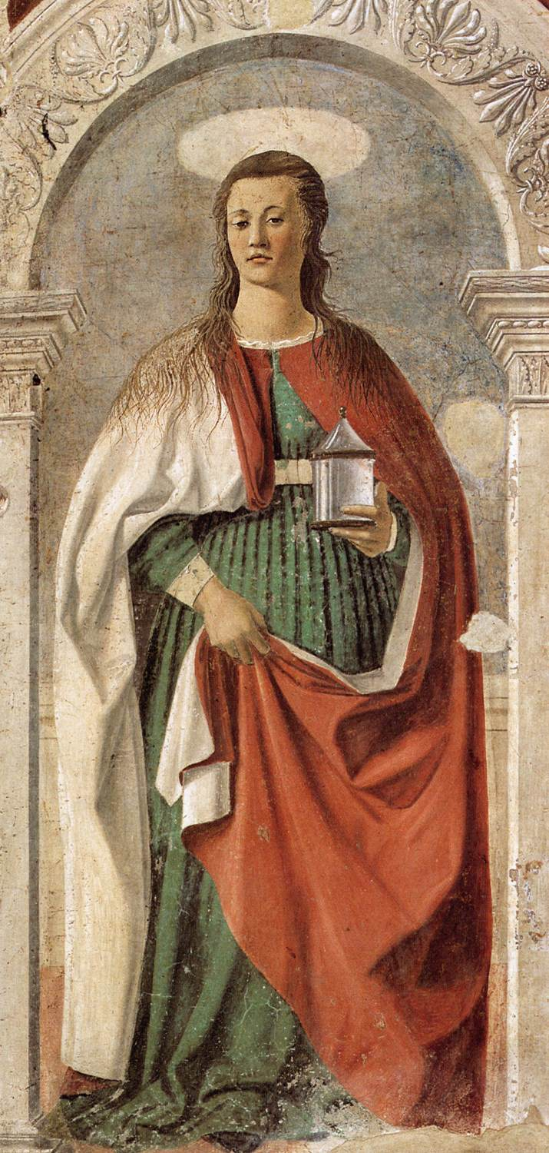
Piero Della Francesca
Saint Mary Magdalen
1460
fresco
Duomo, Arezzo

Slide 7
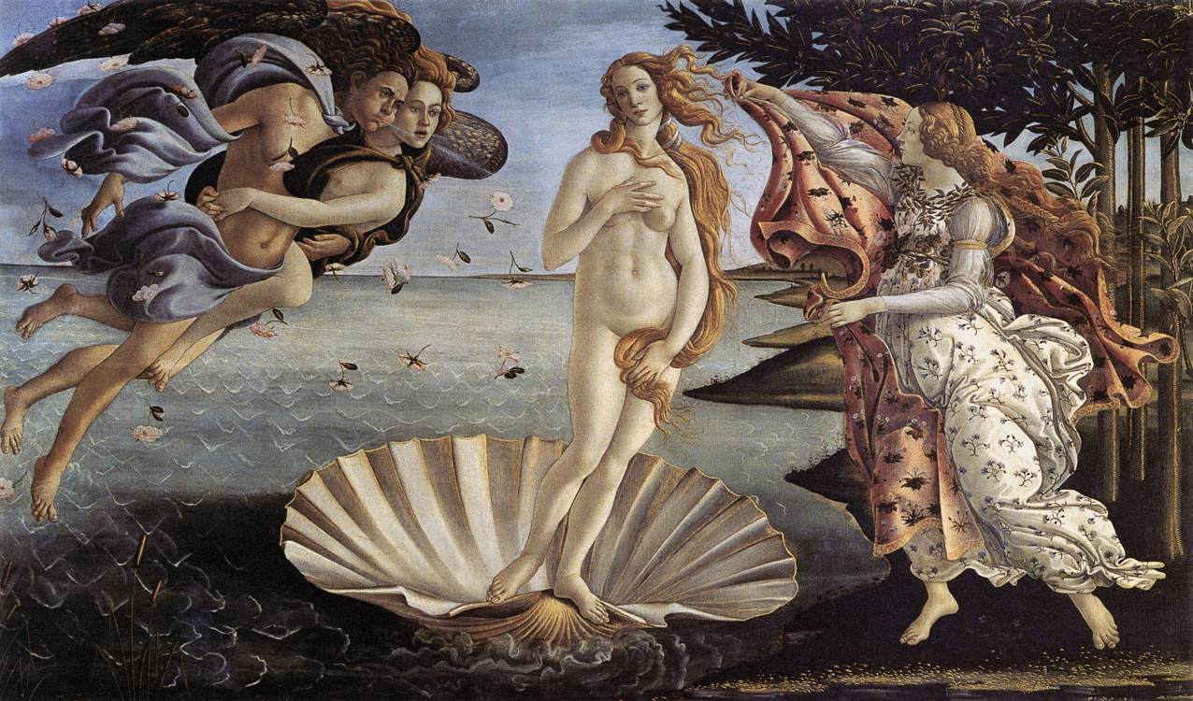
Sandro Botticelli
The Birth of Venus
1484-86

Slide 8
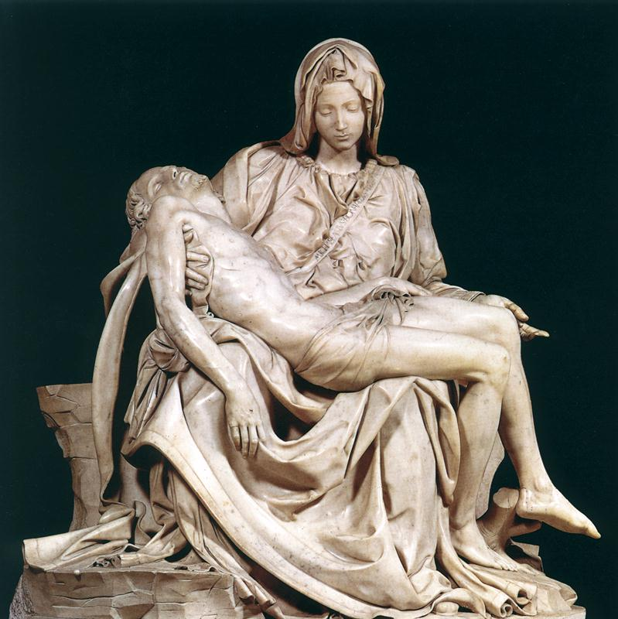
Michelangelo
Pietà
1499
marble

Slide 9
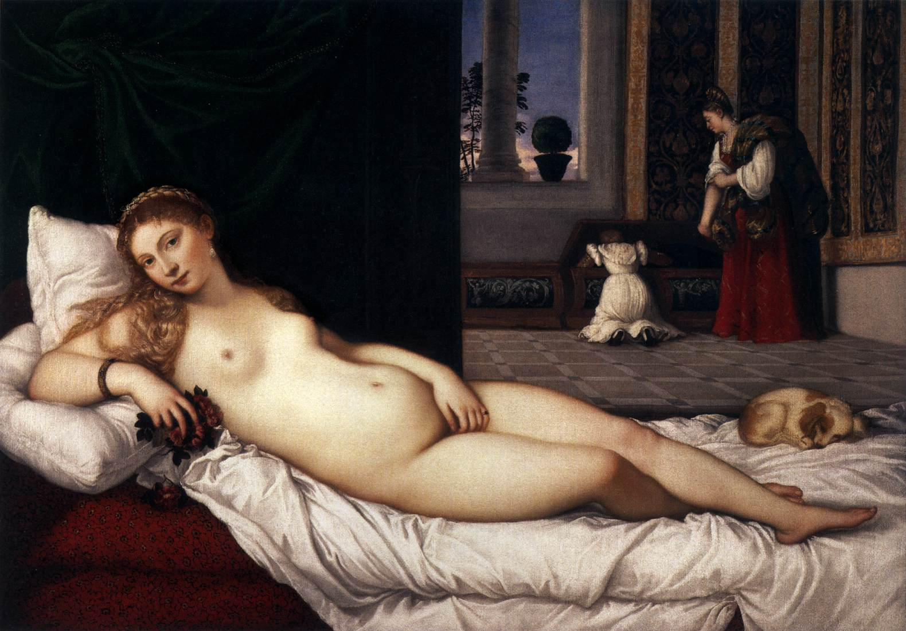
The Venus of Urbino Titian before 1538

Slide 10
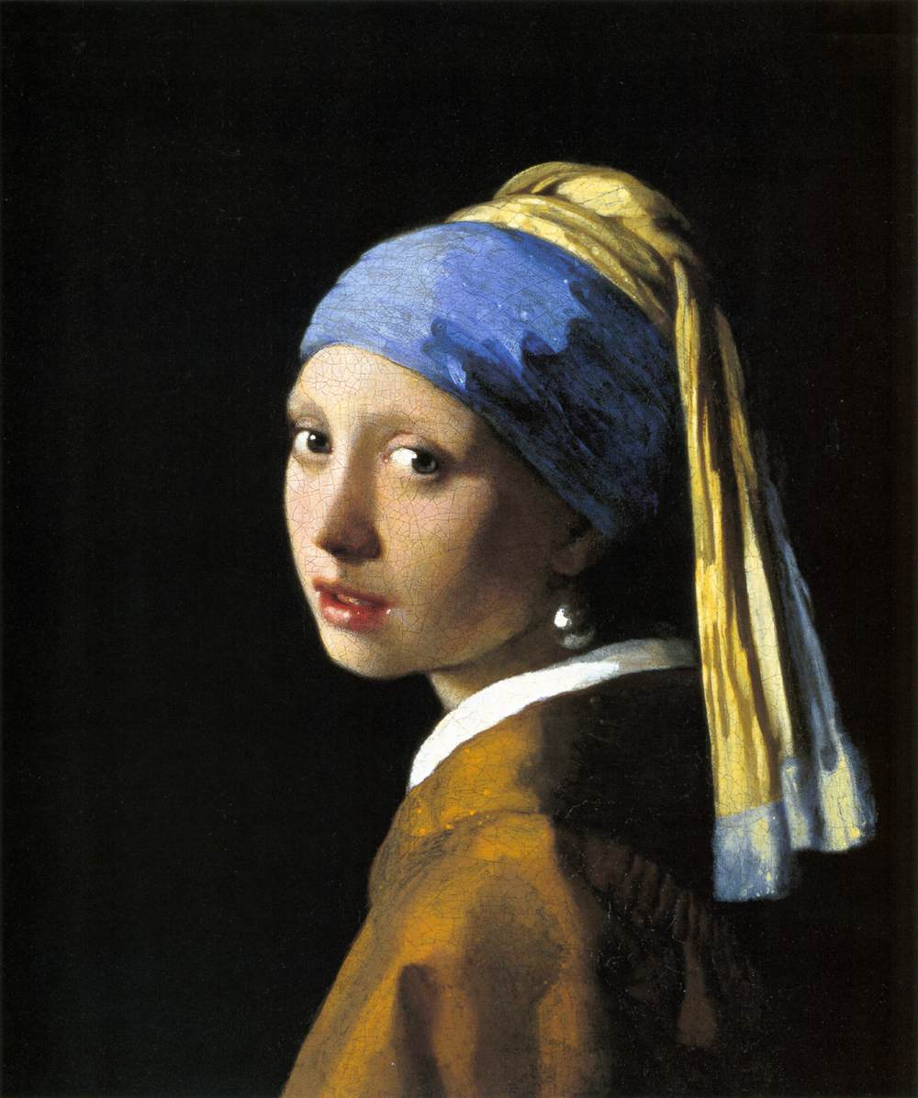
Jan Vermeer
Girl with Pearl Earring
ca. 1665

Slide 11
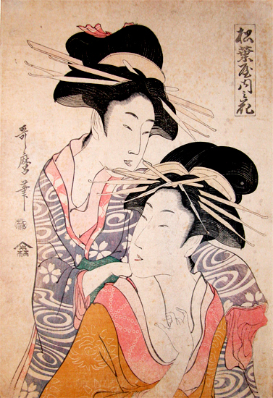


Slide 12
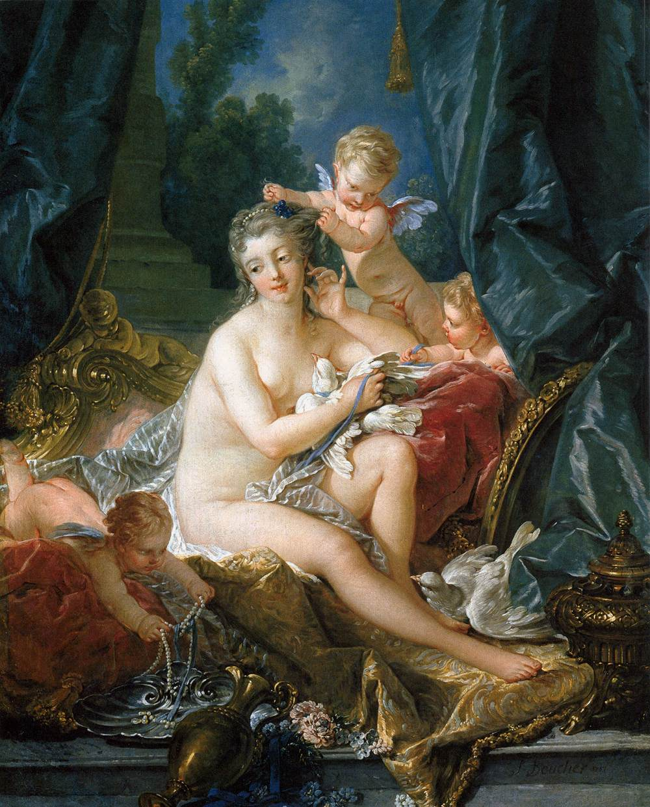
François Boucher
The Toilet of Venus
1751
oil on canvas, 108,3 x 85,1 cm
This painting and its pendant, Venus Consoling Love (National Gallery of Art, Washington, D.C.), were commissioned by Madame de Pompadour, mistress of Louis XV, for her Château de Bellevue, near Paris.
From http://www.metmuseum.org

Slide 13
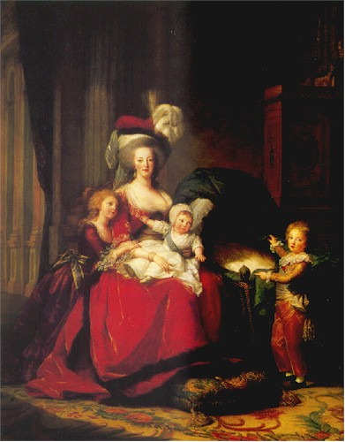
Élisabeth Vigee-Lebrun
Marie Antoinette with Her Children
1787
oil on canvas

Slide 14
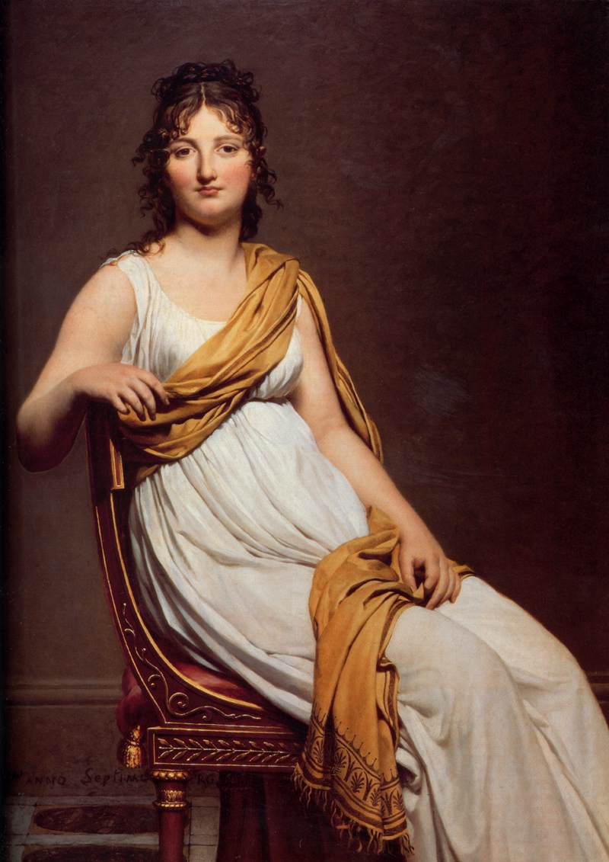
Jacques-Louis David
Madame Raymond de Verninac
1798-99
oil on canvas, 145 x 112 cm
Notes:
DAVID, Jacques-Louis
Madame Raymond de Verninac
1798-99
Oil on canvas, 145 x 112 cm
Musée du Louvre, Paris

Slide 15
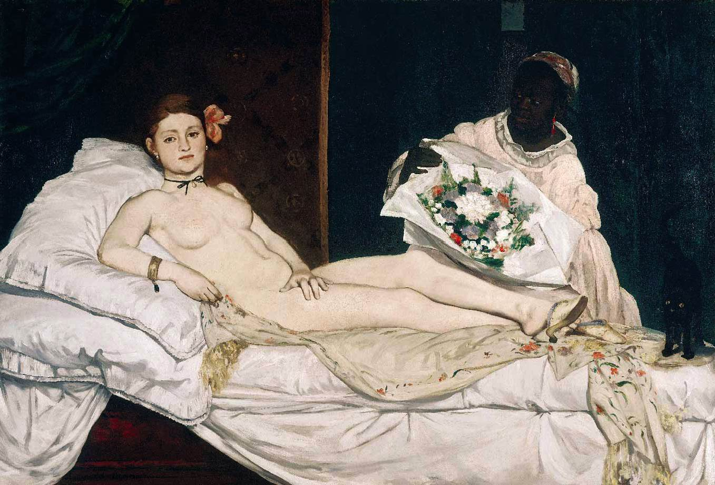
Olympia Manet 1863
Notes:
Sleeping Venus Giorgione c. 1510

Slide 16
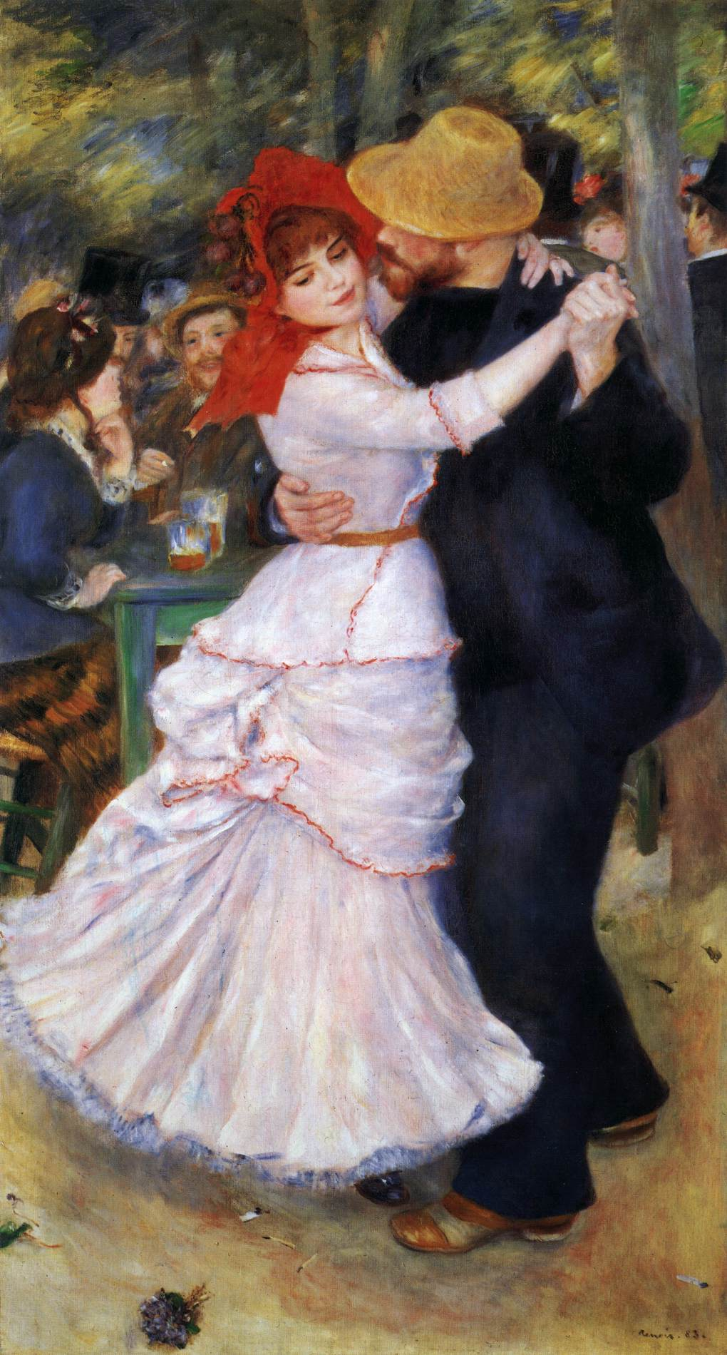
Pierre-Auguste Renoir
Dance at Bougival
1883

Slide 17
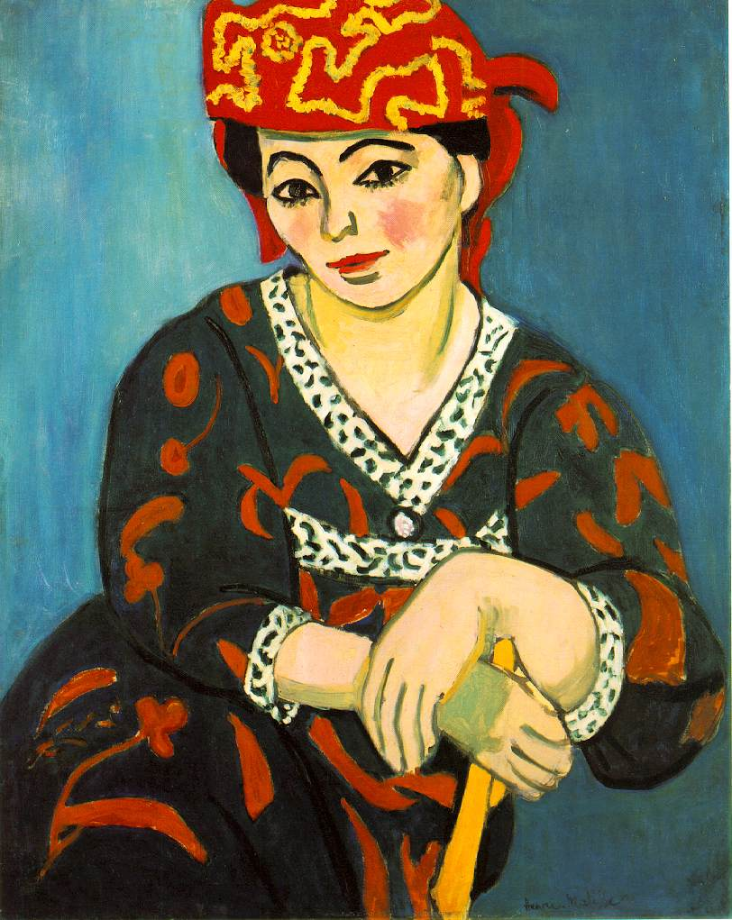
Henri Matisse
Madras Rouge
1907
Notes:
Henri Matisse
Madras Rouge
1907

Slide 18
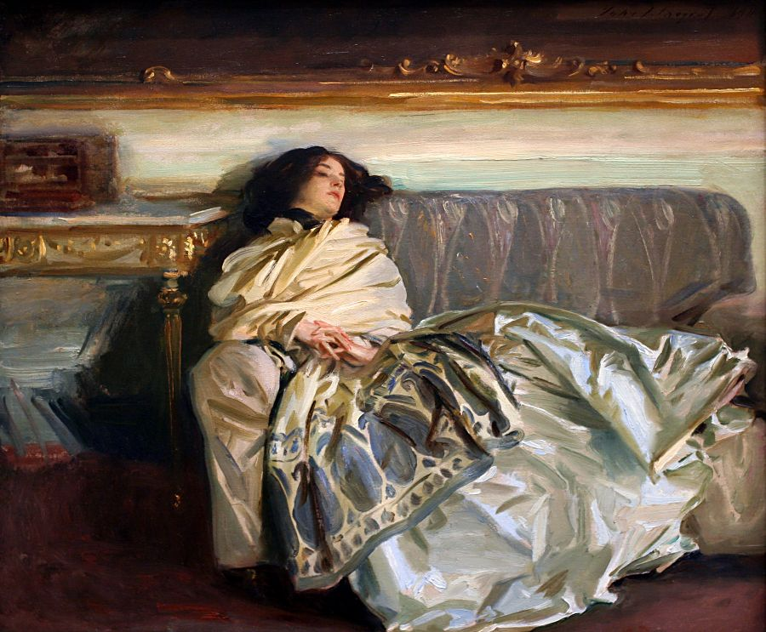
John Singer Sargent Repose 1911

Slide 19
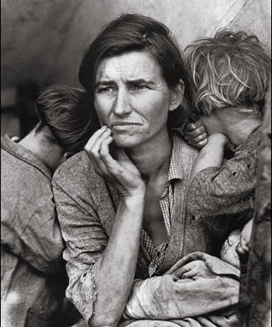
Dorothea Lange
Migrant Mother
1936

