Slide 1
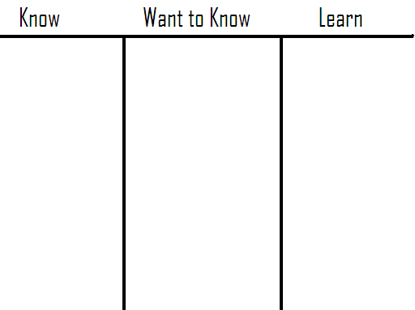
Do Now #1
Complete the K and W part of this KWL on the Constitution.

Slide 2
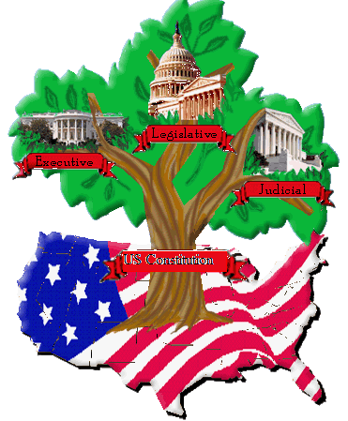
Constitution Video
We are going to watch a video about the Constitution.
As you watch, take notes in the Learn section of your KWL.

Slide 3

USC 1
United States Constitution
Write the title above.
Draw a tree with three branches like this one.
Add this definition to the title page:
Constitution = the supreme law of the United States written in 1787. It was America’s plan for government.

Slide 4
United States Constitution USC 1

Slide 5
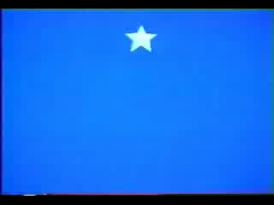
Preamble Worksheet
Today we are going to learn about the first section of the Constitution called the Preamble.
The Preamble is the introduction to the Constitution.
We are going to read the Preamble together and then complete a chart to help explain what it means.

Slide 6
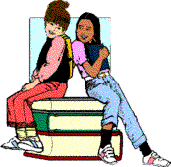
* Complete Preamble worksheet!
Homework

