Slide 1
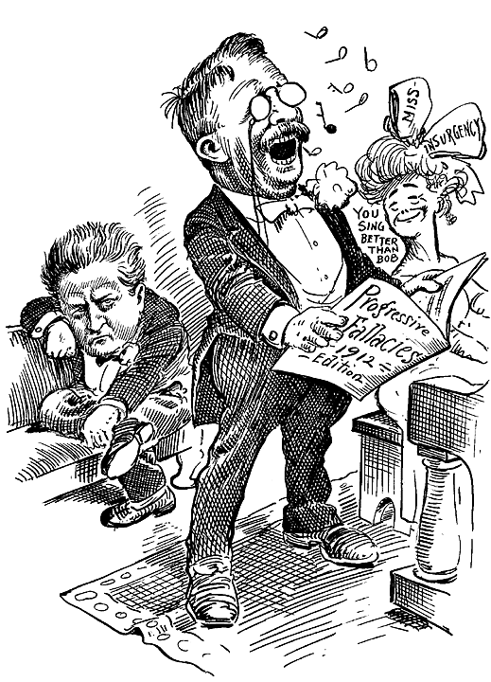
The Progressive Response to Industrialization
TCI Activity
Mrs. Janiak

Slide 2
Directions:
You have eight sources to examine.
For each source, examine the image and description
Write down the notes provided onto your worksheet
Complete the critical thinking question for that source.
Once finished with the primary source, return the paper to the front and pick up a new source. Complete all eight

Slide 3
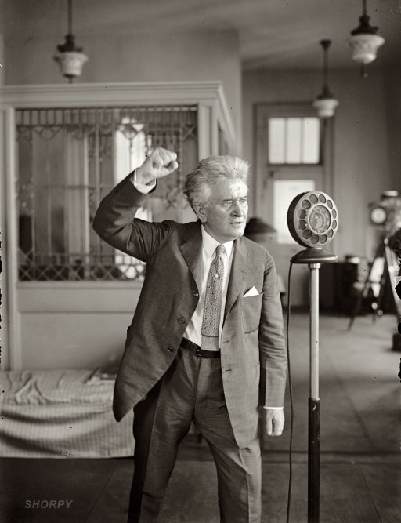
Slide A: “Fighting Bob” La Follette, Progressive Governor of Wisconsin and later Republican Senator in early 1900s
- “Battlin’ Bob” fought to expand democracy, government efficiency and protect natural resources.
Progressives emerged to combat these major U.S. problems by 1900:
Poor working conditions
Consumer fraud
Unfair practices by large corporations
Political corruption
Destruction of wilderness areas to fuel industrial America
-Progressives were generally white, middle-class, both Republican and Democrat

Slide 4
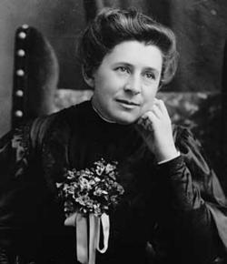
Slide B: Ida Tarbell, an influential journalist of the Progressive Era
To change the problems, the problems must be exposed to the public.
Muckrakers: men and women through print and images, brought the problems to the public.
Lincoln Steffens: city government corruption
Jacob Riis & Lewis Hine: living and working conditions
Ida Tarbell: ruthless business tactics of John D. Rockefeller
Upton Sinclair: meat packing industry

Slide 5
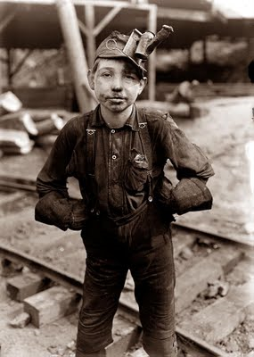
Slide C: 10-year-old coal miner bent from years of toil during his young life.
President Teddy Roosevelt sided with labor unions- the first president to use his power to benefit labor
T.R. created the Department of Commerce and Labor in 1903- to keep companies honest and open to public criticism.

Slide 6
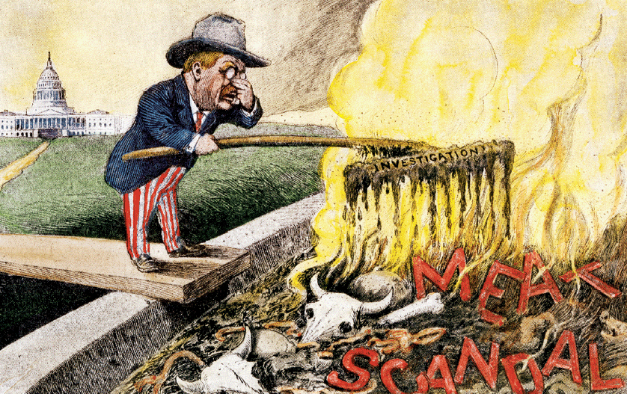
Slide D: a political cartoon depicting food inspection of the meat industry in the early 1900s.
-The 1800s saw a reduction in food quality
-Consumers had no safety against poor quality or misleading advertising
-Meat-packing industry: notorious for unsanitary conditions
Example: 100s of U.S. soldiers died during the Spanish-American War
from tainted meat
-Misuse of chemical additives in canned foods
-Drug industry claimed products could cure a variety of ills
- Roosevelt & Congress passed the Pure Food and Drug Act in 1906

Slide 7
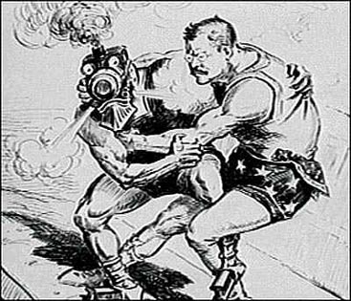
Slide E: Political cartoon of President Teddy Roosevelt wrestling with a figure representing the railroad industry.
-Progressives fought to regulate unfair business practices- they believed monopolies were abusing power and leaving consumers at their mercy
-President Roosevelt “Trust Buster” was intolerant of trusts that abused their power, wanted government to supervise business practices and regulate irresponsible ones
-1914 Federal Trade Commission= prevent large companies from destroying smaller companies
-Clayton Antitrust Act= prohibited pricing that might destroy competition

Slide 8
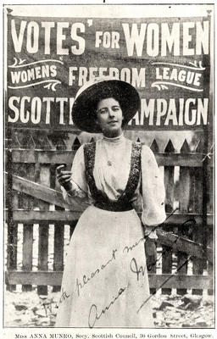
Slide F: Woman in front of a banner for the National Women’s Social and Political Union
Progressives wanted voters to have a bigger impact on public policies.
-1920: Nineteenth Amendment= allowing women’s suffrage (right to vote)

Slide 9
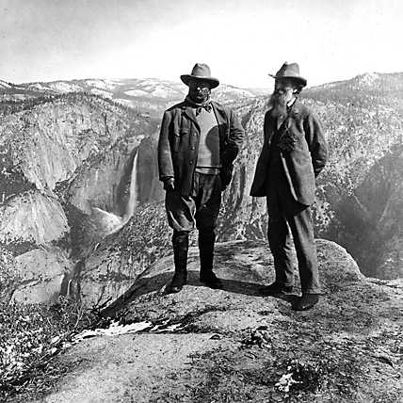
Slide G: President Teddy Roosevelt and conservationist John Muir in front of the Yosemite Valley in California’s Sierra Nevada Mountains.
President Roosevelt helped the conservation of natural resources
  Timberland areas
  5 national wilderness areas
  Foresight to preserve wilderness against industrial and urban development

Slide 10
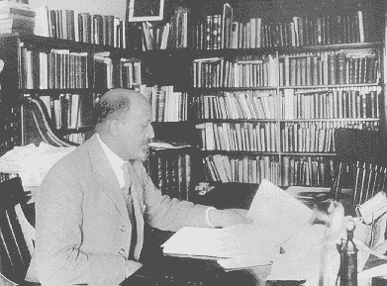
Slide H: prominent leader of the NAACP, W.E.B. Du Bois
Many Progressives were unconcerned with the black struggle.
Southern Progressives worked to strengthen segregation laws
Northern Progressives just ignored segregation and discrimination
National Association for the Advancement of Colored People (NAACP) was formed to help the struggle for equality.
Originally founded by whites, the most prominent leader was a historian, W.E.B. Du Bois

Slide 11
Procedure
Sit in groups of four- everyone should see the screen well.
Appoint one group member as the presenter, this role will rotate each slide.
You will see a series of slides that illustrate the Progressive reform movement of the early 1900s.
After a slide is discussed, your group will answer the critical thinking question and the presenter will present the answer to the class.

