Slide 1
ASL Essay World History
10/9-10/10

Slide 2
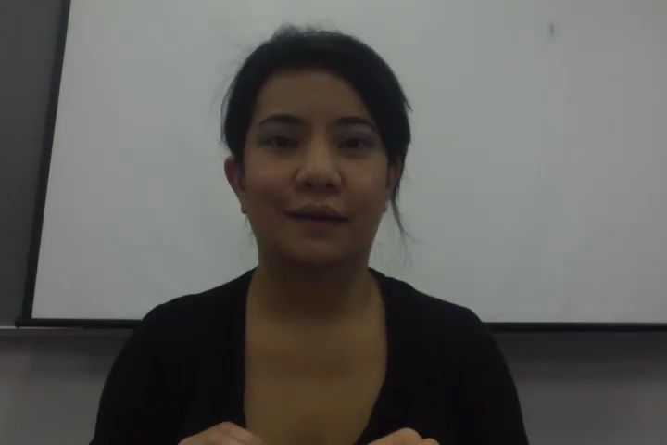
Selfishness…

