Slide 1
Ancient China

Slide 2
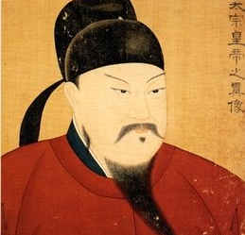
The Splendor of the Tang
Tang Taizong found the Tang Dynasty
Stabilized the government
Goal was efficient government
Brought in bureaucracy
Bureaucracy – a government with many departments

Slide 3
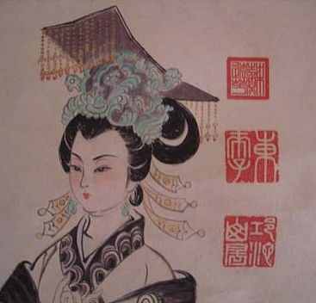
The Splendor of the Tang
Empress Wu was the only woman empress
Tried to raise the role of women
Had scholars write about famous women
Because she was a woman, many feared she threw everything out of balance

Slide 4
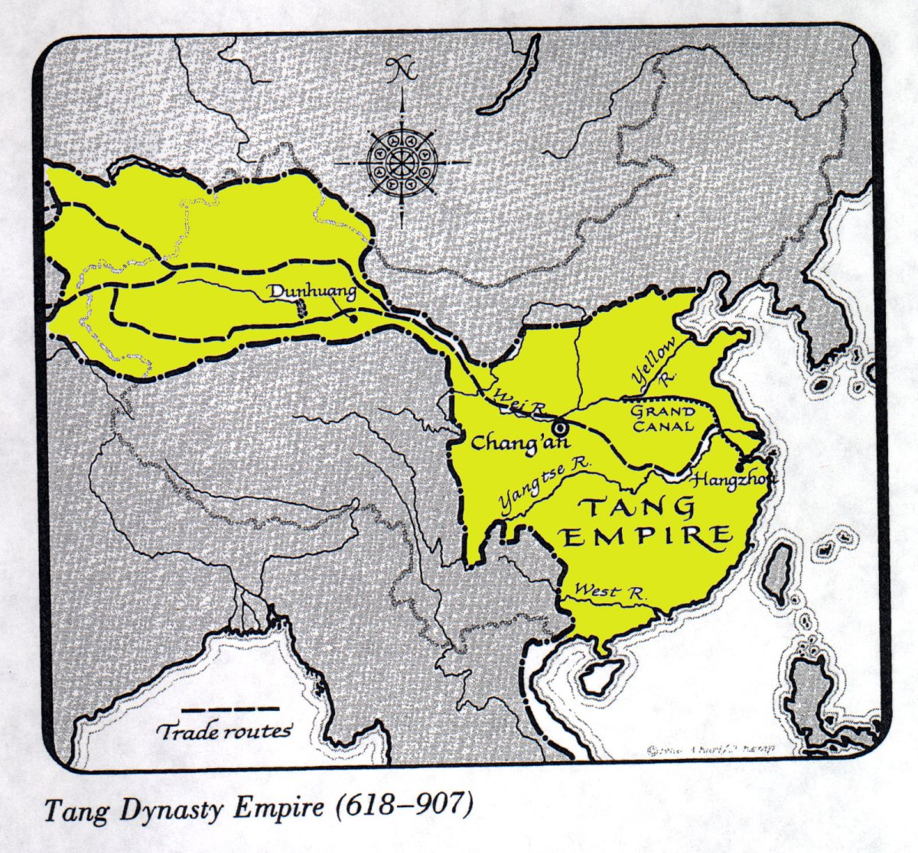
The Splendor of the Tang
Chang’an was established as the capital
Population of 2 million
Was located along the Silk Road

Slide 5
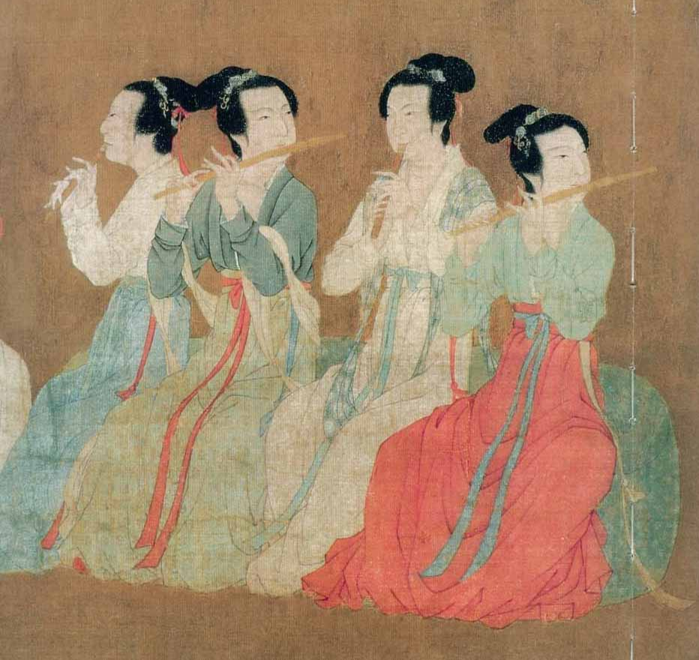
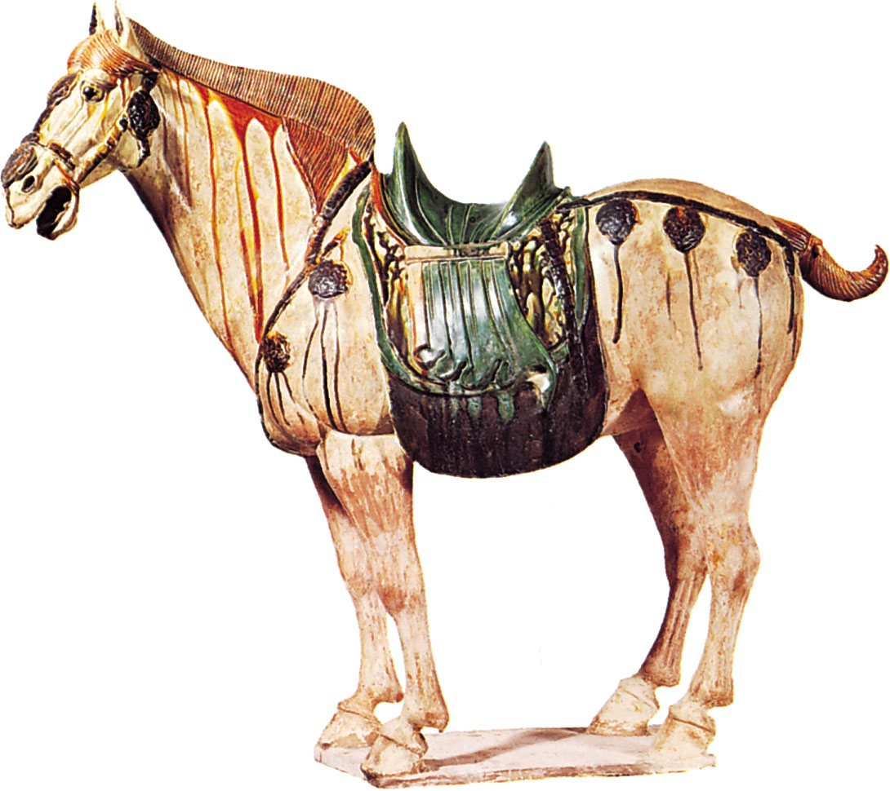
The Splendor of the Tang
Paintings had subtle color
Pottery was glazed

Slide 6
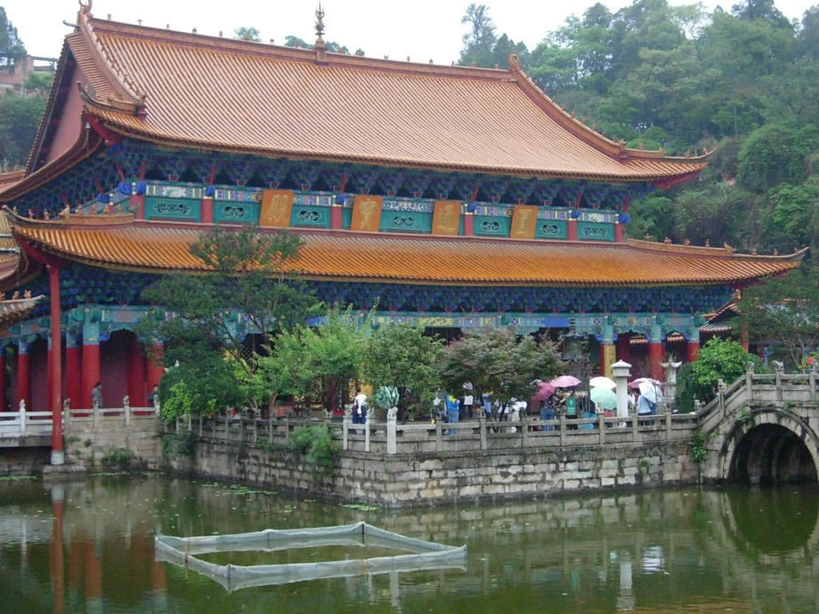
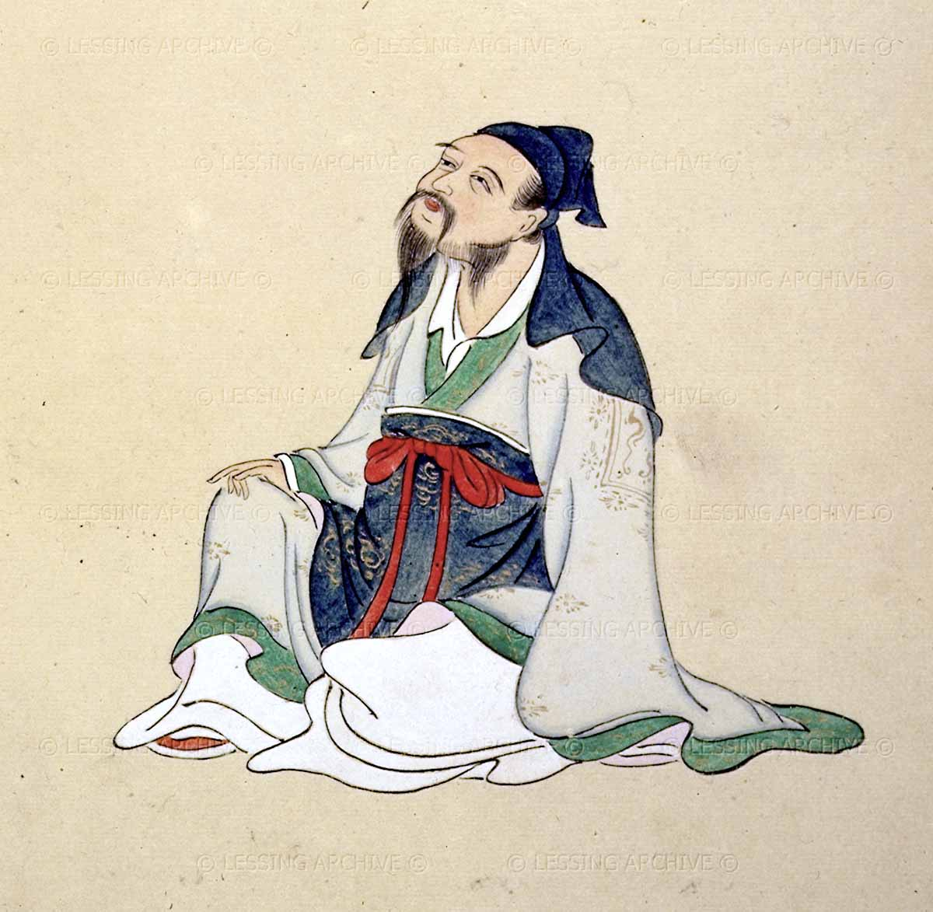
The Splendor of the Tang
Architects built Buddhist Temples
Poetry – Li Bo wrote poems about nature

Slide 7
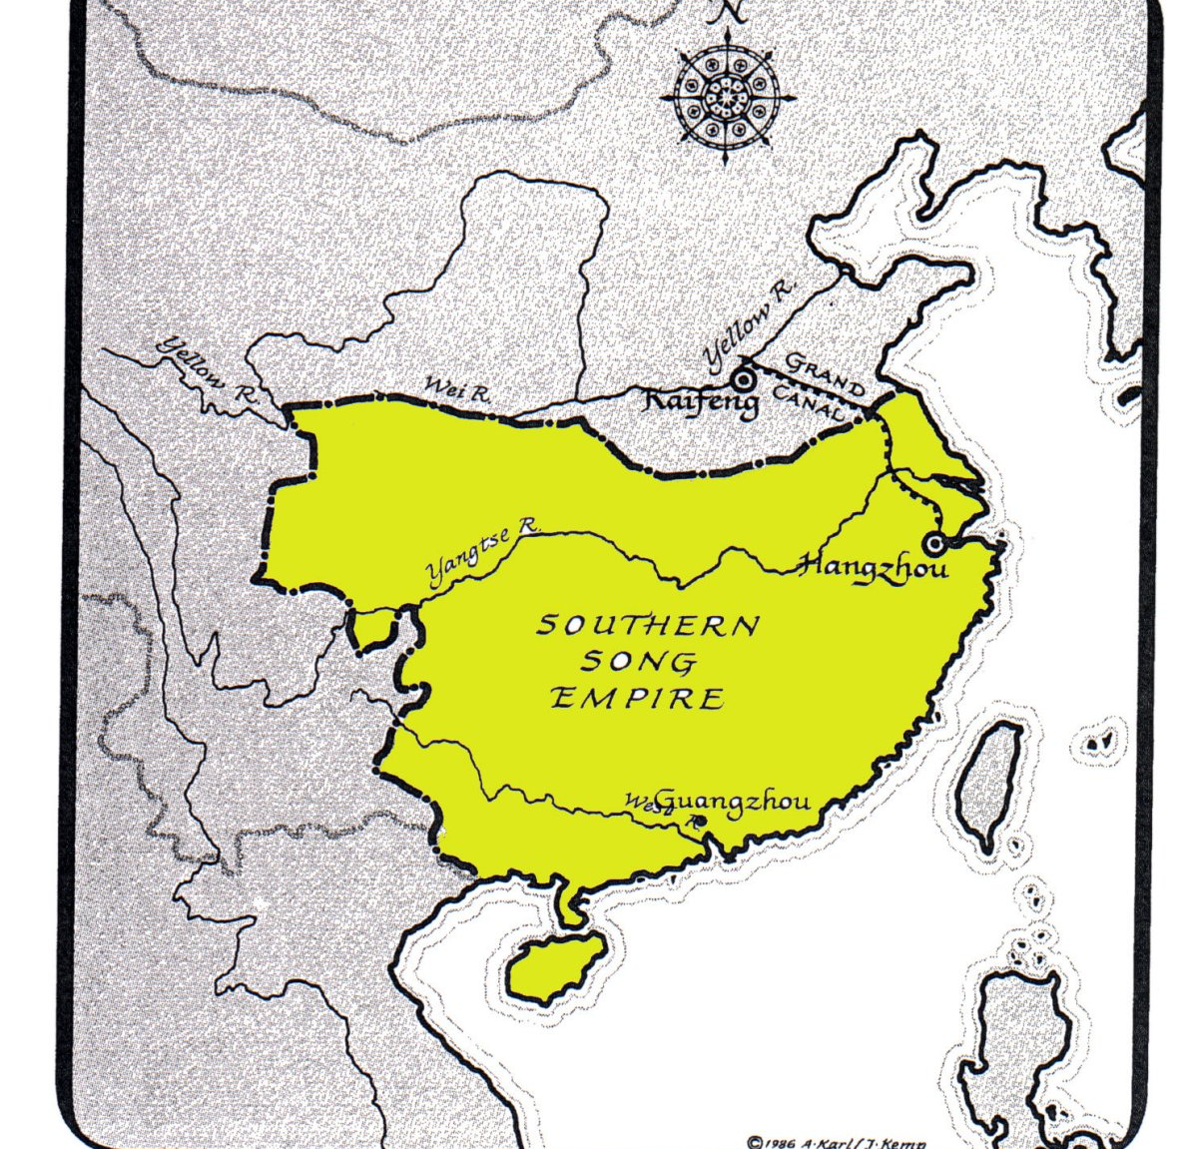
The Song Era of Good Government
Was an era of good government
Several cities with a population of one million or more – south of the Chang (Yangtze) River
After barbarian invasions in the north (1127) moved the capital to Hangzhou

Slide 8
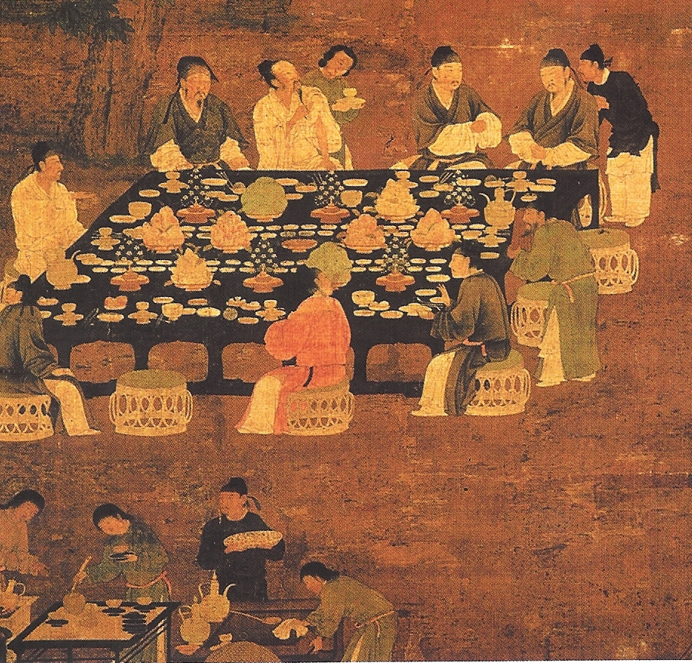
The Song Era of Good Government
Scholar-officials – ran the bureaucracy
Scholar-officials had to pass exams to qualify
Couldn’t serve in own district
Had to change every three years

Slide 9
The Song Era of Good Government
Merit system is a process for hiring and promoting based on talent and skill
Did push aside noble families

Slide 10
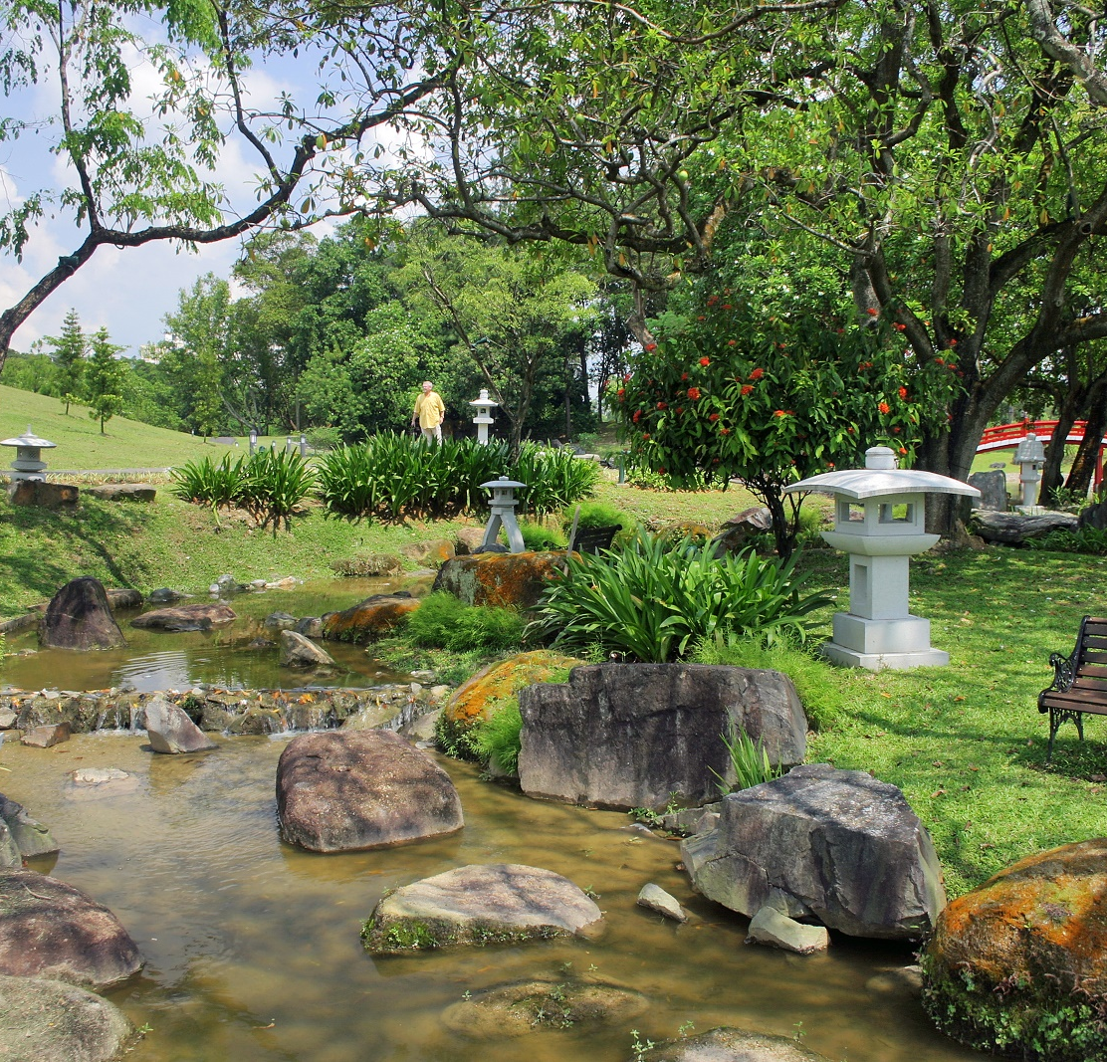
Religion & Thought in Golden Age
Daoism
Started by Lao Tzu
Started as philosophy and developed into religion
Earth, heaven, and people should follow the “Dao” – then all would be well in the world
“Dao” – the way of nature
Some left society to be close to nature

Slide 11

Religion & Thought in Golden Age
Daoism
Take you time to figure out the natural and easy way to do things
Every living thing in the universe shares the same living force
2 sides of the living force – ying and yang
Ying = dark (women, moon, death
Yang = light (men, sun, creation, birth
Needs to be balance

Slide 12
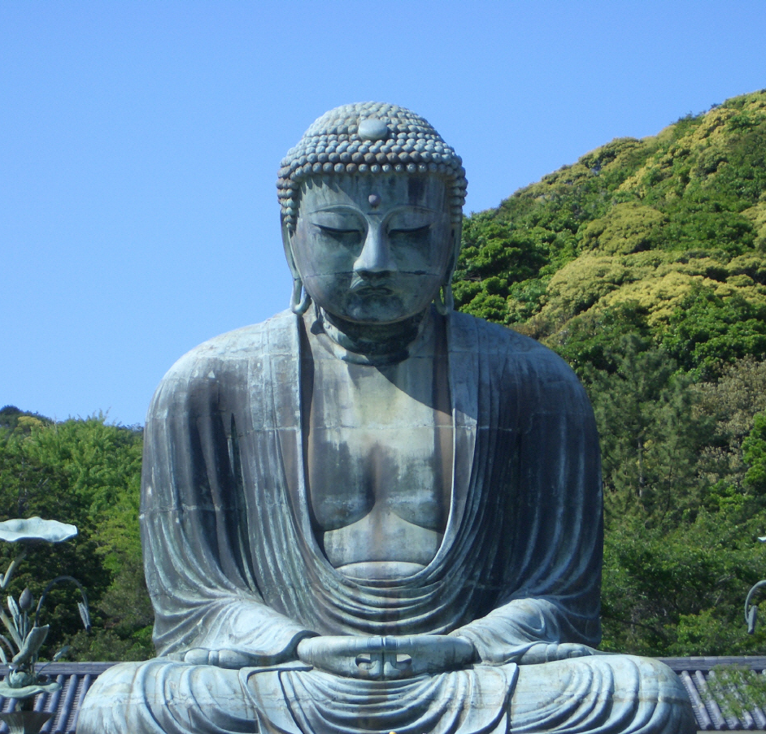
Religion & Thought in Golden Age
Buddhism
Based on spiritual teaching of Siddhartha Guatama from India
The Buddha = “the Enlightened One”
Taught that life involves suffering – to ease suffering requires to give up worldly desires
Those who achieve enlightenment enter “nirvana” or a state of complete peace.

Slide 13
Religion & Thought in Golden Age
Buddhism
Entered China during the Han Dynasty and gained strength before Tang Dynasty
During Tang Dynasty generally accepted
Opposition grew – rulers didn’t like their popularity
AD 845 Emperor Wuzong a devout follower of Daoism order destruction of several monasteries and temples

Slide 14
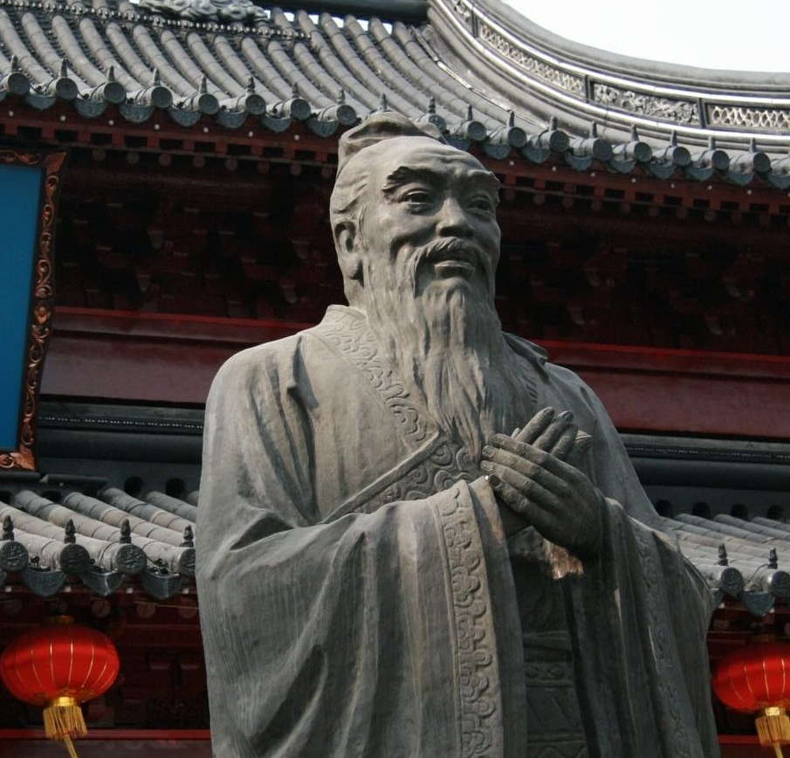
Religion & Thought in Golden Age
Confucianism
Confucius lived from 551 to 479 B.C.
Parents lost wealth but still sent to school (may have know Lao Tzu)
Became a teacher and involved in politics
Later in life traveled around China and gave advice to rulers

Slide 15
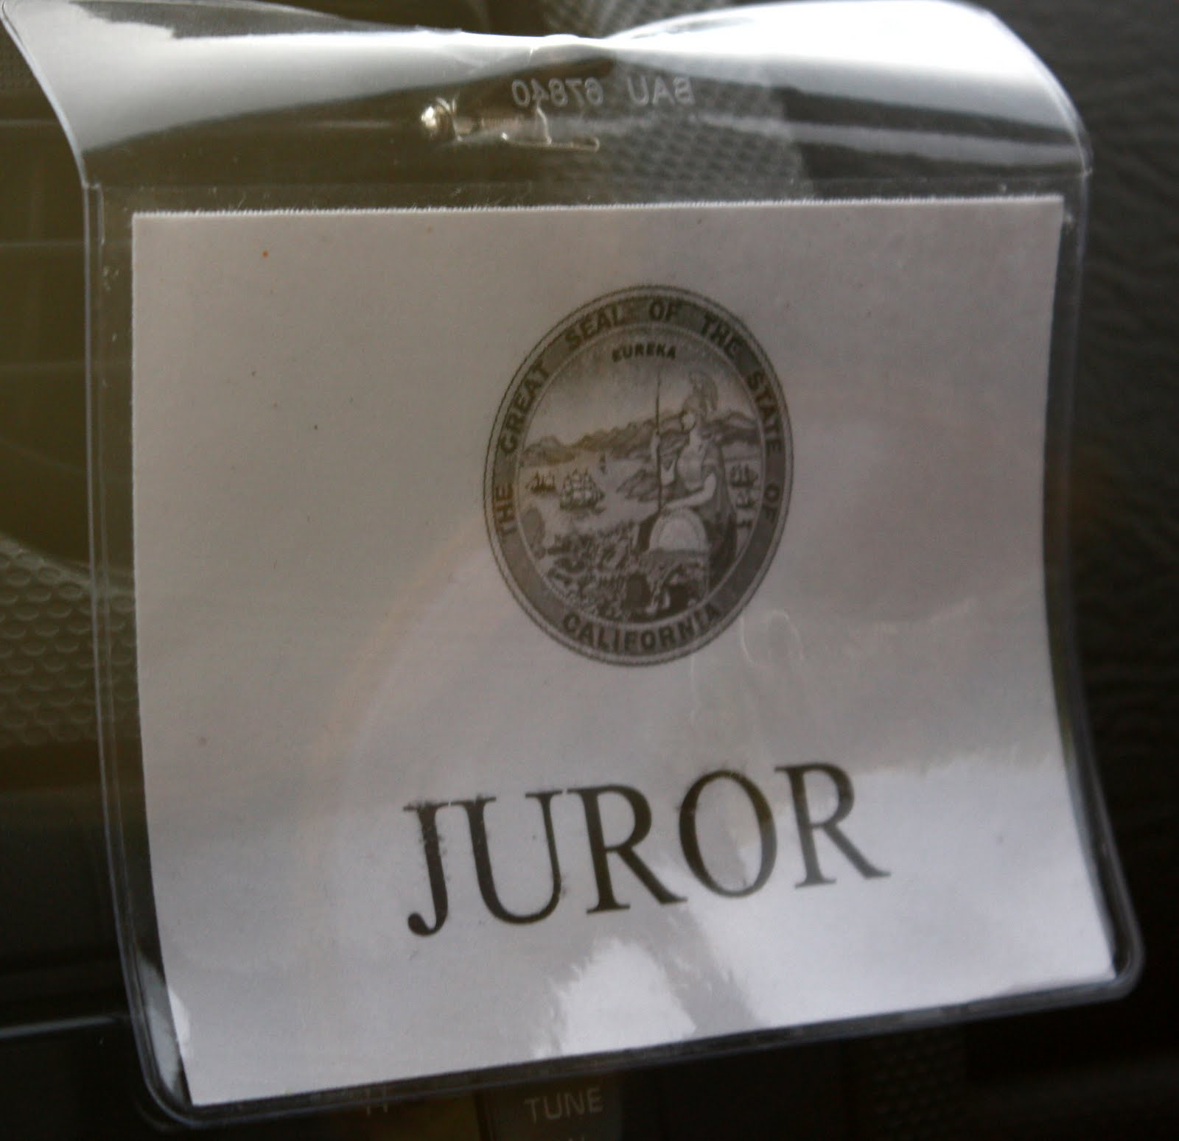
Religion & Thought in Golden Age
Confucianism
Was the main belief system before Buddhism
Beliefs were based on respect for family and social order
Peace is achieved by doing your duty and cooperating with society

Slide 16
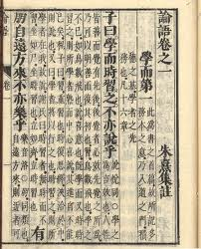
Religion & Thought in Golden Age
Confucianism
Belief system was based on respect for family and social order
5 basic relationships – all had roles but not always equal – each had a duty
1. Ruler and subject
2. Father and son
3. Husband and wife
4. Older brother and younger brother
5. Friend and friend

Slide 17
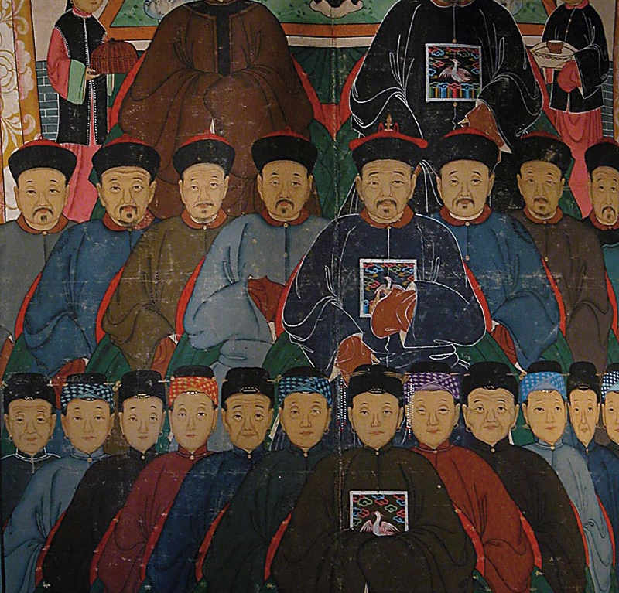
Religion & Thought in Golden Age
Confucianism
Do duty to ancestors
Gain virtue through education
Wise ruler govern through moral example rather than force

Slide 18
Religion & Thought in Golden Age
Confucianism
Neo-Confucianism arose during the Song Era
A form of Confucianism influenced by Daoism/Buddhism
Studied Confucius and discovered new ways to interpret life

Slide 19
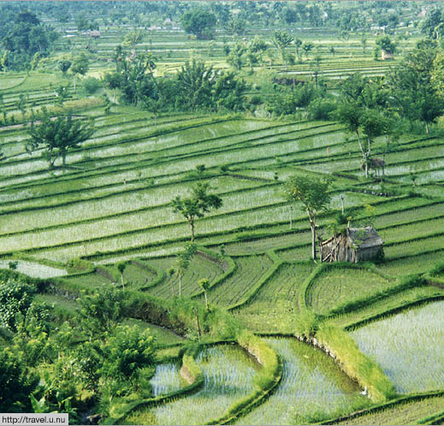
Farming, Technology, & Trade
Farming
When moved to the south had to change what they grew
Rice grew well in the wet, humid south
Rice grows in flooded fields called paddies
Developed a fast ripening rice – 2 to three crops per year
Could feed more people
During Tang Dynasty – wealthy family could own farm land

Slide 20
Farming, Technology, & Trade
Technology
Oceangoing ships – water tight compartments & magnetic compass
Gunpowder – bombs, rockets, and other weapons
Invented paper
In the 800’s invented block printing

Slide 21
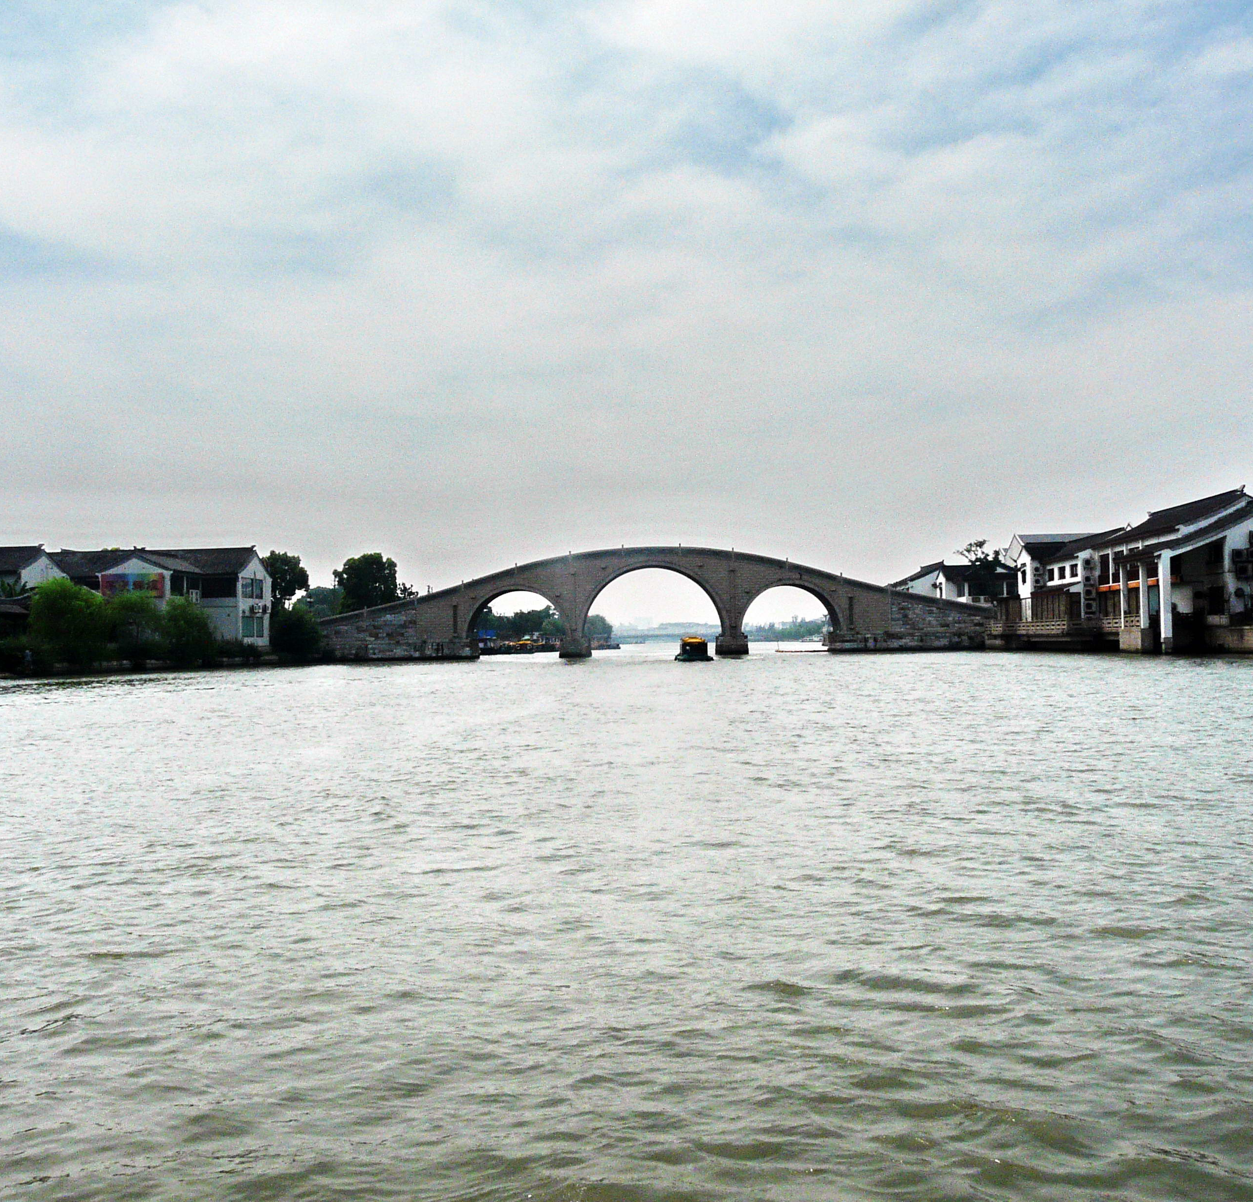
Farming, Technology, & Trade
Trade and Industry
Trade grew - better farming, travel, and money economy
Travel costs dropped because of Grand Canal (connects two major river ways) - then several canals developed out of that
Tang Dynasty – heavy copper coins
Song Dynasty – paper money

Slide 22
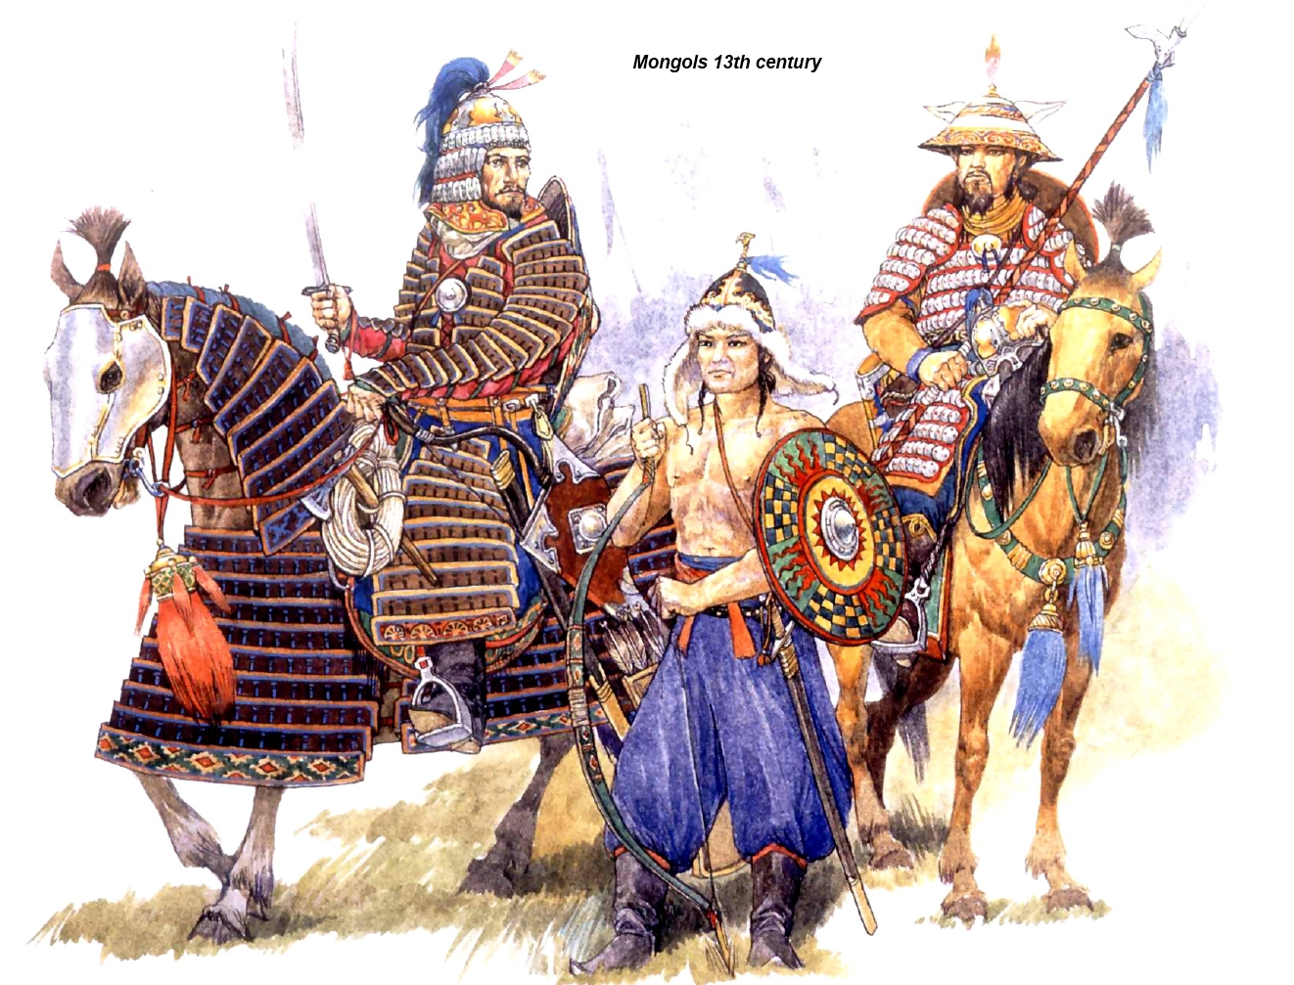
The Mongol Ascendancy
Mongols from a steppe in northwest China
Steppe is large dry grass covered plain
Life was harsh and resources were limited
Were nomads who herded cattle and sheep
In late 1100’s Genghis Khan built and army and began conquering tribes

Slide 23
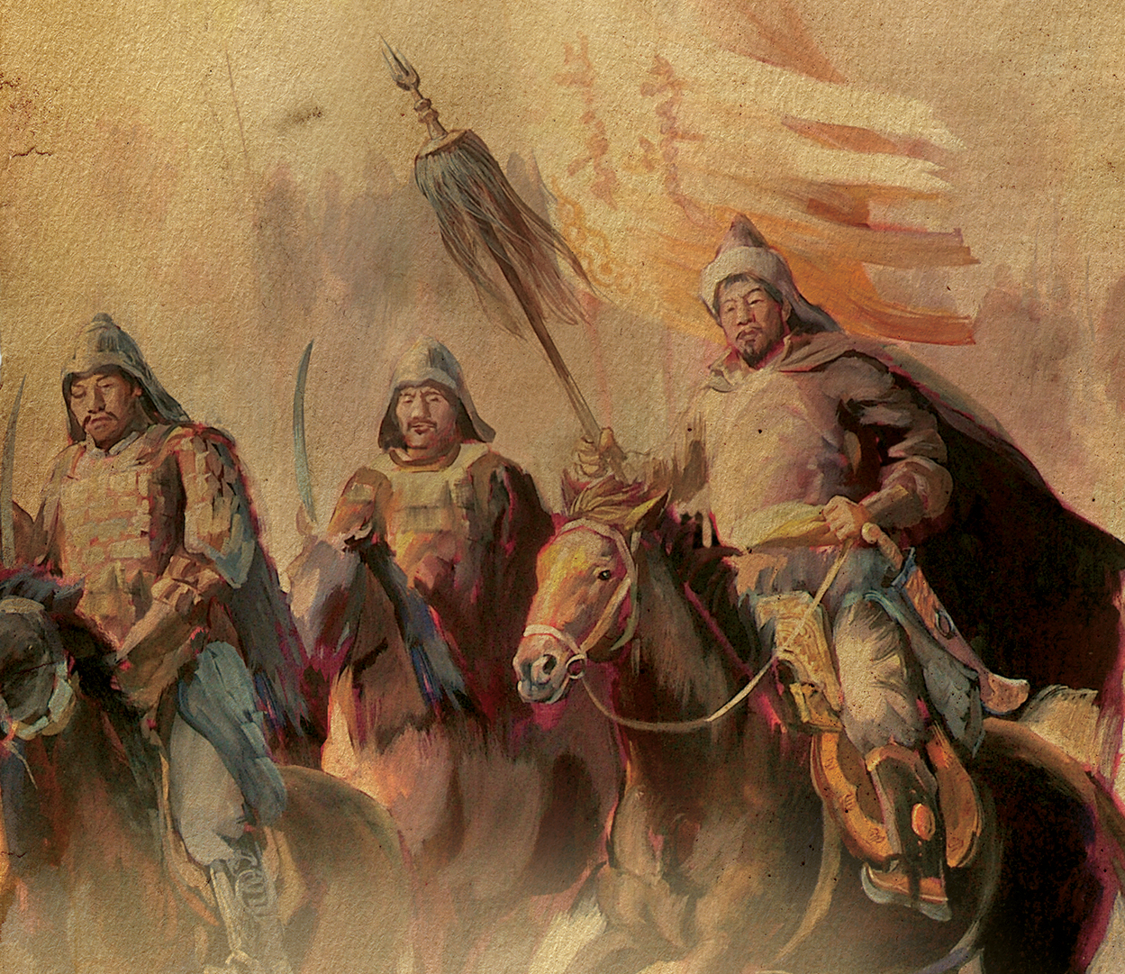
The Mongol Ascendancy
Genghis Khan was a successful leader because he…
Was a prilliant military leader
Was ruthless in battle
Mongols were fierce warriors and expert horsemen – fire an arrow at full gallop
Adopted weapons from the Chinese
Maintained law and order

Slide 24
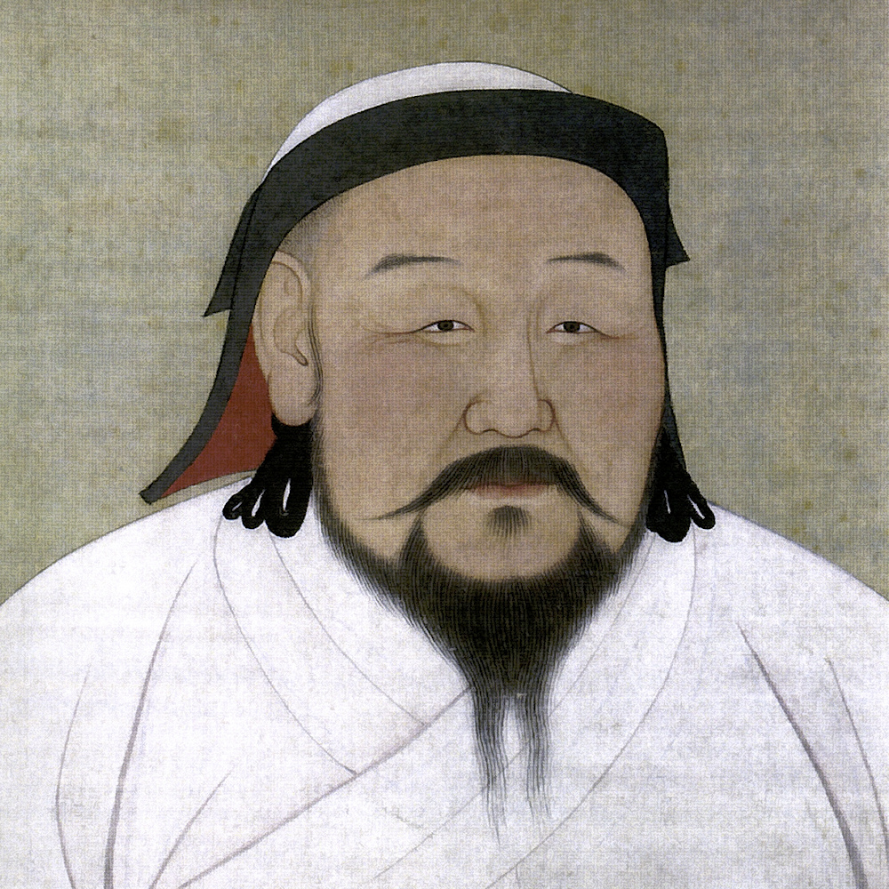
The Mongol Ascendancy
Genghis Khan died in 1227 had captured land from Pacific Ocean to Caspian Sea, most of northern China, Russia, and parts of central Europe
Kubli Khan took over and by 1279 had control of all of China
Got rid of civil service examinations – used followers

Slide 25
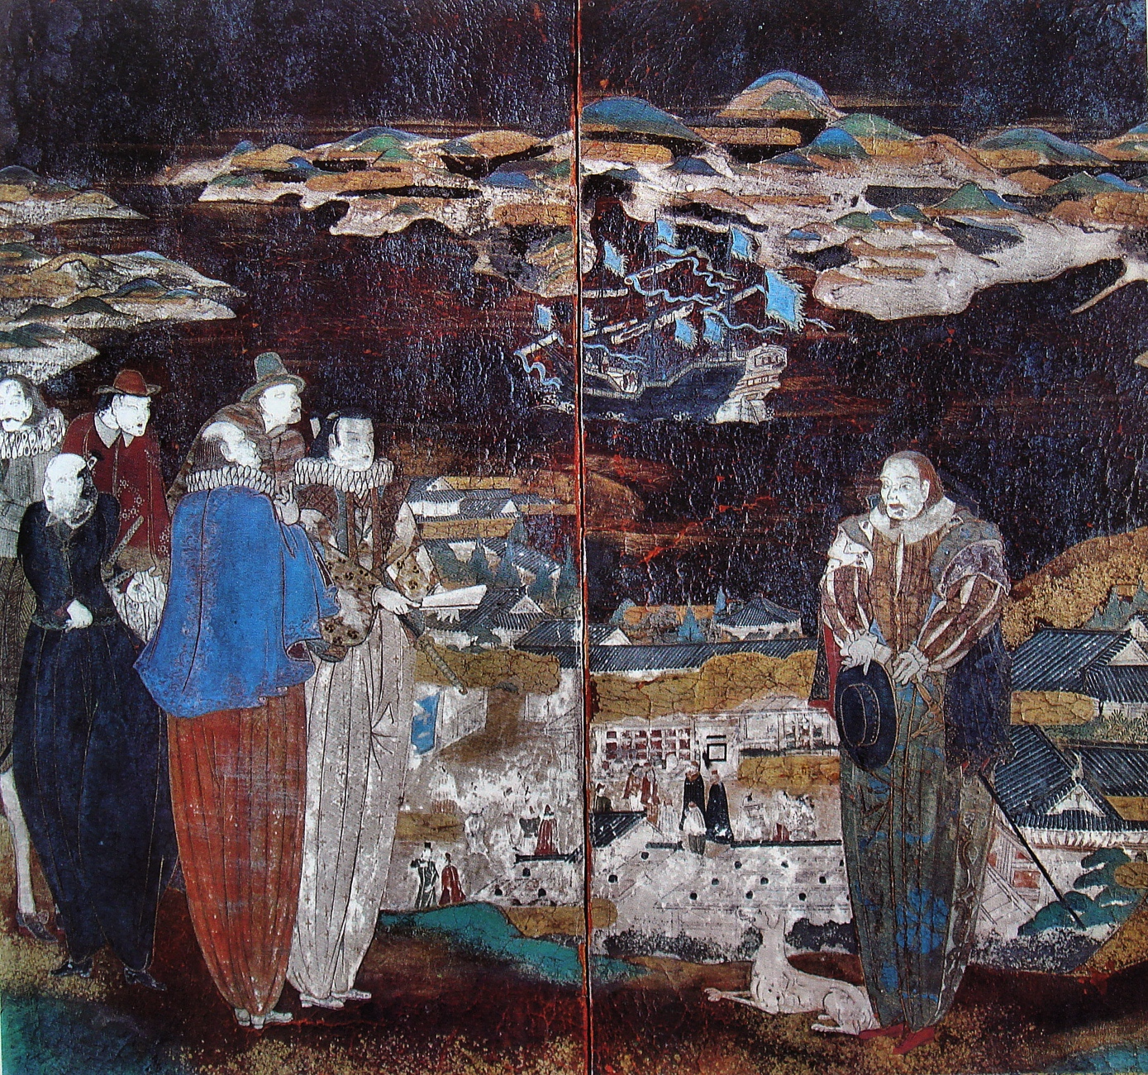
The Mongol Ascendancy
Created 4 levels of a new social order
Mongols
Foreigners
Northern Chinese
Southern Chinese
Turks and other Muslims were largest groups of foreigners
Tibetans could spread their form of Buddhism
Christian missionaries allowed to enter

Slide 26
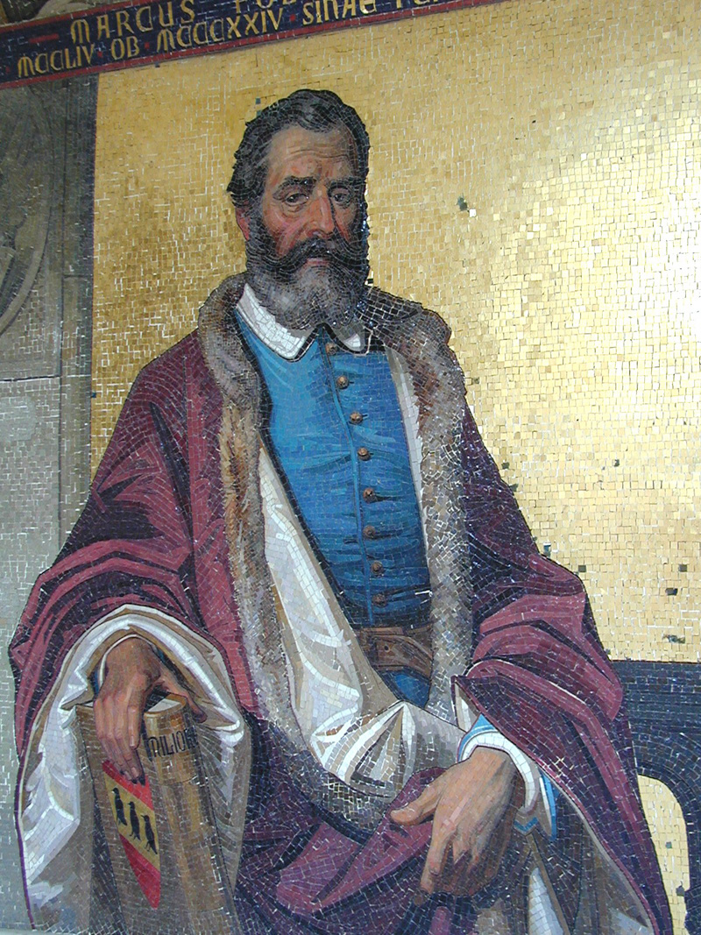
The Mongol Ascendancy
Reopened the Silk Road
Ideas and inventions traveled back and forth from East to West
Caravans carried silk, porcelain, spices, and luxury goods to Islamic Empires and Europe
Marco Polo most famous visitor – stayed for 17 years & was a diplomat traveling in China for Kublai Khan
Published accounts of his travels when he returned

Slide 27
The Ming Dynasty
Ruled for 300 years until 1644
Hongwu was the founder of this dynasty
He revived Confucian values
Revived merit system
Reversed trade policy of Mongols
Tried to rule in best interest of people but was a tyrant

Slide 28
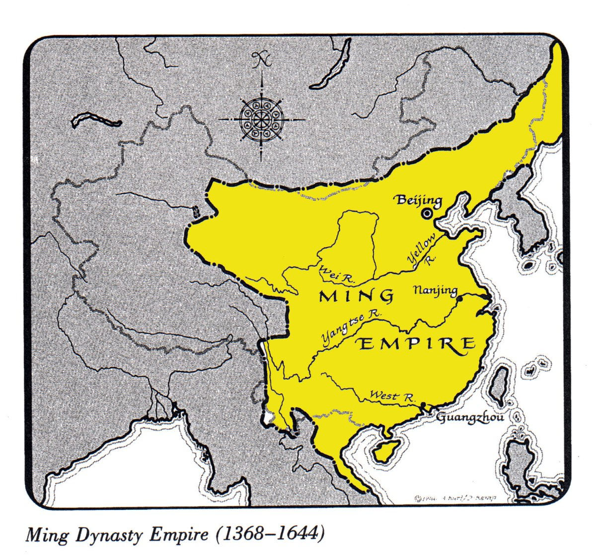
The Ming Dynasty
Yongle took over for his dad, Hongwu, when he died
Moved the capital to Beijing
Moved the capital to strengthen defenses in the north & rebuild the Great Wall
Also wanted to return seat of government to China’s northern heartland

Slide 29
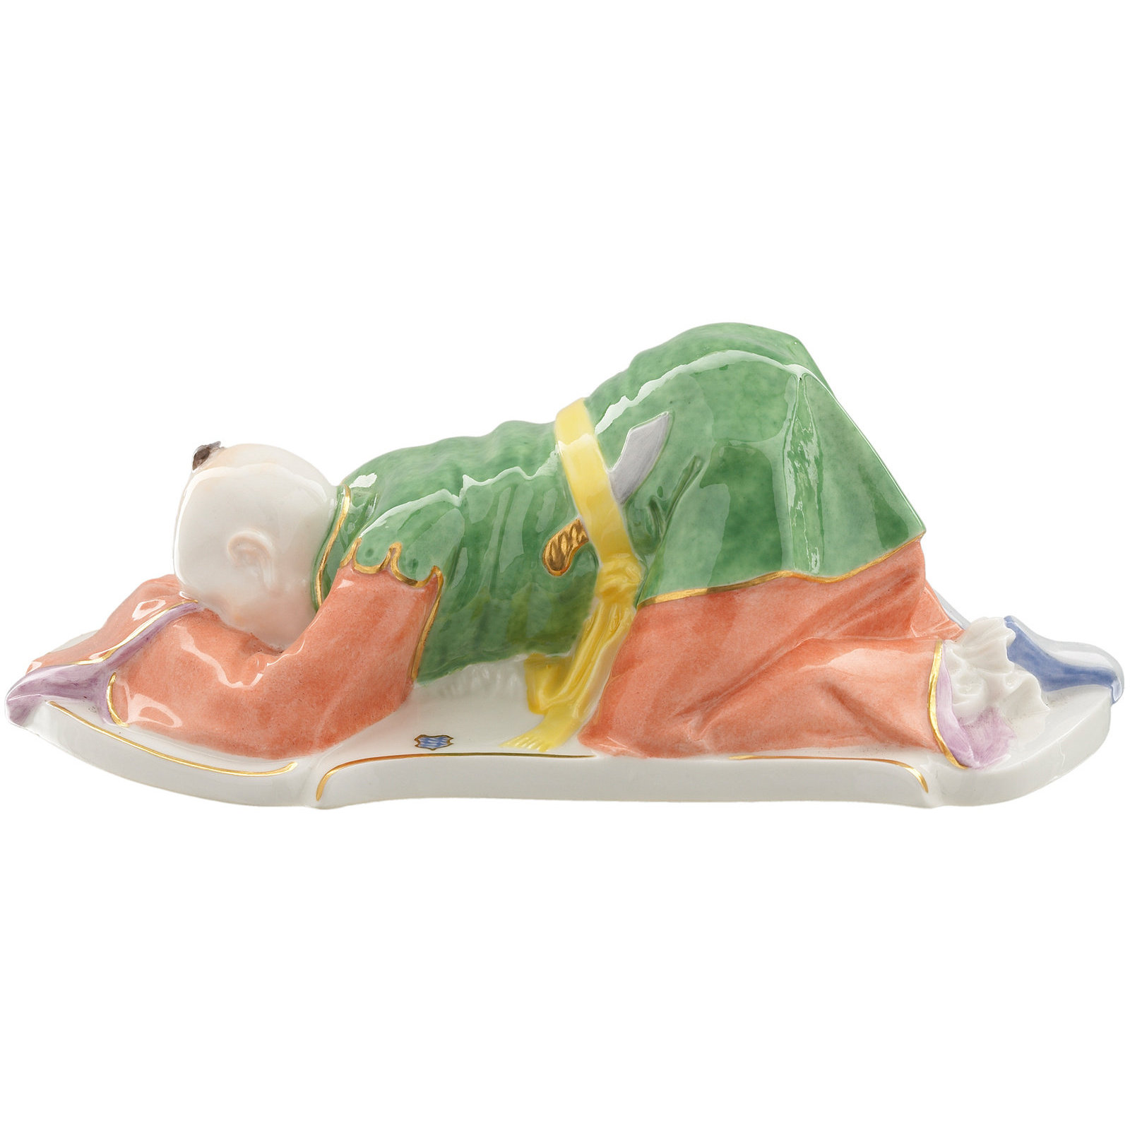
The Ming Dynasty
Tributary System
A tributary system was developed
Surrounding countries had to pay a tribute of money or goods to China (they were more powerful)
Every year country would send a diplomat to kowtow
Kowtow is touch the ground with ones head to show respect and submission to China

Slide 30
The Ming Dynasty
Tributes sent to emperor with the diplomat and the emperor would send gifts in return
Maintained peace and no need for trade
Positive – no $$ for army all to public works
Negative – tradesmen not values and began to smuggle

Slide 31
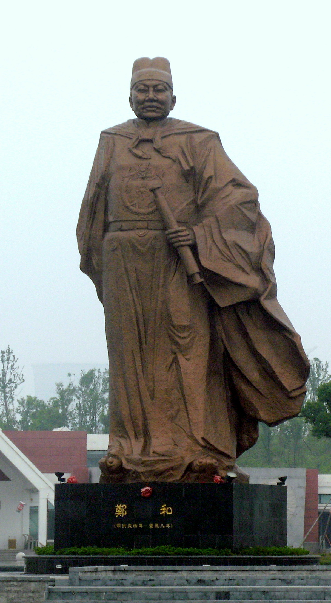
The Ming Dynasty
Tribute System inspired sea voyages to win more tributary states
Zheng He was a leader of voyages
First voyage had 300 ships and 27,000 men
Traveled to Persian gulf and east coast of Africa
Stopped voyages in 1433 – too expensive and had everything they needed at home
China was pretty much closed to outsiders

Slide 32
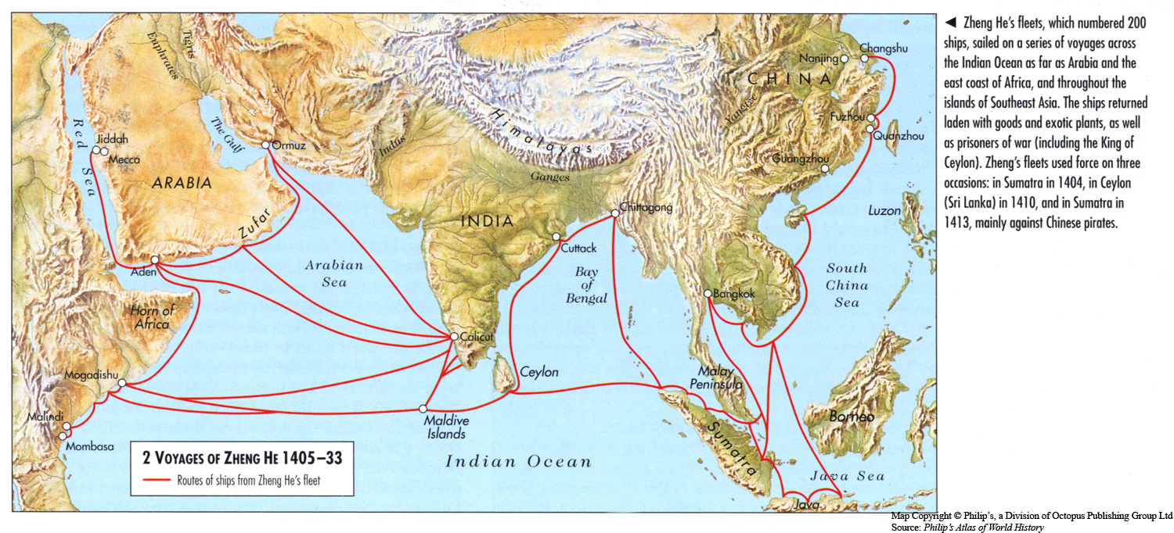
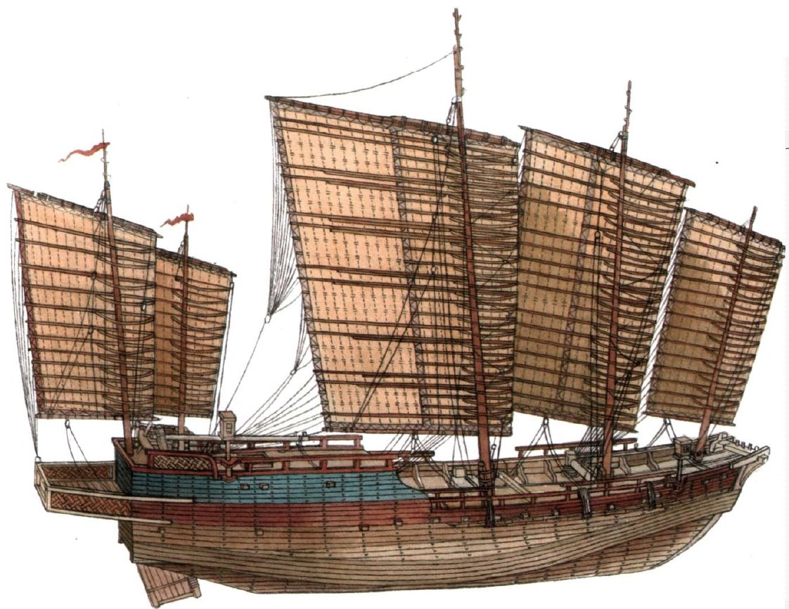
The Ming Dynasty
Zheng He Voyages
Zheng He Ship

Slide 33
China’s Influence in the World
China’s Impact in East Asia
Confucianism & Buddhism in countries like Vietnam, Korea, & Japan
Borrowed writing system and adapted to needs
Art, music, & architecture were imported

Slide 34
China’s Influence on the World
China’s Worldwide Impact
Paper and printing
Gunpowder
Magnetic Compass
Sternpost rudder
Watertight Compartment
Harness for draft animals
Silk cloth
Porcelain dishes
Paper money

