Slide 1
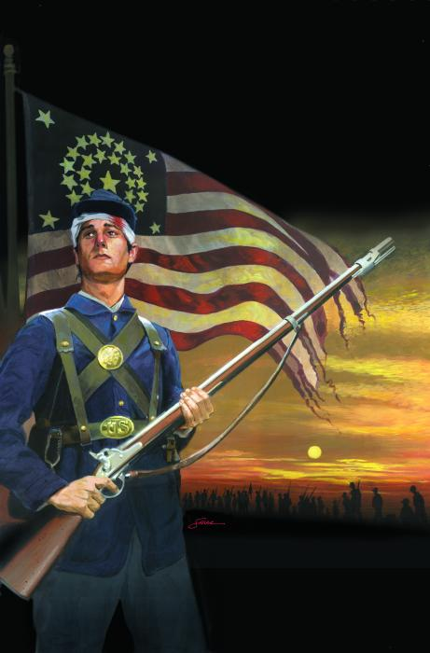
Introduction to Your Visual Essay
Red Badge of Courage

Slide 2
Visual Essay
To begin your visual essay, you must first create an outline for a written essay.
A visual essay includes all of the parts of an essay, but you just present your essay in a different way.

Slide 3
Thesis
The first step of your visual essay is your thesis statement.
Use the following template for your thesis statement.
  A thesis must have author’s name, book title, and how specifics reveal a larger idea.
  WRITE THIS DOWN!
  In The Red Badge of Courage, Stephen Crane uses a variety of literary devices to depict the moods of ___________, ___________ , and ____________ .”

Slide 4
Write your thesis statement on your outline

Slide 5
Topic Sentences
Look at your brainstorming homework:
  What three moods are you focusing on for your essay?
    Make sure these three moods are very different
  What two literary devices are you using to depict EACH mood?
    You should have 6 altogether
    You may only use imagery one time in your entire visual essay

Slide 6
Topic Sentences Continued
Your topic sentences must support your thesis and give more detail than your thesis.
Your first topic sentence will have the first mood you choose.
Your topic sentence will name the two literary devices, in order, and use an action verb to show what these devices do.

Slide 7
Example
Crane utilizes onomatopoeias and similes to create the feeling of fear throughout the various Civil War battles.
Topic Sentence equation
  Author + what does he do + literary devices + action verb + mood.
Write your own topic sentences in your outline and try to be creative in the words you use to present them while also sticking to the equation.

Slide 9
Evidence
Your evidence must support each topic sentence.
You will need to find two pieces of evidence for each topic sentence; each piece will clearly contain a different literary device. However, both literary devices must clearly support the mood in your topic sentence.
  I should be able to tell the mood you chose simply from reading your two devices.
In a visual essay, you evidence is what makes your presentation strong, so find the best of the best pieces to include.

Slide 10
Evidence
Make sure to embed your evidence into some context that sets up your quote.
  Context tells the reader what is happening in the book when the quote occurred.
Always use a parenthetical citation to reference where you got your information.
“Quote” (Crane 43).

Slide 11
Evidence Example
T.S. - Crane utilizes onomatopoeias and similes to create the feeling of fear throughout the various Civil War battles.
As the troops began to relax after a battle, they were able to take in the peacefulness of the countryside. However, suddenly, “A crimson roar came from the distance” and the regiments’ fears instantly took over them once again (Crane 79).
During the first battle, all of the men were running around in absolute fear and confusion, as they were not used to the constant dins and unbearable smoke that consumed the battle field. As the youth frantically ran to avoid this chaos, “A shell screaming like a storm banshee went over the huddled heads of the reserves” (Crane 47).
  Do these topic sentences show one literary device each? Do these devices help to depict the mood of fear? Are they embedded into context that sets up the scene?

Slide 12
Now you try to find two quotes that support your first topic sentence.
  You may use the possible ones you wrote down for your homework due on Monday.
Write these quotes in your outline while embedding them into context.
After 5-10 minutes, discuss these with the class. Make sure you read your topic sentence and then evidence to the class so we can see if your quotes support your topic sentences.

Slide 13
Analysis
This part of your essay is what you present; you are not to write your analysis on your PowerPoint, but use note cards to present the information to the class.
After each quote you should have 2-5 sentences of analysis. That’s 6 note cards with a short analysis on them!

Slide 14
Your analysis should explain how the literary device develops the mood for your particular scene.

Slide 15
Example
During the first battle, all of the men were running around in absolute fear and confusion, as they were not used to the constant dins and unbearable smoke that consumed the battle field. As the youth frantically ran to avoid this chaos, “A shell screaming like a storm banshee went over the huddled heads of the reserves” (Crane 47).
Analysis (pretend this is on a note card):
  This simile adds to the intense mood of the scene as the reader can almost hear the ear-piercing scream. “Screaming like a storm banshee” is a terrifying description as the reserves had to duck in order to not be hit by the shell that is obviously in close proximity to their heads.
Does the analysis explain why this literary device develops the mood? Why or why not?

Slide 16
As the troops began to relax after a battle, they were able to take in the peacefulness of the countryside. However, suddenly, “A crimson roar came from the distance” and the regiments’ fears instantly took over them once again (Crane 79).
Analysis (pretend this is on a note card):
  The onomatopoeia “roar” shows the contrast between the relaxing scene and the beginning of yet another battle. Crane uses “roar” to portray the fear that must be in each of these soldiers as they are caught off guard and forced to resume fighting.

Slide 17
STOP HERE

Slide 18
Image Selection
You must have six meaningful images throughout your presentation.
The images you choose must support your thesis, topic sentence, and evidence.
These will enhance your presentation because you will have to discuss every image you display.

Slide 19
Background
The background you select for your PowerPoint must also support your thesis.
Think about what colors could depict each of your moods or what background would add to your presentation.

Slide 20
Sample presentation

Slide 21
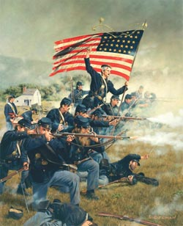
The Red, White, and Blue
Elizabeth Example
Mrs. Cavolt
ELA 8
10 May 2011

Slide 22
In The Red Badge of Courage, Stephen Crane uses a variety of literary devices to depict the moods of fear, excitement, and sorrow.”

Slide 23
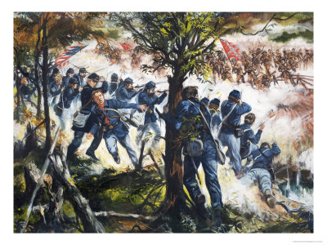
Crane utilizes onomatopoeias and similes to create the feeling of fear throughout the various Civil War battles.

Slide 24
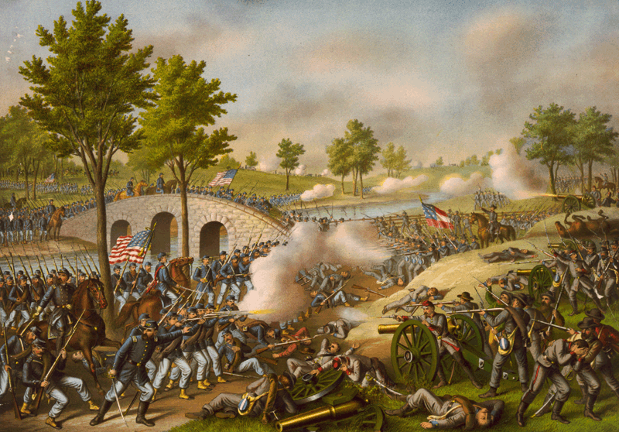
During the first battle, all of the men were running around in absolute fear and confusion, as they were not used to the constant dins and unbearable smoke that consumed the battle field. As the youth frantically ran to avoid this chaos, “A shell screaming like a storm banshee went over the huddled heads of the reserves” (Crane 47).

Slide 25
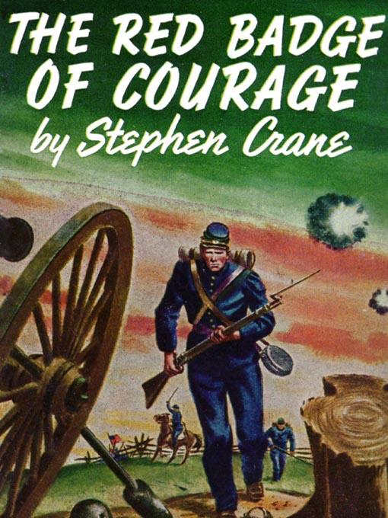
As the troops began to relax after a battle, they were able to take in the peacefulness of the countryside. However, suddenly, “A crimson roar came from the distance” and the regiments’ fears instantly took over them once again (Crane 79).

