Slide 1

Mr. Croft
Room 407

Slide 2
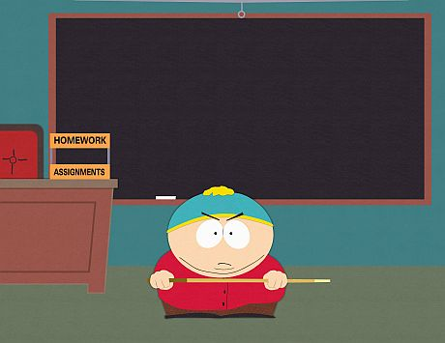
Class Expectations

Slide 3



I STRONGLY recommend that you have a
some
and a
EVERY DAY!

Slide 4
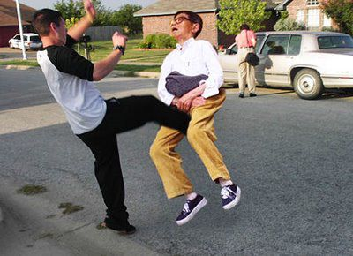

Slide 5
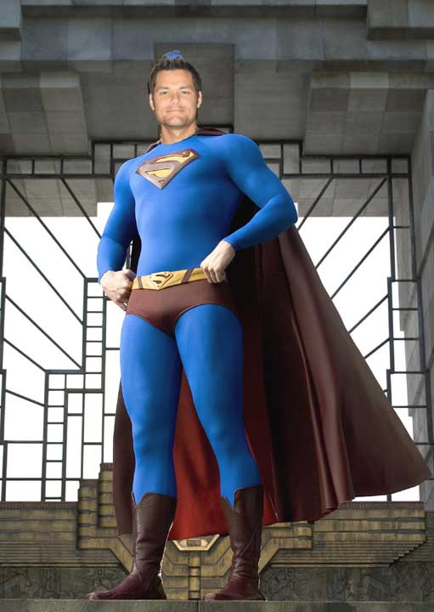
Evaluation
40% Formative
Class work
Homework
Notes
60% Summative
Essays
Tests
Projects

Slide 6

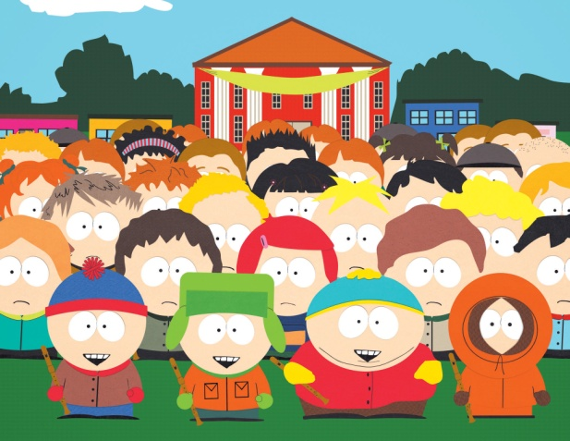

Respect
Yourself
Classmates
Faculty & Staff

Slide 7

Respect Chuck…..
Because Chuck Norris built the log cabin that he was born in.

Slide 8

Tardies
You will need a tardy
Slip EVERY TIME!

Slide 9

Respect Superman….
Because he can choke Batman out.

Slide 10


Slide 11
Cell Phones/”iPods”
Students are allowed to use their cell phones while on campus.
Students may listen to their iPod while on campus. Only one earbud can be used while on campus.
Here are the guidelines:
Students may not use them in class. The only time this is allowed is when the teacher has given special permission to do so for an assignment.
Earbuds must be put away while in class. They may not be visible. They may not be hanging from your shirt, pockets, or ears. Put them away!
Continued reminders will be considered defiance and appropriate consequences will be given.

Slide 12
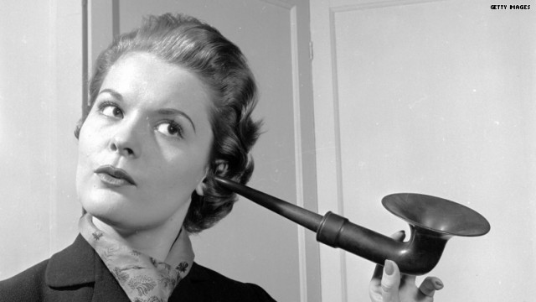
Headphones / Earbuds
On Campus

Slide 13

CENSORED
Blatantly Discourteous Behavior

Slide 14
Defiance
Intentionally not following directions given by a staff member or not following a school rule.
Depending on the severity of the offense, consequences are:
Referral/Removal from class and phone call home.
Lunch Detention
Saturday School
Suspension

Slide 15
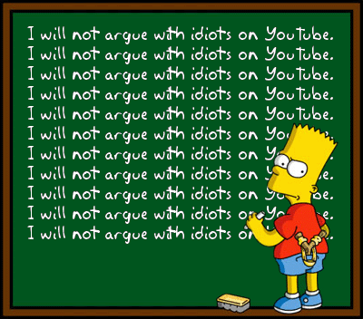
Required
Written
Assignments
1. Tardies
2. Profanity
3. Electronics

Slide 16

Frequently Asked Questions
Do I have to read?
Do I have to write?
Will I have to present?

Slide 17

Does a bear poop in the woods?

