Slide 1
Circulatory and Respiratory Systems
EQ: How does our body provide cells with O₂ and nutrients and removes waste and CO₂?

Slide 2
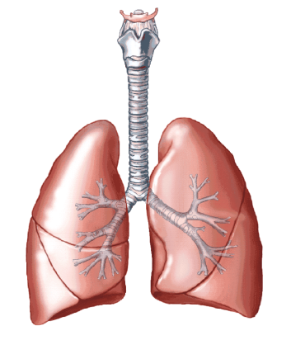
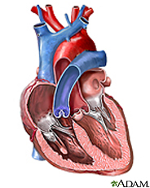
How Circulatory System Maintains Homeostasis
The respiratory and circulatory systems work together to maintain homeostasis
  The circulatory system transports blood and other materials.
    Brings supplies to cells
    Carries away wastes
    Separates oxygen-poor and oxygen rich blood

Slide 3
Respiratory System maintaining homeostasis
The respiratory system is where gas exchange occurs
  Picks up oxygen from inhaled air
  Expels carbon dioxide and water
  - What process is this similar too?

Slide 4
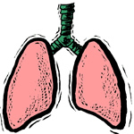

Respiratory System
Structure
  Nose, sinuses, pharynx, trachea, lungs
Function
  Brings in O₂ for cells; gets rid of CO₂ and water vapor

Slide 5
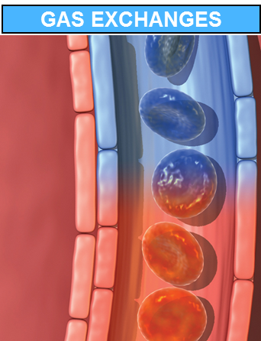
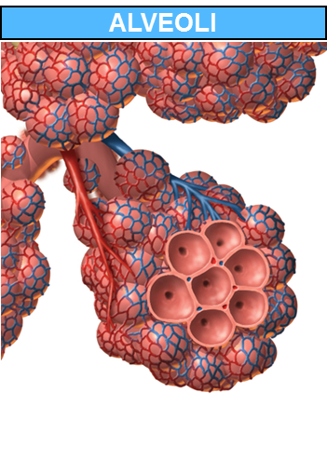
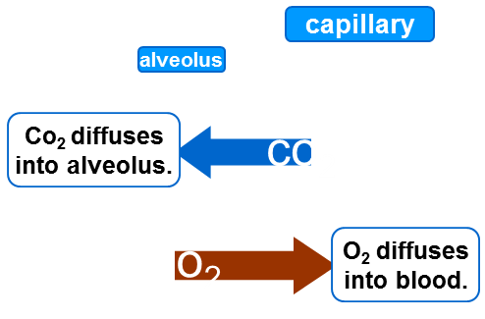
Respiratory System
Gas exchange occurs in the alveoli of the lungs
  Oxygen and carbon dioxide are carried by the blood to and from alveoli

Slide 6
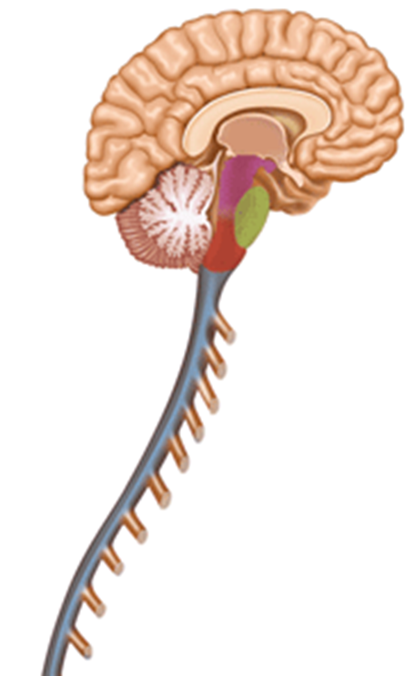
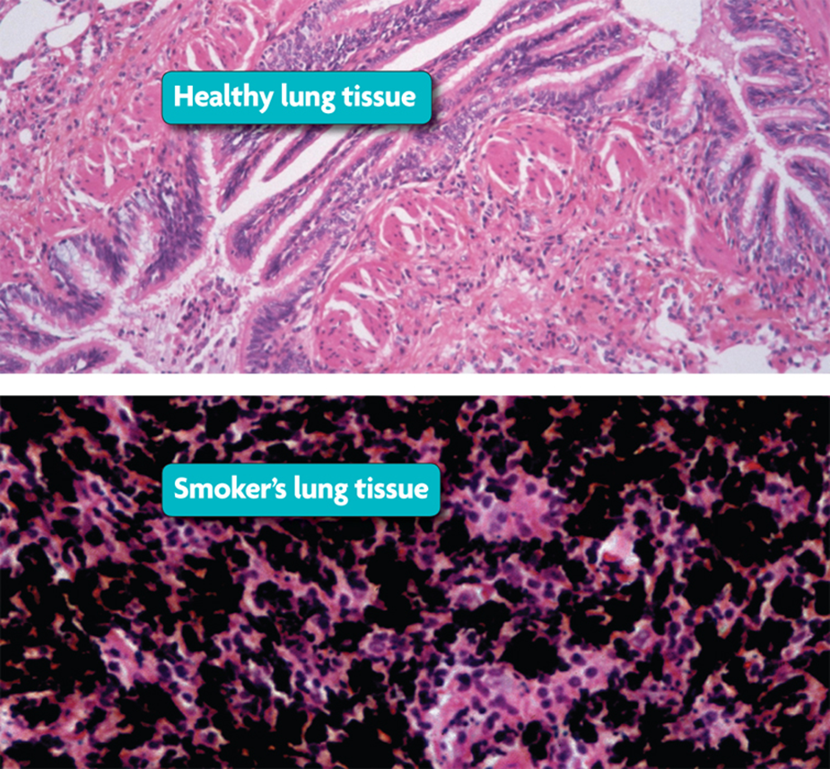
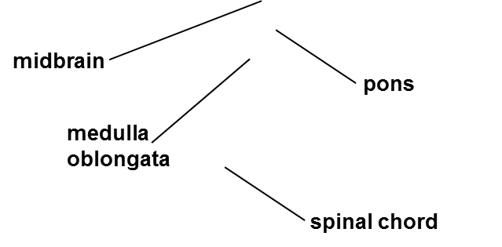
Respiratory System
Breathing is regulated by the brain stem
Smoking is the leading
cause of lung disease.

Slide 7
Reviews Questions
Where in the lungs does gas exchange happen?
How is our breathing rate regulated?

Slide 8
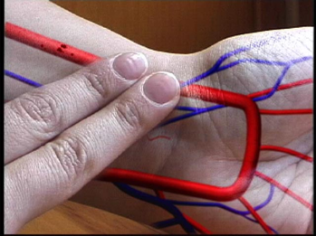
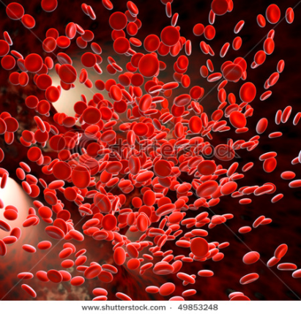
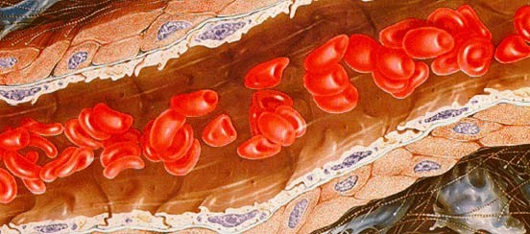
Circulatory System
Structure
  Heart, Blood vessels, blood, lymph nodes, lymphatic vessels
Function
  Transports oxygen, nutrients, wastes; helps regulate body temperature; collects fluid lost from blood vessels and returns it to circulatory system.

Slide 9
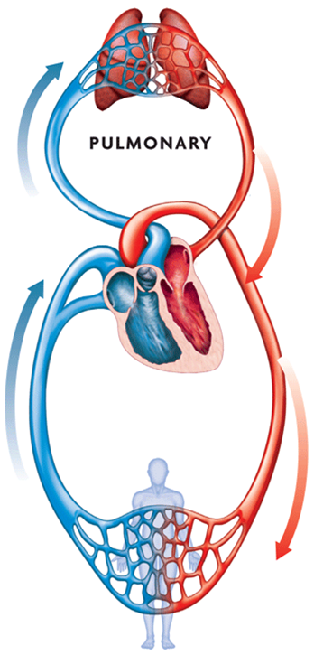
Circulatory System
The heart pumps blood through two main pathways.
  Pulmonary circulations occurs between the heart and the lungs
    We pick up oxygen in the lungs and then bring it to the heart

Slide 10
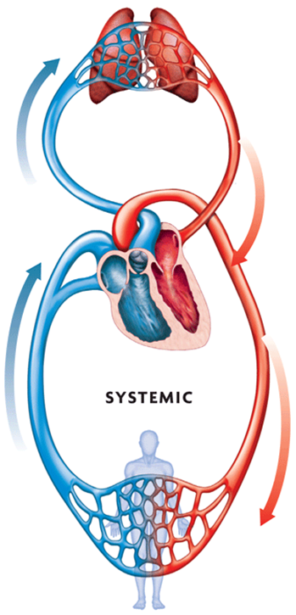
Circulatory System
  Systemic circulation occurs between the heart and the rest of the body.
    Oxygen-rich blood goes to organs, extremities
    Oxygen-poor blood returns to heart

Slide 11
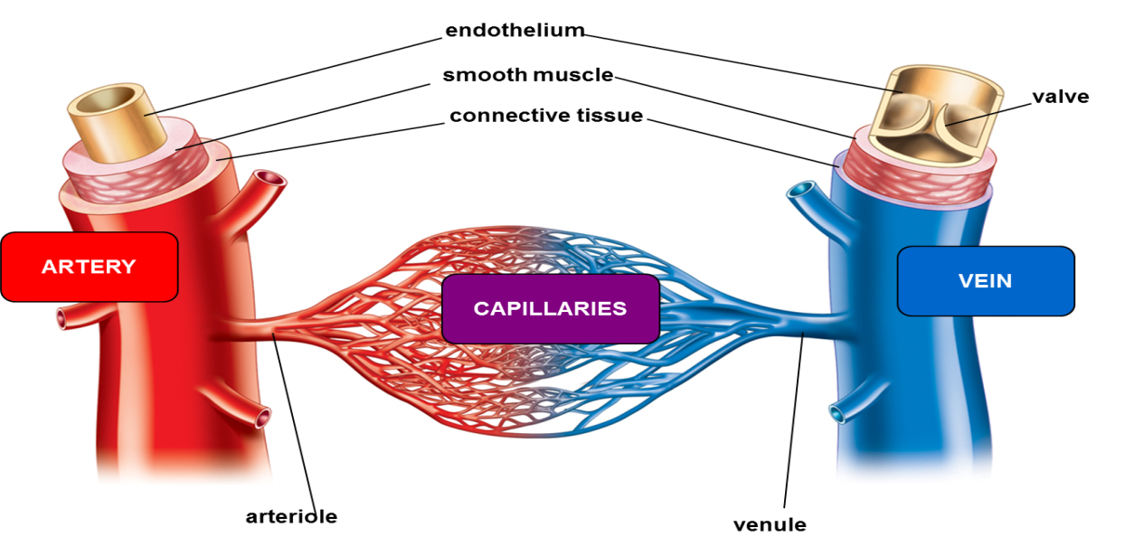
Circulatory System
Arteries, veins and capillaries transport blood to all parts of the body
  Arteries carry blood away from the heart
  Veins carry blood back to the heart
  Capillaries move blood between veins, arteries and cells
    The vessel where gas
    exchange happens in
    our body cells

Slide 12
Review Questions
What are the two main pathways of blood circulation in our body?
Which blood vessel takes blood away from the heart?
Which blood vessel takes away carbon dioxide and provides oxygen to our cells?

