Slide 1
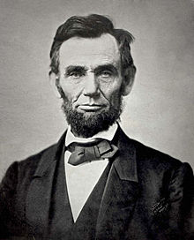
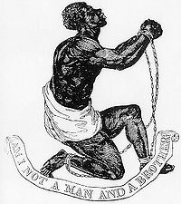
Emancipation Proclamation activity
Did Lincoln free the slaves or did the slaves free themselves?

Slide 2

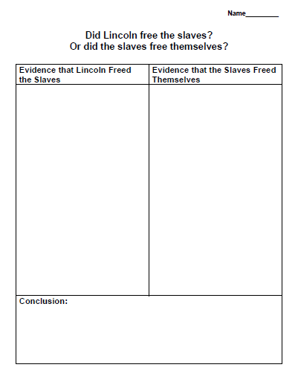
Emancipation Proclamation 9/26/12
1)Use documents
A and B to finish
the chart
2) After charting
the evidence
summarize what
you found in the
Conclusion box.

Slide 3

Analysis Questions
Did Lincoln free the slaves or did the slaves free themselves?
Why have some historians worked really hard to prove that the slaves freed themselves?
Douglass wrote about his meeting with Lincoln almost 20 years later. How might the passage of time affect Douglass’s memory of Lincoln and his evaluation of the Emancipation Proclamation?

