Slide 1
Advanced Mendelian Genetics
EQ: Do Mendel’s principals of genetics apply to all organisms or just to pea plants?

Slide 2
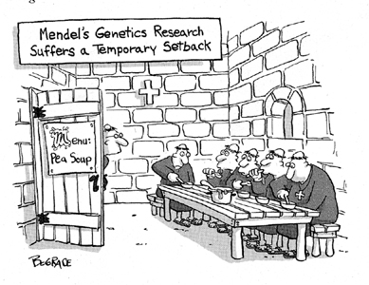

Independent Assortment
To determine if the segregation of one pair of alleles affects the segregation of another pair of alleles, Mendel performed a two-factor cross.

Slide 3
The Two-Factor Cross:F₁
Mendel crossed purebred plants that produced round yellow peas (genotype RRYY) with purebred plants that produced wrinkled green peas (genotype rryy)
All of the offspring produced round green peas (RrYy)
RRYY x rryy

Slide 4
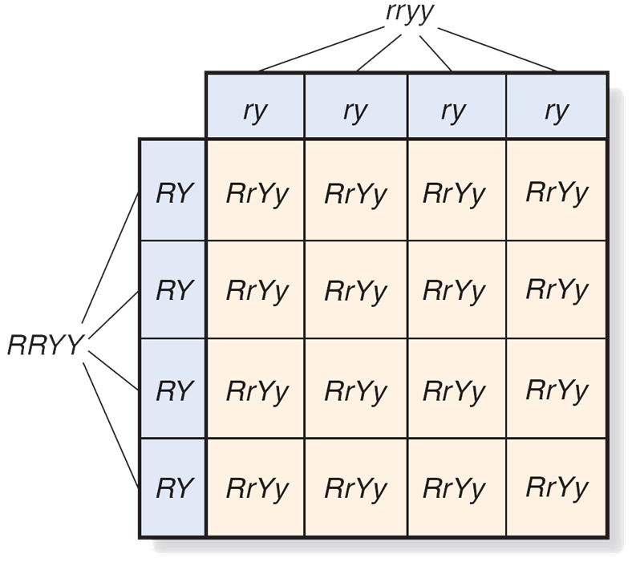
(Do not copy)
The alleles for round (R) and yellow (Y) are dominant over the alleles for wrinkled (r) and green (y)

Slide 5
The Two-Factor Cross: F₂
Mendel crossed the heterzygous F₁ plants (RrYy) with each other to determine if the alleles would segregate from each other in the F₂ generation
RrYy x RrYy

Slide 6
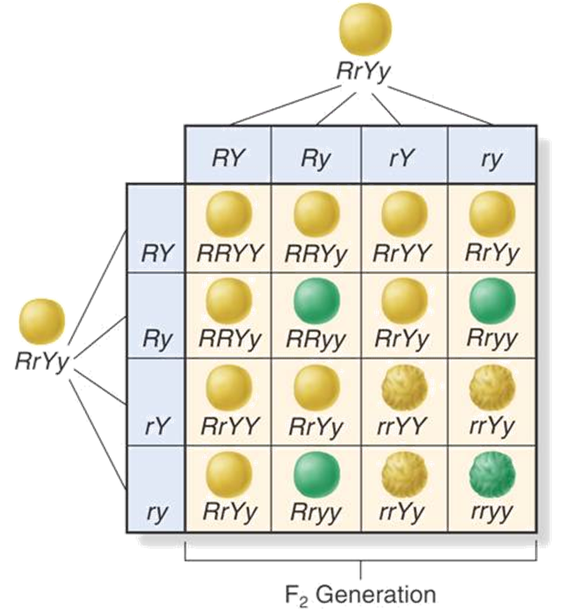

The Two Factor Cross: F₂
The Punnett square predicts a 9:3:3:1 ratio in the F₂ generation

Slide 7
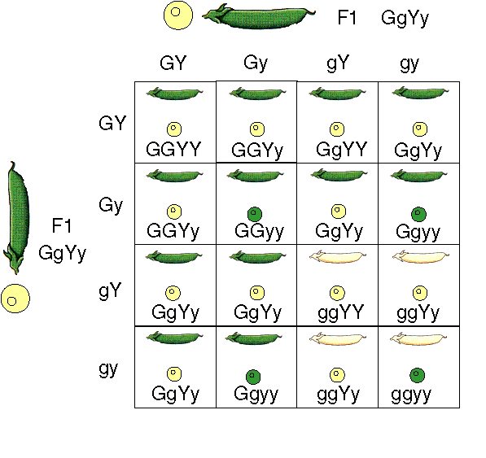
Independent Assortment
The alleles for seed shape segregated independently of those for seed color. This principle is known as independent assortment.
Genes that segregate independently do not influence each other’s inheritance.

Slide 8
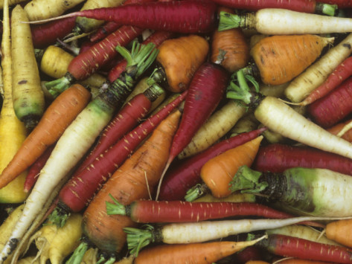

Independent assortment
This principle of independent assortment states that genes for different traits can segregate independently during the formation of gametes.
Independent assortment helps account for many genetic variations observed in living things.

Slide 9
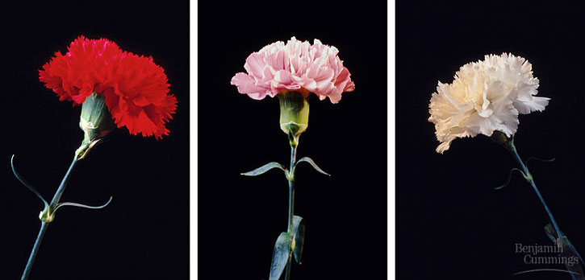
Incomplete Dominance
When one allele is not completely dominant over another it is called incomplete dominance.
In incomplete dominance, the heterozygous phenotype is between the two homozygous phenotypes

Slide 10
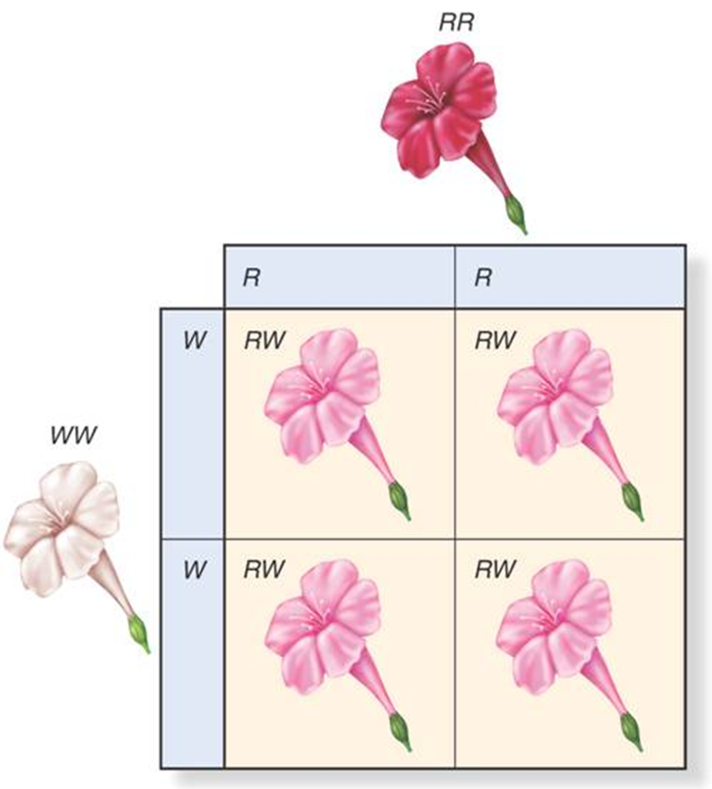
Incomplete Dominance
A cross between red (RR) and white (WW) four o’clock flowers produced pink-colored flowers (RW)

Slide 11
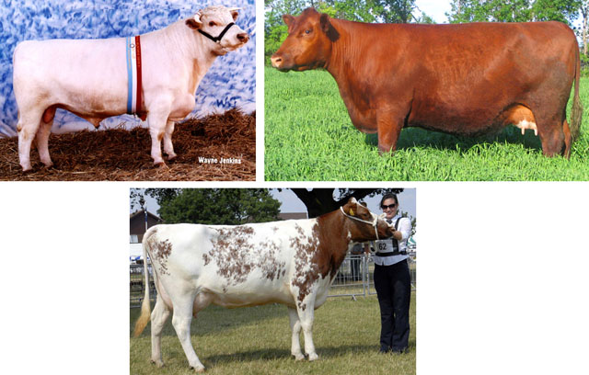
Codominance
In codominance, both alleles contribute to the phenotype
In certain varieties of cows, the allele for white hair is codominant with the allele for brown hair

Slide 12
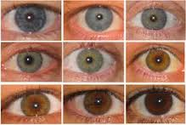
Multiple Alleles
Genes that are controlled by more than two alleles are said to have multiple alleles.
A rabbit’s coat color is determined by a single gene that has at least four different alleles.
Human eye color works in this way.

Slide 13
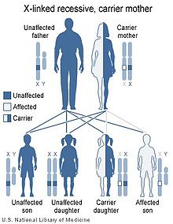
X-Linked Traits
Some traits are only found on the X chromosome which determine gender.
Because males have only 1 X chromosome (Xy) they are more predisposed to genetic disorders than are females (XX) because males only have one copy of the gene while females have two.
Example of a sex-linked trait is colored blindness.

Slide 14
Question 1
Traits controlled by two or more genes are called
Multiple-allele traits
Polygenic traits
Codominant traits
Hybrid traits

Slide 15
Question 2
In four o’clock flowers, the allele for red flowers and white flowers show incomplete dominance. Heterozygous four o’clock plants have
Pink flowers
White flowers
Half white flowers and half red flowers.
Red flowers

Slide 16
Question 3
Mendel’s principals apply to
Pea plants only
Fruit flies only
All organisms
Only plants and animals

