Slide 1
Immune system
EQ: How are the non-specific and specific immune responses different from each other?

Slide 2
Immune System
Structure:
White blood cells, thymus, spleen
Function:
Protects against disease, stores and generates white blood cells

Slide 3
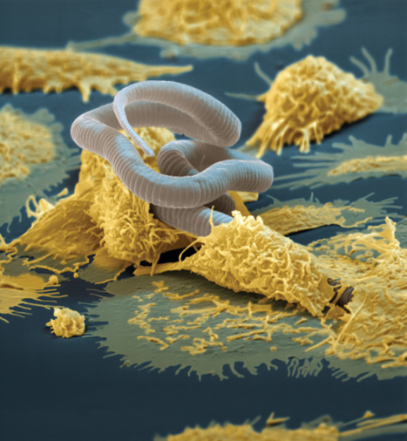
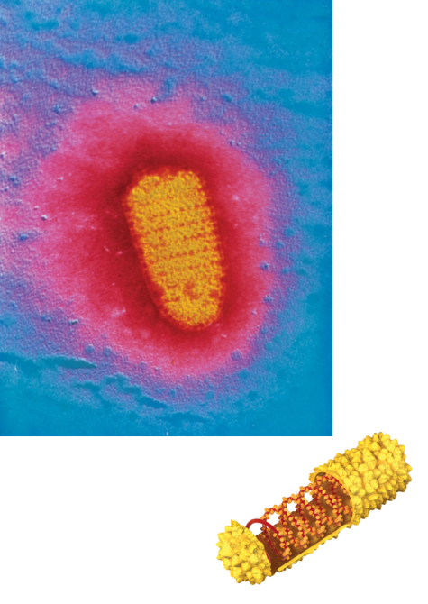
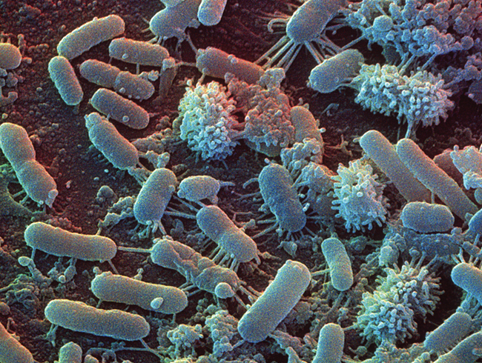
Pathogens
Literally means producer of suffering.
Different types of pathogens
Bacteria – single-celled organism (alive)
Viruses – genetic material surrounded by protein coat (not alive)
Parasites – multicellular organism that feeds on host

Slide 4
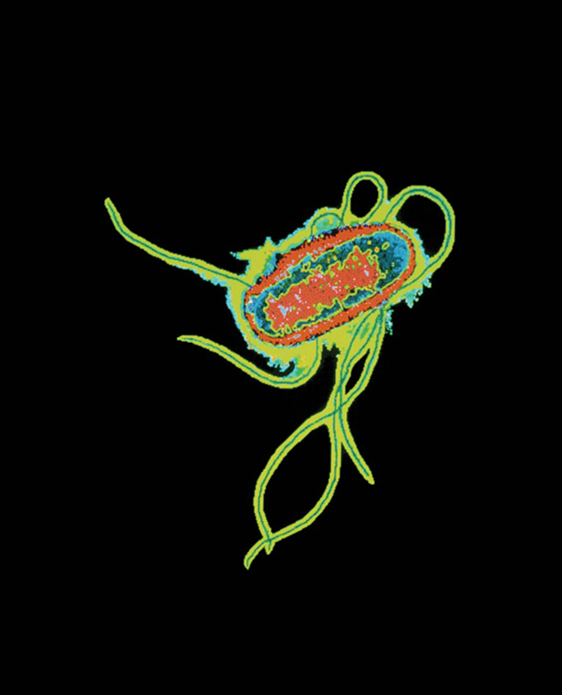
Pathogens
Pathogens can be transferred by direct or indirect contact.
Indirect contact does not require touching an infected individual.
Touching an infected surface
Breathing in infected air.

Slide 5
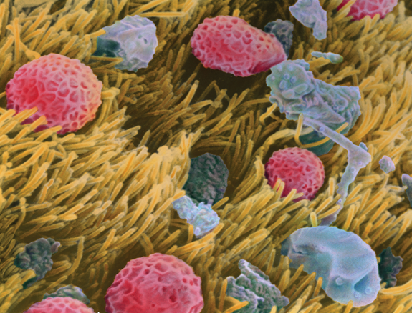
Protection from Pathogens
Immune system fights off pathogens
Other tissues and systems help out the immune system.
Skin is a barrier to infection
Mucous traps pathogens entering the body.
The circulatory system transports immune cells

Slide 6
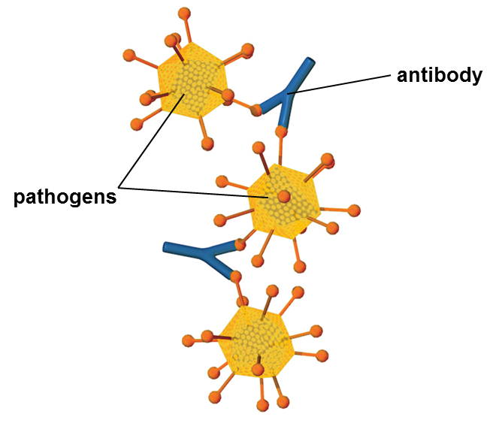
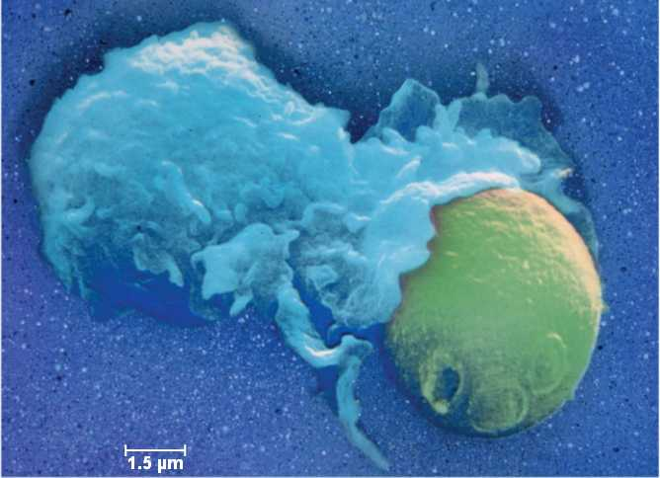
Protection from Pathogens
There are cells and proteins that fight the body’s infections
White blood cells attack infections inside the body
Phagocytes engulf and destroy pathogens
T cells destroy infected cells
B cells produce antibodies

Slide 7
Non-Specific Immune Response
Nonspecific responses are the same for every pathogen. Contains the first and second line of defense against pathogens
First line of defense :
Skin, mucous , chemicals found in body fluids
Second line of defense:
Inflammatory response, fever
Phagocytes or natural killer cells try to destroy anything in sight.

Slide 8
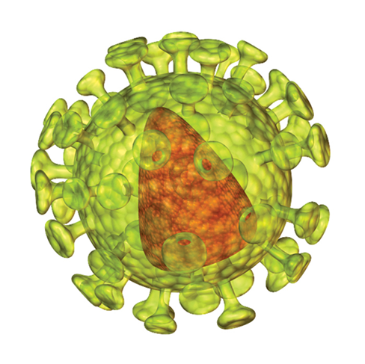
Specific Immune Response
Specific immune response can identify and destroy specific pathogens.
Begins with detection of antigens on the bacteria or virus.
Antigens are surface proteins on pathogens
Each pathogen has a different antigen.

Slide 9
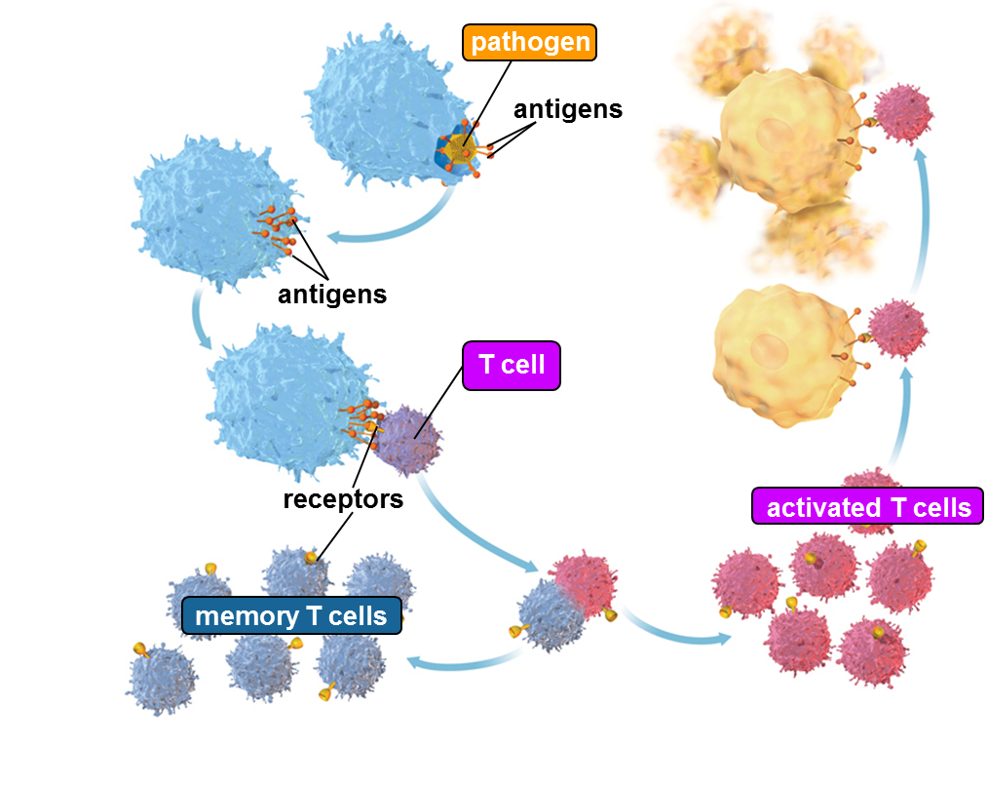
Specific Immune Response
There are two types of specific immune responses.
Cellular immunity uses T cells to destroy infected body cells

Slide 10
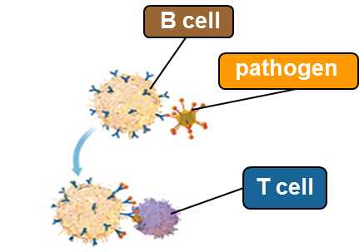
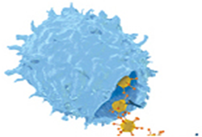
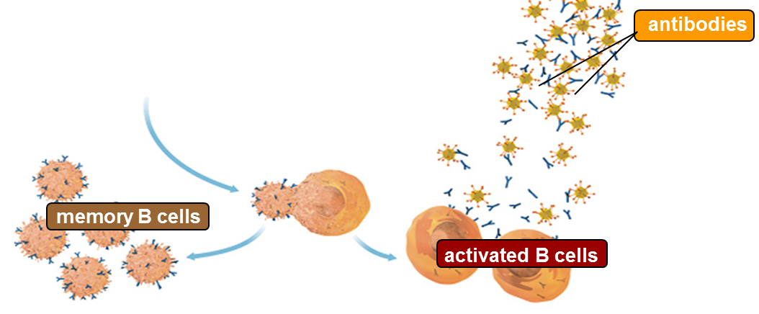
Specific Immune Response
Humoral immunity uses B cells to produce antibodies
Antibodies attach to bacteria or virus and inactivates the pathogen.

Slide 11
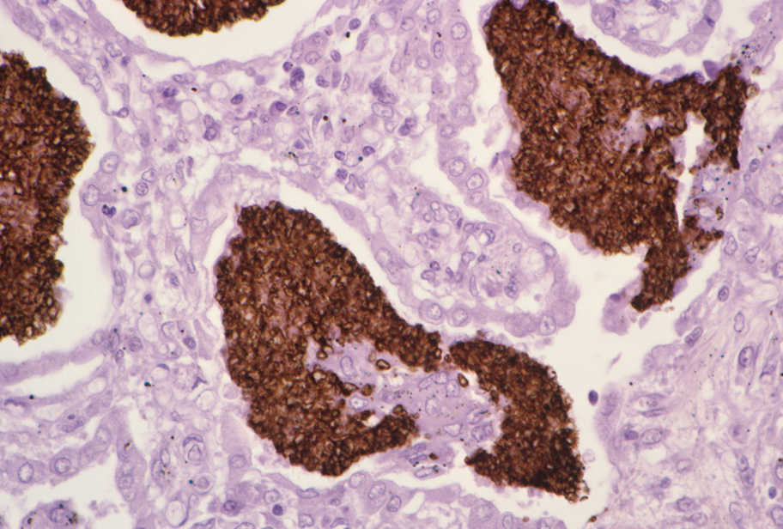
Immune System Disorders
Leukemia – cancer of the white blood cells
White blood cells cannot fight infections
If immune system were healthy, would fight these infections

Slide 12
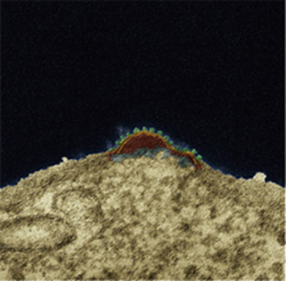
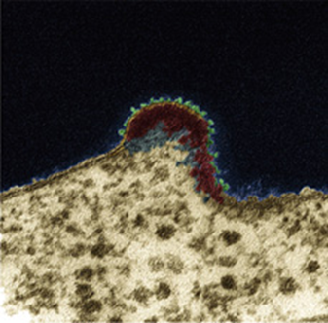
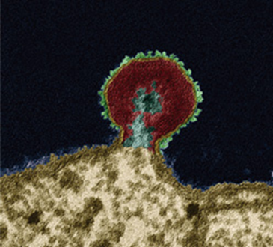
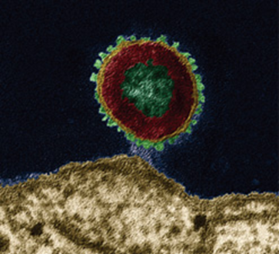
Immune System Disorders
HIV targets the immune system
Attacks and weakens the immune system
Is transmitted by mixing infected blood with a bodily fluid.
HIV infection leads to AIDS
HIV reproduces in white blood cells and destroys them and the body cannot replace the cells fast enough.

