Slide 1
Mitosis/Meiosis
3rd quarter project
By PresenterMedia.com

Slide 2
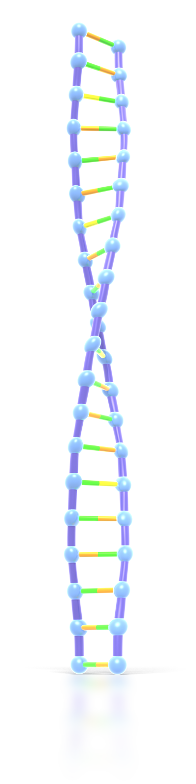
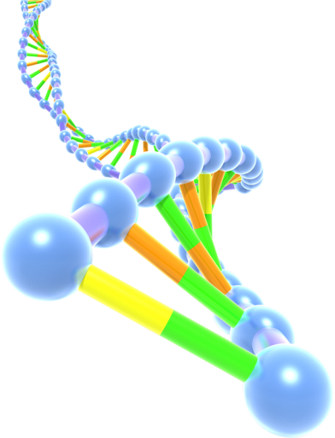
The Phase of Mitosis/Meiosis
The project – you and another person (1 or 2 people per group) will create models that show the different stages of mitosis/meiosis. In addition to your models there are 3 additional parts that must be completed along with your models. Read on for more information.
Part 1 the model
Part 2 & 3 the cards
Part 4 the website

Slide 3
Part 1, Option 1
The Edible Models
With this option you will create 3 dimensional models of an animal cell going through the stages of mitosis. Your models should depict each phase of mitosis as realistically as possible. Your models must include all the organelles directly involved in each stage of mitosis. In this option, your models must be edible! That’s right, we should be able to eat your phases of mitosis! You can build your models out of cakes, brownies, jello, pizza, pancakes, candies, pasta, bread, fruits, vegetables, rice, etc. The list goes on and on! Just be sure that after the presentation of your model, we can eat it!

Slide 4
Part 1, Option 2
The Non-perishable Model
With this option, you will create 3 dimensional models of an animal cell going through the stages of mitosis. Your models should depict each phase of mitosis as realistically as possible. Your models must include all the organelles directly involved in each stage of mitosis. In this option, your models will be made of out non-perishable items.

Slide 5
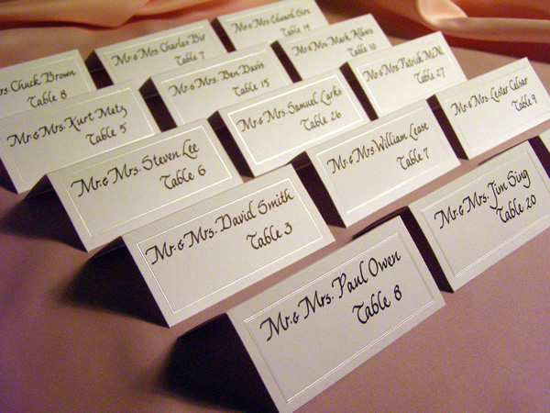
Part 2, the description card for each stage of mitosis
In this part of your project you will have description cards. There is no size limit on your description cards. The cards have to be able to stand upright and must large enough to include the following requirements.
Title of the stage.
Illustration (hand drawn or from internet) of the stage
The main

Slide 6
Part 3, a description card with the key
In this section you will create a description card that describes “what” represents each organelle during the different stages of mitosis.
For example if my models were cakes:
  Cytoplasm – vanilla frosting
  Nucleus – blue frosting
  Centrioles – red liquorish
  Spindle fibers – twizzlers
  Cell membrane – cake
  Chromosomes - twix

Slide 7
Part 4, Put it on the website!
Take a picture of each model with its description card.
In an organized manner, place the picture of each stage of meiosis I. For each picture you must have the following
  Title of the stage
  Events that take space during that stage (same information you wrote on the description card)
Write a reflection on this project .
  What is your overall reaction to this project?
  Did this project help you learn the phases of meiosis I? Why or why not?
If you had to complete this project again, what would you do differently?
http://www.wix.com/devlyn_henriques/mitosis

