Slide 1
Warm-up #11
How did Johann Gutenberg’s printing press work?
Write a paragraph explaining some of the effects of the printing press.

Slide 2

Northern Renaissance Art
Pieter Brueghel, Albrecht Durer, Hans Holbein the Younger and Jan van Eyck

Slide 3
The Northern Renaissance
Pair read pages 314-315.
Pair Share: What is the difference between humanism and Christian humanism?

Slide 4
Art of the Northern and Italian Renaissance
Italian Renaissance Art | Both | Northern Renaissance Art

Slide 5
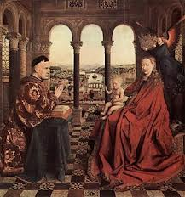
Madonna of Chancellor Rolin by Jan van Eyck

Slide 6
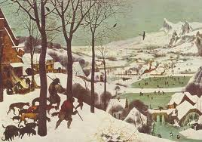
Return of the Hunters by Pieter Brueghel

Slide 7
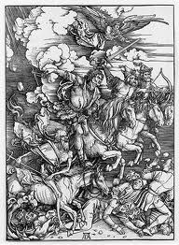
The Four Horsemen of the Apocalypse by Albrecht Durer

Slide 8
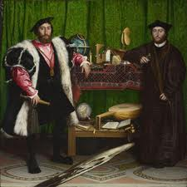
The Ambassadors
Hans Holbein the younger

Slide 9
Homework
Read Chapter 11.3

