Slide 1
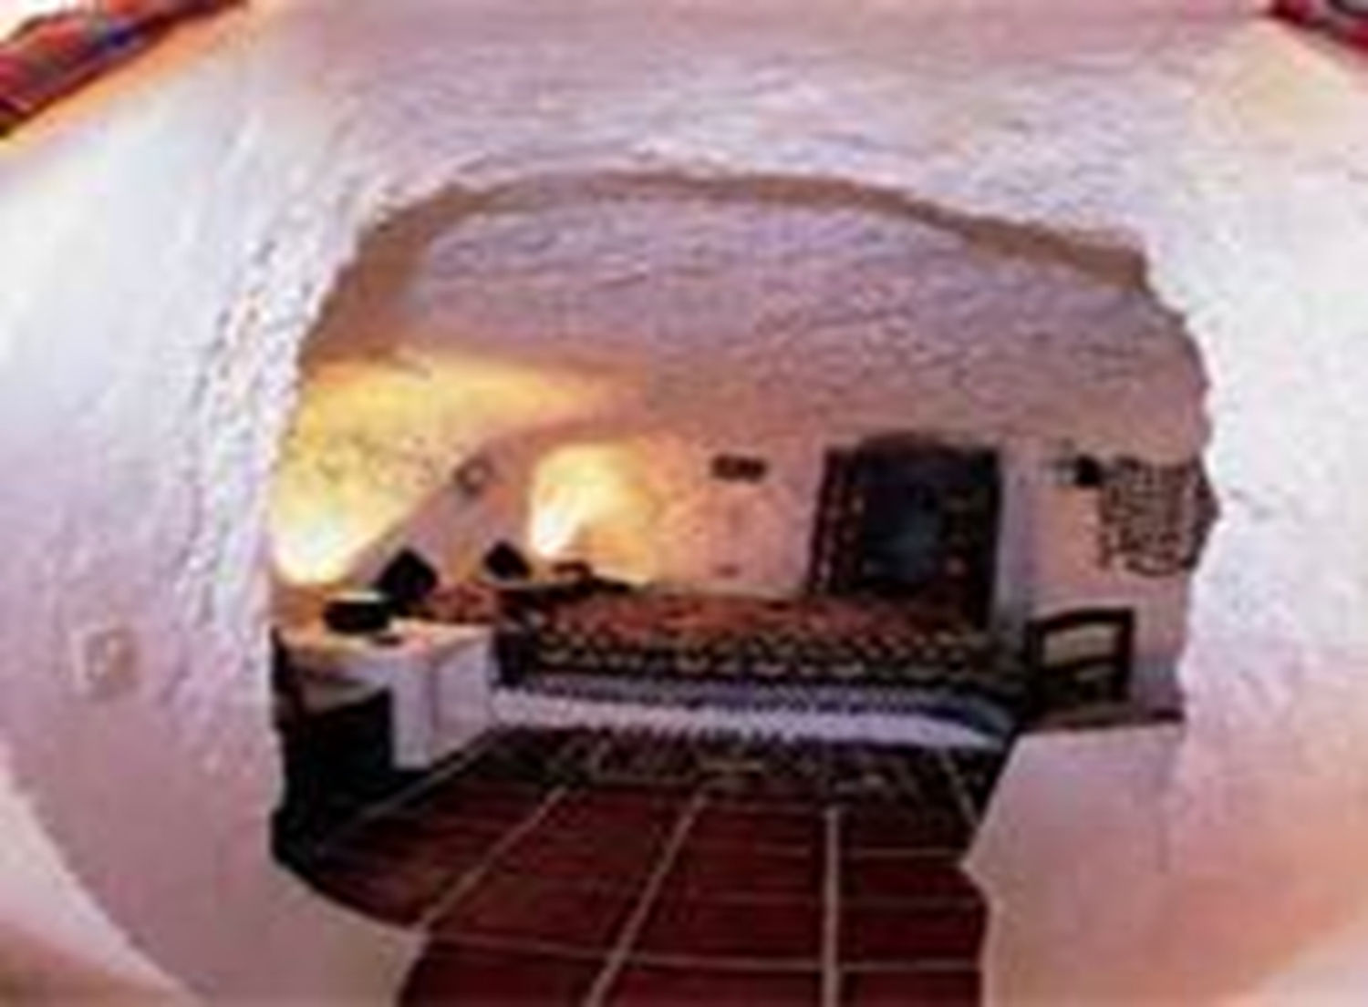
Blood Wedding Act 3
Summary
&
Analysis

Slide 2
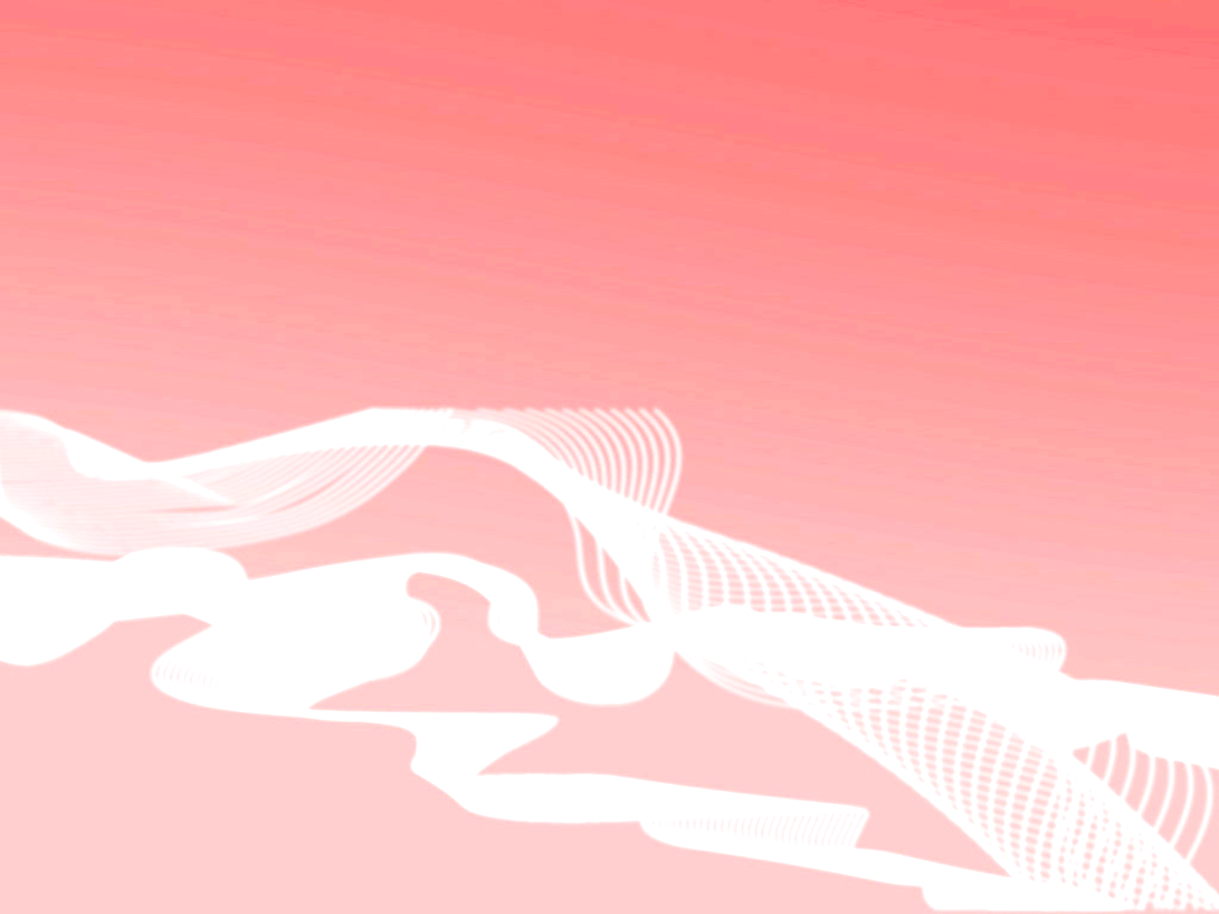
Scene opens ominously at night in a forest
Setting represents danger and nature in its unfettered glory
3 woodcutters appear, speaking of the couple
escaping on horseback and the inevitable pursuit by Bridegroom who is sworn to revenge
Woodcutters comment on the reason for the
escape: the lovers have followed their natural inclination and not bowed to society’s whims
Then they comment on the inevitability of
Capture since all the paths are sealed off
If the moon comes out from behind the clouds, the added light will aid in the capture

Slide 3

The third act is largely written in verse
As in early scenes, when the horse
and a star were emphasized, now the moon is
The moon is described with both
positive and negative images
It is like fate, sometimes good and sometimes bad

Slide 4
Moon does appear, as a woodcutter personified, and gives a monologue veiled with images that allude to its light aiding the capture of Leonardo and the Bride
In this monologue, the images are malevolent
Although “blood” has been invoked throughout the play to symbolize different constructs, from passion to kinship, in this case “blood” refers to death

Slide 5
With the conclusion of the Moon’s monologue,
Death herself appears, in the form of an old beggar woman
Like the Moon, she speaks in verse, commenting
on the action (which does not occur on stage) with symbolic language
Nature’s cover, the vast foliage and whisper of
the river, conceal the ensuing murderous confrontation
The speech is portentous, and the Old Woman
speaks with the authority of Death incarnate
She says there will be screams and the bodies of
men whose throats have been torn.

Slide 6
Moon reappears and the two continue to report
on the battle in veiled, symbolic language
The two seem to work in tandem to insure that
Fate prevails: “We won’t let them cross the river. Silence!”
To further seal fate, Beggar Woman gives the
Bridegroom, who has stumbled across her path, directions to find his wayward bride and Leonardo
Her allusions make it clear that the Bridegroom
will not survive the encounter: “Wait! What broad shoulders! Why don’t you want to be laid out on them, instead of walking around on the soles of such small feet?”

Slide 7
Under the portents of death, evoked in the lines of the
Woodcutters, Leonardo and the Bride appear
They argue and realize that they are hemmed in; escape is unlikely
Leonardo wants to leave the Bride, to spare her his fate
They argue about whose fault the predicament is
The argument continues and the characters begin conversing in
verse, again with images that mingle death and love (life/birth): “I love you! I love you! But leave me! / If I were able to kill you, / I’d wrap you in a shroud / bordered by violets!”
The conversation continues with each character using speech that
mixes images of death (natural decay), violence, and murder
This encounter is perhaps the highlight of the play, as the
playwright’s stage directions indicate that it is to be “violent, filled with great sensuality”
The culmination of the scene is an embrace that equates death
with sexuality and the brutally direct sexual image in the line: “The moon nails us together /My loins are fused to your thighs”

Slide 8
Scene ends as the music is cut short by violent
screams
Beggar Woman appears with her back to the
audience and opens her cloak
She is bat-like…..Fate is now unfolding.
Final scene is but an epilogue to the violent
passion that has just occurred
Stage directions at the beginning of the final
scene are quite specific and without ambiguity
Predominant color is white, as if in marked
contrast to all the dark events that have preceded
There are no shadows, and the room is
reminiscent of a church.

Slide 9
As the scene opens, two of the girls
are playing with a skein of wool, reciting a nursery rhyme: “Jasmine clothing, / Crystal paper. / Born at four, / Dead at ten”
The rhyme, as well as the wool,
indicate how fate unravels, unavoidably
From the conversation that follows, it
is clear that the bodies have been laid out

Slide 10
Mother-in-Law appears with the Wife
Even these minor characters have been
left to a bitter fate
Wife, who has not been at fault, is left a
pregnant widow and must return to her house and live alone in bitter solitude
Her children will most likely end up just
like her, since the entire play alludes to the cyclic nature of predestined events: like father, like son; like mother, like daughter

Slide 11
Beggar Woman appears
When asked about the events that
have passed, she relishes the fact that two men are dead
She speaks poetically, again, invoking
images of death by comparing it to the callousness of nature: “Their eyes are broken flowers. Their teeth / are just two handfuls of frozen snow”

Slide 12
The stage empties amidst the gloomy proclamations of the Girls & Beggar Woman, and Mother & Neighbor enter
Mother is resigned to her fate; she has had much practice burying her family
She’ll be better off, she rationalizes, because now she doesn’t have to worry about anyone close to her dying and her anguish is apparent
When the Bride enters, Mother’s distraught anguish is augmented by the idea of revenge, which she tries to avoid
Nevertheless, she strikes Bride and knocks her to the floor
Neighbor plays peacemaker and tries to part them while Bride says that she wants to die
She (most likely?)lies with claim that, “they can bury me without any man ever having seen himself in the whiteness of my breasts!”

Slide 13
Bride is very confused
She attempts to rationalize and diffuse responsibility for her decision to leave
with Leonardo
Leonardo was her passion, the Bridegroom a mere opportunity at respectability and having a comfortable life
The confession is not accepted by Mother She remains bitter as other neighbors enter

Slide 14
The final act unwinds, again, in verse, as the characters—Wife, Mother, Bride, and Little Girl—exchange allegorical lines mingling images of death, love, nature, and religion
The play ends with Bride and Mother both commenting on the image with which the whole play began—a mere knife and its capacity to end life

Slide 15
http://www.youtube.com/watch?v=zIkU2ohpKmE&feature=player_detailpage
Act 3 scene 2 – 9:37 minutes
http://www.youtube.com/watch?v=iKzwaCTcf0o&feature=player_detailpage
Bride with Mother - end – 5:58 minutes

Slide 16
Analysis
The final act brings about the culmination
of the predestined events that have been alluded to throughout the play
Nothing is left to chance
Free will is thwarted by fate
The fleeing couple has absolutely no
chance of escape, and Bridegroom has no chance of surviving the encounter
Tragedy will take its natural course

Slide 17
As the play progresses, the symbolic elements
that stress the omnipotence of fate become the central focus of the drama
While earlier acts contain allegorical lines and
symbolic metaphors, the first scene in the final act is completely symbolic
Lorca borrows a technique from medieval
morality plays and personifies Death and Fate as an old beggar woman and the moon, respectively
Death, at the instruction of the playwright, does
not appear on the character list, as if her appearance is a surprise

Slide 18
In human form, these figures speak with proclamations
negating the ability of free will to overcome destiny
What’s more, they conspire to ensure the murderous
encounter
Beggar Woman who is Death gives Bridegroom
directions to find the fleeing couple and then accompanies him down to the river
Moon, which in medieval texts is often a symbol of
fate, shines at the opportune moment to reveal Leonardo and Bride
Minor characters as woodcutters are highly symbolic: a
woodcutter chops down a living tree, killing it
In this sense, the Woodcutters are a perfectly natural
choice to report and comment on the pursuit and encounter

Slide 19
With Blood Wedding, Lorca creates a landscape
so rustic and primitive that it virtually stands outside of time
There are no modern objects to place the play in
a specific era, though the locale is most certainly rural Andalusia, a region of southern Spain
The most modern “tool” in the play is a gun,
mentioned briefly by the Bride in her final passionate scene with Leonardo
In fact, one could surmise that the mention of
the gun, the most modern symbol mentioned in the play, is an inadvertent slip by the playwright since it is hardly necessary
Next to the horses, moon, wheat, knife, dahlias
and lace stockings, the gun is rather anachronistic

Slide 20
Perhaps the most significant scene in the play is
the passionate embrace between Leonardo & Bride
Lorca specifically states that this scene is to be
sensuous and violent
The locale of the forest is also quite specific, and
its lush vegetation implies fertility, while a dark night in the forest is an archetype for danger
In this sense, life and death are both present in
the image of the forest
Furthermore, these very same symbols merge
both in the dialogue up to and during the final embrace: “If they tear us apart, it will be / because I am dead.”

Slide 21
Since this scene is so highly symbolic, don’t
assume or try to ascertain what actually occurs on a literal level; the details are relatively unimportant compared to the symbolic representations of the fragility of life and thwarted passion
The audience or readers know that the couple
shared a primal passion (“blood”) for one another
This passion was fateful
We also know that Bridegroom and Leonard
end up dead, down by the river, fulfilling the prophecy inherent in the lullaby from Act I, Scene 2.

Slide 22
Bride too has fulfilled her destiny, to not love her
husband, just as her mother had not loved her father
Bride’s claims of still being unsoiled must be taken
with a grain of salt
The merging or mating of Bride and Leonardo
down by the river is allegorical, a symbolic representation of what actually occurrs
Of course Bride is guilty of infidelity, whether it be
symbolic or actual
As has been stressed throughout the play, her fate
was never her own
So she is, as she pleads, not truly responsible for
her actions; the events (or skein of wool) could not have unfolded in any other manner

Slide 23
Blood Wedding, in addition to fulfilling the criteria of a
classical tragedy where characters lack free will, also
contains slight allusions to Christianity a religion that stresses each person’s ability to choose right from wrong
The image of the lovers nailed together by the moon is
an unmistakable reference to the crucifixion, especially with the Bride referring to the “thorns around my head”
With this metaphor, Lorca equates the passion of the
couple to the Passion of Christ
Additionally, the play ends with the Mother and the
women chanting lines alluding to crucifixion: “Sweet, nails, / Sweet cross, / Sweet Name— / Jesus”
It is ironic that characters whose doom has been
foretold rely on images from a religion whose dogma emphasizes free will

Slide 24
http://www.youtube.com/watch?v=azyNUtTHvaE&feature=player_detailpage
Lullaby interpretation sung in Spanish – 5:26 minutes

