Slide 1
Ch. 5 Key Issue 3
Where are other language families distributed?
Classification of languages
Distribution of language families
  Sino-Tibetan language family
  Other East and Southeast Asian language families
  Afro-Asiatic language family
  Altaic and Uralic language families
  African language families

Slide 2
Distribution of Language Families
People of the world:
  48% speak an Indo-European language
  26% speak Sino-Tibetan
  6% speak Afro-Asiatic
  5% speak Austronesian
  4% speak Dravidian
  3% speak Altaic
  3% speak Niger-Congo
  2% speak Japanese
  3% speak a language belonging to one of the 100 smaller language families

Slide 3
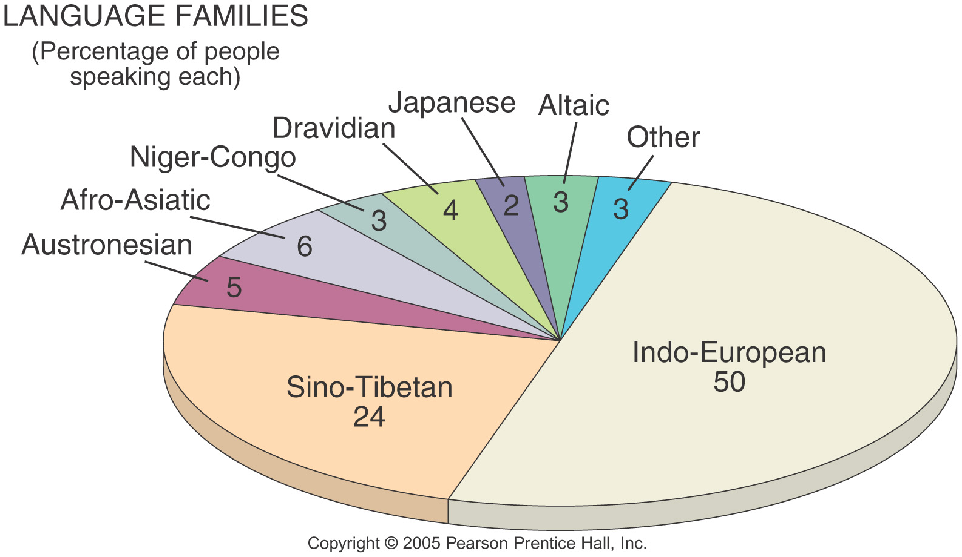
Major Language Families
Percentage of World Population
Fig. 5-11a: The percentage of world population speaking each of the main language families. Indo-European and Sino-Tibetan together represent almost 75% of the world’s people.

Slide 4
Sino-Tibetan Family
Languages spoken in China and smaller countries in Southeast Asia
Chinese gov’t imposes Mandarin as the official country language.
Chinese is based on 420 one-syllable words
Chinese is written with a collection of thousands of characters.
Ideograms: represent ideas or concepts, no specific pronunciations.
Learning to write in Chinese is the biggest difficulty because of the many characters.

Slide 5
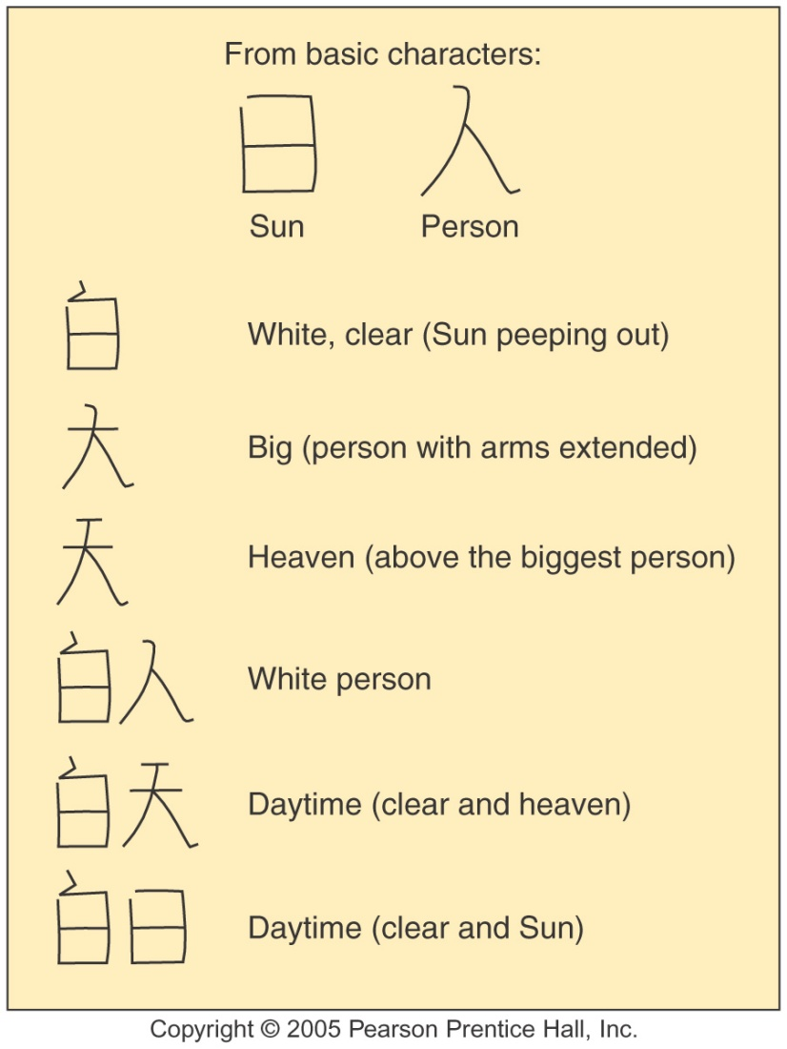
Chinese Ideograms
Fig. 5-13: Chinese language ideograms mostly represent concepts rather than sounds. The two basic characters at the top can be built into more complex words.

Slide 6
Afro-Asiatic Language Family
Includes Arabic and Hebrew, plus northern Africa and southwest Asian languages.
Large % of the world’s Muslims have some Arabic knowledge due to the Quran.

Slide 7
Altaic Languages
Spoken across a 5,000mile stretch of Asia between Turkey, Mongolia and China.
While many of these countries were under Soviet control until the 1990s, they have since returned back to their Altaic languages- Azerbaijan, Kazakhstan, Kyrgyzstan, Turkmenistan and Uzbekistan.

Slide 8
Uralic Languages
Estonia, Finland and Hungary speak languages of the Uralic family.
Uralic languages can be traced back to a common language of Proto-Uralic 7,000 years ago used by people living in the Ural Mountains in present-day Russia. Migrants carried their languages to Europe.

Slide 9
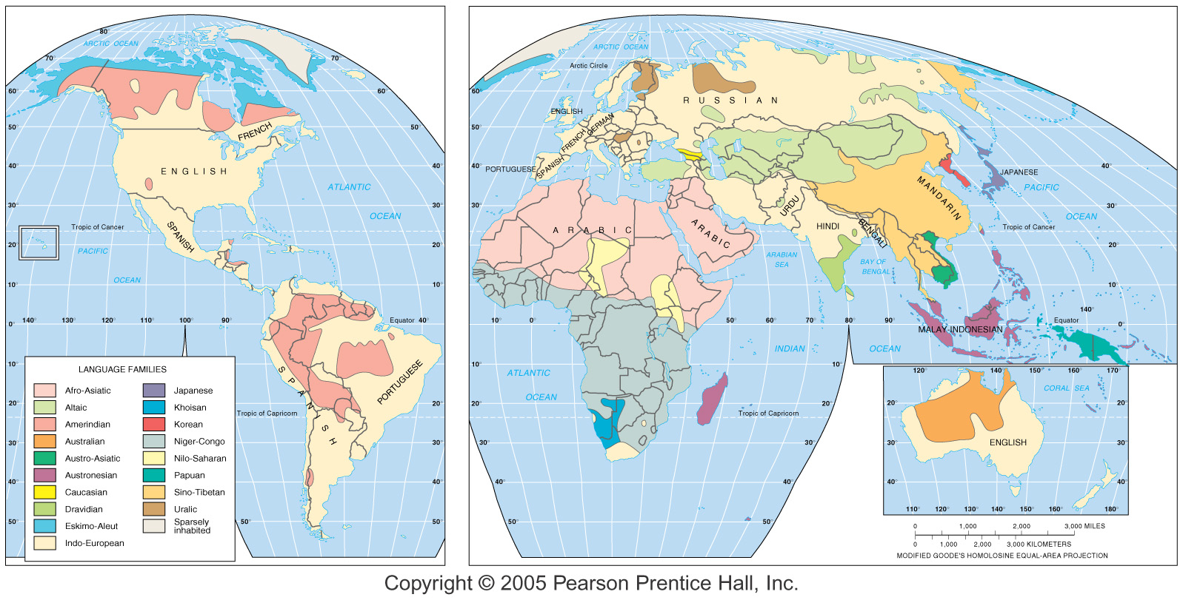
Language Families of the World
Fig. 5-11: Distribution of the world’s main language families. Languages with more than 100 million speakers are named.

Slide 10
African Language Families
Unknown # of languages spoken in Africa
More than 1,000 languages and several thousand dialects.
This results from at least 5,000 years of minimal interaction among other cultures.
Niger-Congo: 95 % of sub-Saharan Africa speak these languages
Nilo-Saharan: a few million people in north-central Africa
Khoisan: 3rd important language, southwest Africa
Austronesian: 6% of the world’s people, Indonesia

Slide 11
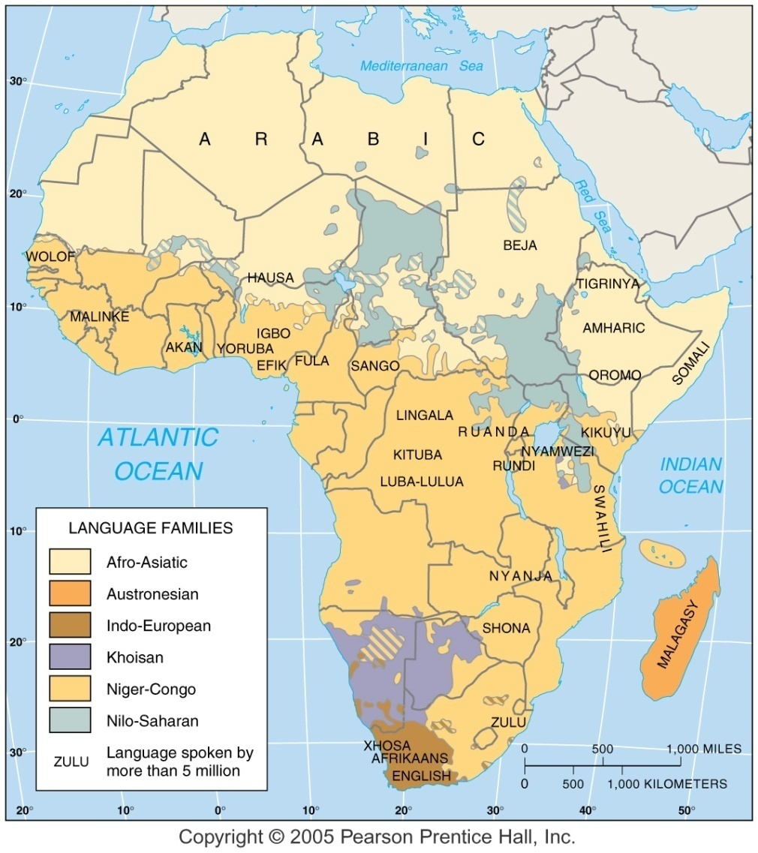
Language Families of Africa
Fig. 5-14: The 1,000 or more languages of Africa are divided among five main language families, including Austronesian languages in Madagascar.

Slide 12
Nigeria: conflict among speakers
Nigeria has 493 languages
Groups living in different regions battle over dominance and discrimination.
Nigeria reflects problems that can arise when cultural diversity and language diversity are packed into a small region.
Language also is identified as a distinct cultural importance.

Slide 13
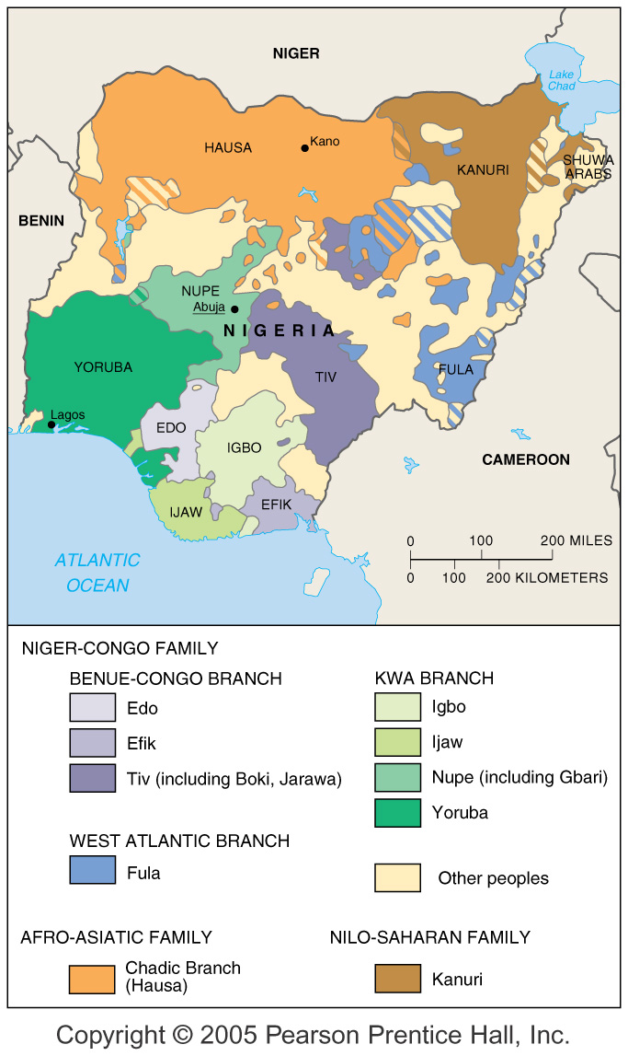
Languages of Nigeria
Fig. 5-15: More than 200 languages are spoken in Nigeria, the largest country in Africa (by population). English, considered neutral, is the official language.

