Slide 1
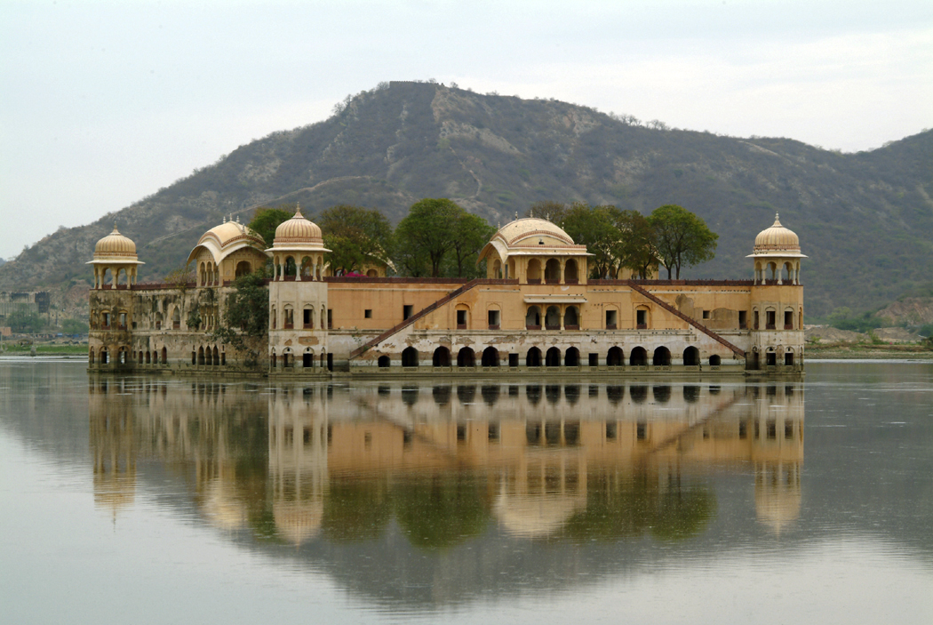
Kubla Khan
How is the setting in “Kubla Khan” depicted?
What images particularly stand out? Look for contrasts especially.
What contributes most to the beauty of the place? Nature or those things that are man-made?
Look for and cite examples of sound devices –alliteration, places where the sounds of the language reinforce what’s being described.
What Romantic characteristics/beliefs do you see reflected in the poem? Explain.
What do you make of the figure at the end of the poem with “flashing eyes” and “floating hair”?

